Slide 1

Chapter 1
Equations and
Inequalities
1.6 Other Types of
Equations
Copyright © 2014, 2010, 2007 Pearson Education, Inc.

Slide 2
Objectives:
Solve polynomial equations by factoring.
Solve radical equations.
Solve equations with rational exponents.
Solve equations that are quadratic in form.
Solve equations involving absolute value.
Solve problems modeled by equations.

Slide 3
Polynomial Equations
A polynomial equation is the result of setting two polynomials equal to each other.
The equation is in general form if one side is 0 and the polynomial on the other side is in descending powers of the variable.
The degree of a polynomial equation is the same as the highest degree of any term in the equation.

Slide 4




Example: Solving a Polynomial Equation by Factoring
Solve by factoring:
Step 1 Move all nonzero terms to one side and obtain zero on the other side.
Step 2 Factor.

Slide 5




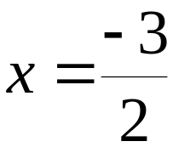

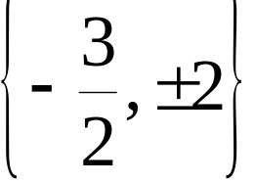
Example: Solving a Polynomial Equation by Factoring
(continued)
Steps 3 and 4 Set each factor equal to zero and solve the resulting equations.
The solution set is
Step 5 Check the solutions in the original equation.

Slide 6
Radical Equations
A radical equation is an equation in which the variable occurs in a square root, cube root, or any higher root.
We solve radical equations with nth roots by raising both sides of the equation to the nth power.

Slide 7
Solving Radical Equations Containing nth Roots
1. If necessary, arrange terms so that one radical is isolated on one side of the equation.
2. Raise both sides of the equation to the nth power to eliminate the isolated nth root.
3. Solve the resulting equation. If this equation still contains radicals, repeat steps 1 and 2.
4. Check all proposed solutions in the original equation.

Slide 8


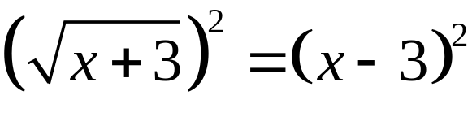

Example: Solving a Radical Equation
Solve:
Step 1 Isolate a radical on one side.
Step 2 Raise both sides to the nth power.

Slide 9






Example: Solving a Radical Equation
(continued)
Step 3 Solve the resulting equation

Slide 10






Example: Solving a Radical Equation
(continued)
Step 4 Check the proposed solutions in the original equation.
Check 6: Check 1:
1 is an extraneous solution. The only solution is x = 6.

Slide 11
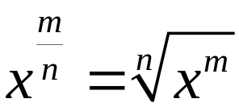
Equations with Rational Exponents
We know that rational exponents represent radicals:
A radical equation with rational exponents can be solved by isolating the expression with the rational exponent, and raising both sides of the equation to a power that is the reciprocal of the rational exponent.

Slide 12
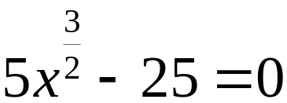
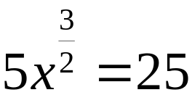
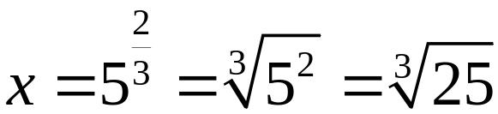
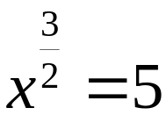
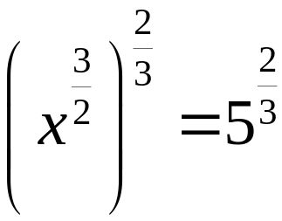
Example: Solving Equations Involving Rational Exponents
Solve:

Slide 13
Equations That Are Quadratic in Form
An equation that is quadratic in form is one that can be expressed as a quadratic equation using an appropriate substitution.

Slide 14

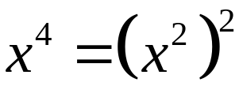








Example: Solving an Equation Quadratic in Form
Solve:
Notice that , we let u = x²

Slide 15

Equations Involving Absolute Value
The absolute value of x describes the distance of x from zero on a number line. To solve an absolute value equation, we rewrite the absolute value equation without absolute value bars.
If c is a positive real number and u represents an algebraic expression, then is equivalent to u = c or u = – c.

Slide 16








Example: Solving an Equation Involving Absolute Value
Solve:
The solution set is

Slide 17

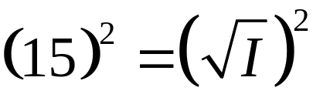




Example: Applications
The formula models weekly television viewing time, H, in hours, by annual income, I, in thousands of dollars. What annual income corresponds to 33.1 hours per week watching TV?
An annual income of $225,000 corresponds to 33.1 hours per week watching TV.

