Slide 1

Chapter 1
Equations and
Inequalities
1.7 Linear Inequalities and
Absolute Value Inequalities
Copyright © 2014, 2010, 2007 Pearson Education, Inc.

Slide 2
Objectives:
Use interval notation.
Find intersections and unions of intervals.
Solve linear inequalities.
Recognize inequalities with no solution or all real numbers as solutions.
Solve compound inequalities.
Solve absolute value inequalities.

Slide 3
Solving an Inequality
Solving an inequality is the process of finding the set of numbers that make the inequality a true statement. These numbers are called the solutions of the inequality and we say that they satisfy the inequality. The set of all solutions is called the solution set of the inequality.

Slide 4
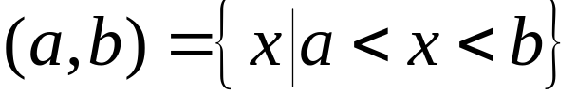
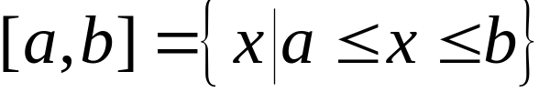
Interval Notation
The open interval (a,b) represents the set of real numbers between, but not including, a and b.
The closed interval [a,b] represents the set of real numbers between, and including, a and b.

Slide 5

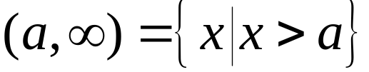

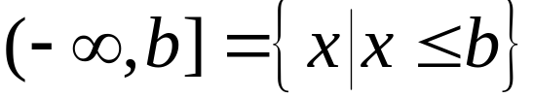
Interval Notation (continued)
The infinite interval represents the set of real numbers that are greater than a.
The infinite interval represents the set of real numbers that are less than or equal to b.

Slide 6


Parentheses and Brackets in Interval Notation
Parentheses indicate endpoints that are not included in an interval. Square brackets indicate endpoints that are included in an interval. Parentheses are always used with or .

Slide 7
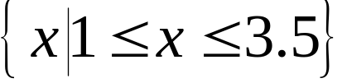


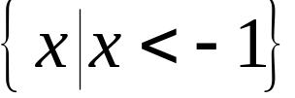

Example: Using Interval Notation
Express the interval in set-builder notation and graph:
[1, 3.5]
Express the interval in set-builder notation and graph:

Slide 8
Finding Intersections and Unions of Two Intervals
1. Graph each interval on a number line.
2. a. To find the intersection, take the portion of the
number line that the two graphs have in common.
b. To find the union, take the portion of the number
line representing the total collection of numbers
in the two graphs.

Slide 9





Example: Finding Intersections and Unions of Intervals
Use graphs to find the set:
Graph of [1,3]:
Graph of (2,6):
Numbers in both [1,3] and (2,6):
Thus,

Slide 10





Solving Linear Inequalities in One Variable
A linear inequality in x can be written in one of the following forms :
In general, when we multiply or divide both sides of an inequality by a negative number, the direction of the inequality symbol is reversed.

Slide 11

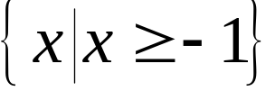

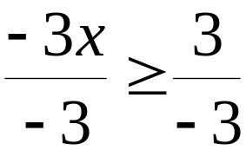



Example: Solving a Linear Inequality
Solve and graph the solution set on a number line:
The solution set is .
The interval notation for this
solution set is .
The number line graph is:

Slide 12




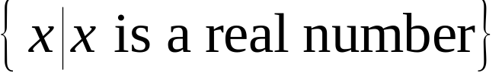
Example: Solving Linear Inequalities
[Recognize inequalities with no solution or all real numbers as solutions]
Solve the inequality:
The inequality is true for all values of x. The solution set
is the set of all real numbers.
In interval notation, the solution is
In set-builder notation, the solution set is

Slide 13



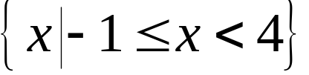

Example: Solving a Compound Inequality
Solve and graph the solution set on a number line:
Our goal is to isolate x in the middle.
In interval notation,
the solution is [-1,4).
In set-builder notation, the solution set is
The number line graph looks like

Slide 14









Solving an Absolute Value Inequality
If u is an algebraic expression and c is a positive number,
1. The solutions of are the numbers that satisfy
2. The solutions of are the numbers that satisfy
or
These rules are valid if is replaced by and
is replaced by

Slide 15




Example: Solving an Absolute Value Inequality
Solve and graph the solution set on a number line:
We begin by expressing the inequality with the
absolute value expression on the left side:
We rewrite the inequality without absolute value bars.
means or

Slide 16


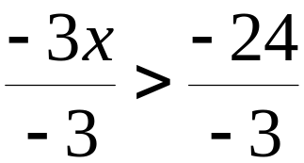
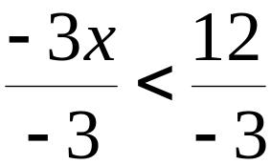


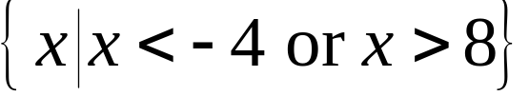

Example: Solving an Absolute Value Inequality
(continued)
We solve these inequalities separately:
The solution set is
The number line graph looks like

