Slide 1

Chapter 2
Functions and
Graphs
2.1 Basic of Functions
and Their Graphs
Copyright © 2014, 2010, 2007 Pearson Education, Inc.

Slide 2
Objectives:
Find the domain and range of a relation.
Determine whether a relation is a function.
Determine whether an equation represents a function.
Evaluate a function.
Graph functions by plotting points.
Use the vertical line test to identify functions.
Obtain information about a function from its graph.
Identify the domain and range of a function from its graph.
Identify intercepts from a function’s graph.

Slide 3
Definition of a Relation
A relation is any set of ordered pairs. The set of all first components of the ordered pairs is called the domain of the relation and the set of all second components is called the range of the relation.

Slide 4
Example: Finding the Domain and Range of a Relation
Find the domain and range of the relation:
{(0, 9.1), (10, 6.7), (20, 10.7), (30, 13.2), (40, 21.2)}
domain: {0, 10, 20, 30, 40}
range: {9.1, 6.7, 10.7, 13.2, 21.2}

Slide 5
Definition of a Function
A function is a correspondence from a first set, called the domain, to a second set, called the range, such that each element in the domain corresponds to exactly one element in the range.

Slide 6
Example: Determining Whether a Relation is a Function
Determine whether the relation is a function:
{(1, 2), (3, 4), (6, 5), (8, 5)}
No two ordered pairs in the given relation have the same first component and different second components. Thus, the relation is a function.

Slide 7
Functions as Equations
If an equation is solved for y and more than one value of y can be obtained for a given x, then the equation does not define y as a function of x.

Slide 8


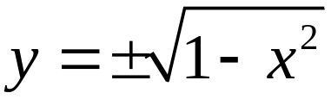

Example: Determining Whether an Equation Represents a Function
Determine whether the equation defines y as a function of x.
The shows that for certain values of x, there are two values of y. For this reason, the equation does not define y as a function of x.

Slide 9
Function Notation
The special notation f(x), read “f of x” or “f at x”, represents the value of the function at the number x.

Slide 10





Example: Evaluating a Function
If evaluate
Thus,

Slide 11
Graphs of Functions
The graph of a function is the graph of its ordered pairs.

Slide 12
Example: Graphing Functions
Graph the functions f(x) = 2x and g(x) = 2x – 3 in the same rectangular coordinate system. Select integers for x, starting with –2 and ending with 2.

Slide 13

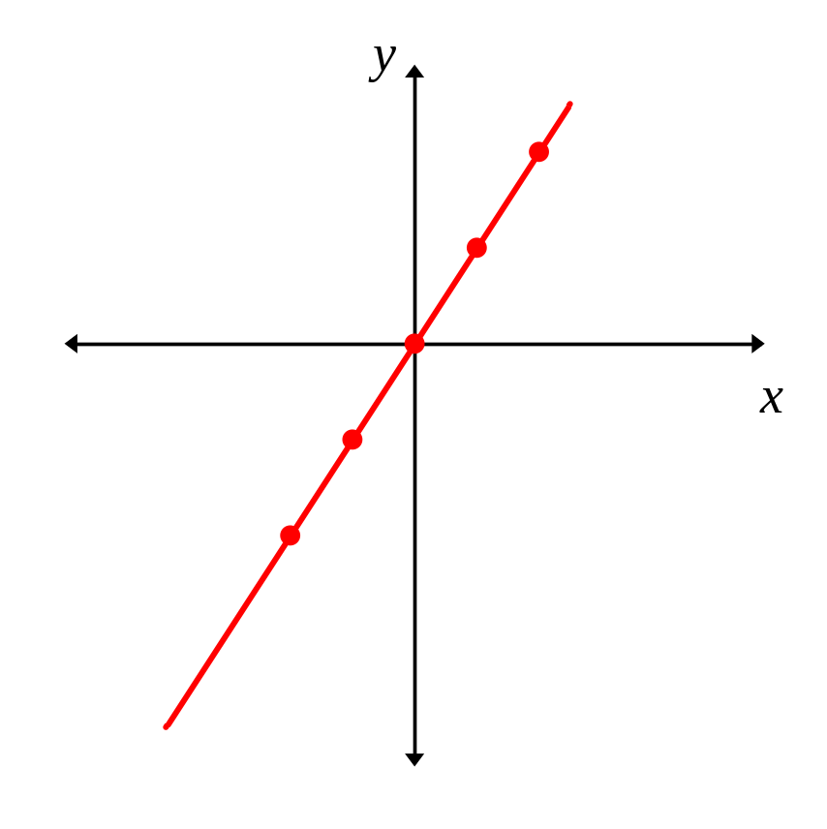

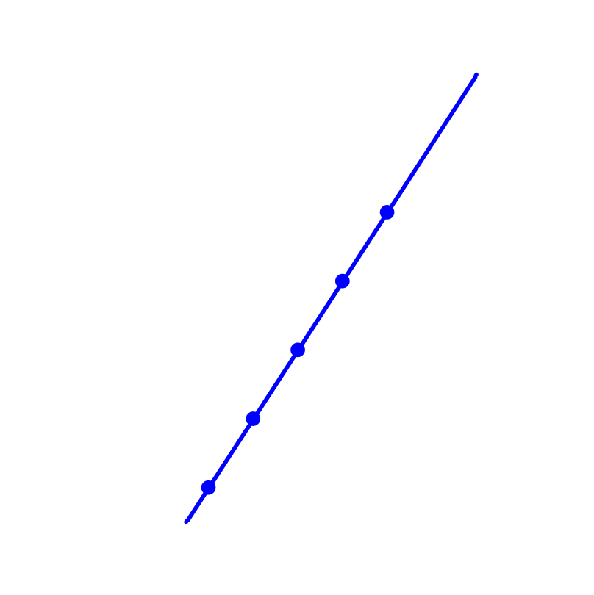
Example: Graphing Functions (continued)
We set up a partial table of coordinates for each function.
We then plot the points and connect them.
x | y = f (x)
–2 | –4
–1 | –2
0 | 0
1 | 2
2 | 4
x | y = f (x)
–2 | –7
–1 | –5
0 | –3
1 | –1
2 | 1

Slide 14
The Vertical Line Test for Functions
If any vertical line intersects a graph in more than one point, the graph does not define y as a function of x.

Slide 15
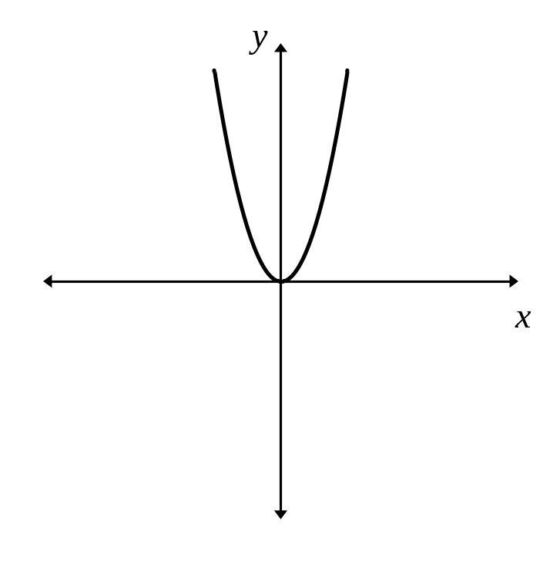
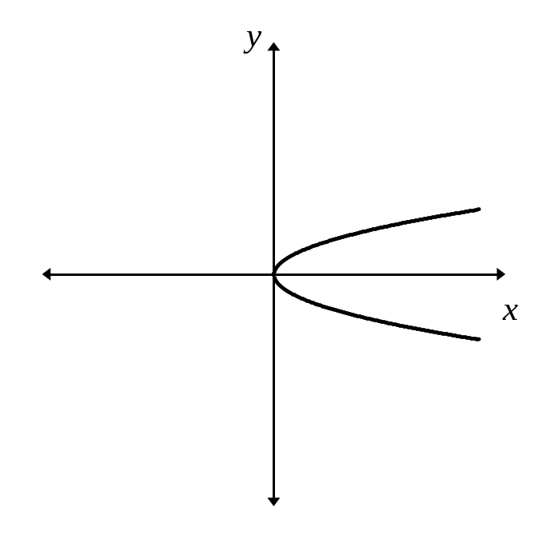
Example: Using the Vertical Line Test
Use the vertical line test to identify graphs in which y is a function of x.
not a function
function

Slide 16
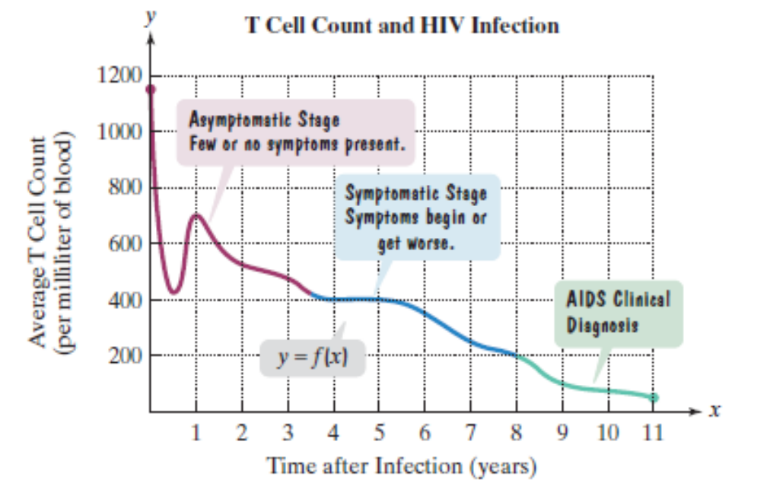
Example: Analyzing the Graph of a Function
Use the graph to find f(5)
f(5)=400
For what value of x
is f(x) = 100?
f(9) = 125, so x = 9.

Slide 17
Identifying Domain and Range from a Function’s Graph
To find the domain of a function from it’s graph, look for all the inputs on the x-axis that correspond to points on the graph.
To find the range of a function from it’s graph, look for all the outputs on the y-axis that correspond to points on the graph.

Slide 18
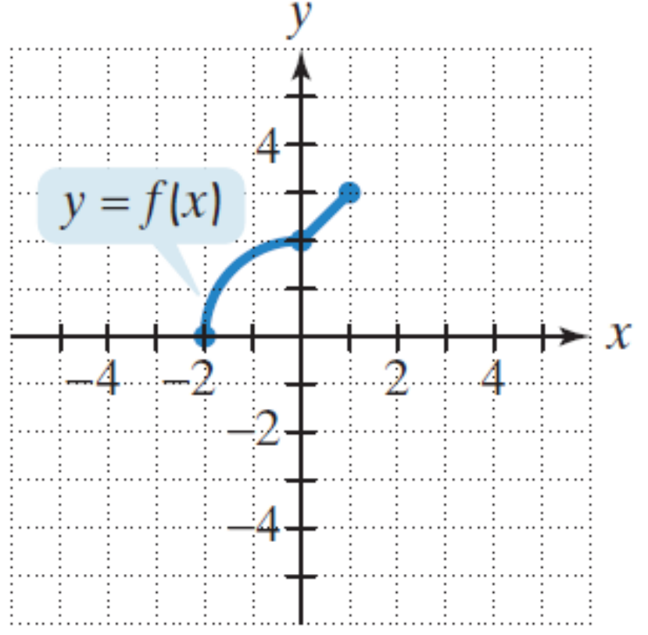
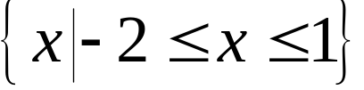

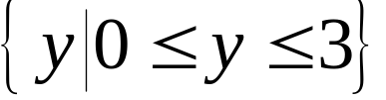

Example: Identifying the Domain and Range of a Function from Its Graph
Use the graph of the function to identify its domain and its range.
Domain
Range

Slide 19
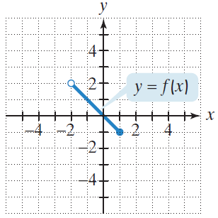
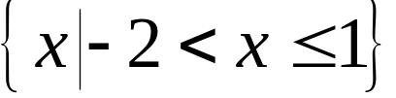

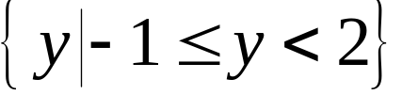

Example: Identifying the Domain and Range of a Function from Its Graph
Use the graph of the function to identify its domain and its range.
Domain
Range

Slide 20
Identifying Intercepts from a Function’s Graph
To find the x-intercepts, look for the points at which the graph crosses the x-axis.
To find the y-intercept, look for the point at which the graph crosses the y-axis.
A function can have more than one x-intercept but at most one y-intercept.

Slide 21
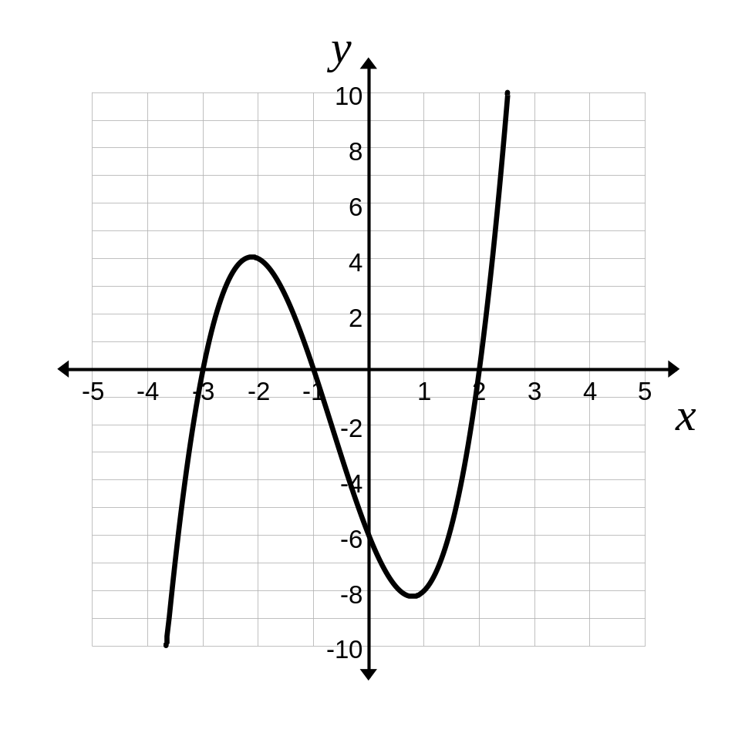


Example: Identifying Intercepts from a Function’s Graph
Identify the x- and y-intercepts for the graph of f(x).
The x-intercepts are
(–3, 0)
(–1, 0)
and (2, 0)
The y-intercept is (0, –6)

