Slide 1

Chapter 2
Functions and
Graphs
2.2 More on Functions
and Their Graphs
Copyright © 2014, 2010, 2007 Pearson Education, Inc.

Slide 2
Objectives:
Identify intervals on which a function increases, decreases, or is constant.
Use graphs to locate relative maxima or minima.
Identify even or odd functions and recognize their symmetries.
Understand and use piecewise functions.
Find and simplify a function’s difference quotient.

Slide 3
Increasing, Decreasing, and Constant Functions
1. A function is increasing on an open interval, I, if f(x₁) < f(x₂) whenever x₁ < x₂ for any x₁ and x₂ in the interval.
2. A function is decreasing on an open interval, I, if f(x₁) > f(x₂) whenever x₁ < x₂ for any x₁ and x₂ in the interval.
3. A function is constant on an open interval, I, if
f(x₁) = f(x₂) for any x₁ and x₂ in the interval.

Slide 4
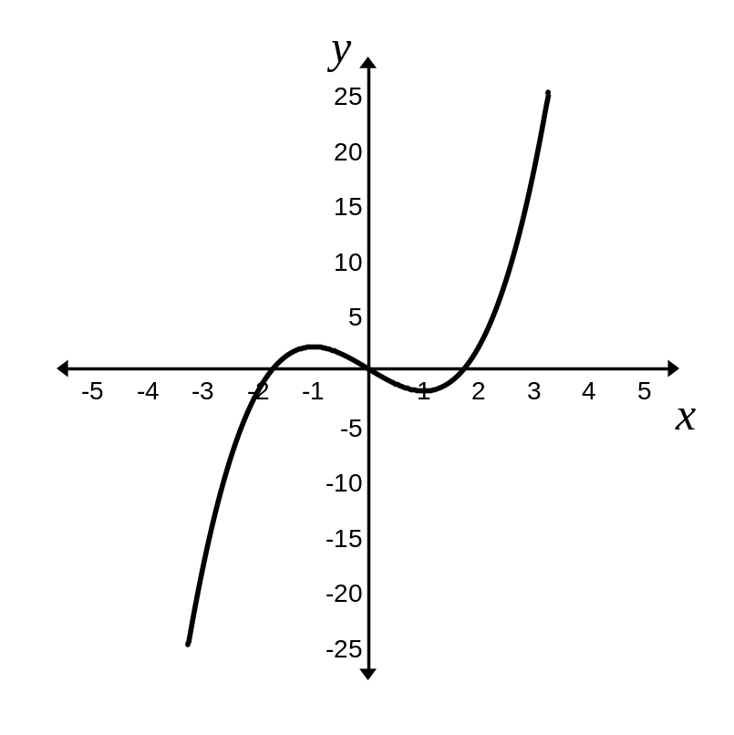



Example: Intervals on Which a Function Increases, Decreases, or is Constant
State the intervals on which the given function is increasing, decreasing, or constant.
increasing on
decreasing on
increasing on

Slide 5


Definitions of Relative Maximum and Relative Minimum
1. A function value f(a) is a relative maximum of f if there exists an open interval containing a such that f(a) > f(x) for all in the open interval.
2. A function value f(b) is a relative minimum of f if there exists an open interval containing b such that f(b) < f(x) for all in the open interval.

Slide 6


Example: Use Graphs to Locate Relative Maxima or Minima
Identify the relative maxima and minima for the graph of f.
f has a relative maximum at
x = – 1
f has a relative minimum at
x = 1

Slide 7
Definitions of Even and Odd Functions
The function f is an even function if f(– x) = f(x) for all x in the domain of f. The right side of the equation of an even function does not change if x is replaced with – x.
The function f is an odd function if f(– x) = – f(x) for all x in the domain of f. Every term on the right side of the equation of an odd function changes its sign if x is replaced with – x.

Slide 8





Example: Identifying Even or Odd Functions
Determine whether the function is even, odd, or neither.
The function is not even.
The function is not odd.
The function is neither odd nor even.

Slide 9
Even Functions and y-Axis Symmetry
The graph of an even function in which f(– x) = f(x) is symmetric with respect to the y-axis.

Slide 10
Odd Functions and Origin Symmetry
The graph of an odd function in which f(– x) = – f(x) is symmetric with respect to the origin.

Slide 11
Piecewise Functions
A function that is defined by two (or more) equations over a specified domain is called a piecewise function.

Slide 12
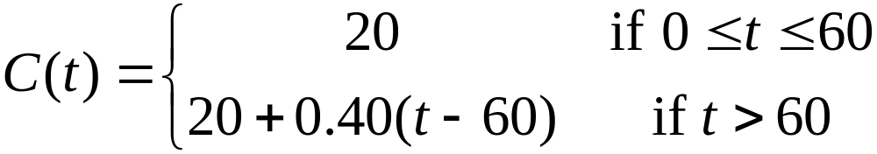






Example: Evaluating a Piecewise Function
Given the function
Find C(40)
Find C(80)

Slide 13
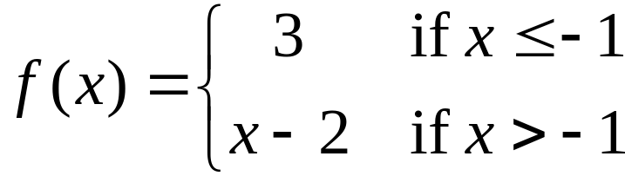
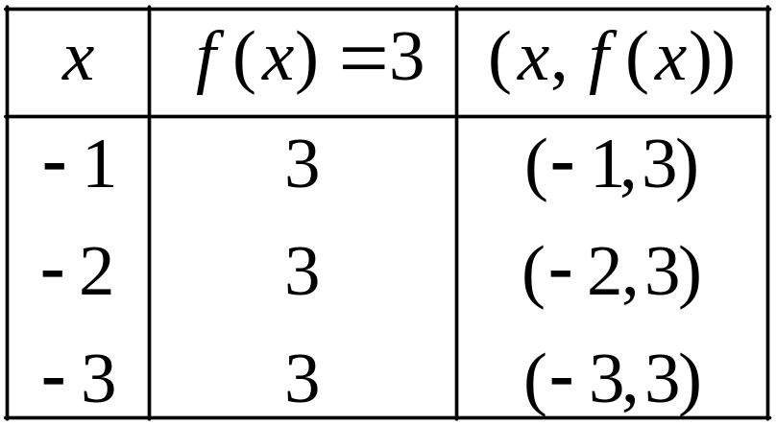
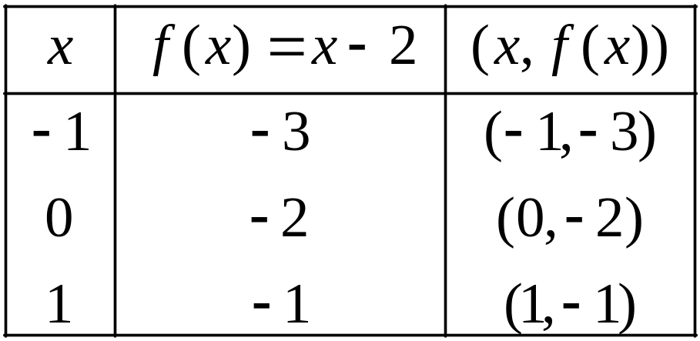
Example: Graphing a Piecewise Function
Graph the piecewise function defined by
We will graph f in two parts, using a partial table of coordinates for each piece of the graph.

Slide 14
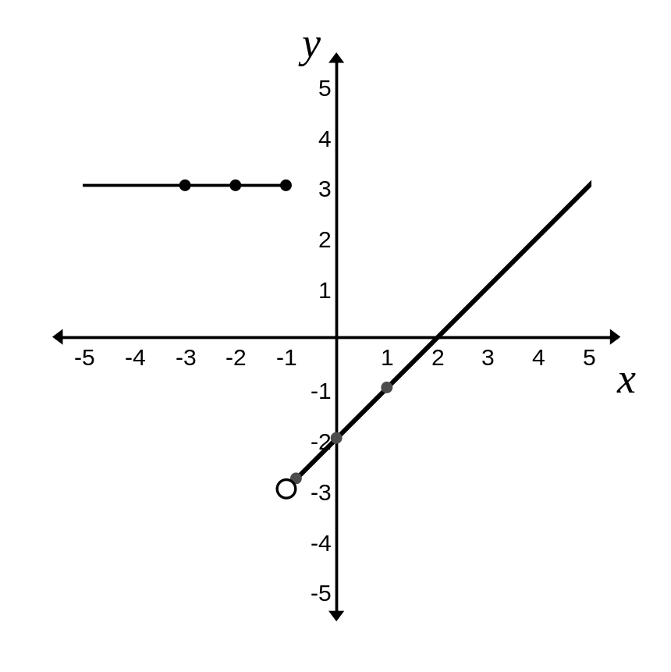
Example: Graphing a Piecewise Function
(continued)
The graph of

Slide 15
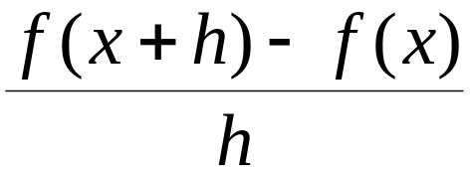

Definition of the Difference Quotient of a Function
The expression
for is called the difference quotient of the function f.

Slide 16




Example: Evaluating and Simplifying a Difference Quotient
If find and simplify the expression.

Slide 17

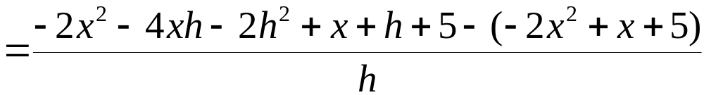
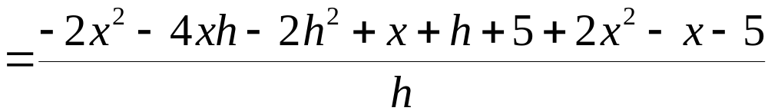
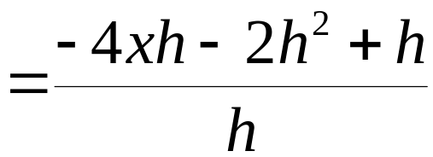
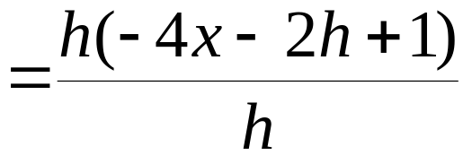

Example: Evaluating and Simplifying a Difference Quotient (continued)
If find and simplify the expression.

