Slide 1

Chapter 2
Functions and
Graphs
2.3 Linear Functions
and Slope
Copyright © 2014, 2010, 2007 Pearson Education, Inc.

Slide 2
Objectives:
Calculate a line’s slope.
Write the point-slope form of the equation of a line.
Write and graph the slope-intercept form of the equation of a line.
Graph horizontal or vertical lines.
Recognize and use the general form of a line’s equation.
Use intercepts to graph the general form of a line’s equation.
Model data with linear functions and make predictions.

Slide 3
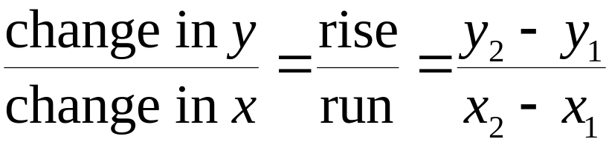

Definition of Slope
The slope of the the line through the distinct points
(x₁, y₁) and (x₂, y₂) is
where

Slide 4
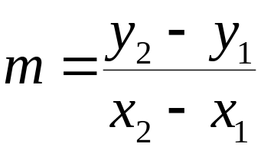
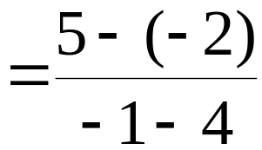
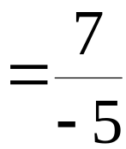
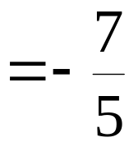
Example: Using the Definition of Slope
Find the slope of the line passing through the points
(4, –2) and (–1, 5)

Slide 5

Point-Slope Form of the Equation of a Line
The point-slope form of the equation of a nonvertical line with slope m that passes through the point (x₁, y₁) is

Slide 6



Example: Writing an Equation in Point-Slope Form for a Line
Write an equation in point-slope form for the line with slope 6 that passes through the point (2, –5). Then solve the equation for y.
The equation in point-slope form is
Solved for y the equation is

Slide 7

Slope-Intercept Form of the Equation of a Line
The slope-intercept form of the equation of a nonvertical line with slope m and y-intercept b is

Slide 8
Graphing y = mx + b Using the Slope and y-Intercept
1. Plot the point containing the y-intercept on the
y-axis. This is the point (0, b).
2. Obtain a second point using the slope, m. Write m as a fraction, and use rise over run, starting at the point containing the y-intercept, to plot this point.
3. Use a straightedge to draw a line through the two points. Draw arrowheads at the ends of the line to show that the line continues indefinitely in both directions.

Slide 9
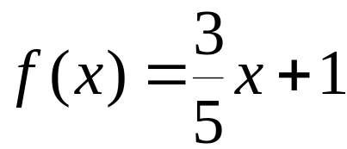
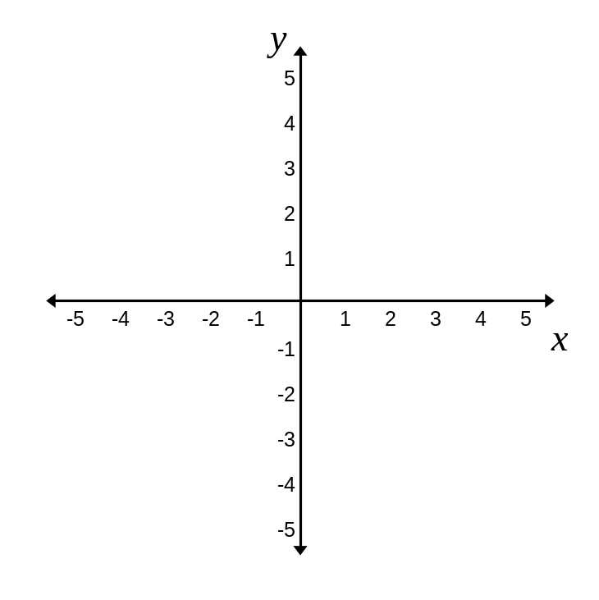

Example: Graphing Using the Slope and y-Intercept
Graph the linear function:
Step 1 Plot the point containing the y-intercept on the y-axis.
The y-intercept is 1.
We plot the point (0, 1)

Slide 10
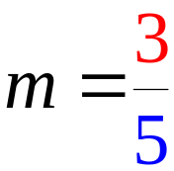
Example: Graphing Using the Slope and y-Intercept
(continued)
Step 2 Obtain a second point using the slope, m. Write m as a fraction, and use rise over run, starting at the point containing the y-intercept, to plot this point.
run = 5
rise = 3
y-intercept=1
We plot the
point (4,5)

Slide 11
Equation of a Horizontal Line
A horizontal line is given by an equation of the form
y = b,
where b is the y-intercept of the line.
The slope of a horizontal line is zero.

Slide 12
Equation of a Vertical Line
A vertical line is given by an equation of the form
x = a,
where a is the x-intercept of the line.
The slope of a vertical line is undefined.

Slide 13

Example: Graphing a Horizontal Line
Graph y = 3 in the rectangular coordinate system.

Slide 14
General Form of the Equation of a Line
Every line has an equation that can be written in the general form
Ax + By + C = 0
where A, B, and C are real numbers, and A and B are not both zero.

Slide 15



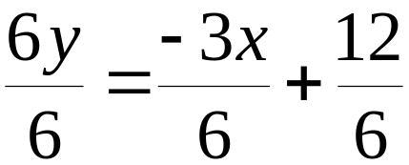
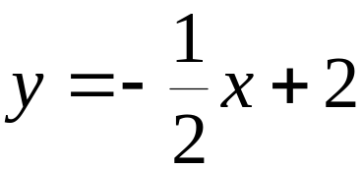
Example: Finding the Slope and the y-Intercept
Find the slope and the y-intercept of the line whose equation is
The slope is
The y-intercept is 2

Slide 16
Using Intercepts to Graph Ax + By + C = 0
1. Find the x-intercept. Let y = 0 and solve for x. Plot the point containing the x-intercept on the x-axis.
2. Find the y-intercept. Let x = 0 and solve for y. Plot the point containing the y-intercept on the y-axis.
3. Use a straightedge to draw a line through the points containing the intercepts. Draw arrowheads at the ends of the line to show that the line continues indefinitely in both directions.

Slide 17





Example: Using Intercepts to Graph a Linear Equation
Graph using intercepts:
Step 1 Find the x-intercept. Let y = 0 and solve for x.
The x-intercept is 2, so the line passes through (2, 0).

Slide 18




Example: Using Intercepts to Graph a Linear Equation
(continued)
Step 2. Find the y-intercept. Let x = 0 and solve for y.
The y-intercept is –3, so the line passes through
(0, –3).

Slide 19

Example: Using Intercepts to Graph a Linear Equation
(continued)
Step 3 Graph the equation by drawing a line through the two points containing the intercepts.

Slide 20
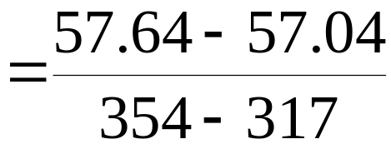
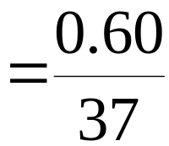

Example: Application
Use the data points (317, 57.04) and (354, 57.64) to obtain a linear function that models average global temperature, f(x), for an atmospheric carbon dioxide concentration of x parts per million. Round m to three decimal places and b to one decimal place.

Slide 21




Example: Application (continued)
Find the equation of the line:
The function models average global temperature, f(x), for an atmospheric carbon dioxide concentration of x parts per million.

