Slide 1

Chapter 2
Functions and
Graphs
2.4 More on Slope
Copyright © 2014, 2010, 2007 Pearson Education, Inc.

Slide 2
Objectives:
1. Find slopes and equations of parallel and perpendicular lines.
2. Interpret slope as rate of change.
3. Find a function’s average rate of change.

Slide 3
Slope and Parallel Lines
1. If two nonvertical lines are parallel, then they have the same slope.
2. If two distinct nonvertical lines have the same slope, then they are parallel.
3. Two distinct vertical lines, both with undefined slopes, are parallel.

Slide 4


Example: Writing Equations of a Line Parallel to a Given Line
Write an equation of the line passing through (–2, 5) and parallel to the line whose equation is
Express the equation in point-slope form.
In point-slope form, the equation of the line is
The slope of the line is 3. A parallel
line will have slope of 3.

Slide 5
Slope and Perpendicular Lines
1. If two nonvertical lines are perpendicular, then the product of their slopes is –1.
2. If the product of the slopes of two lines is –1, then the lines are perpendicular.
3. A horizontal line having zero slope is perpendicular to a vertical line having undefined slope.

Slide 6


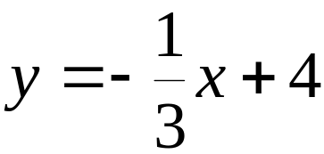

Example: Writing Equations of a Line Perpendicular to a Given Line
Find the slope of any line that is perpendicular to the line whose equation is
The slope is
The slope of any line perpendicular to this line is 3.

Slide 7
Slope as Rate of Change
Slope is defined as the ratio of the change in y to a corresponding change in x. It describes how fast y is changing with respect to x. For a linear function, slope may be interpreted as the rate of change of the dependent variable per unit change in the independent variable.

Slide 8
Example: Slope as Rate of Change
In 1990, 9 million adult men in the United States lived alone. In 2008, 14.7 million adult men in the United States lived alone. Use this information to find the slope of the linear function representing adult men living alone in the United States. Express the slope correct to two decimal places and describe what it represents.
We form the ordered pairs (1990, 9) and (2008, 14.7).

Slide 9
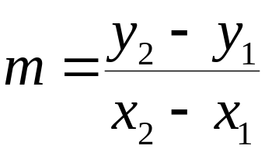
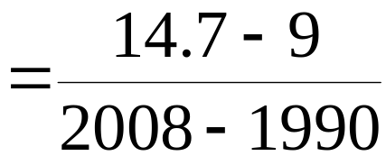
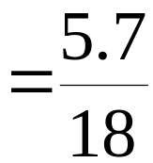

Example: Slope as Rate of Change (continued)
Using the ordered pairs (1990, 9) and (2008, 14.7), we compute the slope:
The number of men living alone increased at a rate of 0.32 million per year.
The rate of change is 0.32 million men per year.

Slide 10
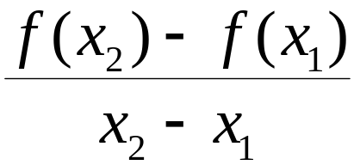
The Average Rate of Change of a Function
Let (x₁, f(x₁)) and (x₂, f(x₂)) be distinct points on the graph of a function f. The average rate of change of f from x₁ to x₂ is

Slide 11

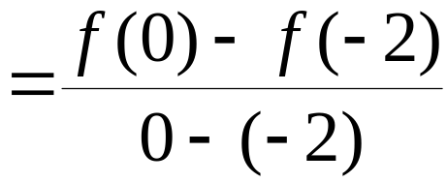
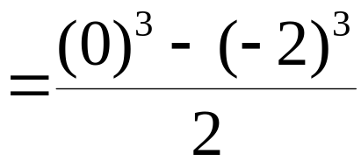
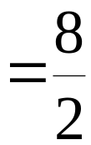

Example: Finding the Average Rate of Change
Find the average rate of change for from
x₁ = –2 to x₂ = 0.

