Slide 1

Chapter 2
Functions and
Graphs
2.5 Transformations of
Functions
Copyright © 2014, 2010, 2007 Pearson Education, Inc.

Slide 2
Objectives:
Recognize graphs of common functions.
Use vertical shifts to graph functions.
Use horizontal shifts to graph functions.
Use reflections to graph functions.
Use vertical stretching and shrinking to graph functions.
Use horizontal stretching and shrinking to graph functions.
Graph functions involving a sequence of transformations.

Slide 3




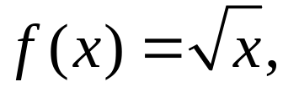

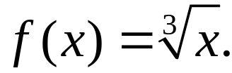
Graphs of Common Functions
Seven functions that are frequently encountered in algebra are:
and
It is essential to know the characteristics of the graphs of these functions.

Slide 4


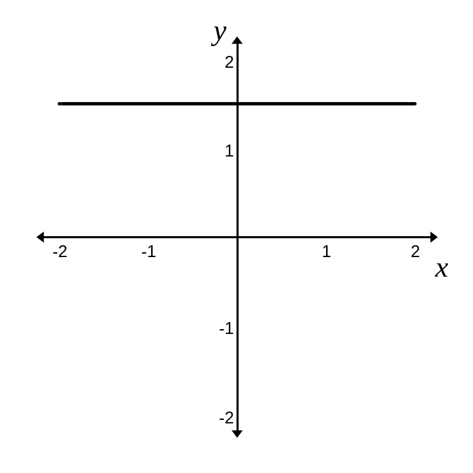
Graphs of Common Functions (continued)
is known as the constant function.
The domain of this function is:
The range of this function is: c
The function is constant on
This function is even.

Slide 5

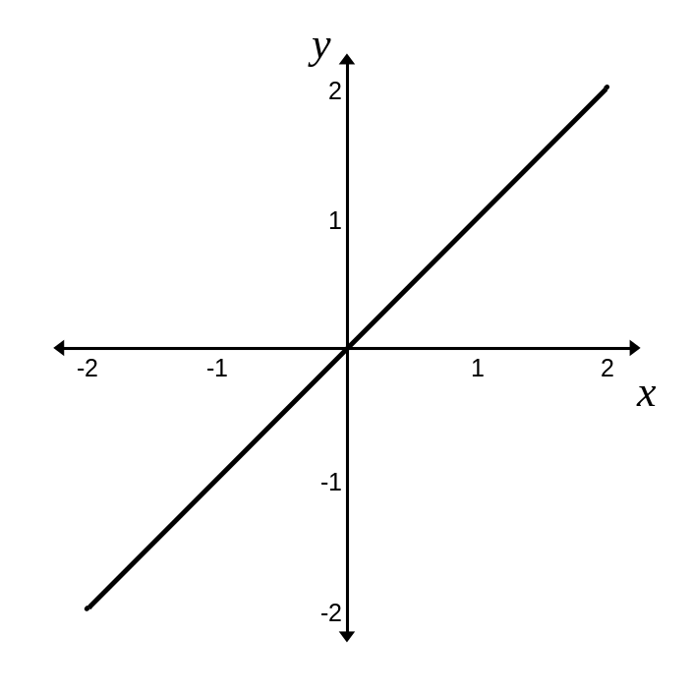
Graphs of Common Functions (continued)
is known as the identity function.
The domain of this function is:
The range of this function is:
The function is increasing on
This function is odd.

Slide 6



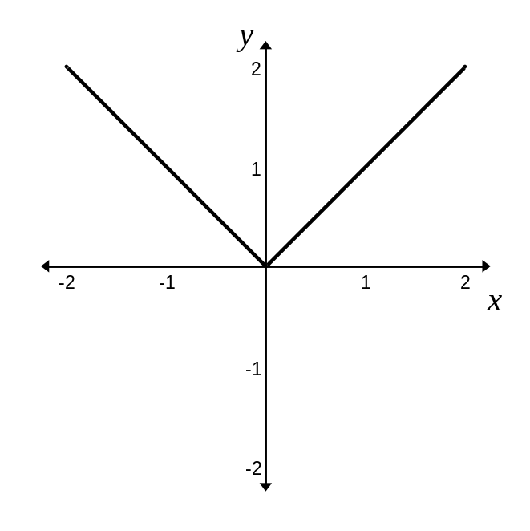

Graphs of Common Functions (continued)
is the absolute value function.
The domain of this function is:
The range of this function is:
The function is decreasing on
and increasing on
This function is even.

Slide 7

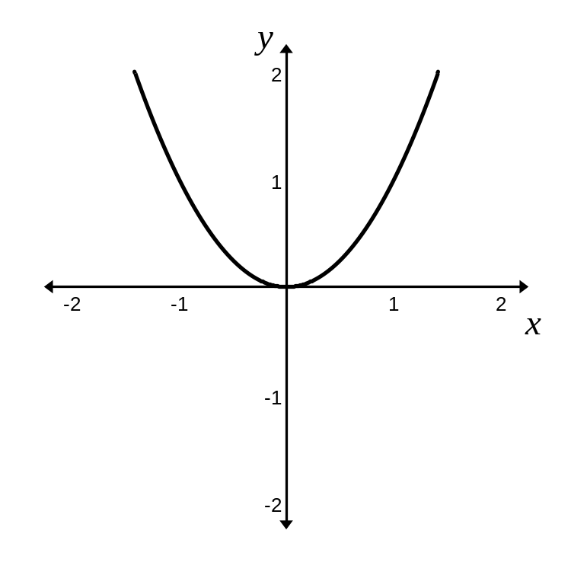
Graphs of Common Functions (continued)
is the standard quadratic function.
The domain of this function is:
The range of this function is:
The function is decreasing on
and increasing on
This function is even.

Slide 8
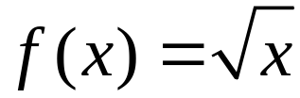
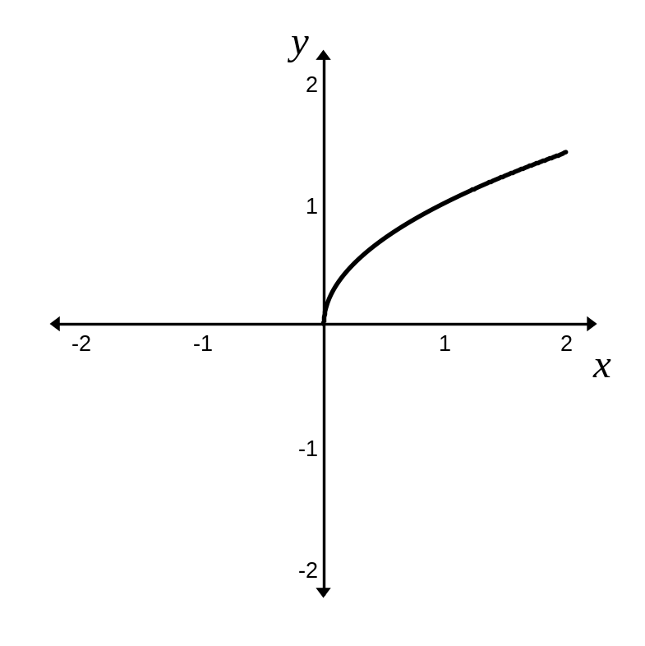
Graphs of Common Functions
is the square root function.
The domain of this function is:
The range of this function is:
The function is increasing on
This function is neither
even nor odd.

Slide 9

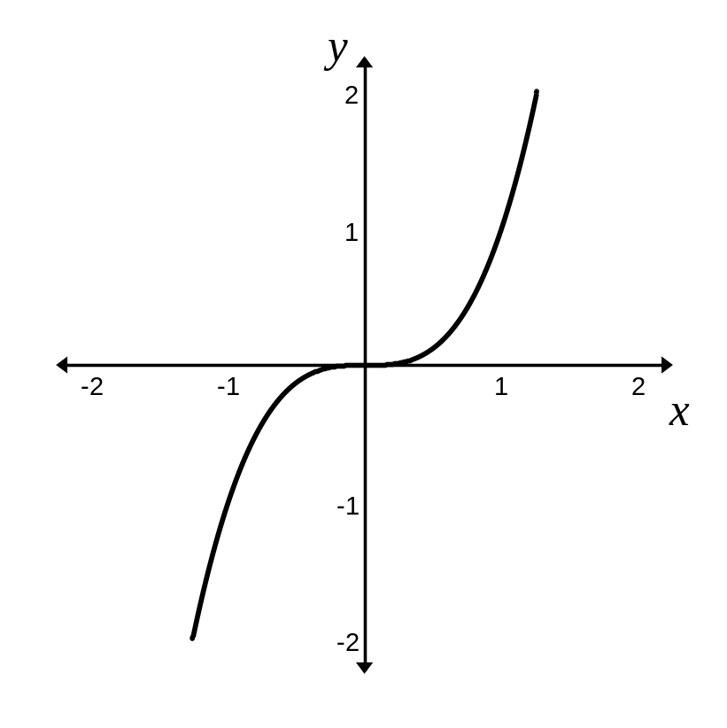
Graphs of Common Functions (continued)
is the standard cubic function.
The domain of this function is:
The range of this function is:
The function is increasing on
This function is odd.

Slide 10
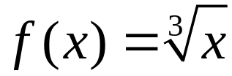
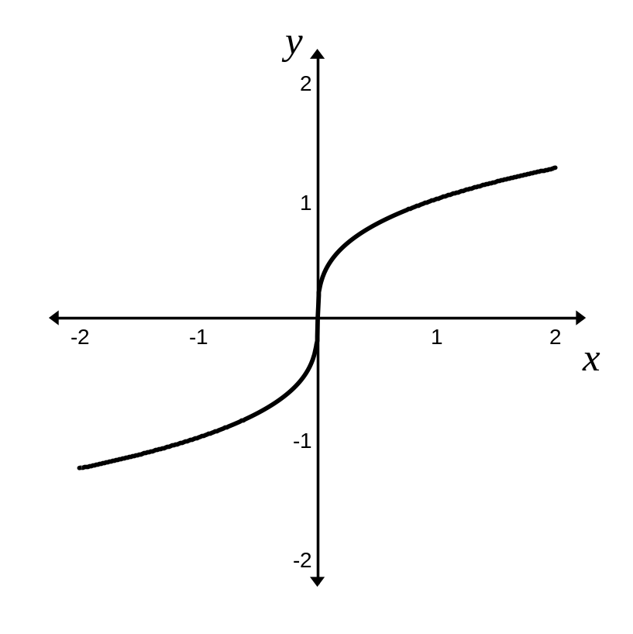
Graphs of Common Functions (continued)
is the cube root function.
The domain of this function is:
The range of this function is:
The function is increasing on
This function is odd.

Slide 11
Vertical Shifts
Let f be a function and c a positive real number.
The graph of y = f(x) + c is the graph of y = f(x) shifted c units vertically upward.
The graph of y = f(x) – c is the graph of y = f(x) shifted c units vertically downward.

Slide 12

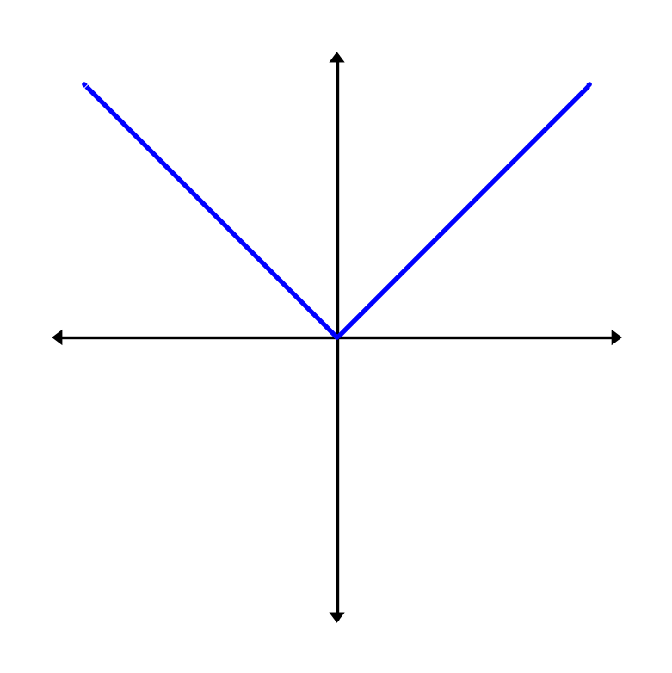
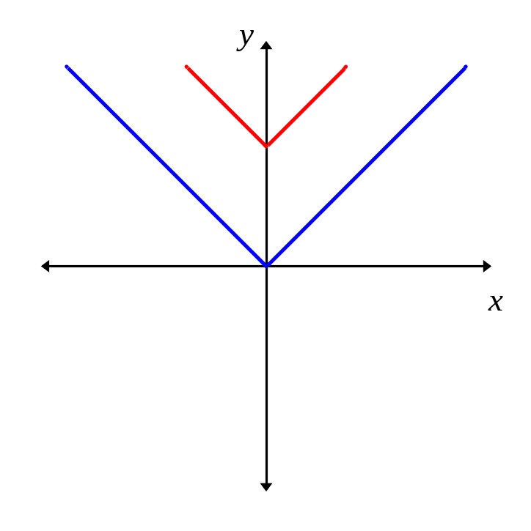


Example: Vertical Shift
Use the graph of to obtain the graph of
The graph will shift vertically up by 3 units.

Slide 13
Horizontal Shifts
Let f be a function and c a positive real number.
The graph of y = f(x + c) is the graph of y = f(x) shifted to the left c units.
The graph of y = f(x – c) is the graph of y = f(x) shifted to the right c units.

Slide 14
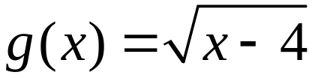
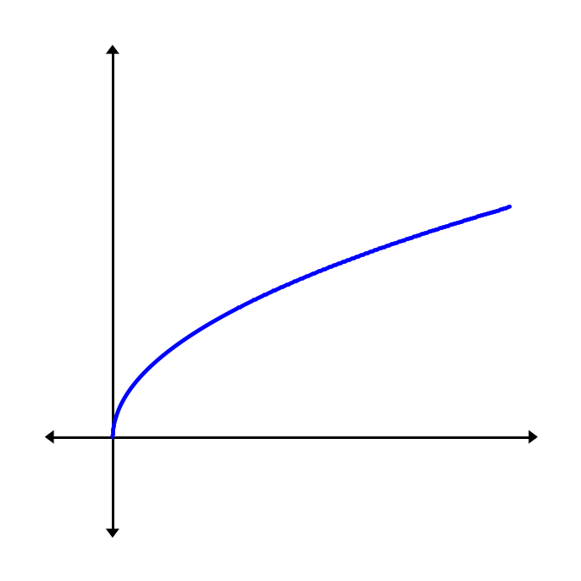
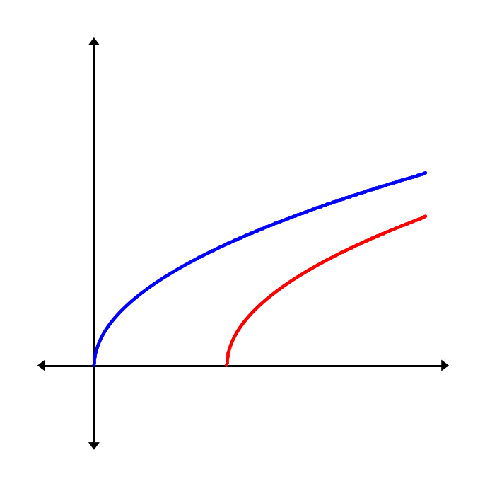
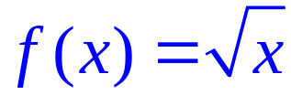
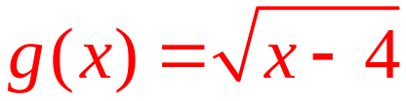
Example: Horizontal Shift
Use the graph of to obtain the graph of
The graph will shift to the right 4 units.

Slide 15
Reflections of Graphs
Reflection about the x-Axis
The graph of y = – f(x) is the graph of y = f(x) reflected about the x-axis.
Reflection about the y-Axis
The graph of y = f(–x) is the graph of y = f(x) reflected about the y-axis.

Slide 16
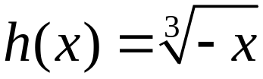
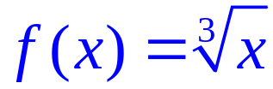
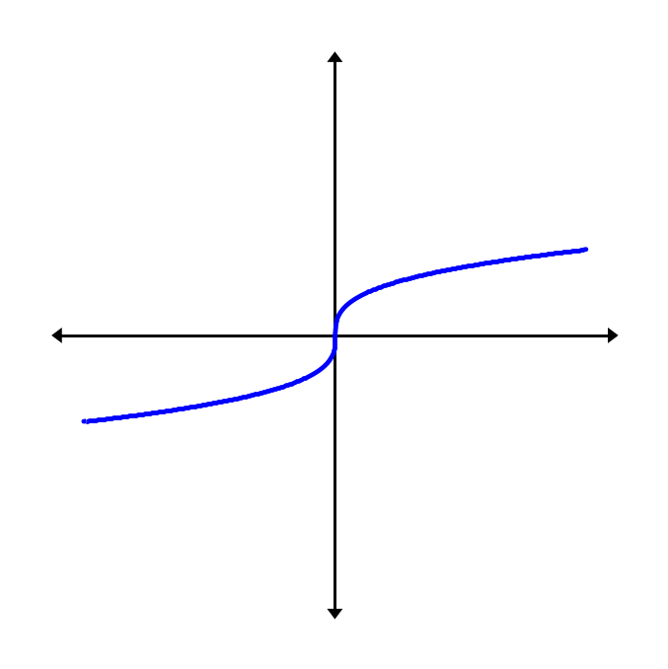
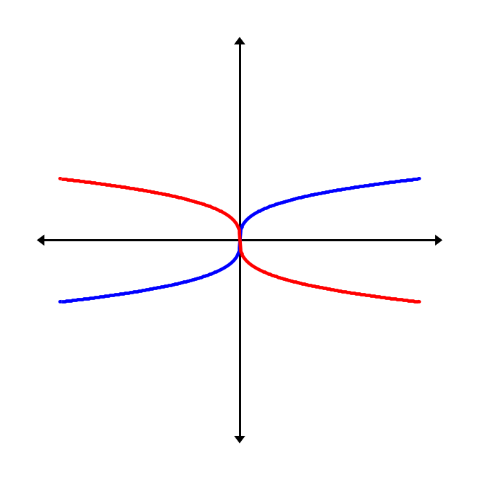
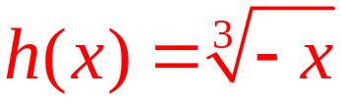
Example: Reflection about the y-Axis
Use the graph of to obtain the graph of
The graph will reflect across the x-axis.

Slide 17
Vertically Stretching and Shrinking Graphs
Let f be a function and c a positive real number.
If c > 1, the graph of y = cf(x) is the graph of y = f(x) vertically stretched by multiplying each of its
y-coordinates by c.
If 0 < c < 1, the graph of y = cf(x) is the graph of
y = f(x) vertically shrunk by multiplying each of its
y-coordinates by c.

Slide 18


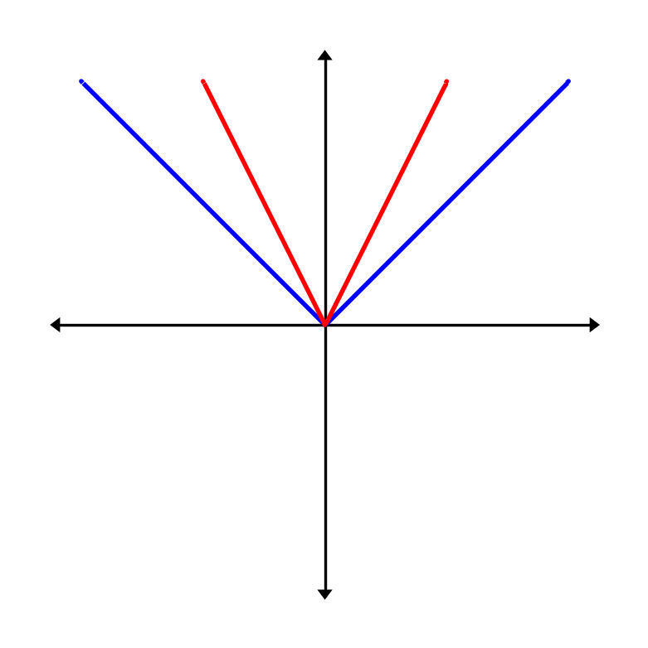
Example: Vertically Shrinking a Graph
Use the graph of to obtain the graph of

Slide 19
Horizontally Stretching and Shrinking Graphs
Let f be a function and c a positive real number.
If c > 1, the graph of y = f(cx) is the graph of y = f(x) horizontally shrunk by dividing each of its x-coordinates by c.
If 0 < c <1, the graph of y = f(cx) is the graph of
y = f(x) horizontally stretched by dividing each of its
x-coordinates by c.

Slide 20
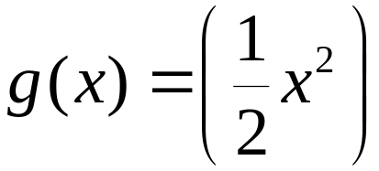

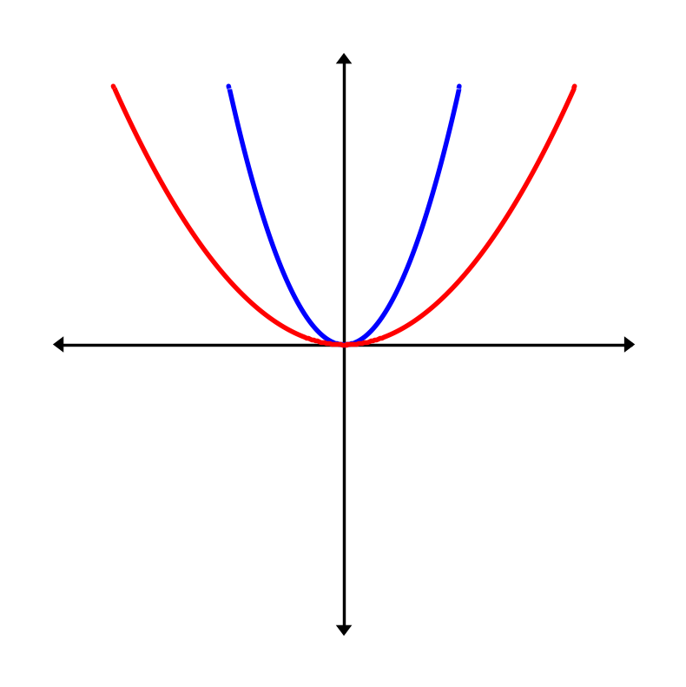
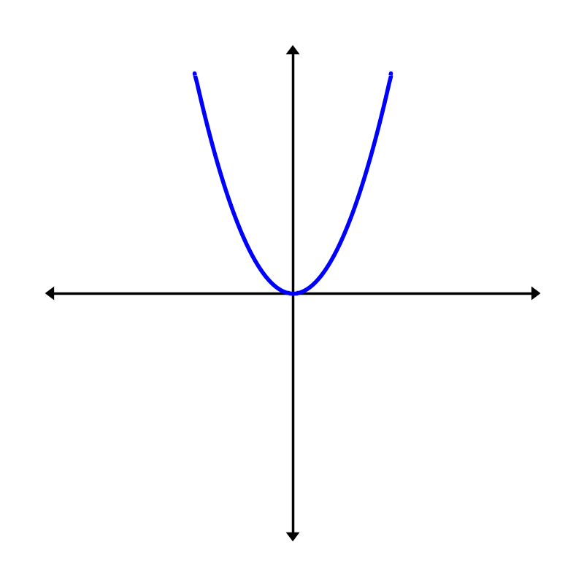
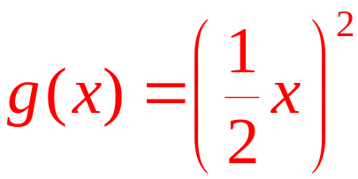
Example: Horizontally Stretching and Shrinking a Graph
Use the graph of to obtain the graph of

Slide 21
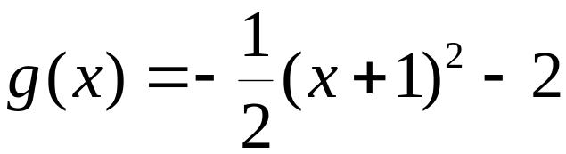
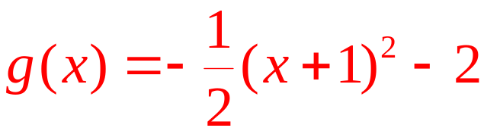
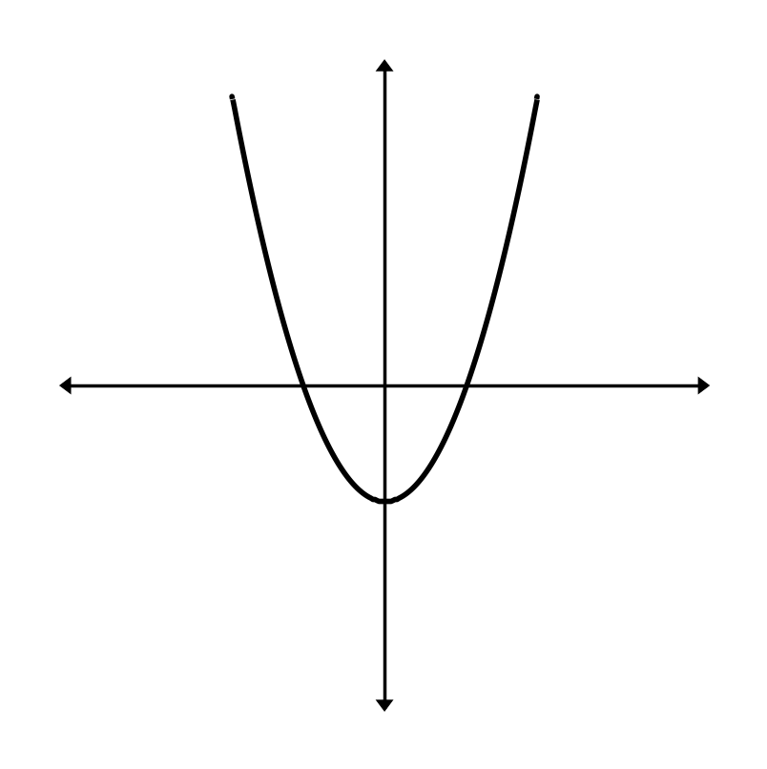
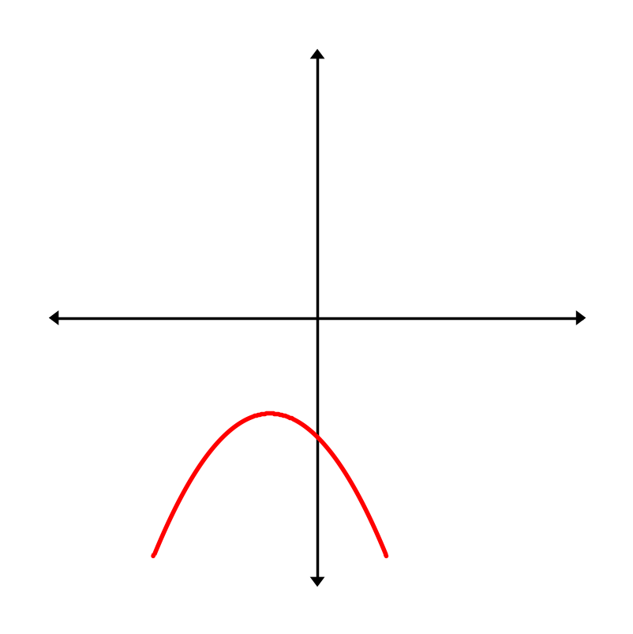
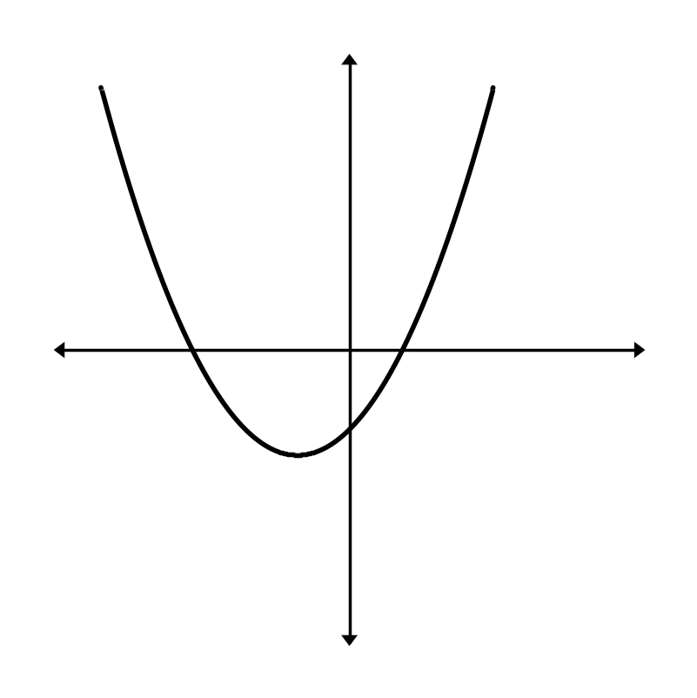
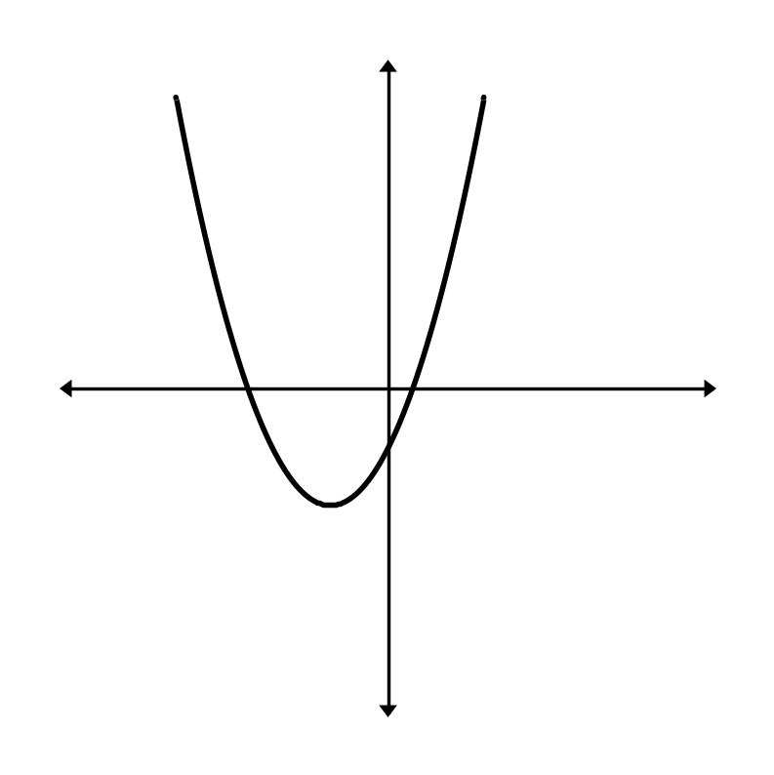
Example: Graphing Using a Sequence of Transformations
Use the graph of to obtain the graph of
We will graph these
transformations in order:
down 2
then left 1
then shrink vertically
then reflect

