Slide 1

Chapter 2
Functions and
Graphs
2.6 Combinations of Functions; Composite
Functions
Copyright © 2014, 2010, 2007 Pearson Education, Inc.

Slide 2
Objectives:
Find the domain of a function.
Combine functions using the algebra of functions, specifying domains.
Form composite functions.
Determine domains for composite functions.
Write functions as compositions.

Slide 3
Finding a Function’s Domain
If a function f does not model data or verbal conditions, its domain is the largest set of real numbers for which the value of f(x) is a real number. Exclude from a function’s domain real numbers that cause division by zero and real numbers that result in a square root of a negative number.

Slide 4
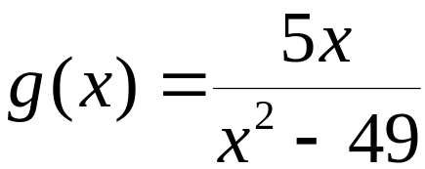





Example: Finding the Domain of a Function
Find the domain of the function
Because division by 0 is undefined, we must exclude from the domain the values of x that cause the denominator to equal zero.
We exclude 7 and – 7 from the domain of g.
The domain of g is

Slide 5





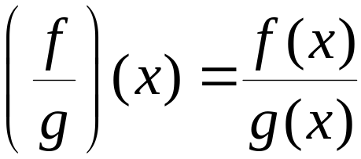
The Algebra of Functions: Sum, Difference, Product, and Quotient of Functions
Let f and g be two functions. The sum f + g, the difference, f – g, the product fg, and the quotient
are functions whose domains are the set of all real numbers common to the domains of f and
defined as follows:
1. Sum:
2. Difference:
3. Product:
4. Quotient:

Slide 6






Example: Combining Functions
Let and Find each of the following:
a.
b. The domain of
The domain of f(x) has no restrictions.
The domain of g(x) has no restrictions.
The domain of is

Slide 7


The Composition of Functions
The composition of the function f with g is denoted
and is defined by the equation
The domain of the composite function is the set of all x such that
1. x is in the domain of g and
2. g(x) is in the domain of f.

Slide 8







Example: Forming Composite Functions
Given and find

Slide 9


Excluding Values from the Domain of
The following values must be excluded from the
input x:
If x is not in the domain of g, it must not be in the domain of
Any x for which g(x) is not in the domain of f must not be in the domain of

Slide 10
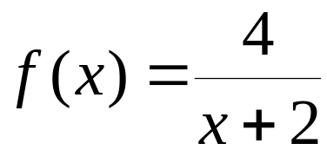
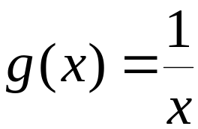

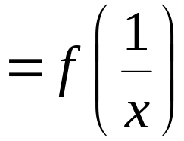
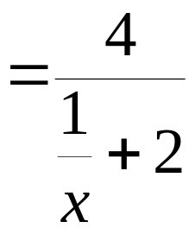
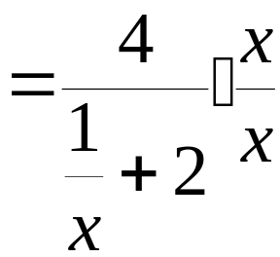
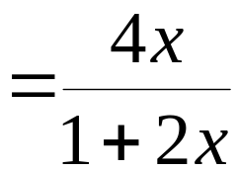
Example: Forming a Composite Function and Finding Its Domain
Given and
Find

Slide 11

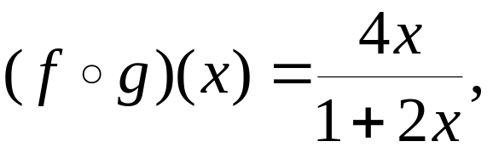
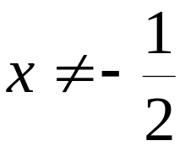
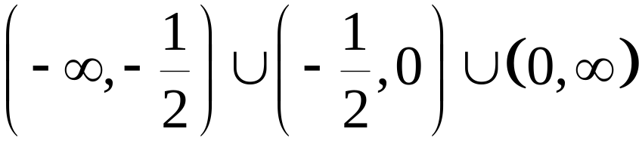
Example: Forming a Composite Function and Finding Its Domain
Given and
Find the domain of
For g(x),
For
The domain of is

Slide 12
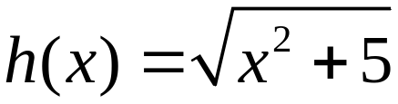
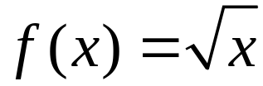


Example: Writing a Function as a Composition
Express h(x) as a composition of two functions:
If and then

