Slide 1

Chapter 2
Functions and
Graphs
2.7 Inverse Functions
Copyright © 2014, 2010, 2007 Pearson Education, Inc.

Slide 2
Objectives:
Verify inverse functions.
Find the inverse of a function.
Use the horizontal line test to determine if a function has an inverse function.
Use the graph of a one-to-one function to graph its inverse function.
Find the inverse of a function and graph both functions on the same axes.

Slide 3
Definition of the Inverse of a Function
Let f and g be two functions such that
f(g(x)) = x for every x in the domain of g
and
g(f(x)) = x for every x in the domain of f
The function g is the inverse of the function f and is denoted f ^{–1} (read “f-inverse). Thus, f(f ^{–1} (x)) = x and
f ^{–1}(f(x))=x. The domain of f is equal to the range of
f ^{–1}, and vice versa.

Slide 4

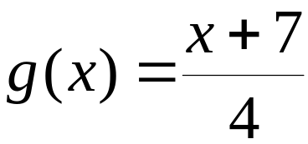
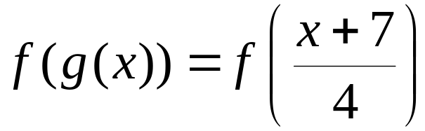
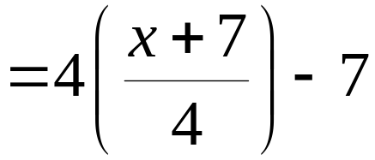


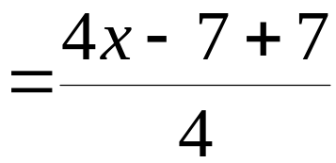
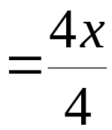


Example: Verifying Inverse Functions
Show that each function is the inverse of the other:
and
verifies that f and g are inverse functions.

Slide 5
Finding the Inverse of a Function
The equation for the inverse of a function f can be found as follows:
1. Replace f(x) with y in the equation for f(x).
2. Interchange x and y.
3. Solve for y. If this equation does not define y as a function of x, the function f does not have an inverse function and this procedure ends. If this equation does define y as a function of x, the function f has an inverse function.

Slide 6
Finding the Inverse of a Function (continued)
The equation for the inverse of a function f can be found as follows:
4. If f has an inverse function, replace y in step 3 by
f ^{–1}(x). We can verify our result by showing that
f(f ^{–1} (x)) = x and f ^{–1} (f(x)) = x

Slide 7




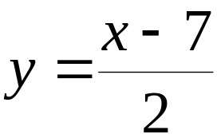
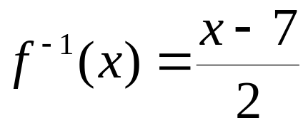
Example: Finding the Inverse of a Function
Find the inverse of
Step 1 Replace f(x) with y:
Step 2 Interchange x and y:
Step 3 Solve for y:
Step 4 Replace y with f ^{–1} (x):

Slide 8
The Horizontal Line Test for Inverse Functions
A function f has an inverse that is a function, f ^{–1}, if there is no horizontal line that intersects the graph of the function f at more than one point.

Slide 9
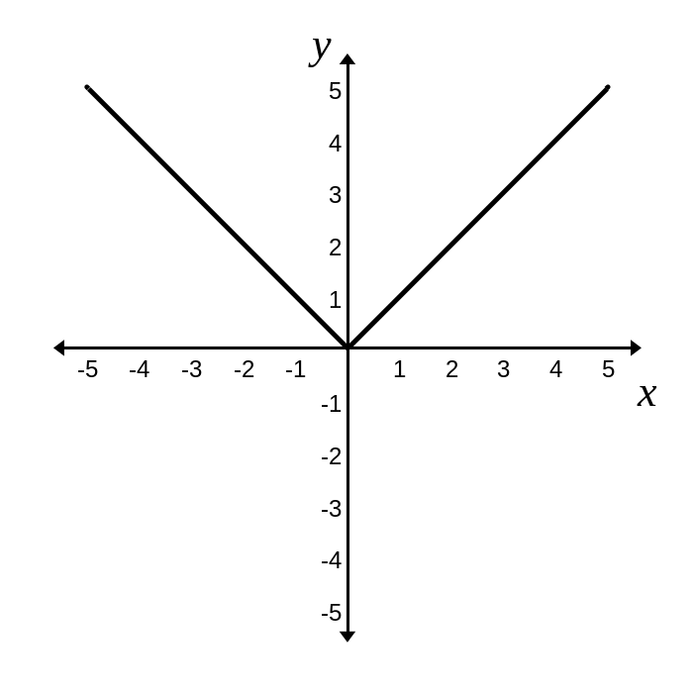
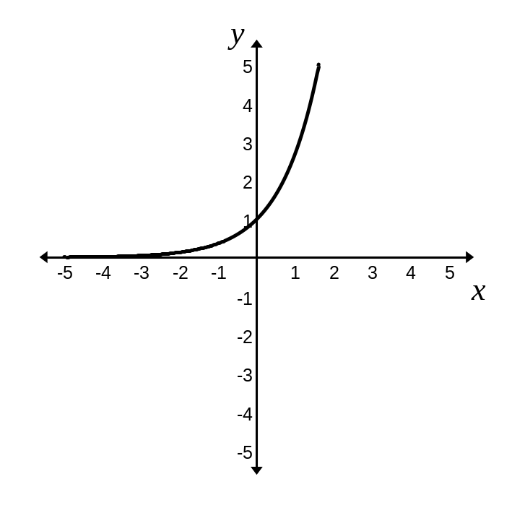
Example: Applying the Horizontal Line Test
Which of the following graphs represent functions that have inverse functions?
a. b.
Graph b represents a function that has an inverse.

Slide 10
Graphs of f and f ^{– 1}
The graph of f ^{–1} is a reflection of the graph of f about the line y = x.

Slide 11
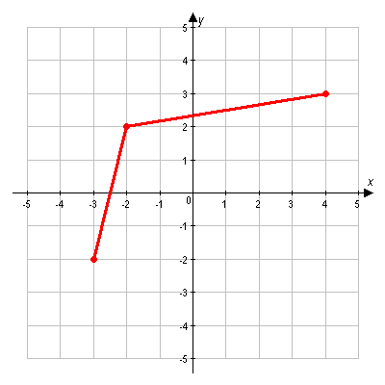
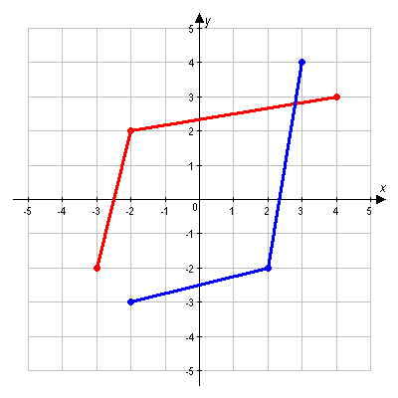


Example: Graphing the Inverse Function
Use the graph of f to draw the graph of f ^{–1}

Slide 12
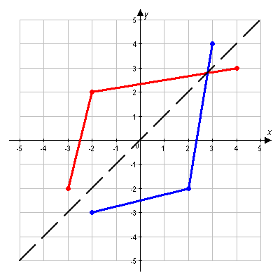

Example: Graphing the Inverse Function
(continued)
We verify our solution by observing the reflection of the graph about the line y = x.

