Slide 1

Chapter 2
Functions and
Graphs
2.8 Distance and Midpoint Formulas; Circles
Copyright © 2014, 2010, 2007 Pearson Education, Inc.

Slide 2
Objectives:
Find the distance between two points.
Find the midpoint of a line segment.
Write the standard form of a circle’s equation.
Give the center and radius of a circle whose equation is in standard form.
Convert the general form of a circle’s equation to standard form.

Slide 3
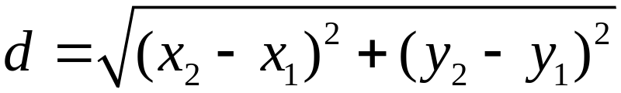
The Distance Formula
The distance, d, between the points (x₁, y₁) and (x₂, y₂) in the rectangular coordinate system is
To compute the distance between two points, find the square of the difference between the x-coordinates plus the square of the difference between the y-coordinates. The principal square root of this sum is the distance.

Slide 4
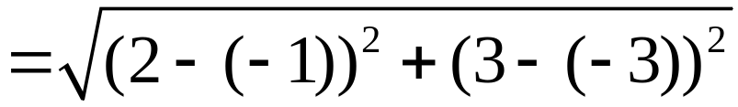
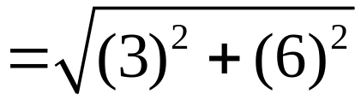





Example: Using the Distance Formula
Find the distance between (–1, –3) and (2, 3). Express the answer in simplified radical form and then round to two decimal places.

Slide 5
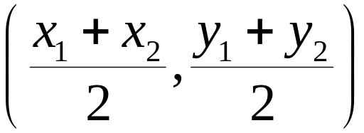
The Midpoint Formula
Consider a line segment whose endpoints are (x₁, y₁) and (x₂, y₂). The coordinates of the segment’s midpoint are
To find the midpoint, take the average of the two
x-coordinates and the average of the two y-coordinates.

Slide 6
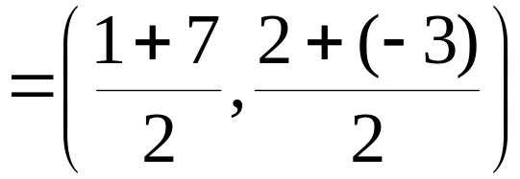
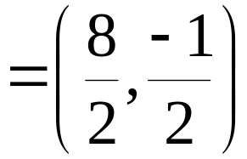
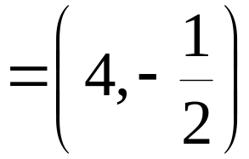
Example: Using the Midpoint Formula
Find the midpoint of the line segment with endpoints
(1, 2) and (7, –3).

Slide 7
Definition of a Circle
A circle is the set of all points in a plane that are equidistant from a fixed point, called the center. The fixed distance from the circle’s center to any point on the circle is called the radius.

Slide 8

The Standard Form of the Equation of a Circle
The standard form of the equation of a circle with center (h, k) and radius r is

Slide 9


Example: Finding the Standard Form of a Circle’s Equation
Write the standard form of the equation of the circle with center (0, –6) and radius 10.
The standard form of the equation of the circle is

Slide 10


Example: Using the Standard Form of a Circle’s Equation to Identify the Center and the Radius of the Circle
Find the center and the radius of the circle whose equation is
The center is (–3, 1)
The radius is

Slide 11

The General Form of the Equation of a Circle
The general form of the equation of a circle is
where D, E, and F are real numbers.

Slide 12

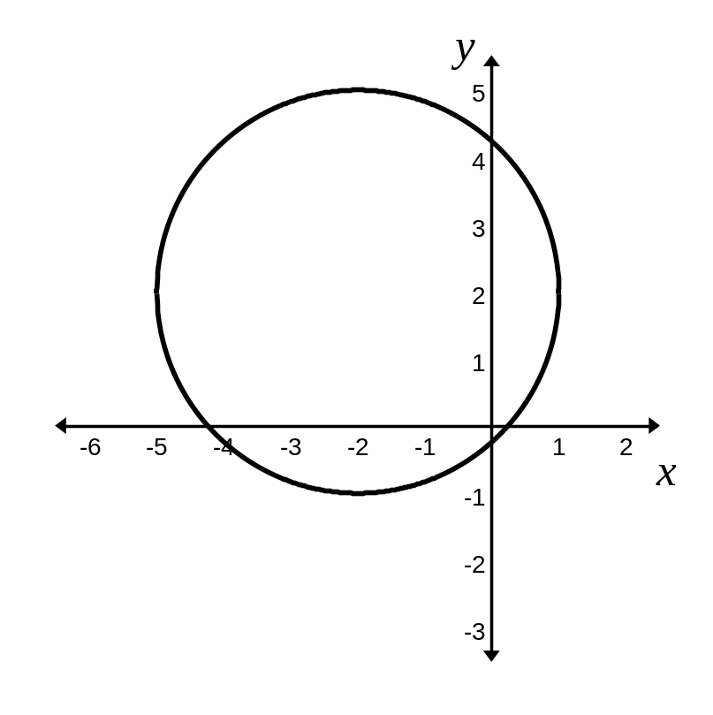




Example: Converting the General Form of a Circle’s Equation to Standard Form
Write in standard form:
The center of the circle is (–2, 2)
The radius of the circle is

