Slide 1

Chapter 5
Trigonometric Functions
5.1 Angles and Radian Measure
Copyright © 2014, 2010, 2007 Pearson Education, Inc.

Slide 2
Objectives:
Recognize and use the vocabulary of angles.
Use degree measure.
Use radian measure.
Convert between degrees and radians.
Draw angles in standard position.
Find coterminal angles.
Find the length of a circular arc.
Use linear and angular speed to describe motion on a circular path.

Slide 3
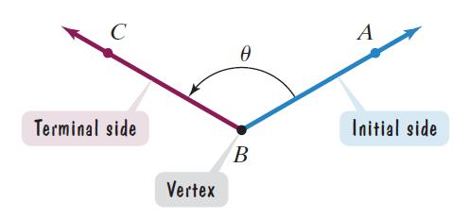
Angles
An angle is formed by two rays that have a common endpoint. One ray is called the initial side and the other the terminal side.

Slide 4
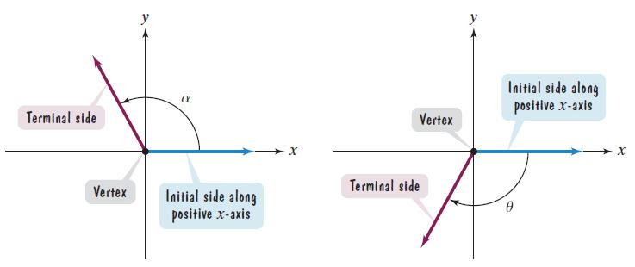
Angles (continued)
An angle is in standard position if its vertex is at the origin of a rectangular coordinate system and its initial side lies along the positive x-axis.

Slide 5


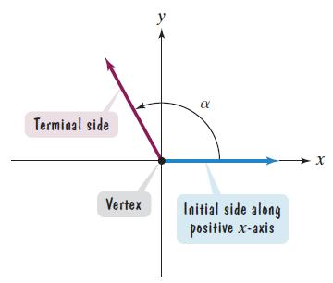
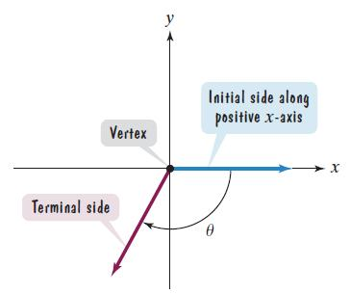
Angles (continued)
When we see an initial side and a terminal side in place, there are two kinds of rotations that could have generated the angle.
Positive angles are generated by counterclockwise rotation. Thus, angle is positive. Negative angles are generated by clockwise rotation. Thus, angle is negative.

Slide 6

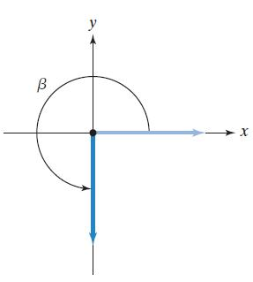
Angles (continued)
An angle is called a quadrantal angle if its terminal side lies on the x-axis or on the y-axis. Angle is an example of a quadrantal angle.

Slide 7
Measuring Angles Using Degrees
Angles are measured by determining the amount of rotation from the initial side to the terminal side. A complete rotation of the circle is 360 degrees, or 360°.
An acute angle measures less than 90°.
A right angle measures 90°.
An obtuse angle measures more than 90° but less than 180°.
A straight angle measures 180°.

Slide 8
Measuring Angles Using Radians
An angle whose vertex is at the center of the circle is called a central angle. The radian measure of any central angle of a circle is the length of the intercepted arc divided by the circle’s radius.

Slide 9
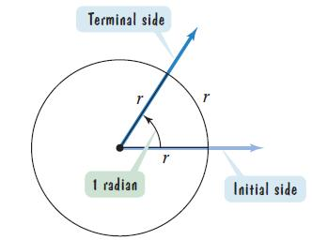
Definition of a Radian
One radian is the measure of the central angle of a circle that intercepts an arc equal in length to the radius of the circle.

Slide 10
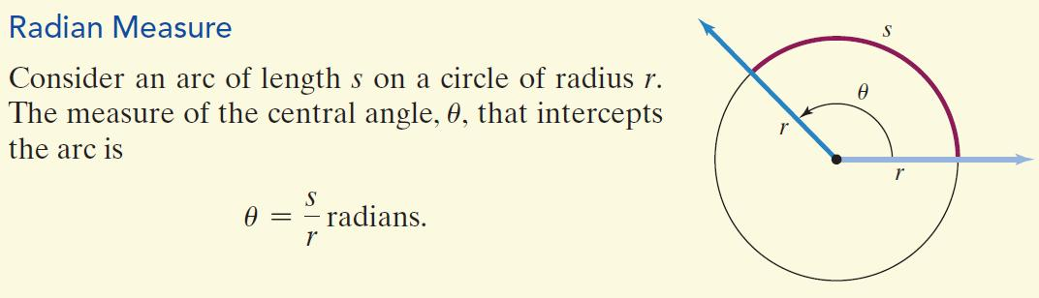
Radian Measure

Slide 11

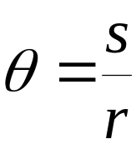
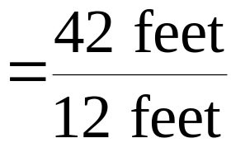

Example: Computing Radian Measure
A central angle, in a circle of radius 12 feet intercepts an arc of length 42 feet. What is the radian measure of ?
The radian measure of is 3.5 radians.

Slide 12
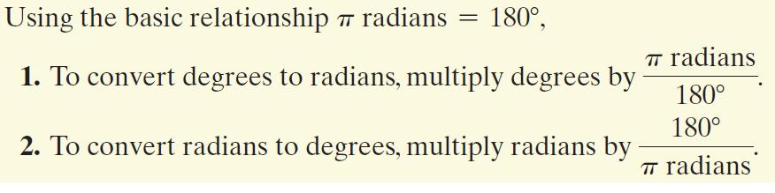
Conversion between Degrees and Radians

Slide 13
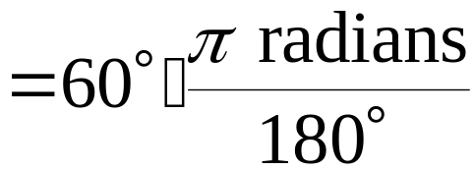
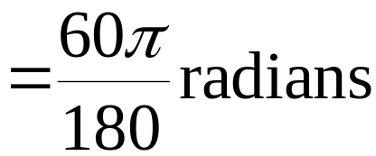
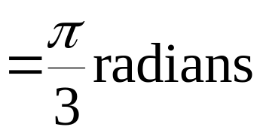
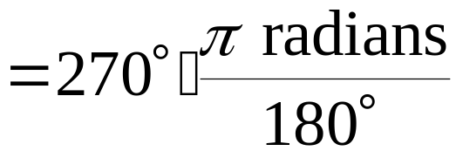
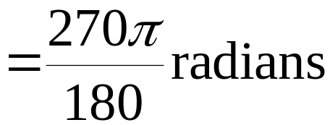
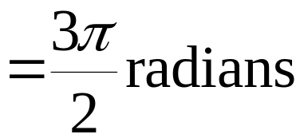
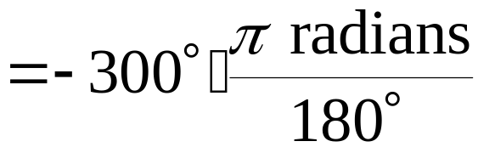
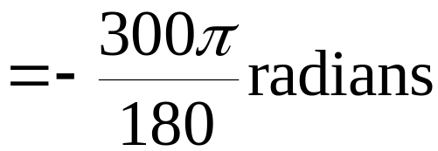
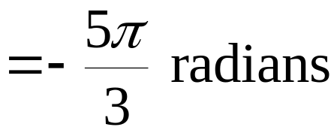
Example: Converting from Degrees to Radians
Convert each angle in degrees to radians:
a. 60°
b. 270°
c. –300°

Slide 14

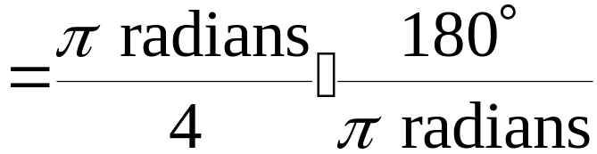
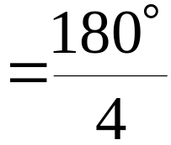

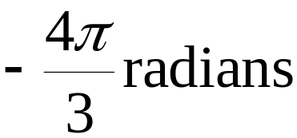
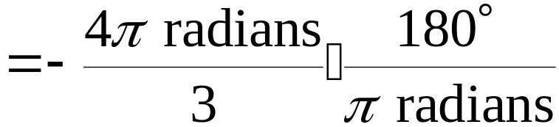
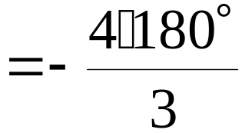

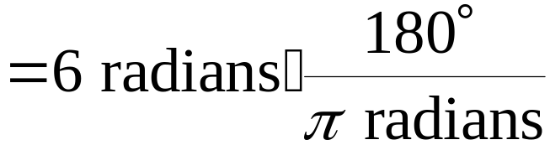
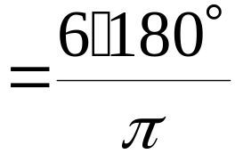


Example: Converting from Radians to Degrees
Convert each angle in radians to degrees:
a.
b.
c.

Slide 15

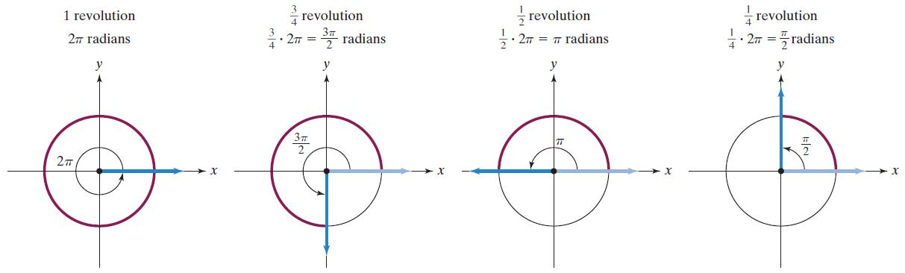
Drawing Angles in Standard Position
The figure illustrates that when the terminal side makes one full revolution, it forms an angle whose radian measure is The figure shows the quadrantal angles formed by 3/4, 1/2, and 1/4 of a revolution.

Slide 16
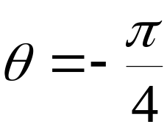
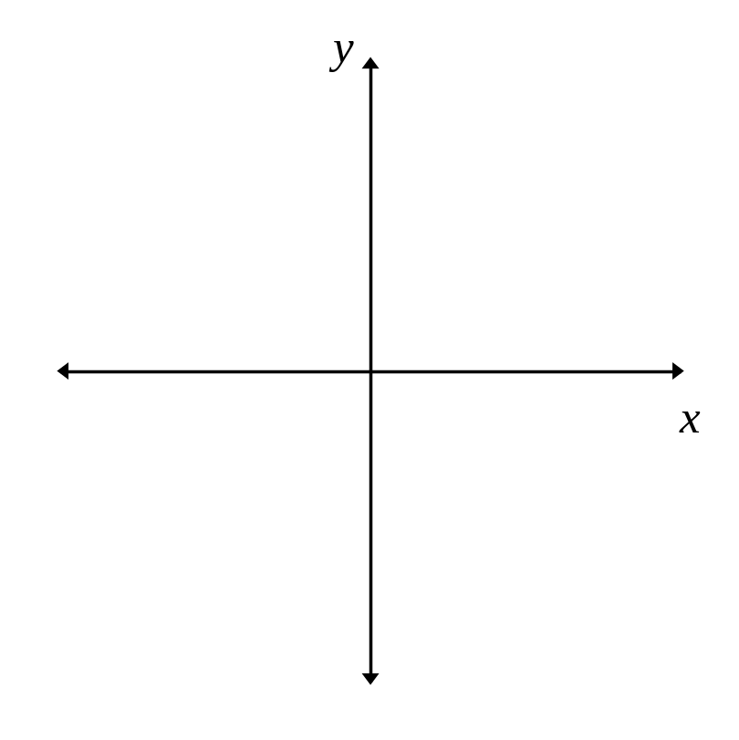
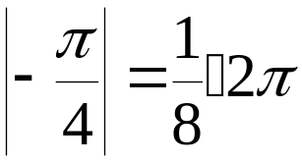

Example: Drawing Angles in Standard Position
Draw and label the angle in standard position:
The angle is negative. It is
obtained by rotating the terminal
side clockwise.
Initial side
Vertex
We rotate the terminal side
clockwise of a revolution.
Terminal side

Slide 17
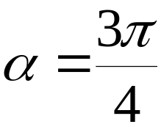
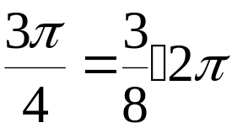

Example: Drawing Angles in Standard Position
Draw and label the angle in standard position:
The angle is positive. It is
obtained by rotating the terminal
side counterclockwise.
Initial side
Terminal side
Vertex
We rotate the terminal side
counter clockwise of a revolution.

Slide 18
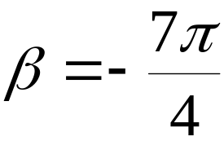
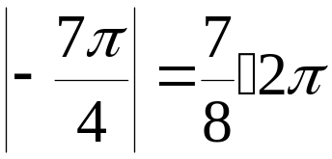

Example: Drawing Angles in Standard Position
Draw and label the angle in standard position:
Terminal side
The angle is negative. It is
obtained by rotating the terminal
side clockwise.
We rotate the terminal side
clockwise of a revolution.
Initial side
Vertex

Slide 19
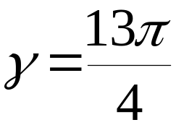
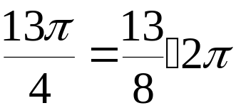

Example: Drawing Angles in Standard Position
Draw and label the angle in standard position:
Vertex
The angle is positive. It is
obtained by rotating the terminal
side counterclockwise.
Initial side
We rotate the terminal side
counter clockwise of a revolution.
Terminal side

Slide 20
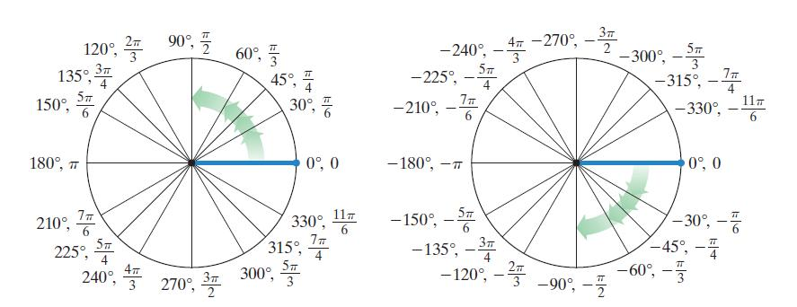
Degree and Radian Measures of Angles Commonly Seen in Trigonometry
In the figure below, each angle is in standard position, so that the initial side lies along the positive x-axis.

Slide 21
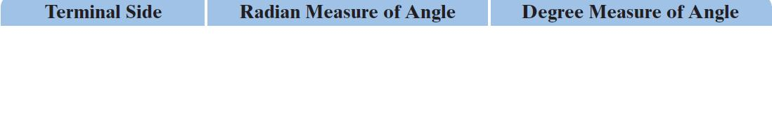
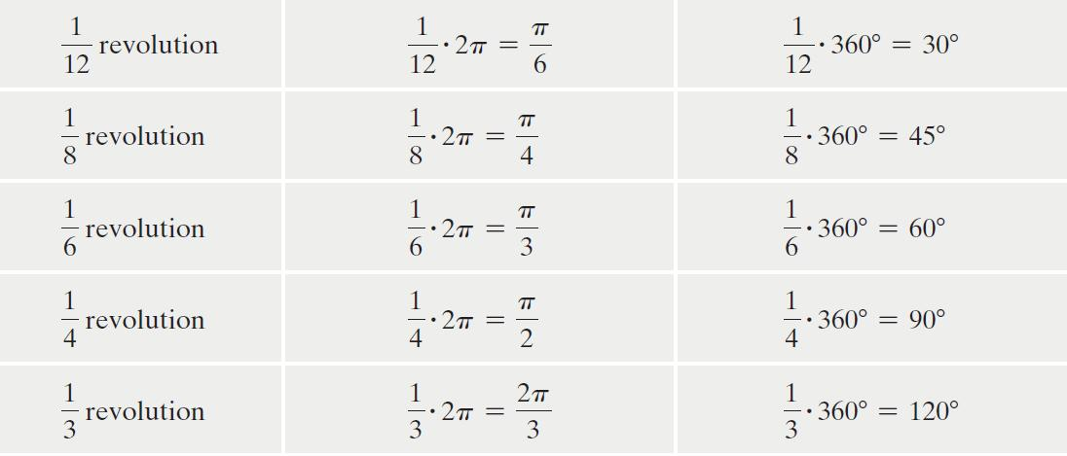
Positive Angles in Terms of Revolutions of the Angle’s Terminal Side Around the Origin

Slide 22
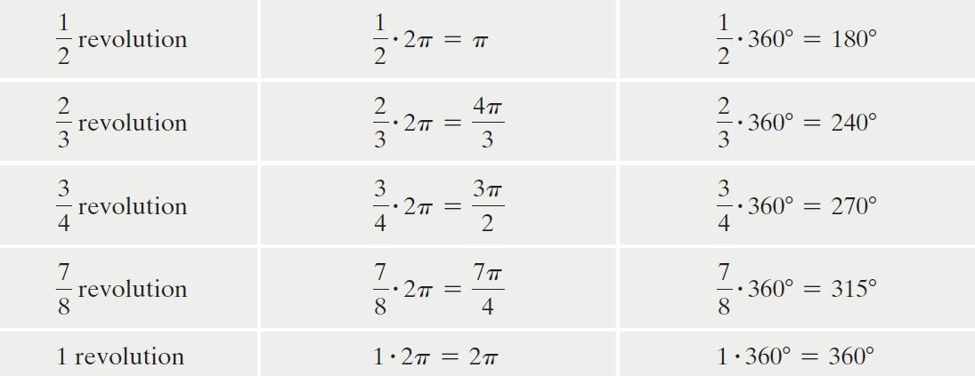
Positive Angles in Terms of Revolutions of the Angle’s Terminal Side Around the Origin (continued)

Slide 23
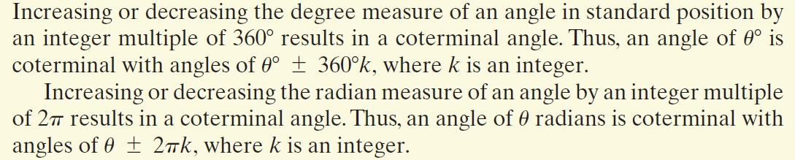
Coterminal Angles
Two angles with the same initial and terminal sides but
possibly different rotations are called coterminal angles.

Slide 24
Example: Finding Coterminal Angles
Assume the following angles are in standard position. Find a positive angle less than 360° that is coterminal with each of the following:
a. a 400° angle
400° – 360° = 40°
b. a –135° angle
–135° + 360° = 225°

Slide 25

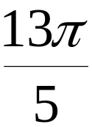
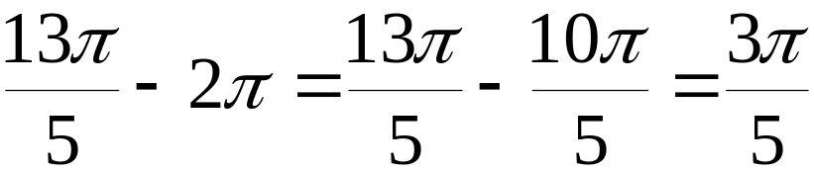
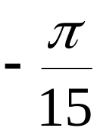
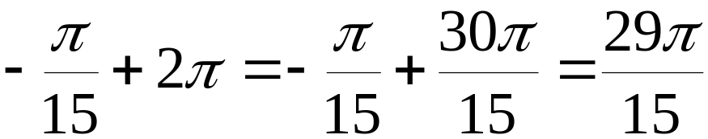
Example: Finding Coterminal Angles
Assume the following angles are in standard position. Find a positive angle less than that is coterminal with each of the following:
a. a angle
b. a angle

Slide 26
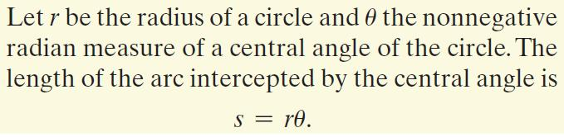
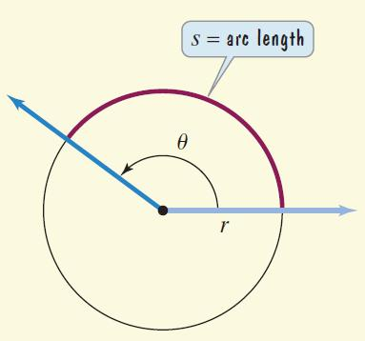
The Length of a Circular Arc

Slide 27

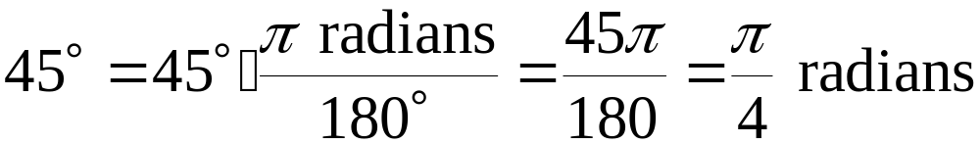
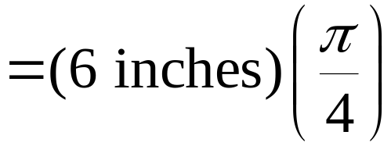
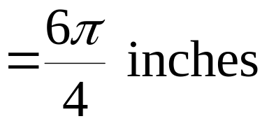


Example: Finding the Length of a Circular Arc
A circle has a radius of 6 inches. Find the length of the arc intercepted by a central angle of 45°. Express arc length in terms of Then round your answer to two decimal places.
We first convert 45° to radians:

Slide 28

Definitions of Linear and Angular Speed

Slide 29

Linear Speed in Terms of Angular Speed

Slide 30




Example: Finding Linear Speed
Long before iPods that hold thousands of songs and play them with superb audio quality, individual songs were delivered on 75-rpm and 45-rpm circular records. A 45-rpm record has an angular speed of 45 revolutions per minute. Find the linear speed, in inches per minute, at the point where the needle is 1.5 inches from the record’s center.
Before applying the formula we must express in terms of radians per second:

Slide 31



Example: Finding Linear Speed (continued)
A 45-rpm record has an angular speed of 45 revolutions per minute. Find the linear speed, in inches per minute, at the point where the needle is 1.5 inches from the record’s center.
The angular speed of the record is radians per minute. The linear speed is

