Slide 1

Chapter 5
Trigonometric
Functions
5.2 Right Triangle Trigonometry
Copyright © 2014, 2010, 2007 Pearson Education, Inc.

Slide 2
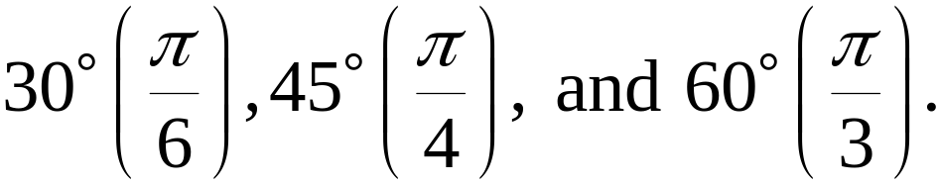
Objectives:
Use right triangles to evaluate trigonometric functions.
Find function values for
Recognize and use fundamental identities.
Use equal cofunctions of complements.
Evaluate trigonometric functions with a calculator.
Use right triangle trigonometry to solve applied problems.

Slide 3
The Six Trigonometric Functions
The six trigonometric functions are:
Function Abbreviation
sine sin
cosine cos
tangent tan
cosecant csc
secant sec
cotangent cot

Slide 4
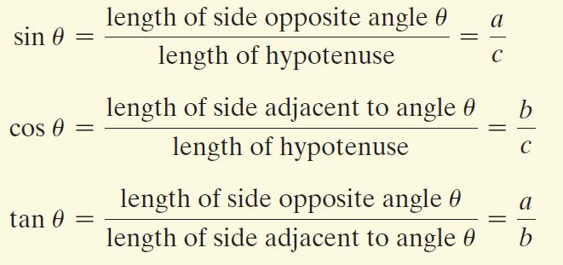
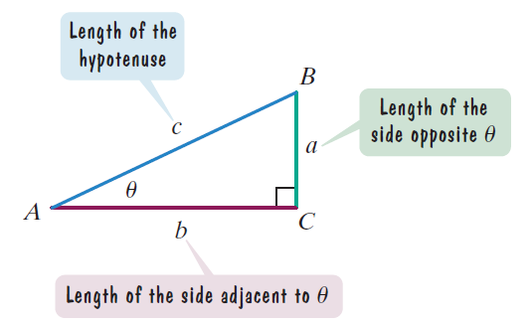

Right Triangle Definitions of Trigonometric Functions
In general, the trigonometric functions
of depend only on the size of angle
and not on the size of the triangle.

Slide 5
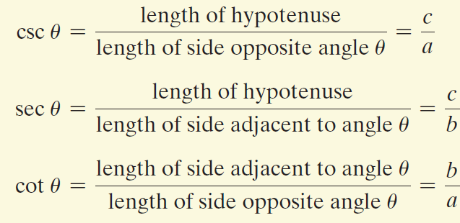
Right Triangle Definitions of Trigonometric Functions
(continued)
In general, the trigonometric functions
of depend only on the size of angle
and not on the size of the triangle.

Slide 6
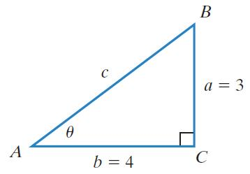



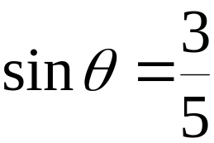
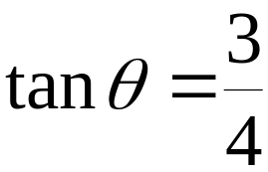
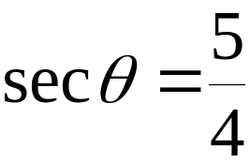
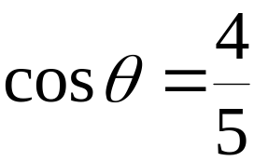
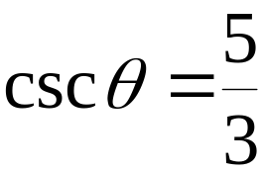
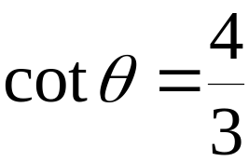
Example: Evaluating Trigonometric Functions
Find the value of the six trigonometric functions in the figure.
We begin by finding c.

Slide 7

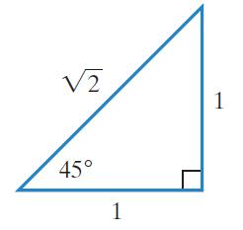
Function Values for Some Special Angles
A right triangle with a 45°, or radian, angle is isosceles – that is, it has two sides of equal length.

Slide 8


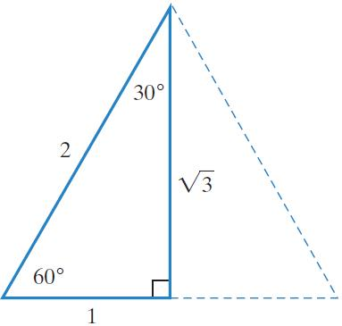
Function Values for Some Special Angles (continued)
A right triangle that has a 30°, or radian, angle also has a 60°, or radian angle. In a 30-60-90 triangle, the measure of the side opposite the 30° angle is one-half the measure of the hypotenuse.

Slide 9
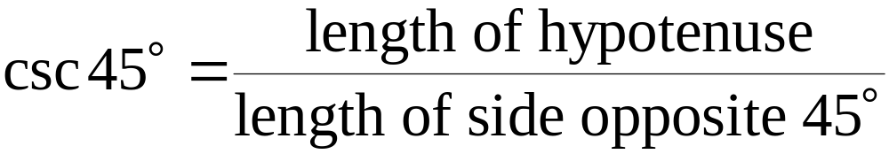
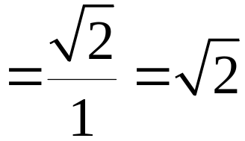
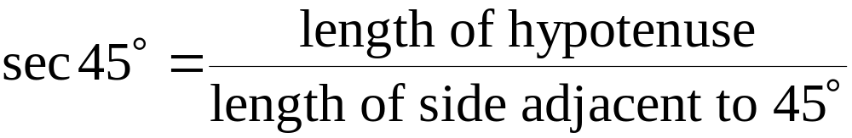

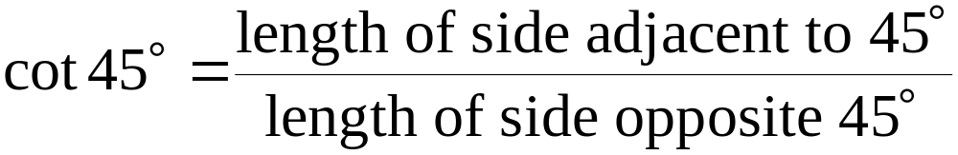
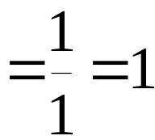
Example: Evaluating Trigonometric Functions of 45°
Use the figure to find csc 45°, sec 45°, and cot 45°.

Slide 10
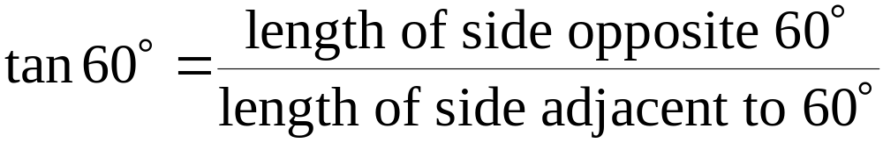
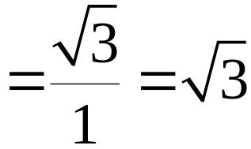

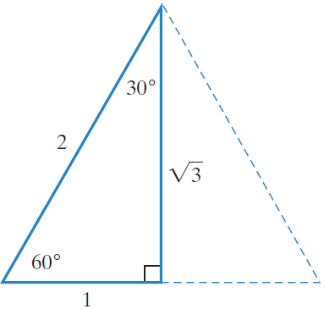
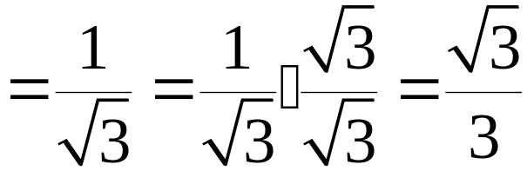
Example: Evaluating Trigonometric Functions of 30° and 60°
Use the figure to find tan 60° and tan 30°. If a radical appears in a denominator, rationalize the denominator.

Slide 11
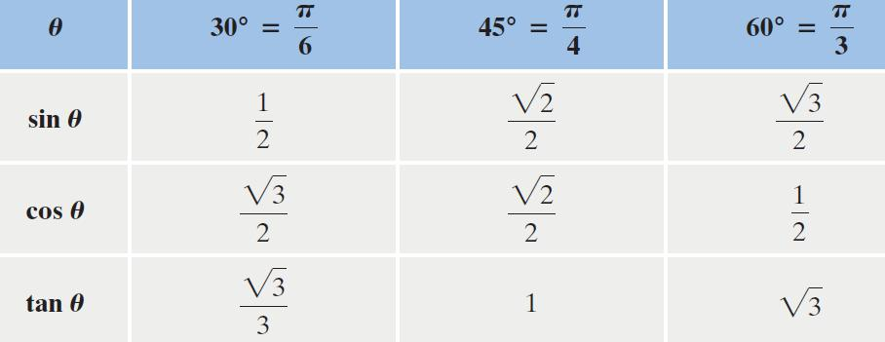
Trigonometric Functions of Special Angles

Slide 12
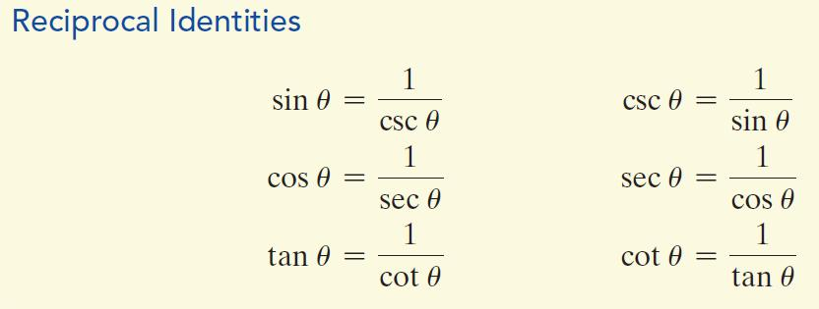
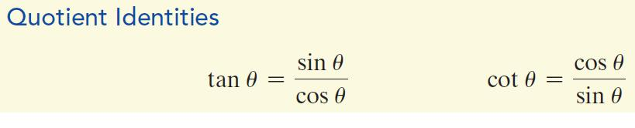
Fundamental Identities

Slide 13
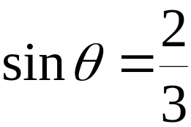
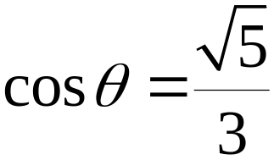
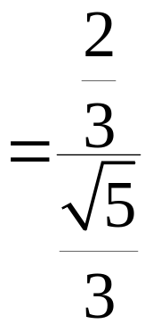
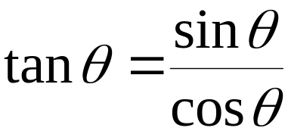
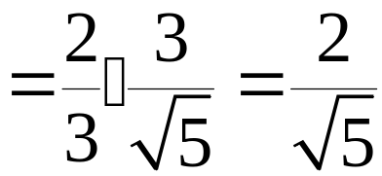
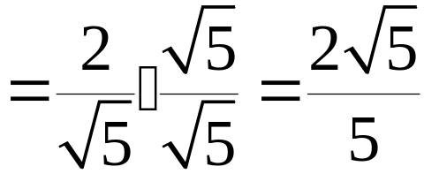
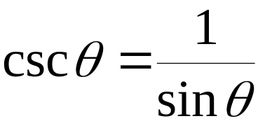
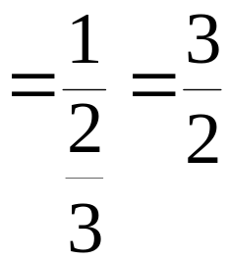
Example: Using Quotient and Reciprocal Identities
Given and find the value of each of the four remaining trigonometric functions.

Slide 14
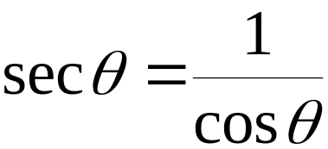
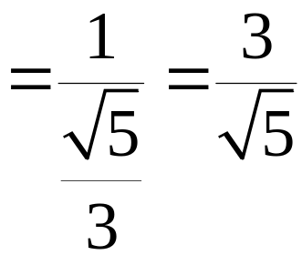
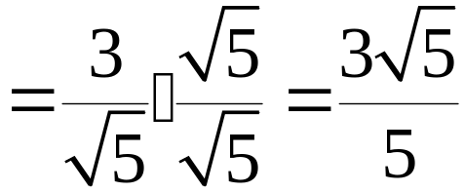
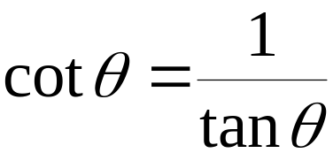
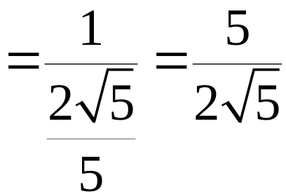
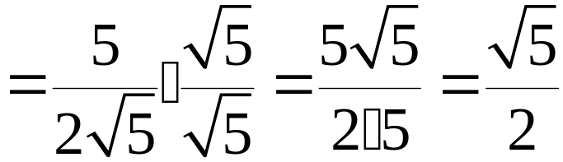
Example: Using Quotient and Reciprocal Identities
(continued)
Given and find the value of each of the four remaining trigonometric functions.

Slide 15
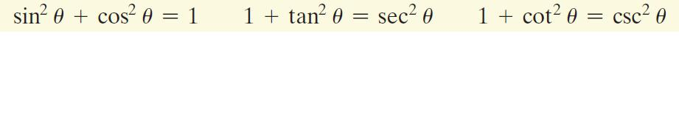
The Pythagorean Identities

Slide 16
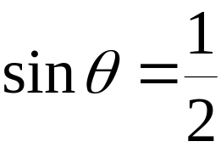


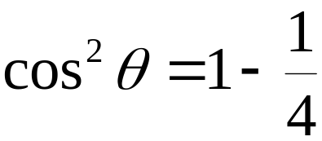

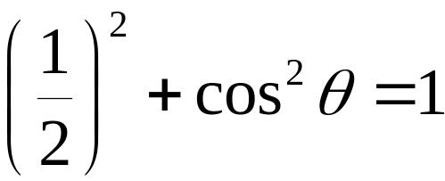
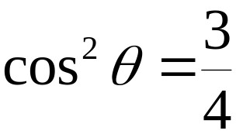
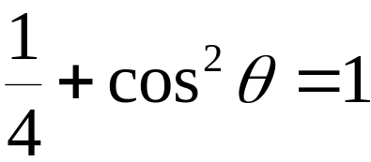
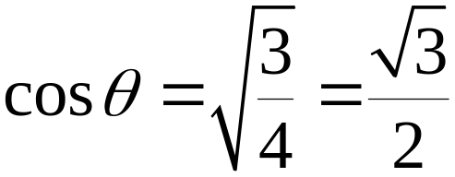
Example: Using a Pythagorean Identity
Given that and is an acute angle, find the value of using a trigonometric identity.

Slide 17



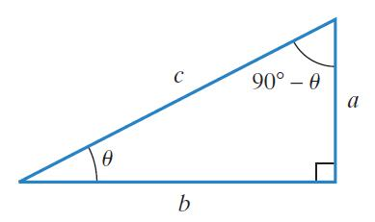
Trigonometric Functions and Complements
Two positive angles are complements if their sum is 90° or Any pair of trigonometric functions f and g for which and are called cofunctions.

Slide 18
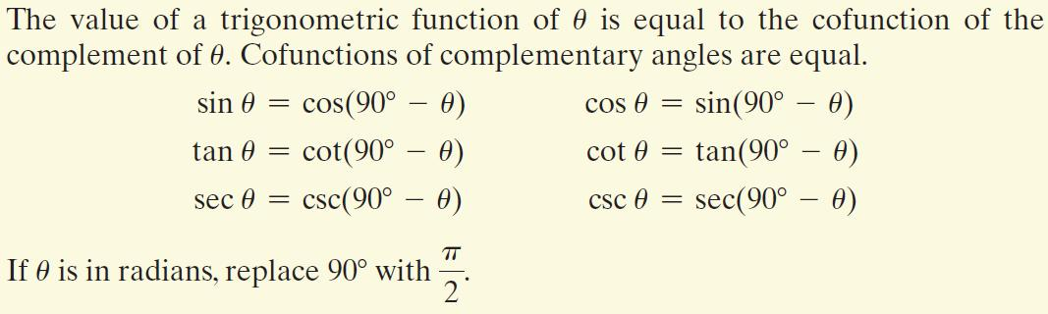
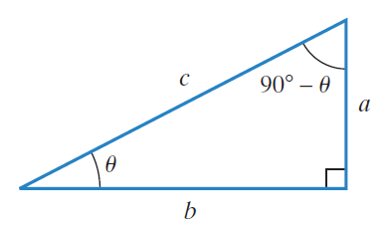
Cofunction Identities

Slide 19


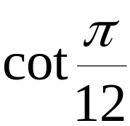

Using Cofunction Identities
Find a cofunction with the same value as the given expression:
a.
b.

Slide 20
Using a Calculator to Evaluate Trigonometric Functions
To evaluate trigonometric functions, we will use the keys on a calculator that are marked SIN, COS, and TAN. Be sure to set the mode to degrees or radians, depending on the function that you are evaluating. You may consult the manual for your calculator for specific directions for evaluating trigonometric functions.

Slide 21


Example: Evaluating Trigonometric Functions with a Calculator
Use a calculator to find the value to four decimal places:
a. sin 72.8° (hint: Be sure to set the calculator to degree mode)
b. csc 1.5 (hint: Be sure to set the calculator to radian mode)

Slide 22

Applications: Angle of Elevation and Angle of Depression
An angle formed by a horizontal line and the line of sight to an object that is above the horizontal line is called the angle of elevation. The angle formed by the horizontal line and the line of sight to an object that is below the horizontal line is called the angle of depression.

Slide 23




Example: Problem Solving Using an Angle of Elevation
The irregular blue shape in the figure represents a lake. The distance across the lake, a, is unknown. To find this distance, a surveyor took the measurements shown in the figure. What is the distance across the lake?
The distance across the lake
is approximately 333.9 yards.

