Slide 1

Chapter 5
Trigonometric Functions
5.3 Trigonometric Functions of Any Angle
Copyright © 2014, 2010, 2007 Pearson Education, Inc.

Slide 2
Objectives:
Use the definitions of trigonometric functions of any angle.
Use the signs of the trigonometric functions.
Find reference angles.
Use reference angles to evaluate trigonometric functions.

Slide 3


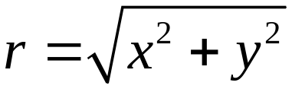
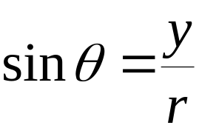
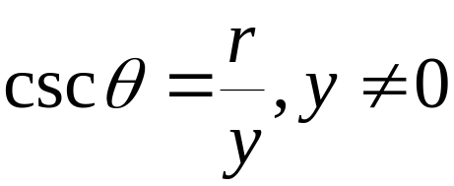
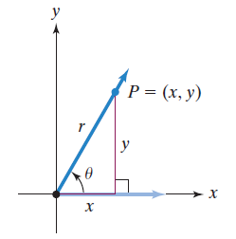
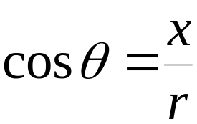
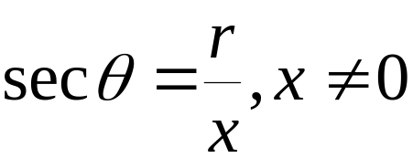
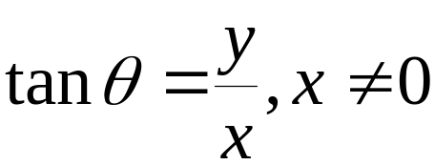
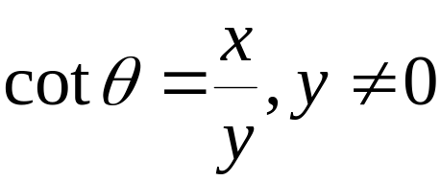
Definitions of Trigonometric Functions of Any Angle
Let be any angle in standard position and let P = (x, y) be a point on the terminal side of If is the distance from (0, 0) to (x, y), the six trigonometric functions of are defined by the following ratios:

Slide 4
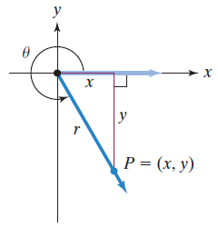
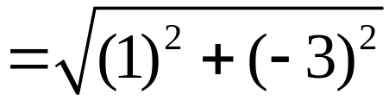

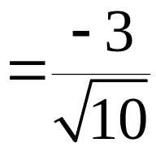
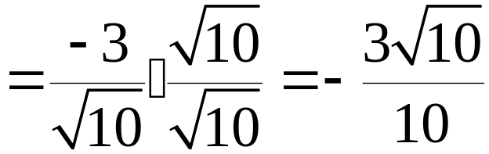
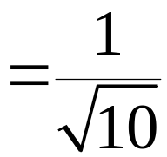
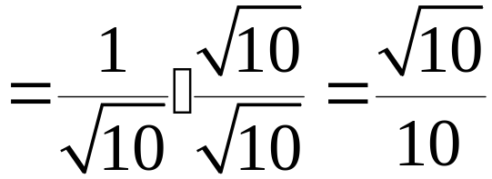
Example: Evaluating Trigonometric Functions
Let P = (1, –3) be a point on the terminal side of Find each of the six trigonometric functions of
P = (1, –3) is a point on the terminal side of
x = 1 and y = –3

Slide 5

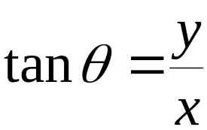
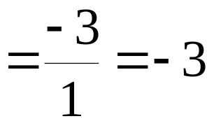
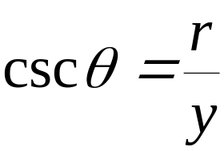
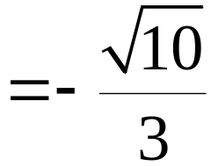
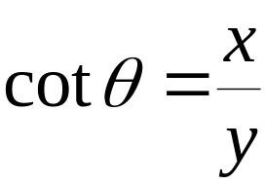
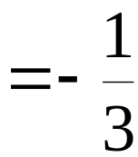
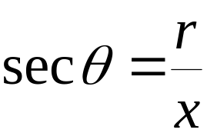
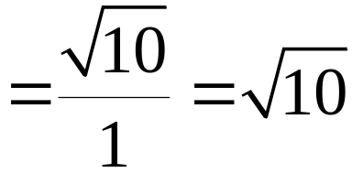
Example: Evaluating Trigonometric Functions
(continued)
Let P = (1, –3) be a point on the terminal side of Find each of the six trigonometric functions of
We have found that

Slide 6
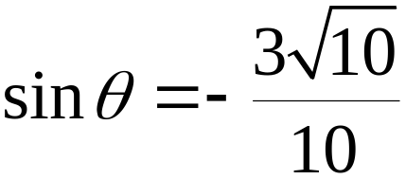
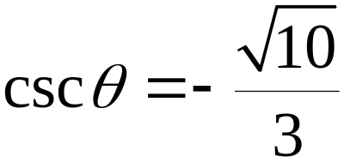
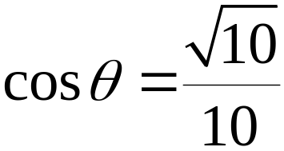

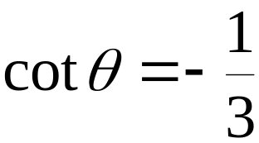

Example: Evaluating Trigonometric Functions
(continued)
Let P = (1, –3) be a point on the terminal side of Find each of the six trigonometric functions of

Slide 7


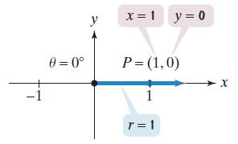
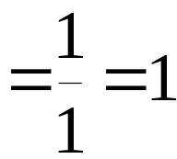
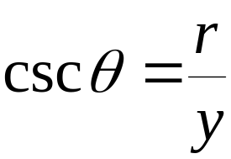
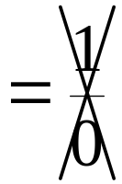

Example: Trigonometric Functions of Quadrantal Angles
Evaluate, if possible, the cosine function and the cosecant function at the following quadrantal angle:
If then the terminal side of the angle is on the positive x-axis. Let us select the point P = (1, 0) with x = 1 and y = 0.
is undefined.

Slide 8
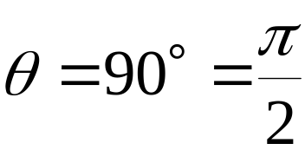
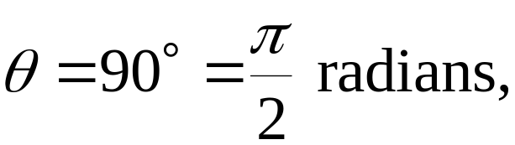
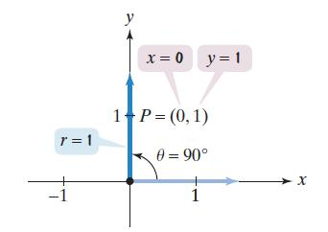
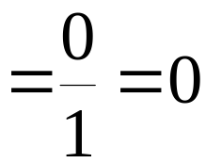
Example: Trigonometric Functions of Quadrantal Angles
Evaluate, if possible, the cosine function and the cosecant function at the following quadrantal angle:
If then the terminal side of the angle is on the positive y-axis. Let us select the point P = (0, 1) with x = 0 and y = 1.

Slide 9


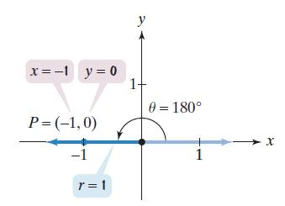
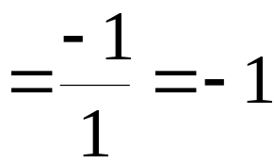
Example: Trigonometric Functions of Quadrantal Angles
Evaluate, if possible, the cosine function and the cosecant function at the following quadrantal angle:
If then the terminal side of the angle is on the positive x-axis. Let us select the point P = (–1, 0) with x = –1 and y = 0.
is undefined.

Slide 10
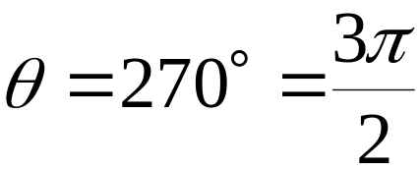
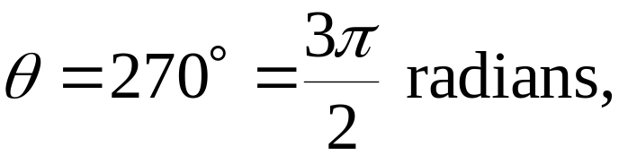
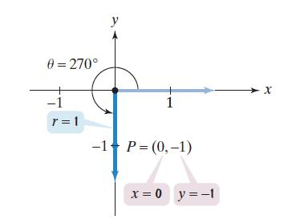
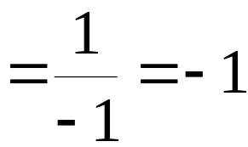
Example: Trigonometric Functions of Quadrantal Angles
Evaluate, if possible, the cosine function and the cosecant function at the following quadrantal angle:
If then the terminal side of the angle is on the negative y-axis. Let us select the point P = (0, –1) with x = 0 and y = –1.

Slide 11
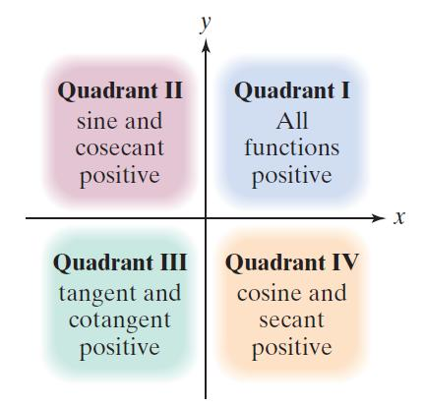
The Signs of the Trigonometric Functions

Slide 12

Example: Finding the Quadrant in Which an Angle Lies
If name the quadrant in which the angle lies.
lies in Quadrant III.

Slide 13
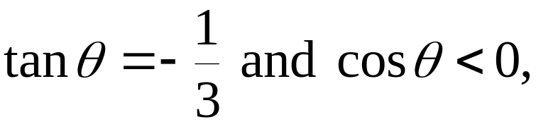

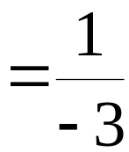

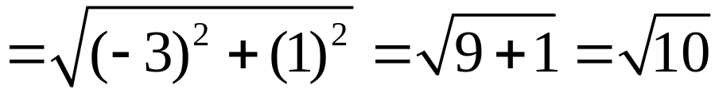
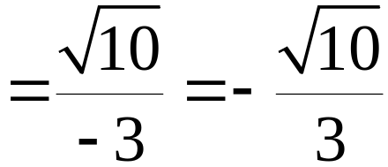
Example: Evaluating Trigonometric Functions
Given find
Because both the tangent and the cosine are negative, lies in Quadrant II.

Slide 14
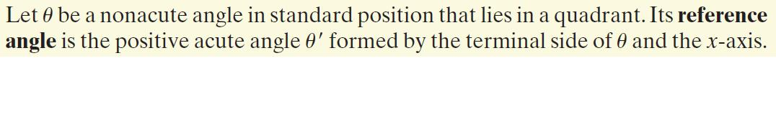
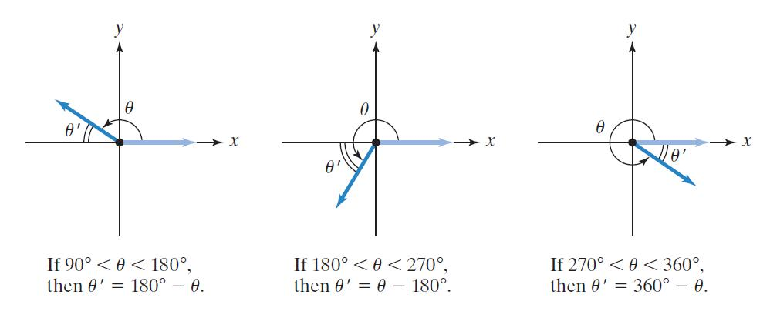
Definition of a Reference Angle

Slide 15




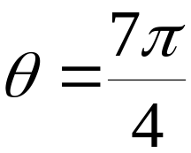
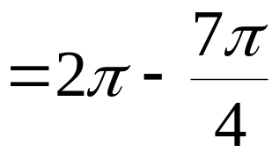
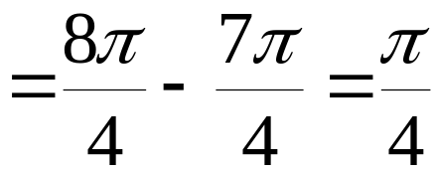






Example: Finding Reference Angles
Find the reference angle, for each of the following angles:
a.
b.
c.
d.

Slide 16



Finding Reference Angles for Angles Greater Than 360° or Less Than –360°

Slide 17






Example: Finding Reference Angles
Find the reference angle for each of the following angles:
a.
b.
c.

Slide 18

Using Reference Angles to Evaluate Trigonometric Functions

Slide 19

A Procedure for Using Reference Angles to Evaluate Trigonometric Functions

Slide 20








Example: Using Reference Angles to Evaluate Trigonometric Functions
Use reference angles to find the exact value of
Step 1 Find the reference angle, and
Step 2 Use the quadrant in which lies to prefix the appropriate sign to the function value in step 1.

Slide 21





Example: Using Reference Angles to Evaluate Trigonometric Functions
Use reference angles to find the exact value of
Step 1 Find the reference angle, and
Step 2 Use the quadrant in which lies to prefix the appropriate sign to the function value in step 1.

Slide 22






Example: Using Reference Angles to Evaluate Trigonometric Functions
Use reference angles to find the exact value of
Step 1 Find the reference angle, and
Step 2 Use the quadrant in which lies to prefix the appropriate sign to the function value in step 1.

