Slide 1

Chapter 5
Trigonometric Functions
5.4 Trigonometric Functions of Real Numbers; Periodic Functions
Copyright © 2014, 2010, 2007 Pearson Education, Inc.

Slide 2
Objectives:
Use a unit circle to define trigonometric functions of real numbers.
Recognize the domain and range of sine and cosine functions.
Use even and odd trigonometric functions.
Use periodic properties.

Slide 3

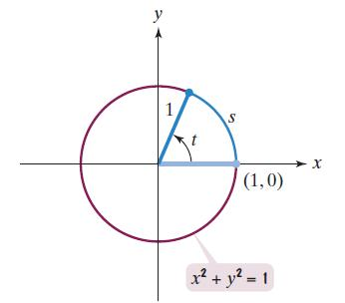
The Unit Circle
A unit circle is a circle of radius 1, with its center at the origin of a rectangular coordinate system. The equation of this circle is

Slide 4

The Unit Circle (continued)
In a unit circle, the radian measure of the central angle is equal to the length of the intercepted arc. Both are given by the same real number t.

Slide 5
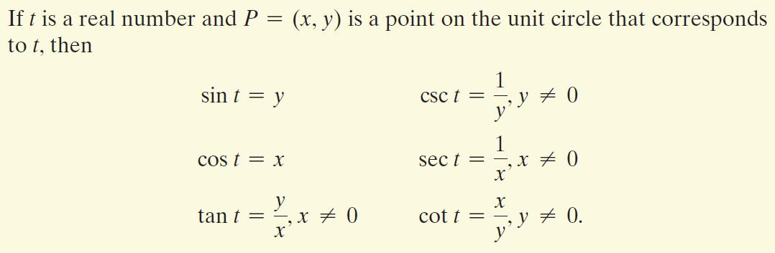
Definitions of the Trigonometric Functions in Terms of a Unit Circle

Slide 6
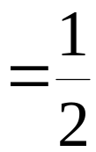

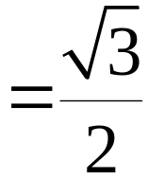
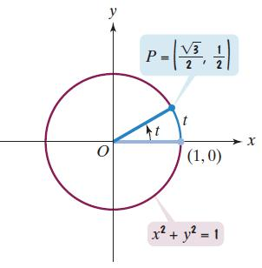

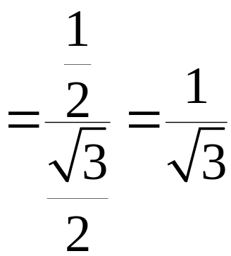
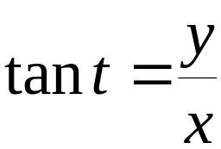
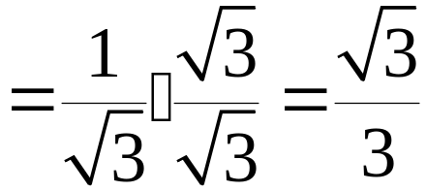
Example: Finding Values of the Trigonometric Functions
Use the figure to find the values of the trigonometric functions at t.

Slide 7
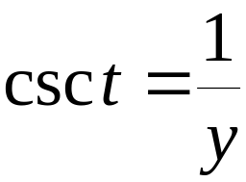
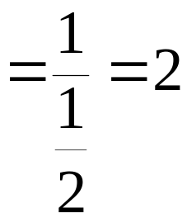
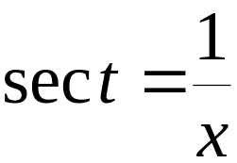
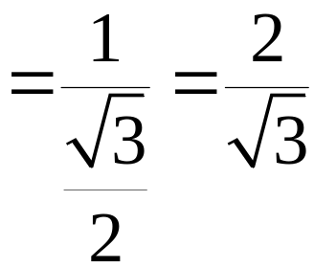
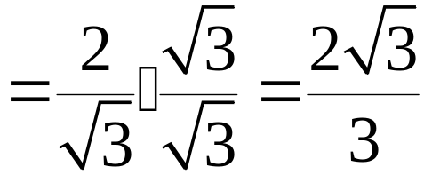
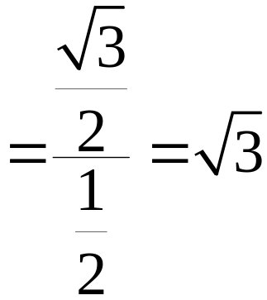
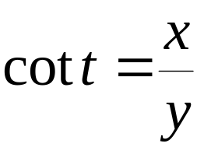
Example: Finding Values of the Trigonometric Functions
Use the figure to find the values of the trigonometric functions at t.

Slide 8
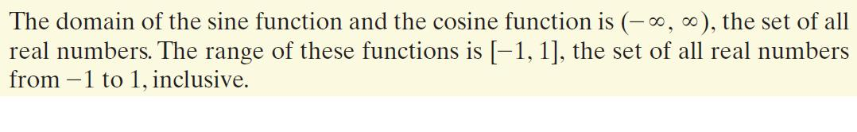
The Domain and Range of the Sine and Cosine Functions

Slide 9
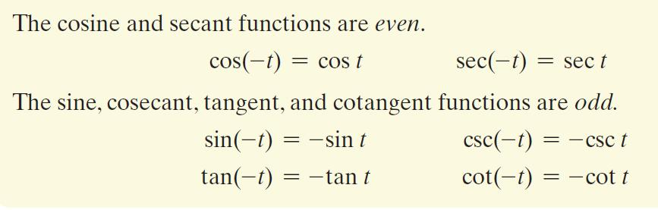
Even and Odd Trigonometric Functions

Slide 10


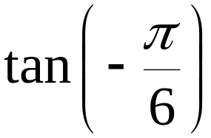
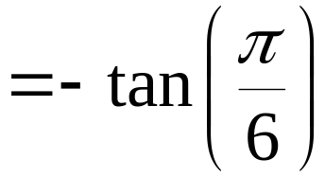
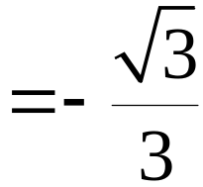
Example: Using Even and Odd functions to Find Exact Values
Find the exact value of each trigonometric function:
a.
b.

Slide 11
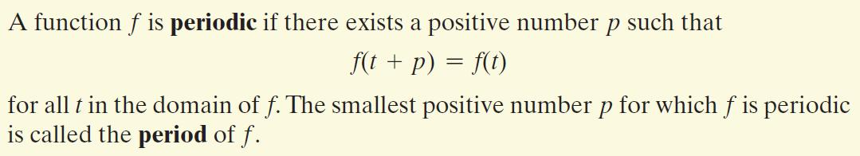
Definition of a Periodic Function

Slide 12
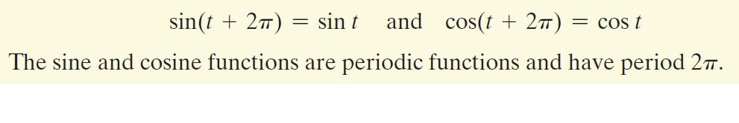
Periodic Properties of the Sine and Cosine Functions

Slide 13
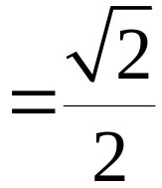



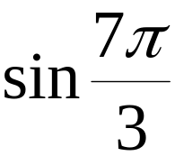
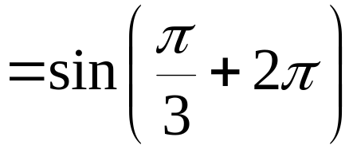
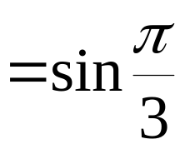
Example: Using Periodic Properties to Find Exact Values
Find the exact value of each trigonometric function:
a.
b.

Slide 14
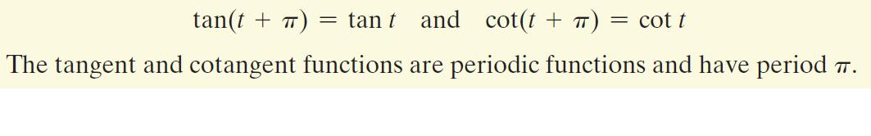
Periodic Properties of the Tangent and Cotangent Functions

Slide 15
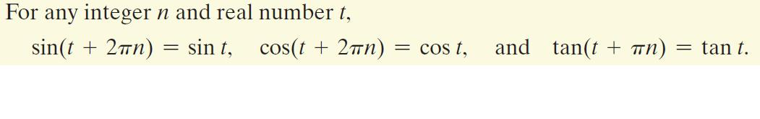
Repetitive Behavior of the Sine, Cosine, and Tangent Functions

