Slide 1

Chapter 5
Trigonometric Functions
5.5 Graphs of Sine and Cosine Functions
Copyright © 2014, 2010, 2007 Pearson Education, Inc.

Slide 2
Objectives:
Understand the graph of y = sin x.
Graph variations of y = sin x.
Understand the graph of y = cos x.
Graph variations of y = cos x.
Use vertical shifts of sine and cosine curves.
Model periodic behavior.

Slide 3
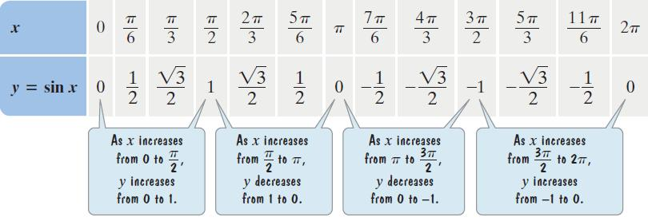
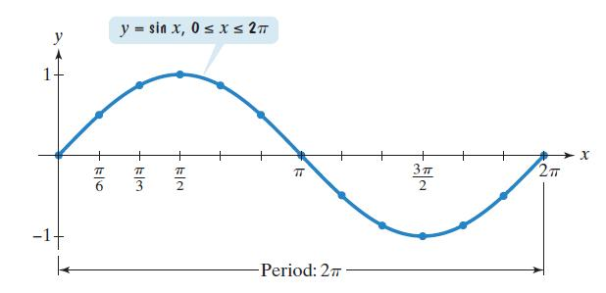
The Graph of y = sinx

Slide 4



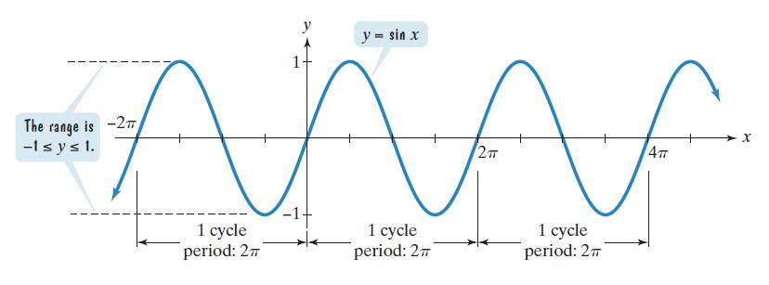
Some Properties of the Graph of y = sinx
The domain is
The range is [–1, 1].
The period is
The function is an odd function:

Slide 5
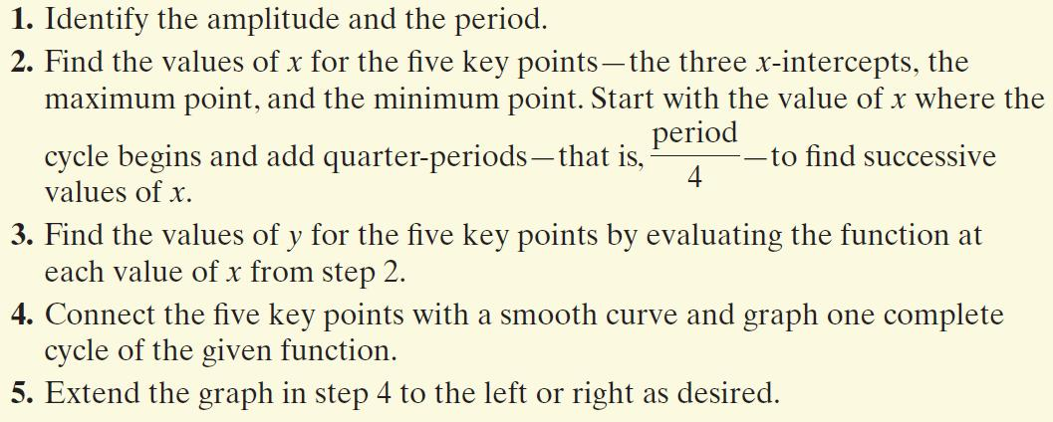
Graphing Variations of y = sinx

Slide 6





Example: Graphing a Variation of y = sinx
Determine the amplitude of Then graph
and for
Step 1 Identify the amplitude and the period.
The equation is of the form y = Asinx with A = 3. Thus, the amplitude is This means that the maximum value of y is 3 and the minimum value of y is – 3. The period is

Slide 7

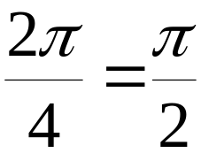
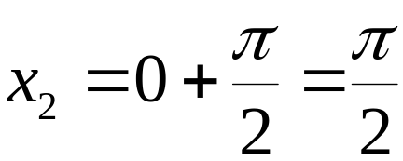
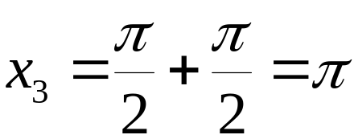

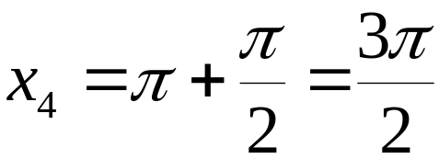
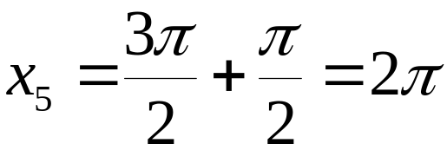
Example: Graphing a Variation of y = sinx
(continued)
Determine the amplitude of Then graph
and for
Step 2 Find the values of x for the five key points. To generate x-values for each of the five key points, we begin by dividing the period, by 4. The cycle begins at x₁ = 0. We add quarter periods to generate x-values for each of the key points.

Slide 8







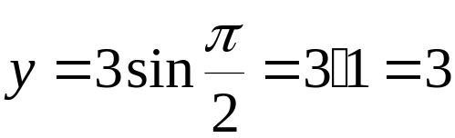
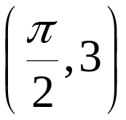




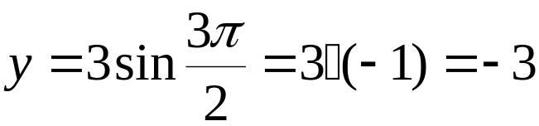
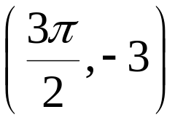



Example: Graphing a Variation of y = sinx
(continued)
Step 3 Find the values of y for the five key points.

Slide 9
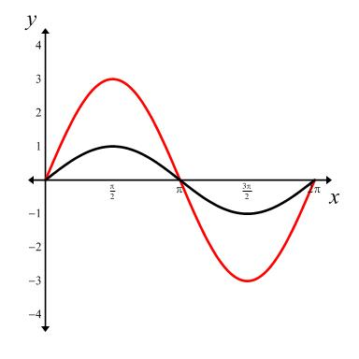


Example: Graphing a Variation of y = sinx
(continued)
Determine the amplitude of Then graph
and for
Step 4 Connect the five key
points with a smooth curve
and graph one complete cycle
of the given function.
amplitude = 3
period

Slide 10
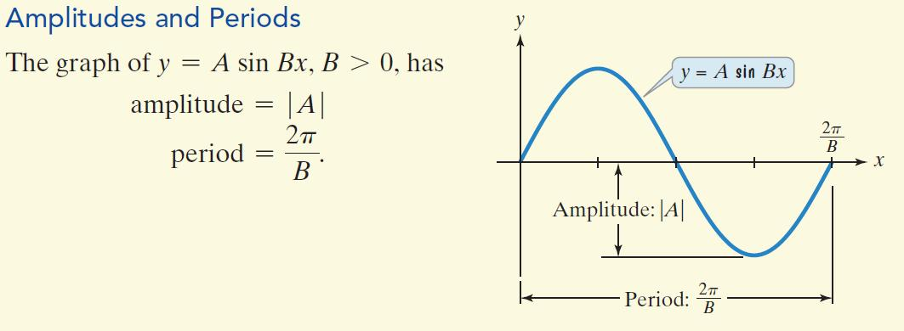
Amplitudes and Periods

Slide 11
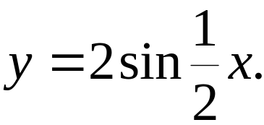

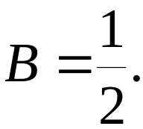
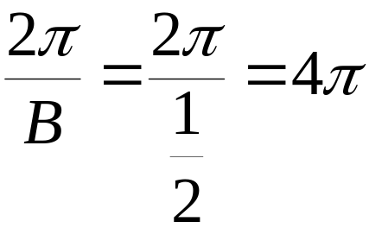



Example: Graphing a Function of the Form y = AsinBx
Determine the amplitude and period of Then graph the function for
Step 1 Identify the amplitude and the period.
The equation is of the form y = A sinBx with A = 2 and
The maximum value of y is 2, the minimum value of y is –2. The period of tells us that the graph completes one cycle from 0 to
amplitude:
period:

Slide 12

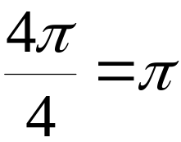




Example: Graphing a Function of the Form y = AsinBx
(continued)
Step 2 Find the values of x for the five key points.
To generate x-values for each of the five key points, we begin by dividing the period, by 4. The cycle begins at x₁ = 0. We add quarter periods to generate x-values for each of the key points.

Slide 13
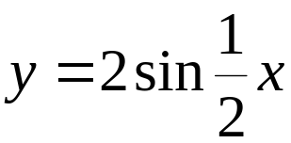
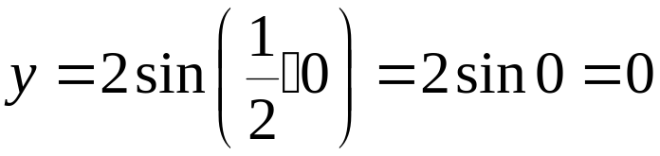
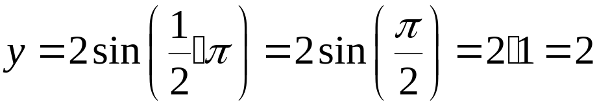

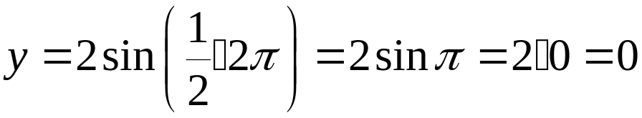

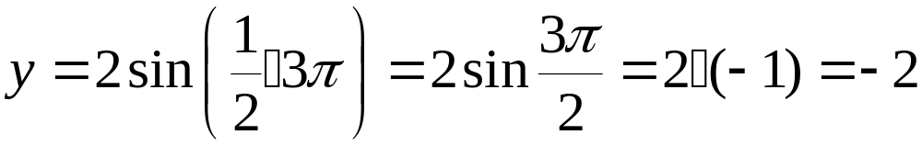

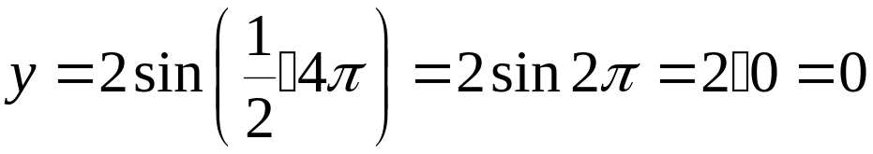


Example: Graphing a Function of the Form y = AsinBx
(continued)
Step 3 Find the values of y for the five key points.

Slide 14
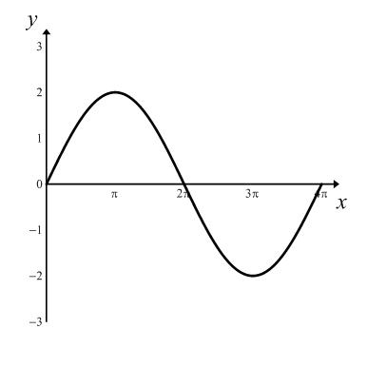
Example: Graphing a Function of the Form y = AsinBx
(continued)
Determine the amplitude and period of Then graph the function for
Step 4 Connect the five key points
with a smooth curve and graph
one complete cycle of the
given function.
amplitude = 2
period

Slide 15
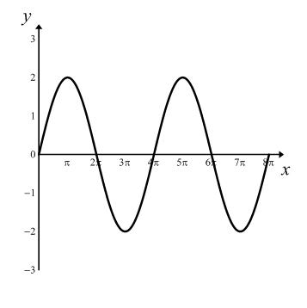

Example: Graphing a Function of the Form y = AsinBx
(continued)
Determine the amplitude and period of Then graph the function for
Step 5 Extend the graph in step 4 to the left or right as desired. We will extend the graph to include
the interval
amplitude = 2
period

Slide 16
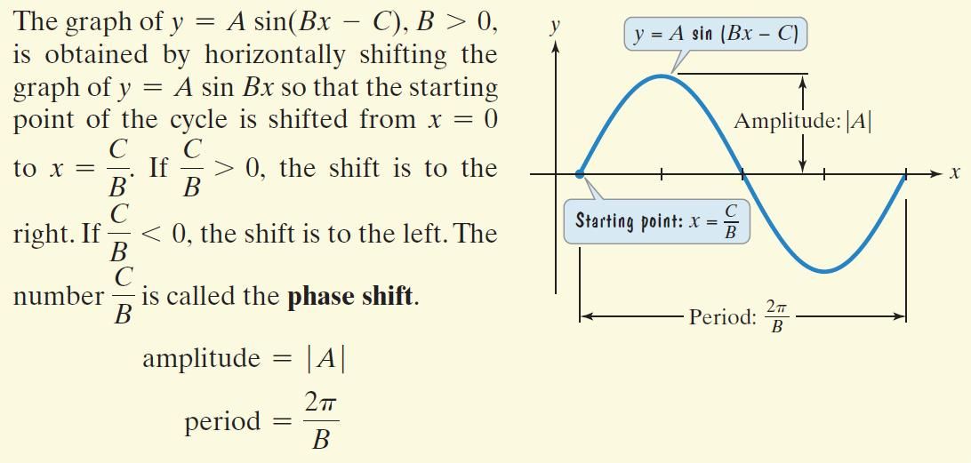
The Graph of y = Asin(Bx – C)

Slide 17
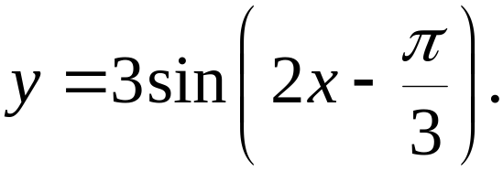
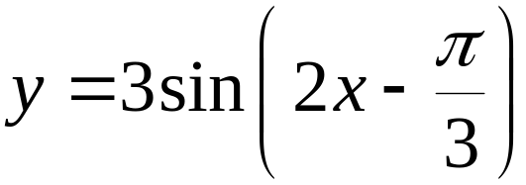
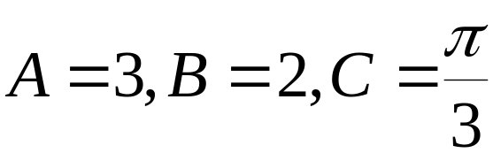
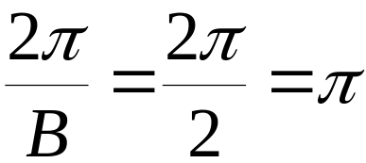

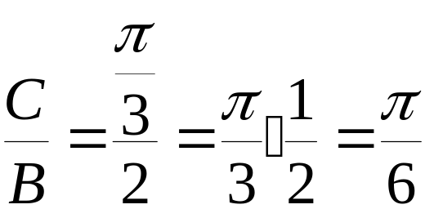
Example: Graphing a Function of the Form y = Asin(Bx – C)
Determine the amplitude, period, and phase shift of
Then graph one period of the function.
Step 1 Identify the amplitude, the period, and the phase shift.
amplitude:
period:
phase shift:

Slide 18
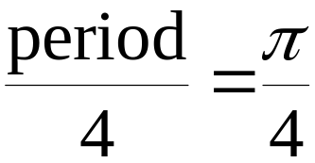
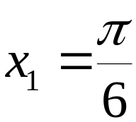
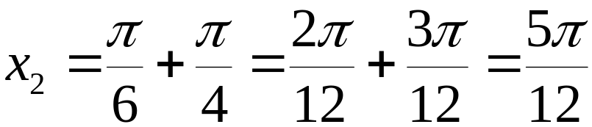
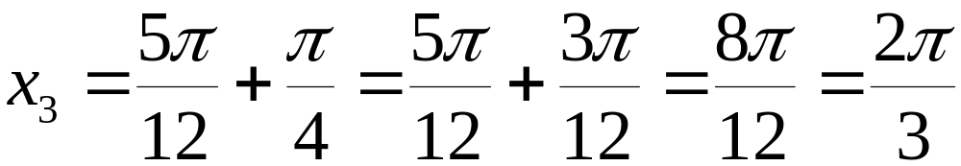
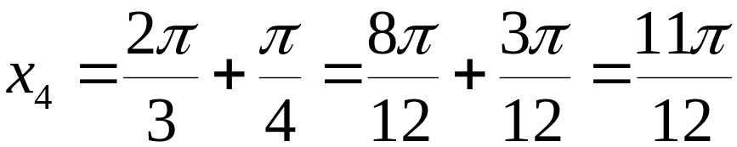
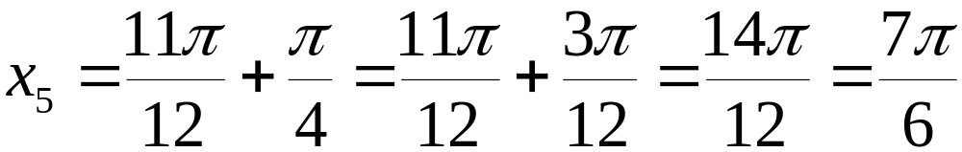
Example: Graphing a Function of the Form y = Asin(Bx – C) (continued)
Step 2 Find the values of x for the five key points.

Slide 19
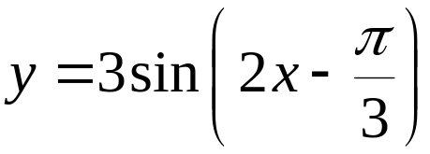

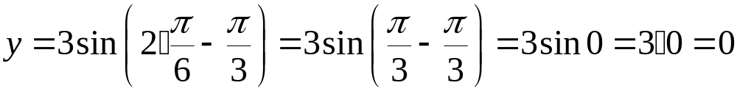
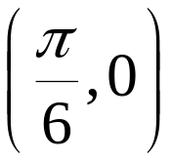
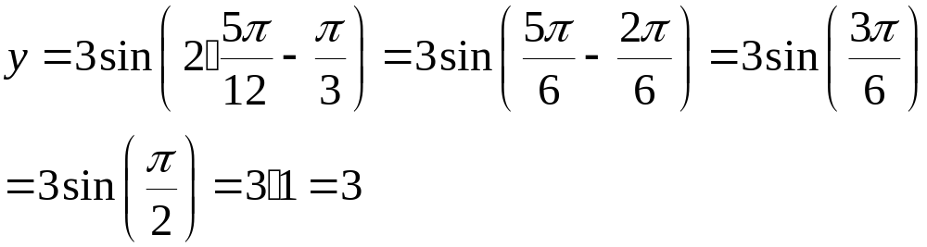

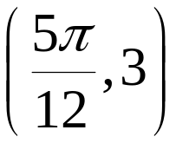
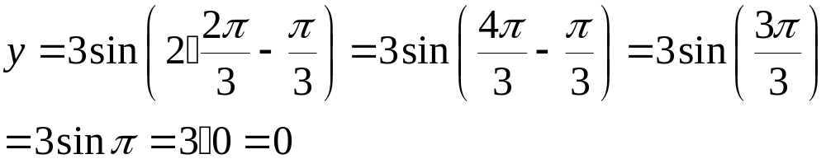

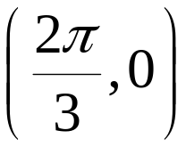
Example: Graphing a Function of the Form y = Asin(Bx – C) (continued)
Step 3 Find the values of y for the five key points.

Slide 20
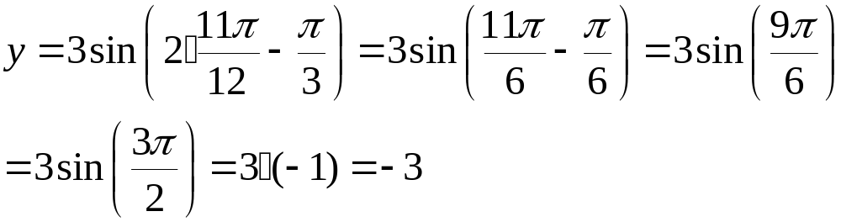
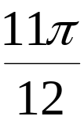
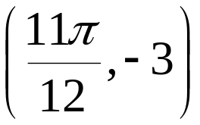

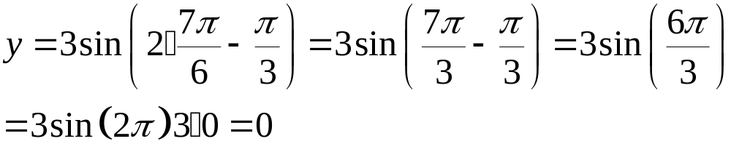

Example: Graphing a Function of the Form y = Asin(Bx – C) (continued)
Step 3 (cont) Find the values of y for the five key points.

Slide 21


Example: Graphing a Function of the Form y = Asin(Bx – C) (continued)
Step 4 Connect the five key points with a smooth curve and graph one complete cycle of the function
amplitude = 3
phase shift
period

Slide 22


The graph of y = cosx

Slide 23

Some Properties of the Graph of y = cosx
The domain is
The range is [–1, 1].
The period is
The function is an even function:

Slide 24



Sinusoidal Graphs
The graphs of sine
functions and cosine
functions are called
sinusoidal graphs.
The graph of
is the
graph of
with a phase shift
of

Slide 25

Graphing Variations of y = cosx

Slide 26





Example: Graphing a Function of the Form y = AcosBx
Determine the amplitude and period of
Then graph the function for
Step 1 Identify the amplitude and the period.
amplitude:
period:

Slide 27





Example: Graphing a Function of the Form y = AcosBx
(continued)
Determine the amplitude and period of
Then graph the function for
Step 2 Find the values of x for the five key points.

Slide 28






Example: Graphing a Function of the Form y = AcosBx
(continued)
Step 3 Find the values of y for the five key points.

Slide 29





Example: Graphing a Function of the Form y = AcosBx
(continued)
Step 3 Find the values of y for the five key points.

Slide 30

Example: Graphing a Function of the Form y = AcosBx
(continued)
Determine the amplitude and period of
Then graph the function for
Step 4 Connect the five key
points with a smooth curve
and graph one complete
cycle of the given function.
amplitude = 4
period = 2

Slide 31

Example: Graphing a Function of the Form y = AcosBx
(continued)
Determine the amplitude and period of
Then graph the function for
Step 5 Extend the graph
to the left or right
as desired.
amplitude = 4
period = 2

Slide 32

The Graph of y = Acos(Bx – C)

Slide 33




Example: Graphing a Function of the Form y = Acos(Bx – C)
Determine the amplitude, period, and phase shift of
Then graph one period of the function.
Step 1 Identify the amplitude, the period, and the phase shift.
amplitude:
period:
phase shift:

Slide 34





Example: Graphing a Function of the Form y = Acos(Bx – C) (continued)
Determine the amplitude, period, and phase shift of
Then graph one period of the function.
Step 2 Find the x-values for the five key points.

Slide 35







Example: Graphing a Function of the Form y = Acos(Bx – C) (continued)
Step 3 Find the values of y for the five key points.

Slide 36





Example: Graphing a Function of the Form y = Acos(Bx – C) (continued)
Step 3 (cont) Find the values of y for the five key points.

Slide 37


Example: Graphing a Function of the Form y = Acos(Bx – C) (continued)
Step 3 (cont) Find the values of y for the five key points.

Slide 38

Example: Graphing a Function of the Form y = Acos(Bx – C) (continued)
Determine the amplitude, period, and phase shift of
Then graph one period of the function.
Step 4 Connect the five
key points with
a smooth curve
and graph one
complete cycle of the
given function.
amplitude
period

Slide 39




Vertical Shifts of Sinusoidal Graphs
For sinusoidal graphs of the form
and
the constant D causes a vertical shift in the graph.
These vertical shifts result in sinusoidal graphs oscillating about the horizontal line y = D rather than about the x-axis.
The maximum value of y is
The minimum value of y is

Slide 40





Example: A Vertical Shift
Graph one period of the function
Step 1 Identify the amplitude, period, phase shift, and vertical shift.
amplitude:
period:
phase shift:
vertical shift:
one unit upward

Slide 41

Example: A Vertical Shift
Graph one period of the function
Step 2 Find the values of x for the five key points.

Slide 42








Example: A Vertical Shift
Step 3 Find the values of y for the five key points.

Slide 43


Example: A Vertical Shift
Step 3 (cont) Find the values of y for the five key points.

Slide 44

Example: A Vertical Shift
Graph one period of the function
Step 4 Connect the five
key points with
a smooth curve
and graph one
complete cycle of
the given function.

Slide 45
Example: Modeling Periodic Behavior
A region that is 30° north of the Equator averages a minimum of 10 hours of daylight in December. Hours of daylight are at a maximum of 14 hours in June. Let x represent the month of the year, with 1 for January, 2 for February, 3 for March, and 12 for December. If y represents the number of hours of daylight in month x, use a sine function of the form y = Asin(Bx – C) + D to model the hours of daylight.
Because the hours of daylight range from a minimum of 10 to a maximum of 14, the curve oscillates about the middle value, 12 hours. Thus, D = 12.

Slide 46
Example: Modeling Periodic Behavior
(continued)
A region that is 30° north of the Equator averages a minimum of 10 hours of daylight in December. Hours of daylight are at a maximum of 14 hours in June. Let x represent the month of the year, with 1 for January, 2 for February, 3 for March, and 12 for December. If y represents the number of hours of daylight in month x, use a sine function of the form y = Asin(Bx – C) + D to model the hours of daylight.
The maximum number of hours of daylight is 14, which is 2 hours more than 12 hours. Thus, A, the amplitude, is 2; A = 2.

Slide 47



Example: Modeling Periodic Behavior
A region that is 30° north of the Equator averages a minimum of 10 hours of daylight in December. Hours of daylight are at a maximum of 14 hours in June. Let x represent the month of the year, with 1 for January, 2 for February, 3 for March, and 12 for December. If y represents the number of hours of daylight in month x, use a sine function of the form y = Asin(Bx – C) + D to model the hours of daylight.
One complete cycle occurs over a period of 12 months.

Slide 48




Example: Modeling Periodic Behavior
The starting point of the cycle is March, x = 3.
The phase shift is

Slide 49


Example: Modeling Periodic Behavior
A region that is 30° north of the Equator averages a minimum of 10 hours of daylight in December. Hours of daylight are at a maximum of 14 hours in June. Let x represent the month of the year, with 1 for January, 2 for February, 3 for March, and 12 for December. If y represents the number of hours of daylight in month x, use a sine function of the form y = Asin(Bx – C) + D to model the hours of daylight.
The equation that models the hours of daylight is

