Slide 1

Chapter 5
Trigonometric Functions
5.6 Graphs of Other Trigonometric Functions
Copyright © 2014, 2010, 2007 Pearson Education, Inc.

Slide 2
Objectives:
Understand the graph of y = tan x.
Graph variations of y = tan x.
Understand the graph of y = cot x.
Graph variations of y = cot x.
Understand the graphs of y = csc x and y = sec x.
Graph variations of y = csc x and y = sec x.

Slide 3
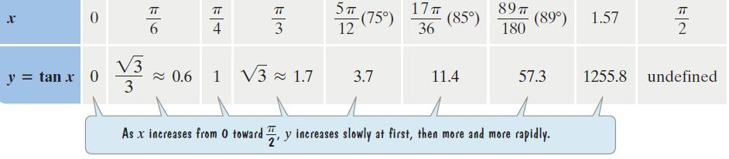
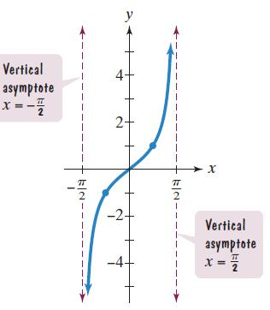


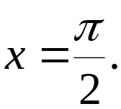
The Graph of y = tan x
Period:
The tangent function is an odd function.
The tangent function is undefined at

Slide 4
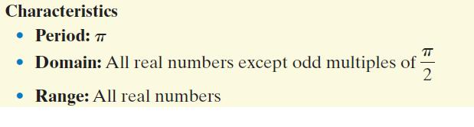
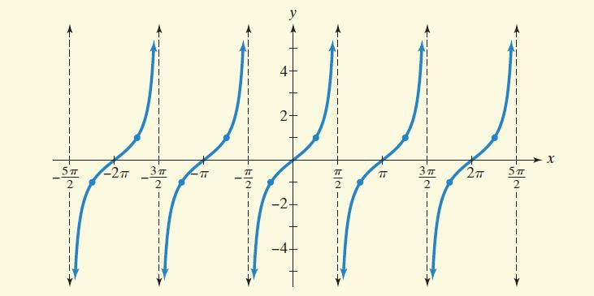
The Tangent Curve: The Graph of y = tan x and Its Characteristics

Slide 5
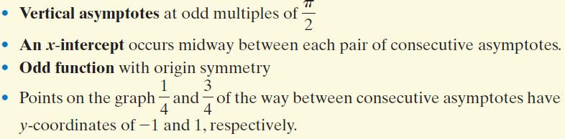
The Tangent Curve: The Graph of y = tan x and Its Characteristics (continued)

Slide 6
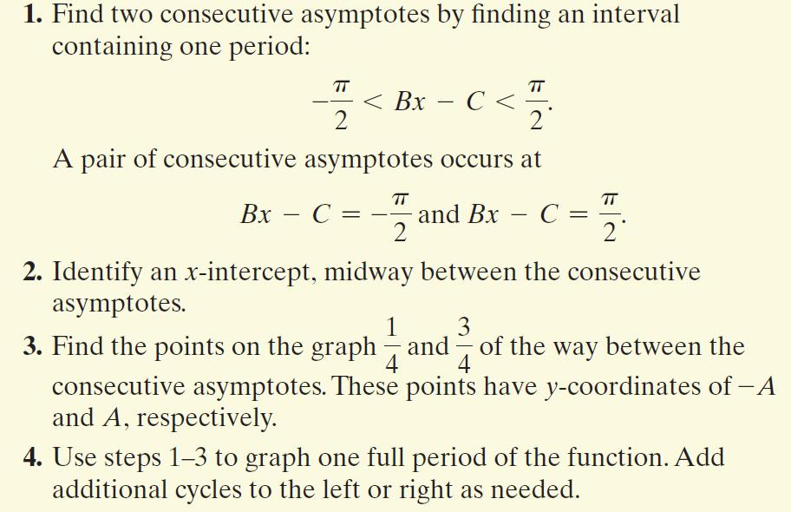
Graphing Variations of y = tan x

Slide 7
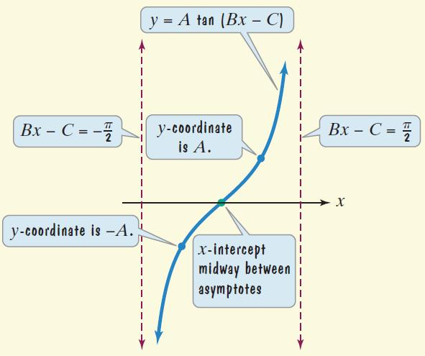
Graphing Variations of y = tan x (continued)

Slide 8
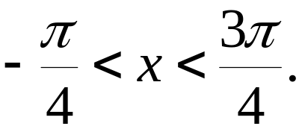
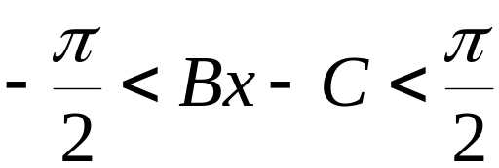
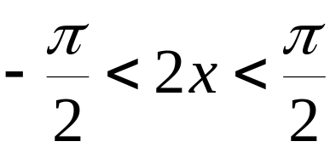
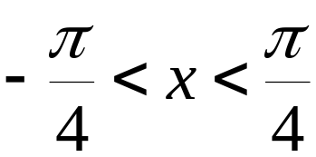
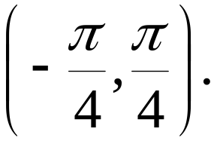
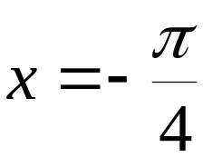
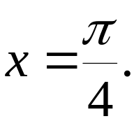
Example: Graphing a Tangent Function
Graph y = 3 tan 2x for
A = 3, B = 2, C = 0
Step 1 Find two consecutive asymptotes.
An interval containing one period is Thus, two consecutive asymptotes occur at and

Slide 9
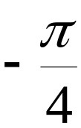

Example: Graphing a Tangent Function (continued)
Graph y = 3 tan 2x for
Step 2 Identify an x-intercept, midway between the consecutive asymptotes.
x = 0 is midway between and
The graph passes through (0, 0).

Slide 10




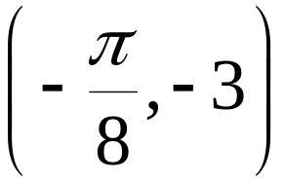
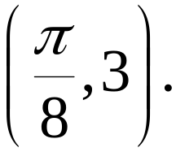
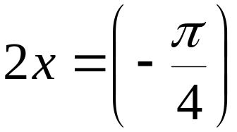
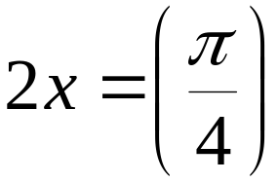
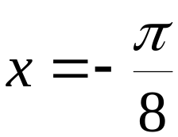
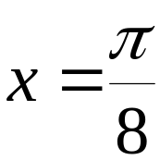
Example: Graphing a Tangent Function (continued)
Graph y = 3 tan 2x for
Step 3 Find points on the graph 1/4 and 3/4 of the way between the consecutive asymptotes. These points have y-coordinates of –A and A.
The graph passes through
and

Slide 11
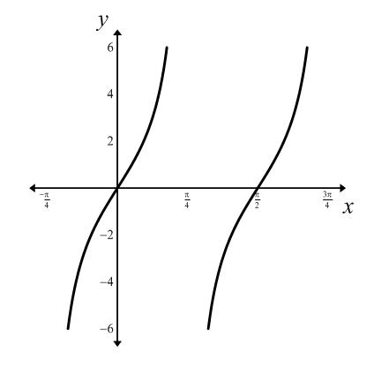
Example: Graphing a Tangent Function (continued)
Graph y = 3 tan 2x for
Step 4 Use steps 1-3 to
graph one full period
of the function.

Slide 12
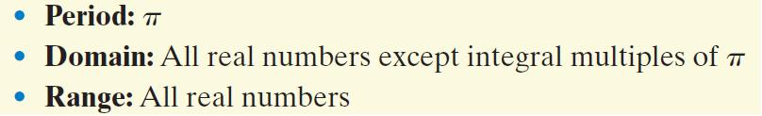
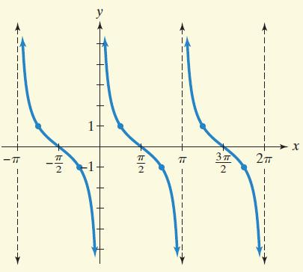
The Cotangent Curve: The Graph of y = cot x and Its Characteristics

Slide 13
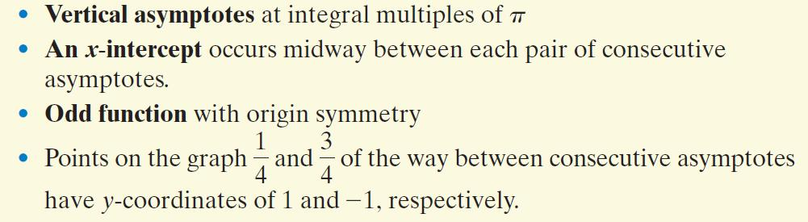
The Cotangent Curve: The Graph of y = cot x and Its Characteristics (continued)

Slide 14
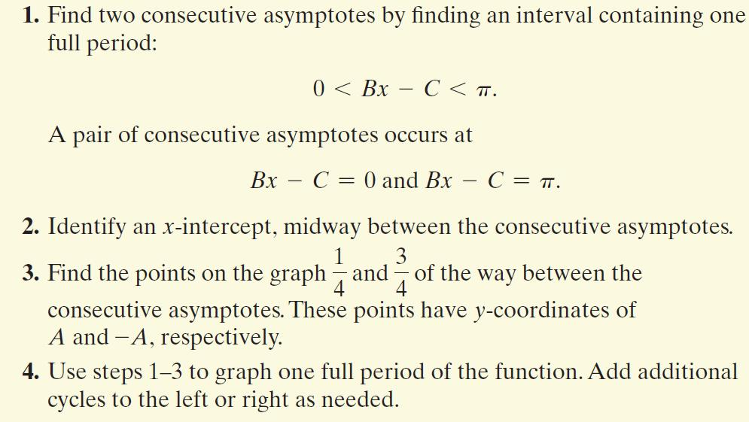
Graphing Variations of y = cot x

Slide 15
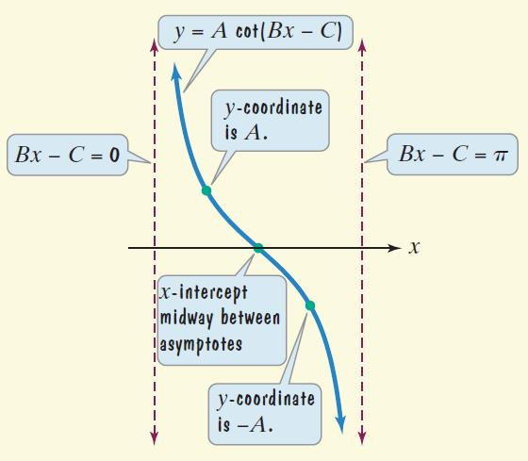
Graphing Variations of y = cot x (continued)

Slide 16
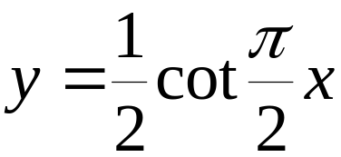
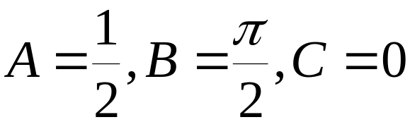
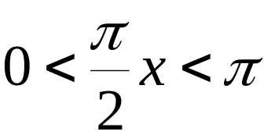


Example: Graphing a Cotangent Function
Graph
Step 1 Find two consecutive asymptotes.
An interval containing one period is (0, 2). Thus, two consecutive asymptotes occur at x = 0 and x = 2.

Slide 17
Example: Graphing a Cotangent Function (continued)
Graph
Step 2 Identify an x-intercept midway between the consecutive asymptotes.
x = 1 is midway between x = 0 and x = 2.
The graph passes through (1, 0).

Slide 18
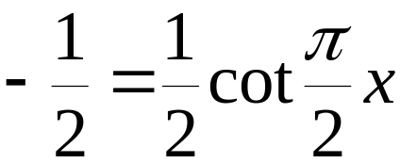
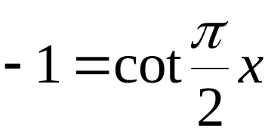
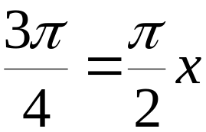
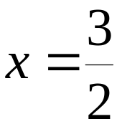
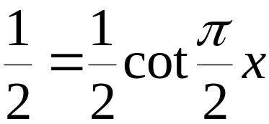
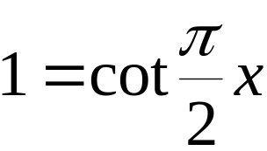
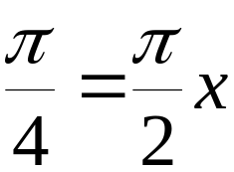
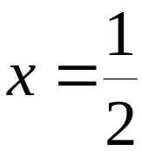
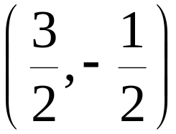
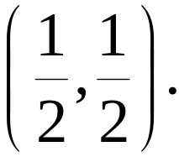
Example: Graphing a Cotangent Function (continued)
Graph
Step 3 Find points on the graph 1/4 and 3/4 of the way between consecutive asymptotes. These points have y-coordinates of A and –A.
The graph passes through and

Slide 19
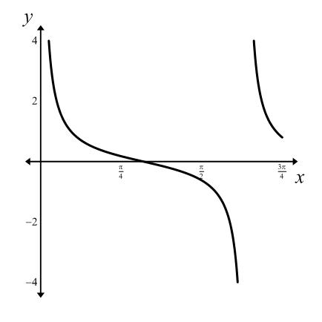
Example: Graphing a Cotangent Function (continued)
Graph
Step 4 Use steps 1-3 to
graph one full period
of the function.

Slide 20
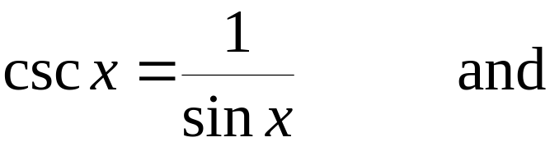
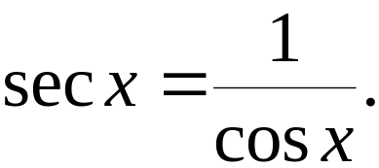
The Graphs of y = csc x and y = sec x
We obtain the graphs of the cosecant and the secant curves by using the reciprocal identities
We obtain the graph of y = csc x by taking reciprocals of the y-values in the graph of y = sin x. Vertical asymptotes of y = csc x occur at the x-intercepts of y = sin x.
We obtain the graph of y = sec x by taking reciprocals of the y-values in the graph of y = cos x. Vertical asymptotes of y = sec x occur at the x-intercepts of y = cos x.

Slide 21
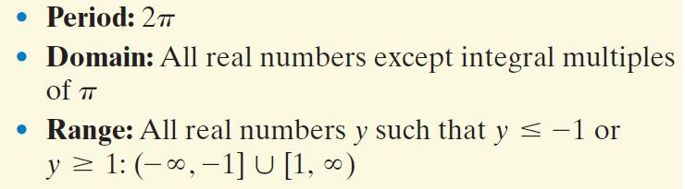
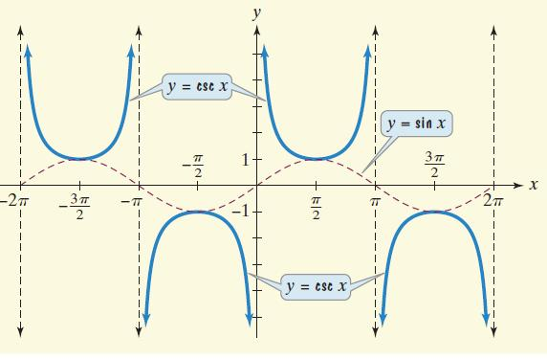
The Cosecant Curve: The Graph of y = csc x and Its Characteristics

Slide 22

The Cosecant Curve: The Graph of y = csc x and Its Characteristics (continued)

Slide 23
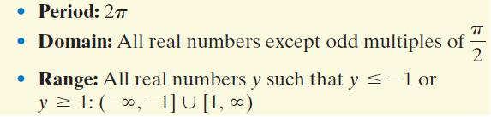
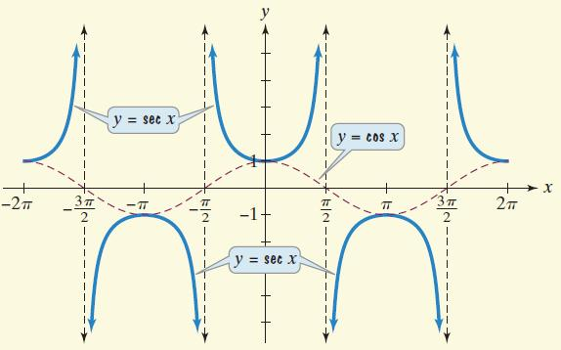
The Secant Curve: The Graph of y = sec x and Its Characteristics

Slide 24

The Secant Curve: The Graph of y = sec x and Its Characteristics (continued)

Slide 25
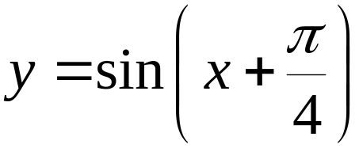
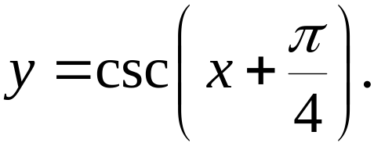

Example: Using a Sine Curve to Obtain a Cosecant Curve
Use the graph of to obtain the graph of
The x-intercepts of
the sine graph correspond
to the vertical asymptotes
of the cosecant graph.

Slide 26



Example: Using a Sine Curve to Obtain a Cosecant Curve
(continued)
Use the graph of to obtain the graph of
Using the asymptotes as guides,
we sketch the graph of

Slide 27



Example: Graphing a Secant Function
Graph y = 2 sec 2x for
We begin by graphing the reciprocal function, y = 2 cos 2x. This equation is of the form y = A cos Bx, with A = 2 and B = 2.
amplitude:
period:
We will use quarter-periods
to find x-values for the
five key points.

Slide 28


Example: Graphing a Secant Function (continued)
Graph y = 2 sec 2x for
The x-values for the five key points are:
Evaluating the function y = 2 cos 2x at each of these values of x, the key points are:

Slide 29



Example: Graphing a Secant Function (continued)
Graph y = 2 sec 2x for
The key points for our graph of y = 2 cos 2x are:
We draw vertical asymptotes
through the x-intercepts to use
as guides for the graph of
y = 2 sec 2x.

Slide 30



Example: Graphing a Secant Function (continued)
Graph y = 2 sec 2x for

Slide 31


The Six Curves of Trigonometry

Slide 32


The Six Curves of Trigonometry (continued)

Slide 33


The Six Curves of Trigonometry (continued)

Slide 34


The Six Curves of Trigonometry (continued)

Slide 35


The Six Curves of Trigonometry (continued)

Slide 36


The Six Curves of Trigonometry (continued)

