Slide 1

Chapter 5
Trigonometric Functions
5.7 Inverse Trigonometric Functions
Copyright © 2014, 2010, 2007 Pearson Education, Inc.

Slide 2
Objectives:
Understand and use the inverse sine function.
Understand and use the inverse cosine function.
Understand and use the inverse tangent function.
Use a calculator to evaluate inverse trigonometric functions.
Find exact values of composite functions with inverse trigonometric functions.

Slide 3
Inverse Functions
Here are some helpful things to remember from our earlier discussion of inverse functions:
If no horizontal line intersects the graph of a function more than once, the function is one-to-one and has an inverse function.
If the point (a, b) is on the graph of f, then the point (b, a) is on the graph of the inverse function, denoted f ^{–1}. The graph of f ^{–1} is a reflection of the graph of f about the line y = x.

Slide 4
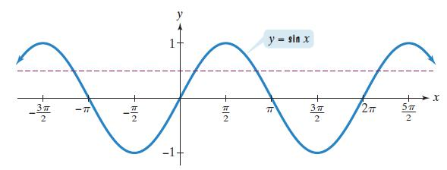
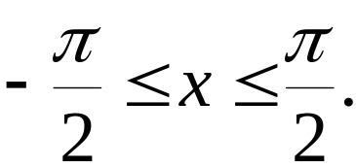
The Inverse Sine Function
The horizontal line test shows that the sine function
is not one-to-one; y = sin x has an inverse function on
the restricted domain

Slide 5
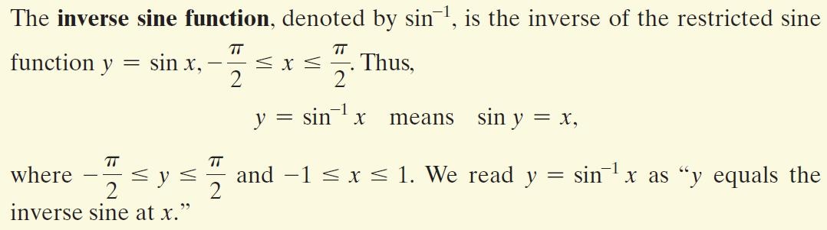
The Inverse Sine Function (continued)

Slide 6
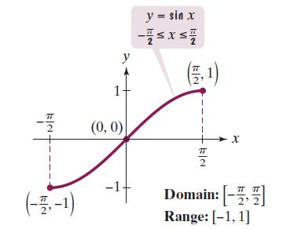
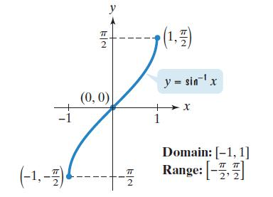
Graphing the Inverse Sine Function
One way to graph y = sin^{–1} x is to take points on the graph of the restricted sine function and reverse the order of the coordinates.

Slide 7
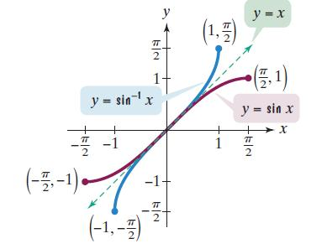
Graphing the Inverse Sine Function (continued)
Another way to obtain the graph of y = sin^{–1} x is to reflect the graph of the restricted sine function about the line y = x.

Slide 8

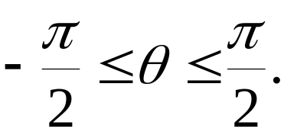



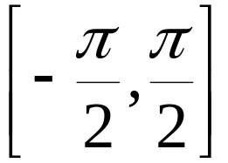

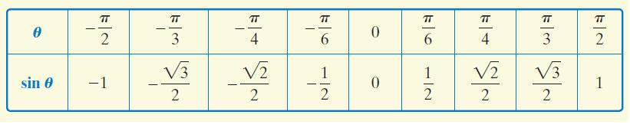
Finding Exact Values of sin^{–1}x
1. Let
2. Rewrite as where
3. Use the exact values in the table to find the value of in that satisfies

Slide 9
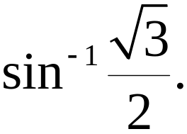

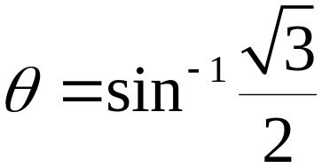
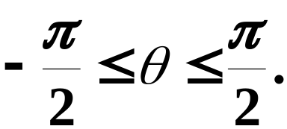


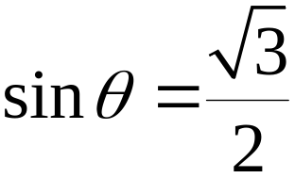
Example: Finding the Exact Value of an Inverse Sine Function
Step 1 Let
Step 2 Rewrite as where
Find the exact value of

Slide 10
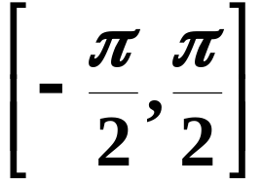



Example: Finding the Exact Value of an Inverse Sine Function (continued)
Step 3 Use the exact value in the table to find the value of in that satisfies
Find the exact value of
The angle in whose sine is is

Slide 11
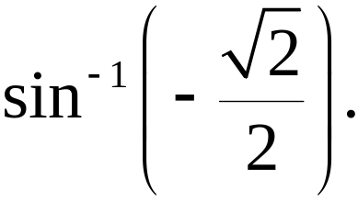
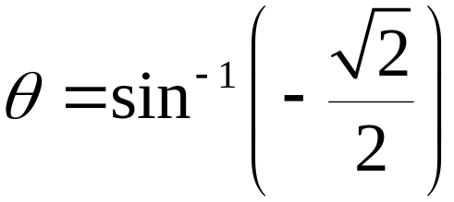
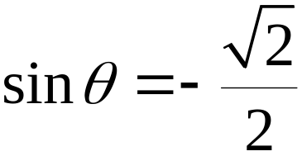
Example: Finding the Exact Value of an Inverse Sine Function
Step 1 Let
Step 2 Rewrite as where
Find the exact value of

Slide 12
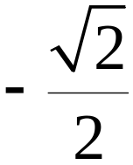
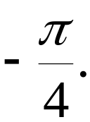
Example: Finding the Exact Value of an Inverse Sine Function (continued)
Step 3 Use the exact value in the table to find the value of in that satisfies
Find the exact value of
The angle in whose sine is is

Slide 13
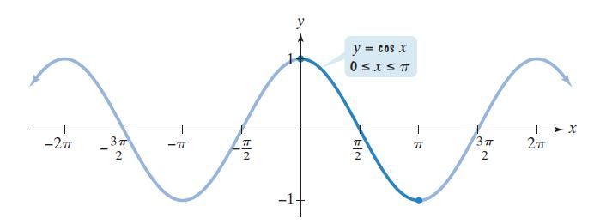

The Inverse Cosine Function
The horizontal line test shows that the cosine function
is not one-to-one. y = cos x has an inverse function on
the restricted domain

Slide 14
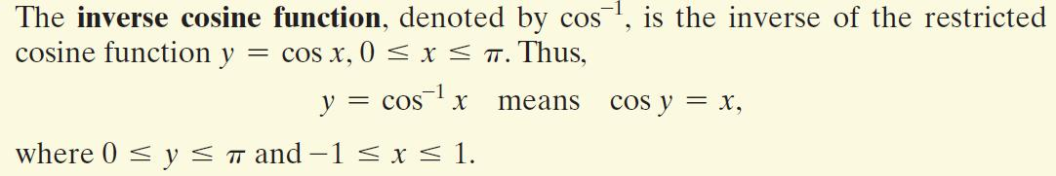
The Inverse Cosine Function (continued)

Slide 15
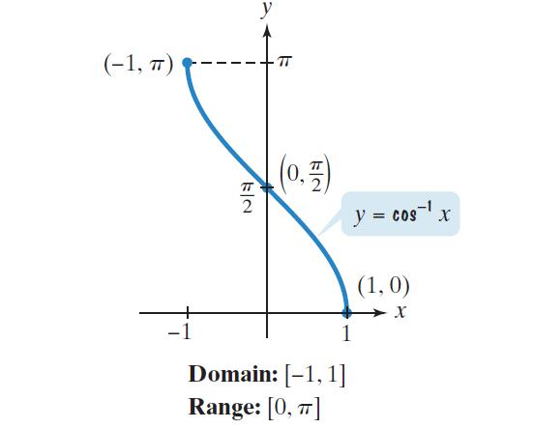
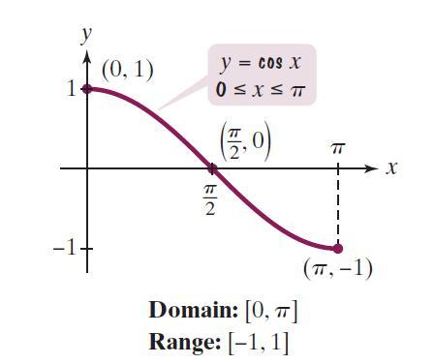
Graphing the Inverse Cosine Function
One way to graph y = cos^{–1} x is to take points on the graph of the restricted cosine function and reverse the order of the coordinates.

Slide 16






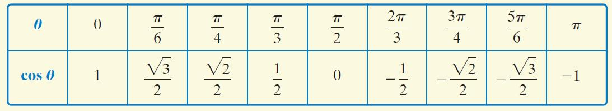
Finding Exact Values of cos^{–1} x
1. Let
2. Rewrite as where
3. Use the exact values in the table to find the value of in that satisfies

Slide 17
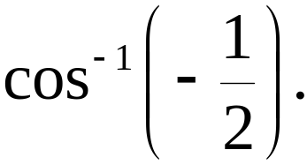

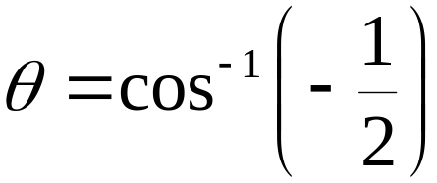



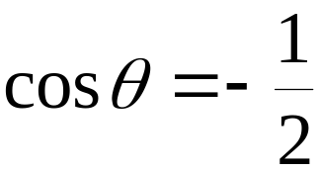
Example: Finding the Exact Value of an Inverse Cosine Function
Step 1 Let
Step 2 Rewrite as where
Find the exact value of

Slide 18


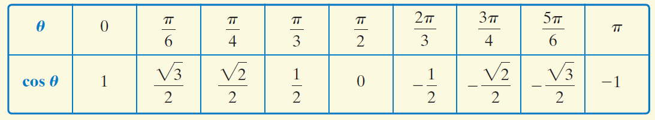

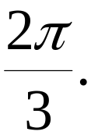
Example: Finding the Exact Value of an Inverse Cosine Function (continued)
Step 3 Use the exact value in the table to find the value of in that satisfies
Find the exact value of
The angle in whose cosine is is

Slide 19
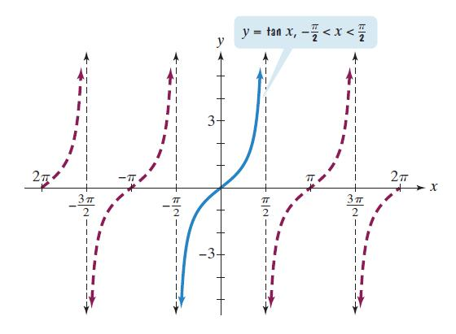
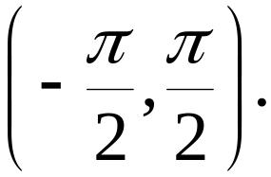
The Inverse Tangent Function
The horizontal line test shows that the tangent function
is not one-to-one. y = tan x has an inverse function on
the restricted domain

Slide 20
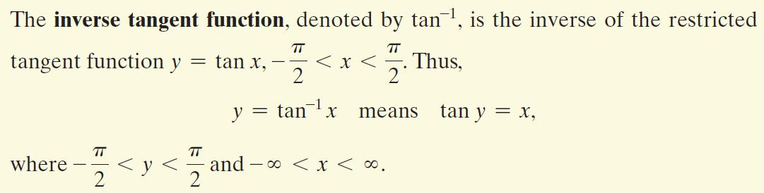
The Inverse Tangent Function (continued)

Slide 21
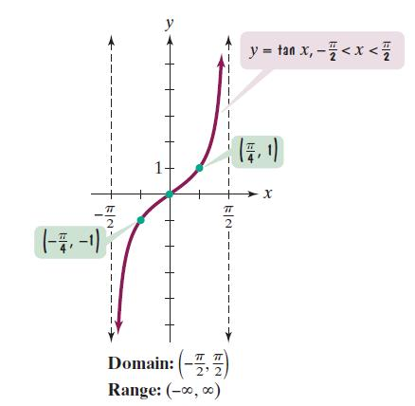
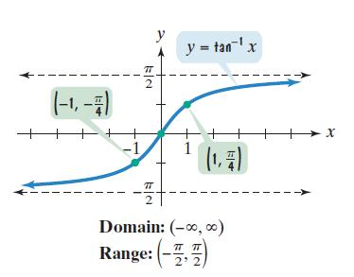
Graphing the Inverse Tangent Function
One way to graph y = tan^{–1} x is to take points on the graph of the restricted tangent function and reverse the order of the coordinates.

Slide 22

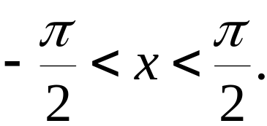


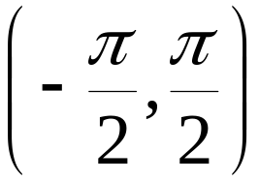

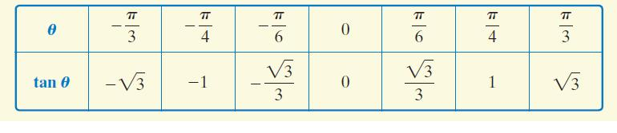
Finding Exact Values of tan^{–1} x
1. Let
2. Rewrite as where
3. Use the exact values in the table to find the value of in that satisfies

Slide 23
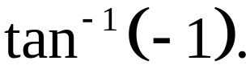

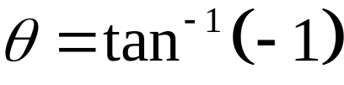
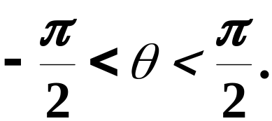



Example: Finding the Exact Value of an Inverse Tangent Function
Step 1 Let
Step 2 Rewrite as where
Find the exact value of

Slide 24
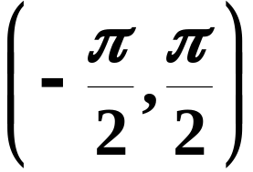

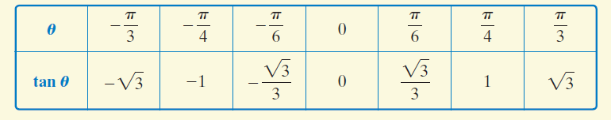
Example: Finding the Exact Value of an Inverse Sine Function (continued)
Step 3 Use the exact value in the table to find the value of in that satisfies
Find the exact value of
The angle in whose tangent is –1 is

Slide 25
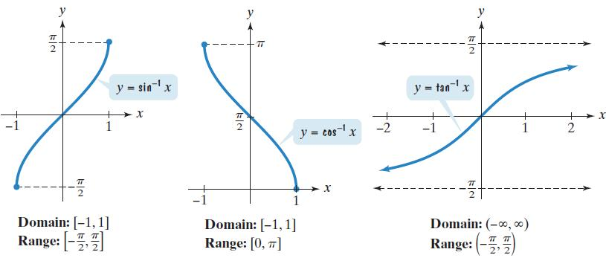
Graphs of the Three Basic Inverse Trigonometric Functions

Slide 26
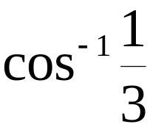
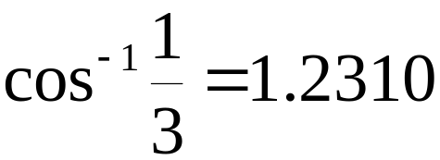


Example: Calculators and Inverse Trigonometric Functions
Use a calculator to find the value to four decimal places of each function:
a.
b.

Slide 27
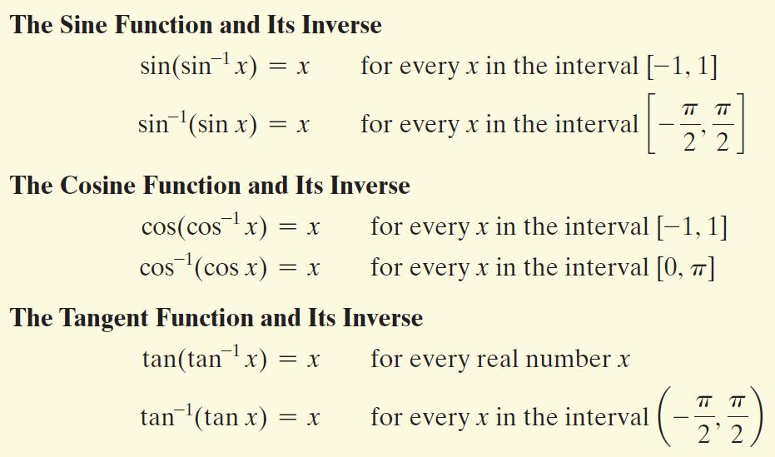
Inverse Properties

Slide 28




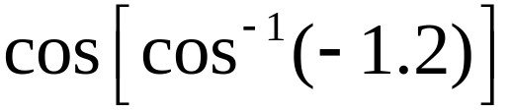
Example: Evaluating Compositions of Functions and Their Inverses
Find the exact value, if possible:
a.
b.
c.
–1.2 is not included in the domain of the inverse cosine function. is not defined.

