Slide 1

Chapter 5
Trigonometric Functions
5.8 Applications of Trigonometric Functions
Copyright © 2014, 2010, 2007 Pearson Education, Inc.

Slide 2
Objectives:
Solve a right triangle.
Solve problems involving bearings.
Model simple harmonic motion.

Slide 3
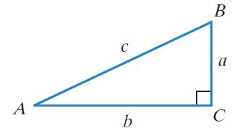
Solving Right Triangles
Solving a right triangle means finding the missing lengths of its sides and the measurements of its angles. We will label right triangles so that side a is opposite angle A, side b is opposite angle B, and side c, the hypotenuse, is opposite right angle C.
When solving a right triangle,
we will use the sine, cosine,
and tangent functions, rather
than their reciprocals.

Slide 4
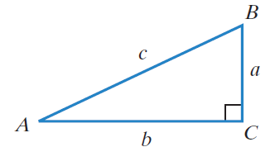

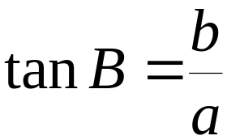
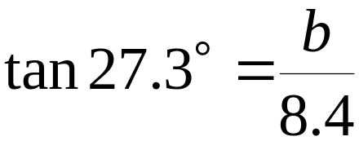
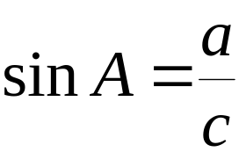
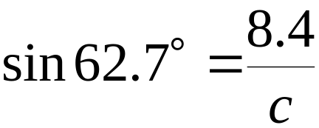

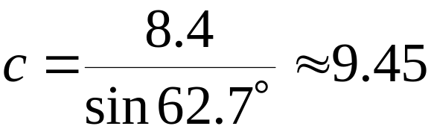
Example: Solving a Right Triangle
Let A = 62.7° and a = 8.4. Solve
the right triangle, rounding lengths
to two decimal places.

Slide 5

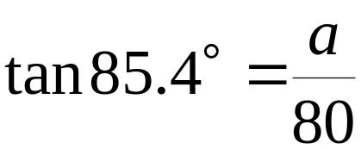




Example: Finding a Side of a Right Triangle
From a point on level ground 80 feet from the base of the Eiffel Tower, the angle of elevation is 85.4°. Approximate the height of the Eiffel Tower to the nearest foot.
The height of the Eiffel Tower is
approximately 994 feet.

Slide 6
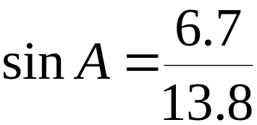



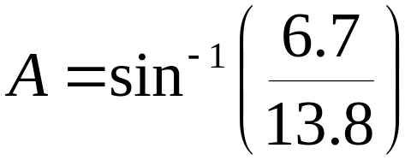

Example: Finding an Angle of a Right Triangle
A guy wire is 13.8 yards long and is attached from the ground to a pole 6.7 yards above the ground. Find the angle, to the nearest tenth of a degree, that the wire makes with the ground.
The wire makes an angle of
approximately 29.0° with the ground.

Slide 7
Trigonometry and Bearings
In navigation and surveying problems, the term bearing is used to specify the location of one point relative to another. The bearing from point O to point P is the acute angle, measured in degrees, between ray OP and a north-south line. The north-south line and the east-west line intersect at right angles. Each bearing has three parts: a letter (N or S), the measure of an acute angle, and a letter (E or W).

Slide 8
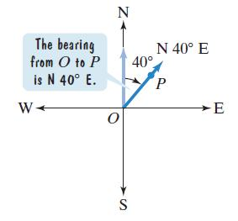
Trigonometry and Bearings (continued)
If the acute angle is measured from
the north side of the north-south line,
then we write N first.
Second, we write the measure of the
acute angle.
If the acute angle is measured on the
east side of the north-south line, then
we write E last.

Slide 9
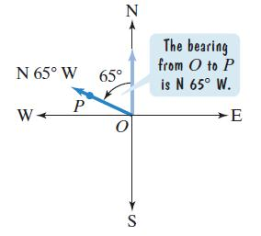
Trigonometry and Bearings (continued)
If the acute angle is measured from
the north side of the north-south line,
then we write N first.
Second, we write the measure of the
acute angle.
If the acute angle is measured on the
west side of the north-south line, then
we write W last.

Slide 10
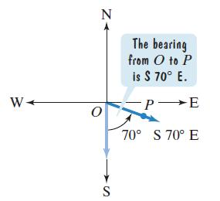
Trigonometry and Bearings (continued)
If the acute angle is measured from
the south side of the north-south line,
then we write S first.
Second, we write the measure of the
acute angle.
If the acute angle is measured on the
east side of the north-south line, then
we write E last.

Slide 11
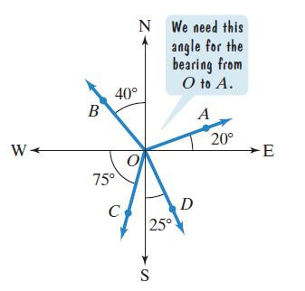
Example: Understanding Bearings
Use the figure to find each of the following:
a. the bearing from O to D
Point D is located to the south and to
the east of the north-south line.
The bearing from O to D is S25°E.
b. the bearing from O to C
Point C is located to the south and to
the west of the north-south line.
The bearing from O to C is S15°W.

Slide 12
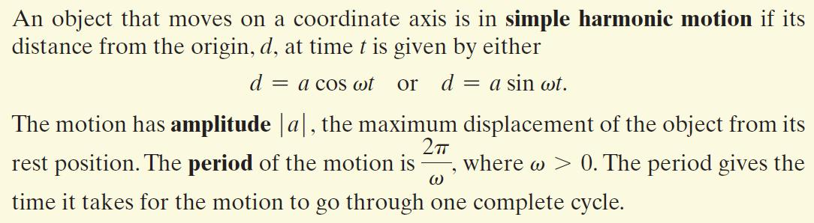
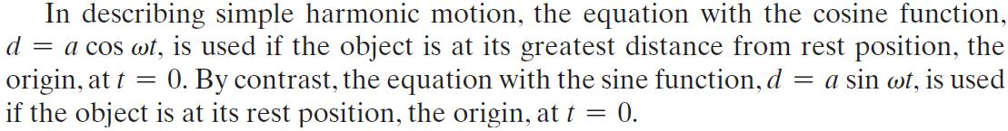
Simple Harmonic Motion

Slide 13


Example: Finding an Equation for an Object in Simple Harmonic Motion
A ball on a spring is pulled 6 inches below its rest position and then released. The period for the motion is 4 seconds. Write the equation for the ball’s simple harmonic motion.
When the ball is released (t = 0), the ball’s distance from its rest position is 6 inches down. Because it is down, d is negative.
The greatest distance from rest position occurs at t = 0. Thus, we will us the equation with the cosine function,

Slide 14


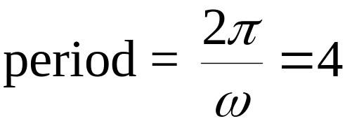
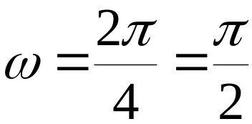

Example: Finding an Equation for an Object in Simple Harmonic Motion
A ball on a spring is pulled 6 inches below its rest position and then released. The period for the motion is 4 seconds. Write the equation for the ball’s simple harmonic motion.
is the maximum displacement. Because the ball is initially below rest position, a = –6
The value of can be found using the formula for the period.

Slide 15
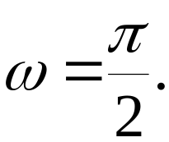
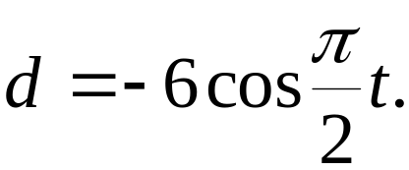
Example: Finding an Equation for an Object in Simple Harmonic Motion
A ball on a spring is pulled 6 inches below its rest position and then released. The period for the motion is 4 seconds. Write the equation for the ball’s simple harmonic motion.
We have found that a = –6 and The equation for the ball’s simple harmonic motion is

Slide 16
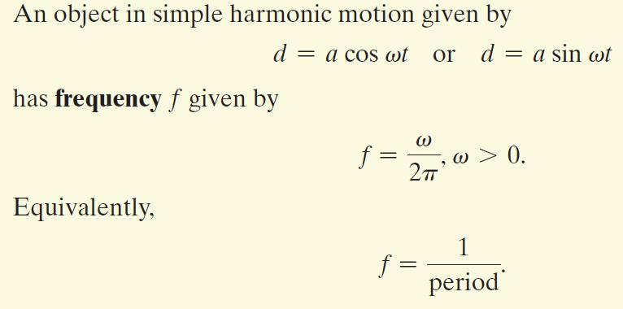
Frequency of an Object in Simple Harmonic Motion

Slide 17
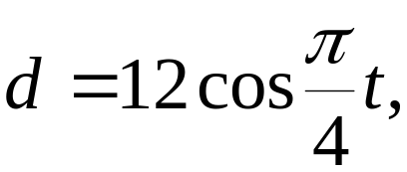
Example: Analyzing Simple Harmonic Motion
An object moves in simple harmonic motion described by
where t is measured in seconds and d in centimeters. Find the maximum displacement.
The maximum displacement from the rest position is the amplitude. Because a = 12, the maximum displacement is 12 centimeters.

Slide 18
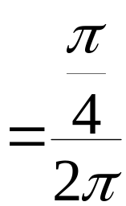
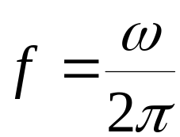
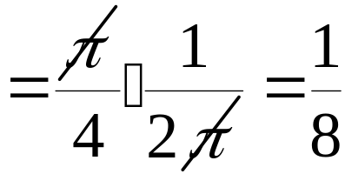

Example: Analyzing Simple Harmonic Motion
An object moves in simple harmonic motion described by
where t is measured in seconds and d in centimeters. Find the frequency.
The frequency is cycle per second.

Slide 19
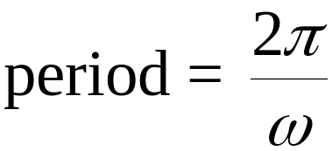
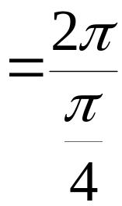
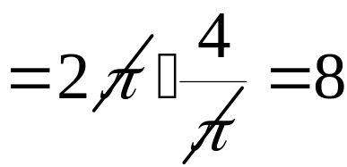
Example: Analyzing Simple Harmonic Motion
An object moves in simple harmonic motion described by
where t is measured in seconds and d in centimeters. Find the time required for one cycle.
The time required for one cycle is the period.
The time required for one cycle is 8 seconds.

