Slide 1

Chapter 6
Analytic Trigonometry
6.1 Verifying Trigonometric Identities
Copyright © 2014, 2010, 2007 Pearson Education, Inc.

Slide 2
Objectives:
Use the fundamental trigonometric identities to verify identities.

Slide 3
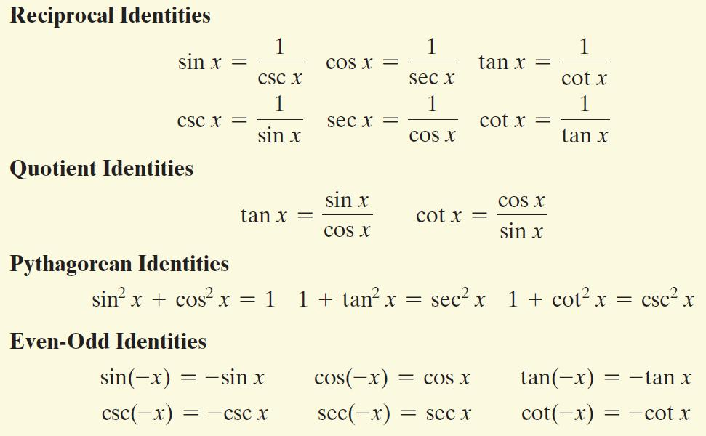
The Fundamental Identities

Slide 4
Using Fundamental Identities to Verify Other Identities
To verify an identity, we show that one side of the identity can be simplified so that it is identical to the other side. Each side of the equation is manipulated independently of the other side of the equation. Start with the side containing the more complicated expression. If you substitute one or more of the fundamental identities on the more complicated side, you will often be able to rewrite it in a form identical to that of the other side.

Slide 5


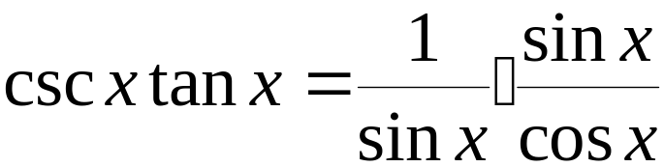
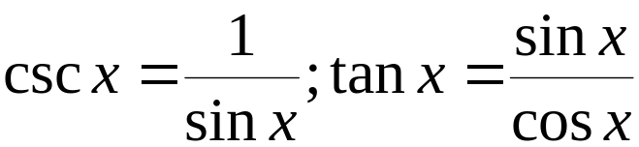
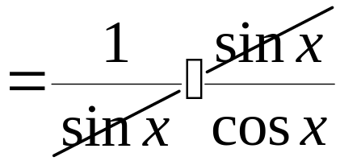
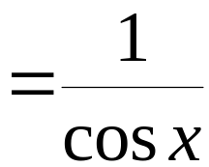
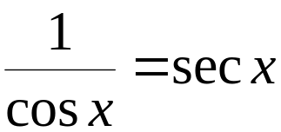

Example: Changing to Sines and Cosines to Verify an Identity
Verify the identity:
Divide the numerator and the
denominator by the common factor.
Multiply the remaining factors in
the numerator and denominator.
The identity is verified.

Slide 6


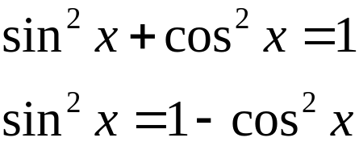


Example: Using Factoring to Verify an Identity
Verify the identity:
Factor sin x from
the two terms.
Multiply.
The identity is verified.

Slide 7
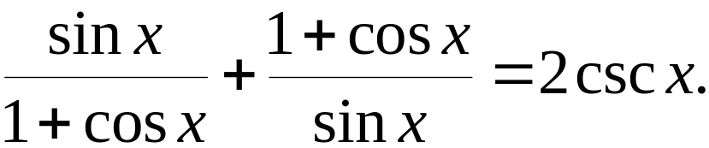

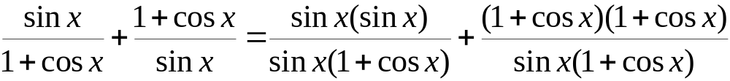
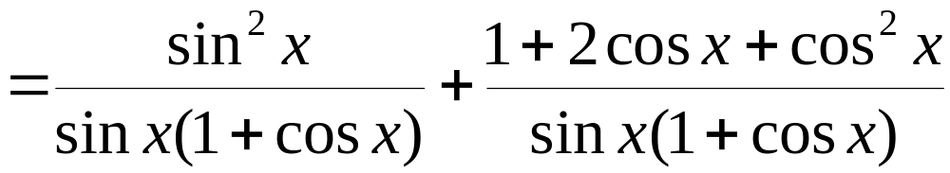
Example: Combining Fractional Expressions to Verify an Identity
Verify the identity:
The least common denominator is
sin x(1 + cos x)
Use FOIL to multiply
(1 + cos x)(1 + cos x)

Slide 8
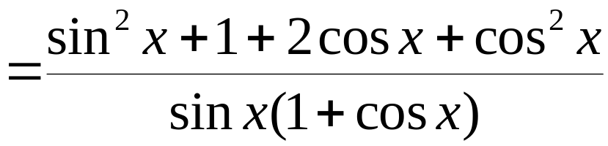
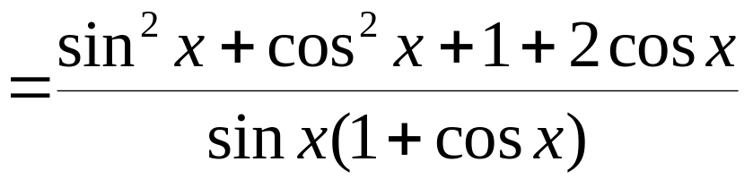
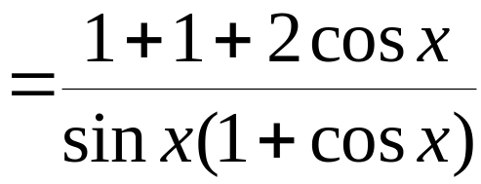

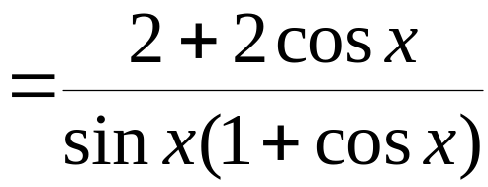
Example: Combining Fractional Expressions to Verify an Identity (continued)
Verify the identity:
Add the numerators. Put this
sum over the LCD.
Regroup terms in the numerator.
Add constant terms in the numerator.

Slide 9
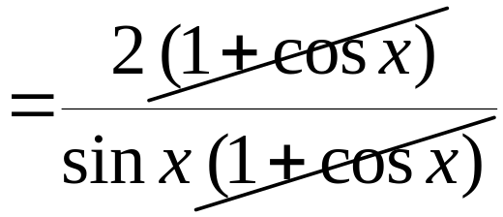
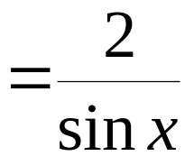
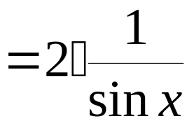
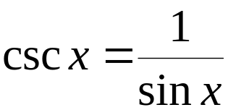

Example: Combining Fractional Expressions to Verify an Identity (continued)
Verify the identity:
Factor and simplify.
Factor out the constant term.
The identity is verified.

Slide 10
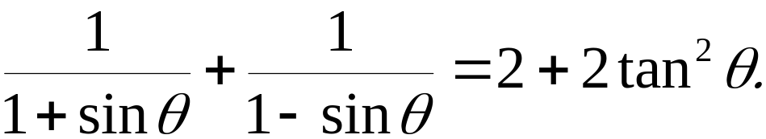
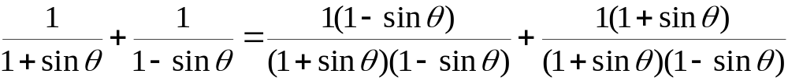
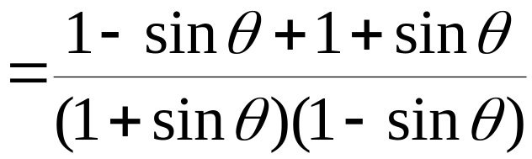
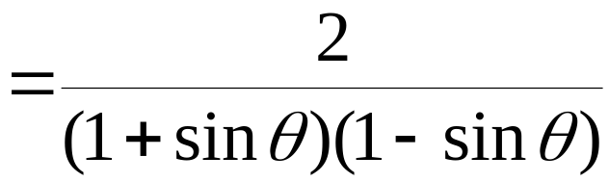
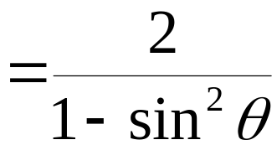
Example: Working with Both Sides Separately to Verify an Identity
Verify the identity:
We begin by working with the left side
Add numerators. Put this sum
over the LCD.
Simplify the numerator.
Multiply the factors
in the denominator.
Rewrite each side
with the LCD.

Slide 11
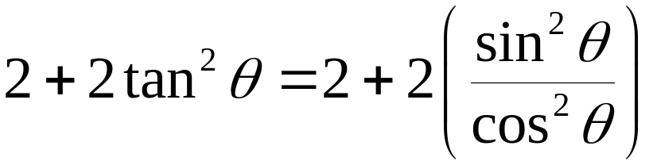
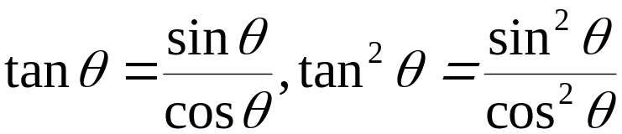
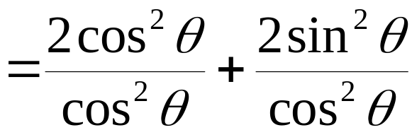
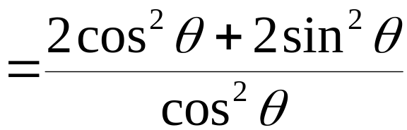
Example: Working with Both Sides Separately to Verify an Identity (continued)
Verify the identity:
We work with the right side.
Rewrite each numerator with the LCD.
Add numerators. Put this sum
over the LCD.

Slide 12
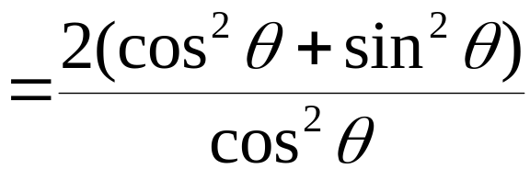
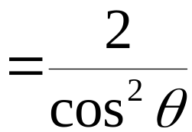

Example: Working with Both Sides Separately to Verify an Identity (continued)
Verify the identity:
We are working with the right side of the identity.
Factor out the constant term, 2.

Slide 13
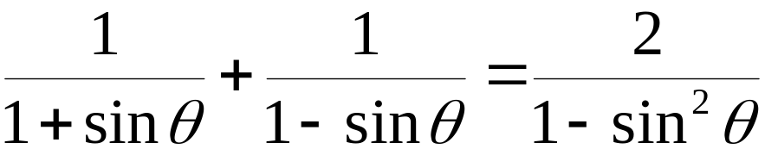
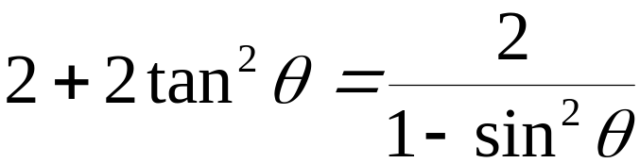
Example: Working with Both Sides Separately to Verify an Identity (continued)
Verify the identity:
Working with the left side, we found that
Working with the right side, we found that
The identity is verified because both sides are equal.

