Slide 1

Chapter 6
Analytic Trigonometry
6.2 Sum and Difference Formulas
Copyright © 2014, 2010, 2007 Pearson Education, Inc.

Slide 2
Objectives:
Use the formula for the cosine of the difference of two angles.
Use sum and difference formulas for cosines and sines.
Use sum and difference formulas for tangents.

Slide 3
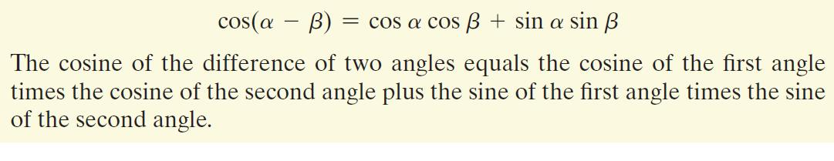
The Cosine of the Difference of Two Angles

Slide 4
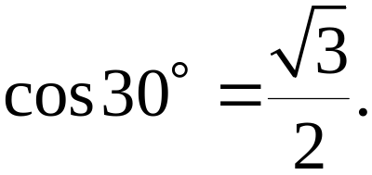
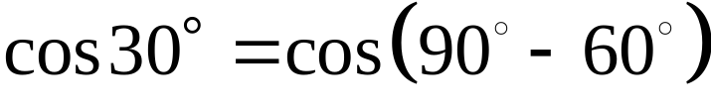
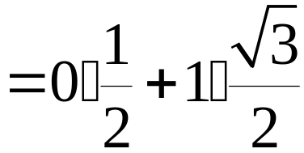
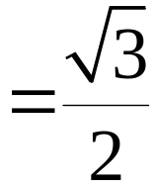
Example: Using the Difference Formula for Cosines to Find an Exact Value
We know that Obtain this exact value using
and the difference formula for cosines.

Slide 5

Example: Using the Difference Formula for Cosines to Find an Exact Value
Find the exact value of

Slide 6
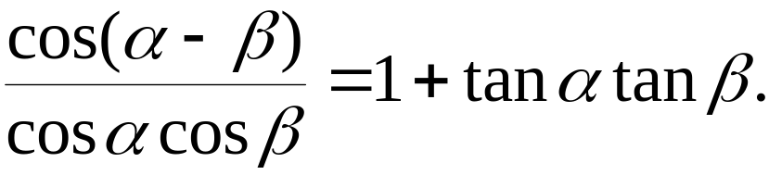
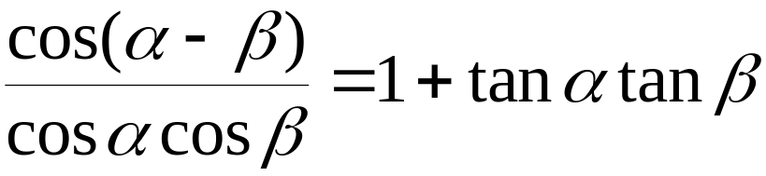
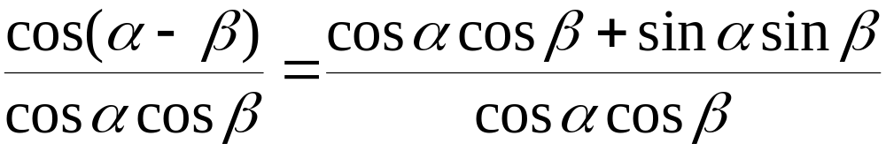
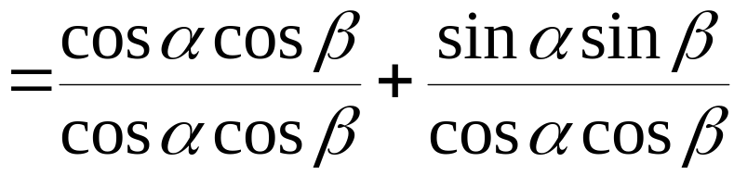
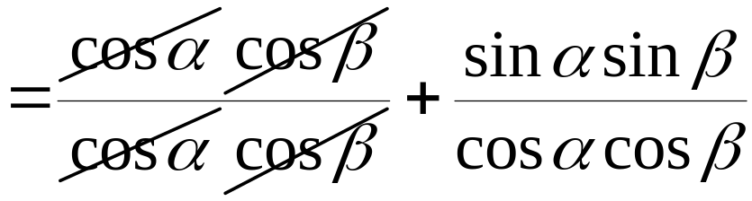
Example: Verifying an Identity
Verify the identity:
Divide by cos α cos β.

Slide 7
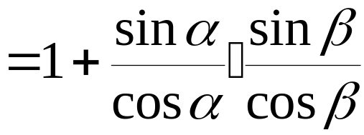

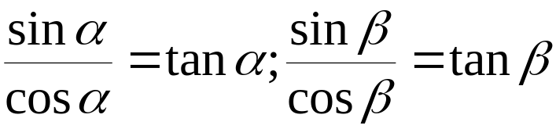
Example: Verifying an Identity (continued)
Verify the identity:
We have divided by cos α cos β and simplified.
The identity is verified.

Slide 8
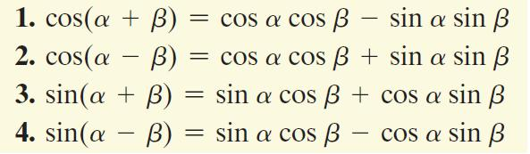
Sum and Difference Formulas for Cosines and Sines

Slide 9
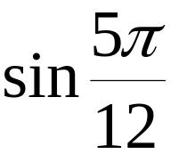
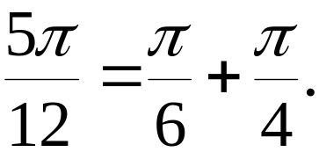
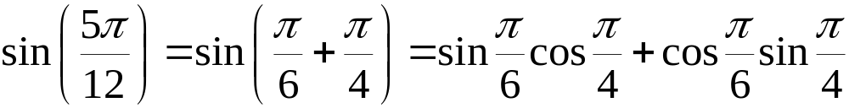
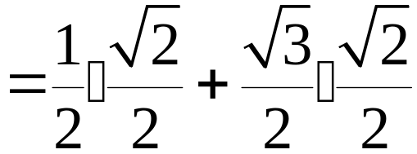
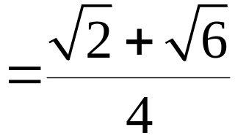
Example: Using the Sine of a Sum to Find an Exact Value
Find the exact value of using the fact that

Slide 10
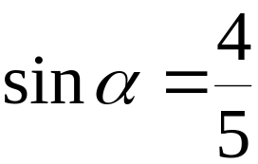

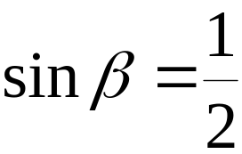




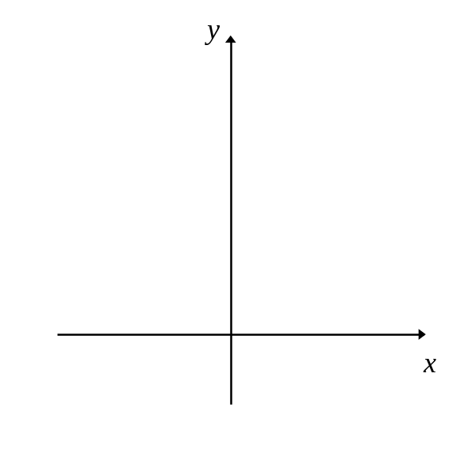
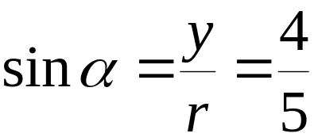






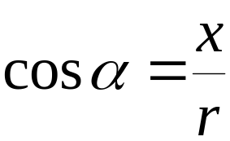
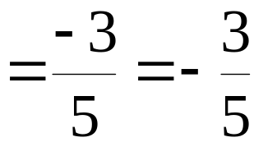

Example: Finding Exact Values
Suppose that for a quadrant II angle and
for a quadrant I angle Find the exact value of

Slide 11

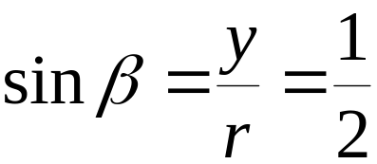






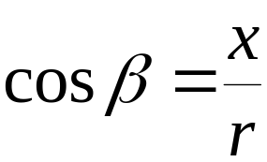
Example: Finding Exact Values (continued)
Suppose that for a quadrant II angle and
for a quadrant I angle Find the exact value of

Slide 12

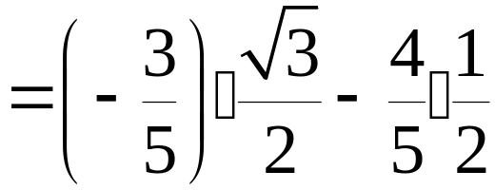
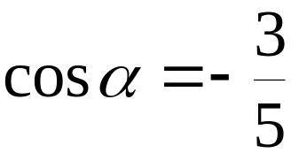
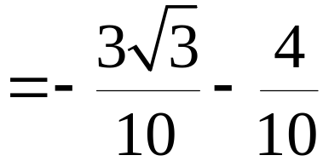
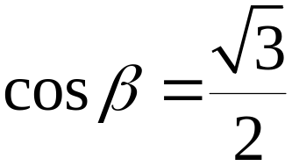
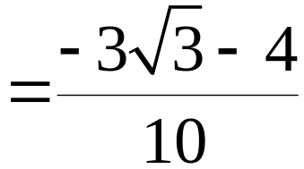
Example: Finding Exact Values (continued)
Suppose that for a quadrant II angle and
for a quadrant I angle Find the exact value
of
From our previous work:

Slide 13

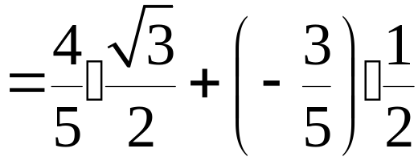
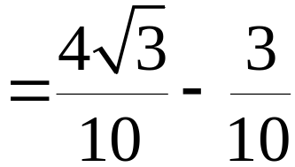
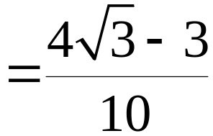
Example: Finding Exact Values (continued)
Suppose that for a quadrant II angle and
for a quadrant I angle Find the exact value
of
From our previous work:

Slide 14
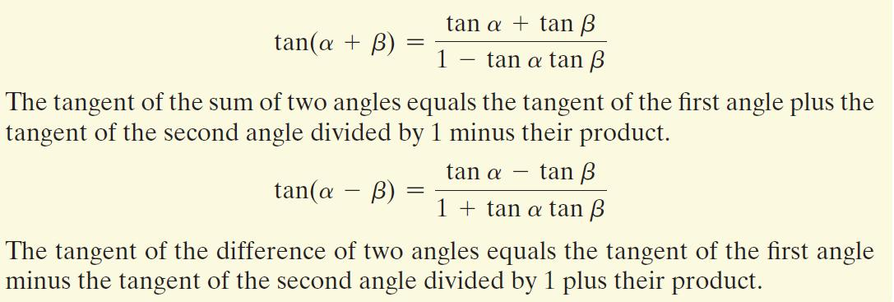
Sum and Difference Formulas for Tangets

Slide 15


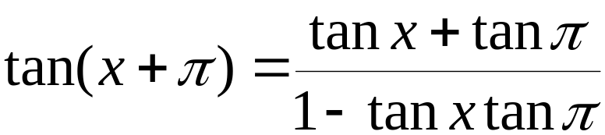
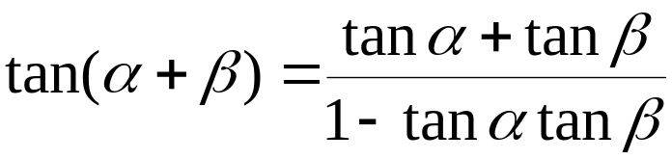
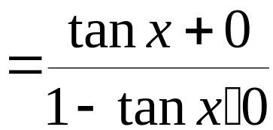

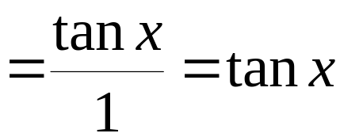
Example: Verifying an Identity
Verify the identity:
Simplify. The identity is verified.

