Slide 1

Chapter 6
Analytic Trigonometry
6.3 Double-Angle, Power-Reducing, and Half-Angle Formulas
Copyright © 2014, 2010, 2007 Pearson Education, Inc.

Slide 2
Objectives:
Use the double-angle formulas.
Use the power-reducing formulas.
Use the half-angle formulas.

Slide 3
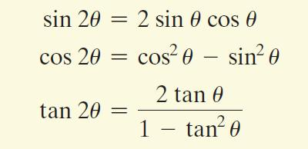
Double-Angle Formulas

Slide 4
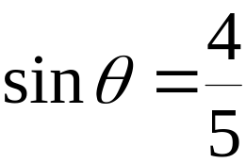



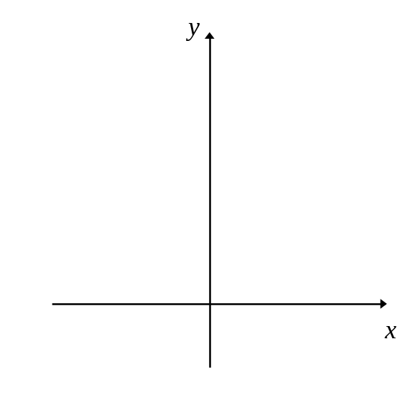

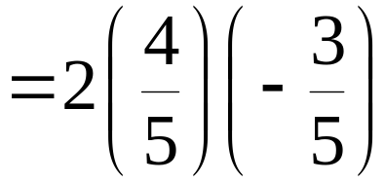




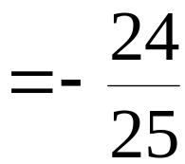




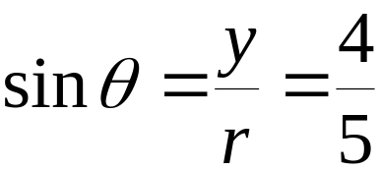
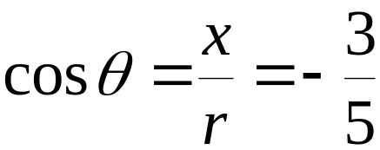
Example: Using Double-Angle Formulas to Find Exact Values
If and lies in quadrant II, find the exact value of

Slide 5


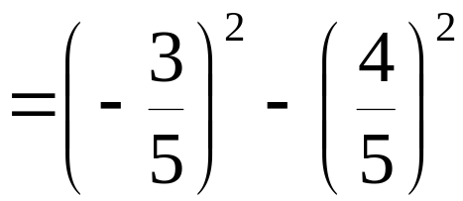
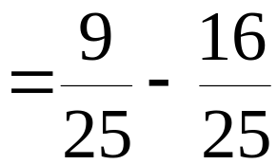
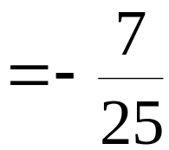
Example: Using Double-Angle Formulas to Find Exact Values (continued)
If and lies in quadrant II, find the exact value of

Slide 6

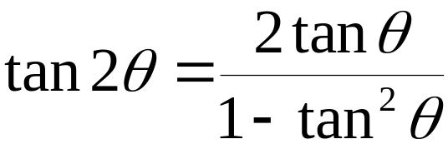
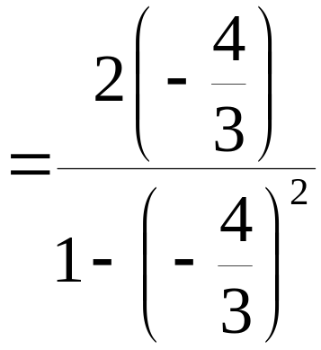
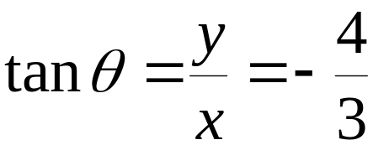
Example: Using Double-Angle Formulas to Find Exact Values (continued)
If and lies in quadrant II, find the exact value of

Slide 7
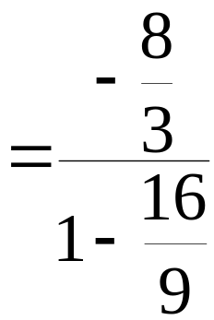
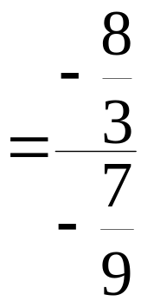
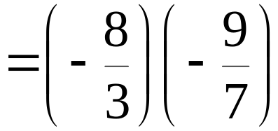
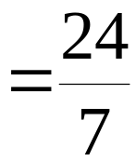
Example: Using Double-Angle Formulas to Find Exact Values (continued)
If and lies in quadrant II, find the exact value of

Slide 8

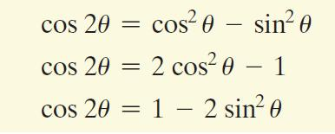
Three Forms of the Double-Angle Formula for

Slide 9



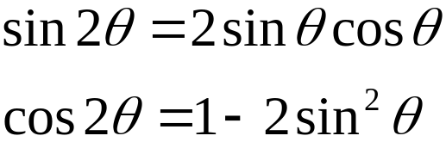
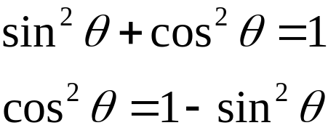
Example: Verifying an Identity
Verify the identity:
Multiply.

Slide 10

Example: Verifying an Identity (continued)
Verify the identity:
continued from
previous page
Multiply.
Simplify. The identity is verified.

Slide 11
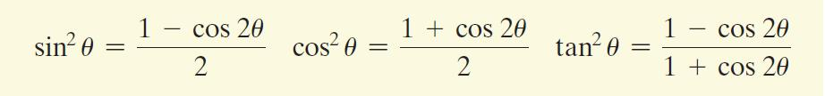
Power-Reducing Formulas

Slide 12
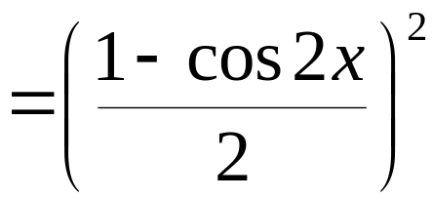
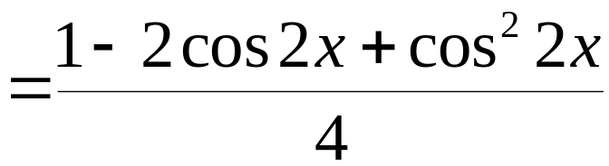
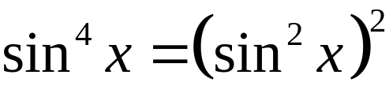
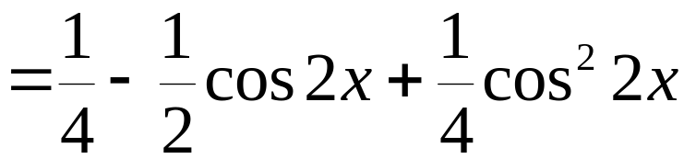
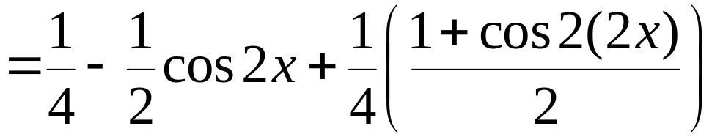
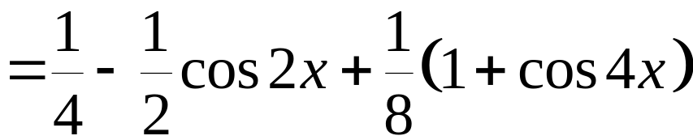
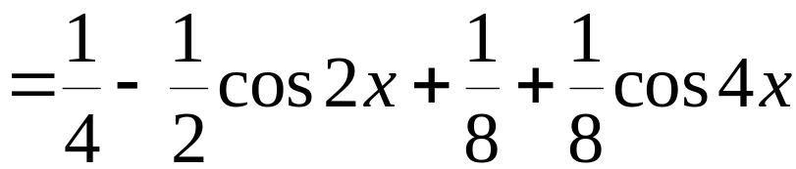
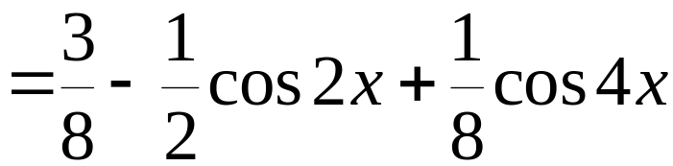
Example: Reducing the Power of a Trigonometric Function
Write an equivalent expression for sin⁴ x that does not contain powers of trigonometric functions greater than 1.

Slide 13
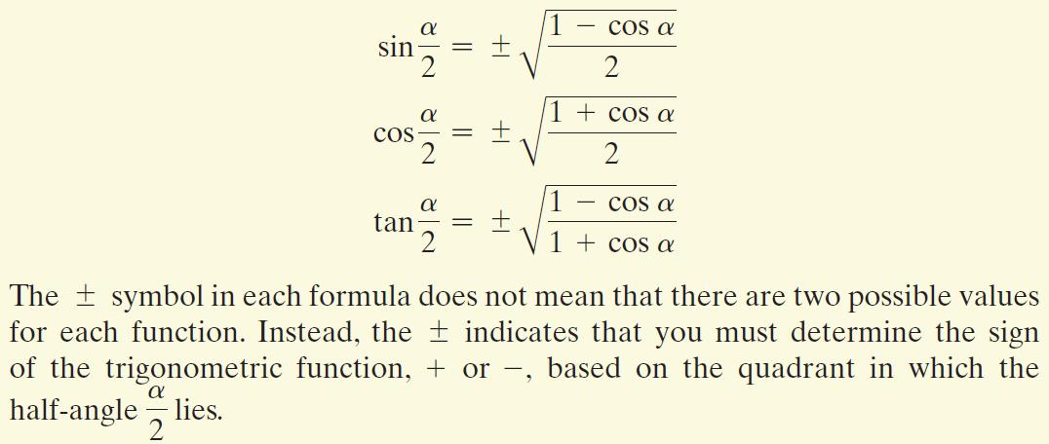
Half-Angle Formulas

Slide 14
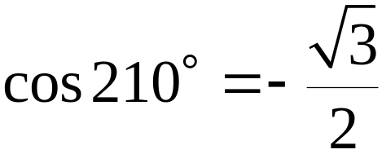
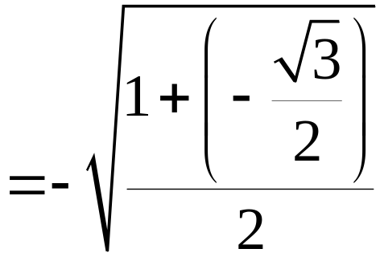
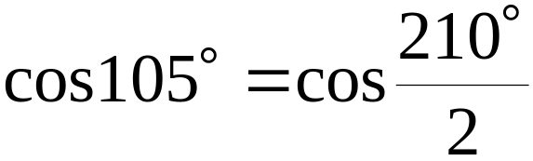
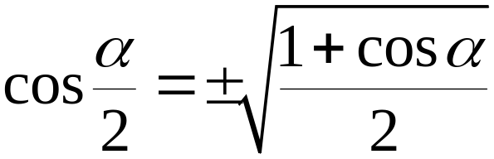
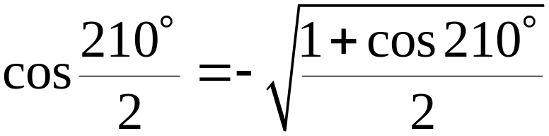
Example: Using the Half-Angle Formula to Find an Exact Value
Use to find the exact value of cos105°.

Slide 15
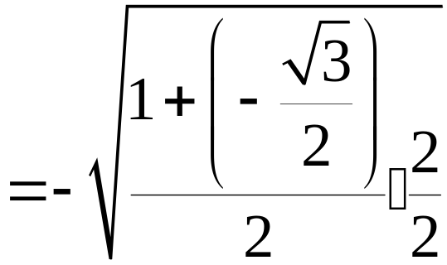
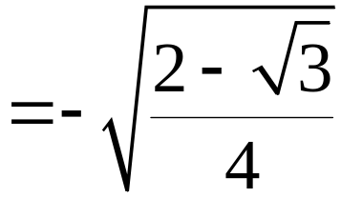
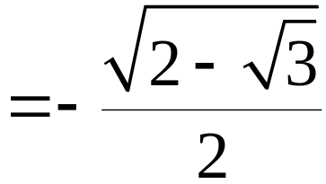
Example: Using the Half-Angle Formula to Find an Exact Value (continued)
Use to find the exact value of cos105°.

Slide 16
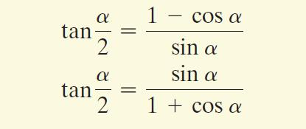
Half-Angle Formulas for Tangent

