Slide 1

Chapter 6
Analytic Trigonometry
6.4 Product-to-Sum and Sum-to-Product Formulas
Copyright © 2014, 2010, 2007 Pearson Education, Inc.

Slide 2
Objectives:
Use the product-to-sum formulas.
Use the sum-to-product formulas.

Slide 3
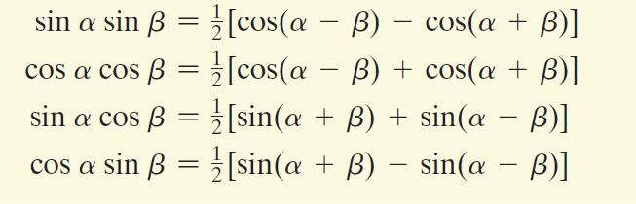
The Product-to-Sum Formulas

Slide 4

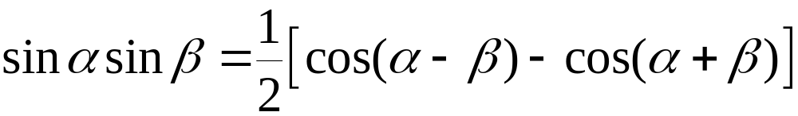
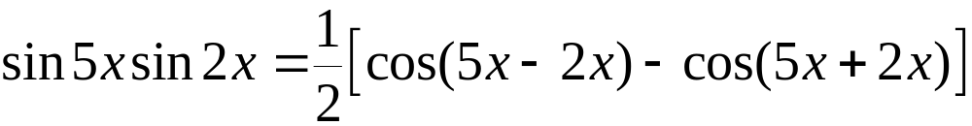
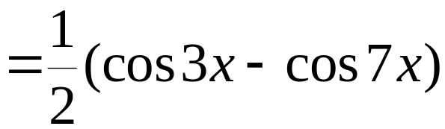
Example: Using the Product-to-Sum Formulas
Express the product as a sum or difference:

Slide 5

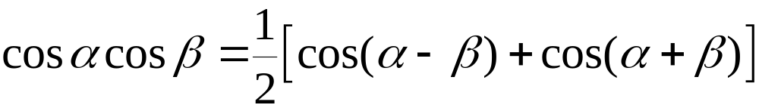
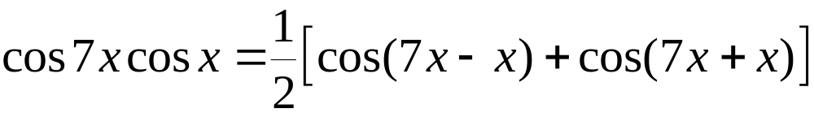
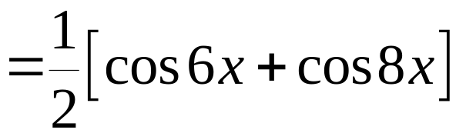
Example: Using the Product-to-Sum Formulas
Express the product as a sum or difference:

Slide 6
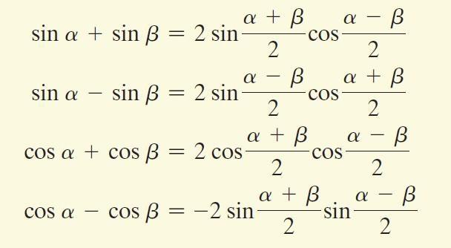
The Sum-to-Product Formulas

Slide 7

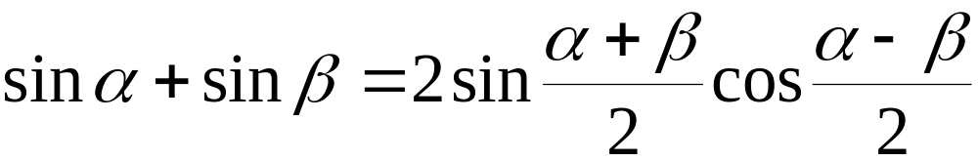
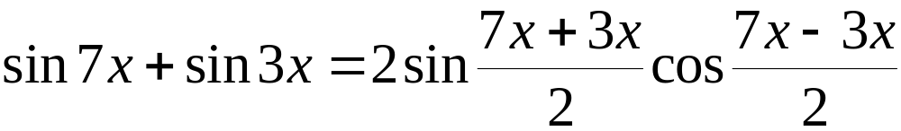

Example: Using the Sum-to-Product Formulas
Express the sum as a product:

Slide 8

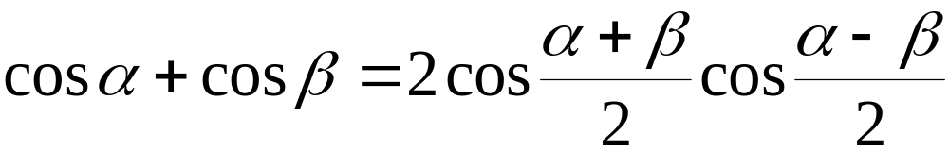
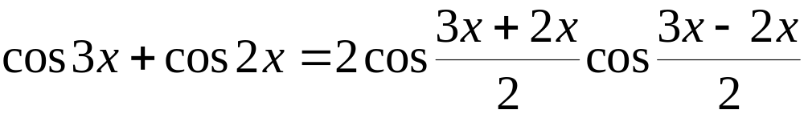
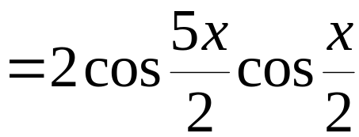
Example: Using the Sum-to-Product Formulas
Express the sum as a product:

