Slide 1

Chapter 6
Analytic Trigonometry
6.5 Trigonometric Equations
Copyright © 2014, 2010, 2007 Pearson Education, Inc.

Slide 2
Objectives:
Find all solutions of a trigonometric equation.
Solve equations with multiple angles.
Solve trigonometric equations quadratic in form.
Use factoring to separate different functions in trigonometric equations.
Use identities to solve trigonometric equations.
Use a calculator to solve trigonometric equations.

Slide 3
Trigonometric Equations and Their Solutions
A trigonometric equation is an equation that contains a trigonometric expression with a variable, such as sin x.
The values that satisfy such an equation are its solutions. (There are trigonometric equations that have no solution.)
When an equation includes multiple angles, the period of the function plays an important role in ensuring that we do not leave out any solutions.

Slide 4



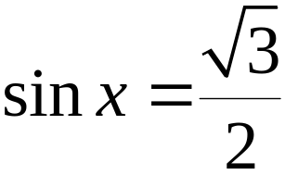
Example: Finding all Solutions of a Trigonometric Equation
Solve the equation:
Step 1 Isolate the function on one side of the equation.

Slide 5
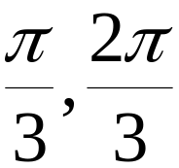

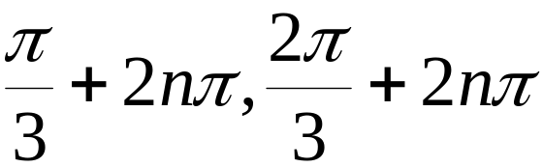
Example: Finding all Solutions of a Trigonometric Equation (continued)
Solve the equation:
Step 2 Solve for the variable.
Solutions for this equation in are:
The solutions for this equation are:

Slide 6

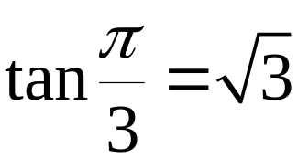

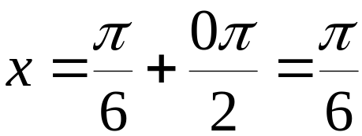
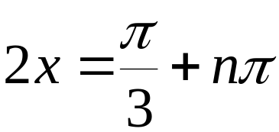

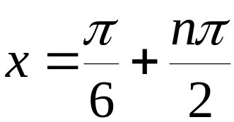
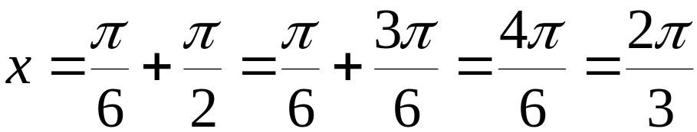

Example: Solving an Equation with a Multiple Angle
Solve the equation:
Because the period is all solutions for
this equation are given by

Slide 7
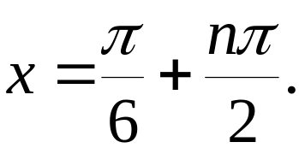
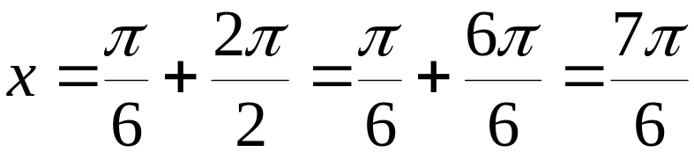

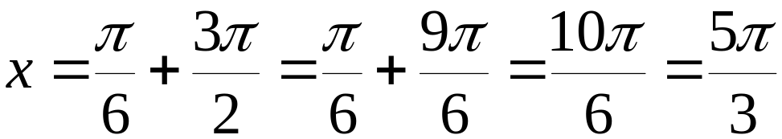

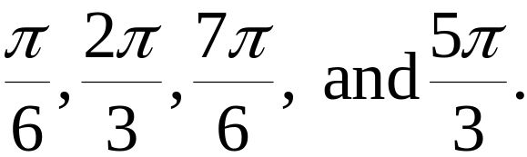
Example: Solving an Equation with a Multiple Angle
(continued)
Solve the equation:
Because the period is all solutions for this equation are
given by
In the interval , the solutions are:

Slide 8



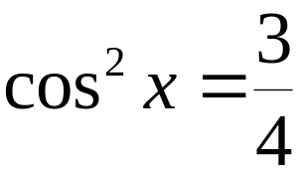
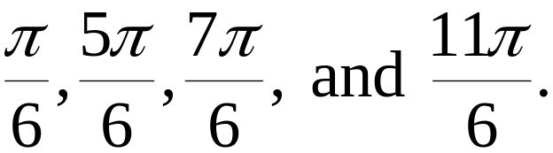
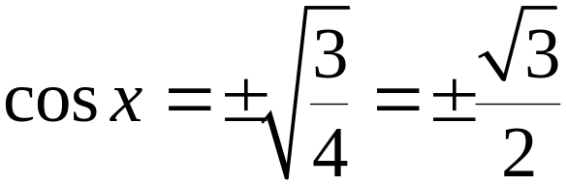
Example: Solving a Trigonometric Equation Quadratic in Form
Solve the equation:
The solutions in the interval
for this equation are:

Slide 9






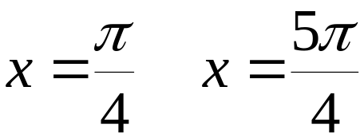

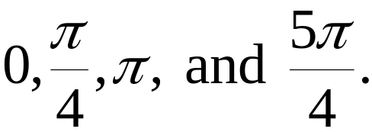
Example: Using Factoring to Separate Different Functions
Solve the equation:
The solutions for this equation in the interval are:

Slide 10




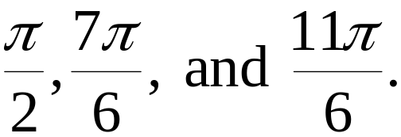



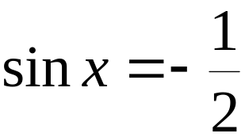

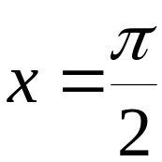
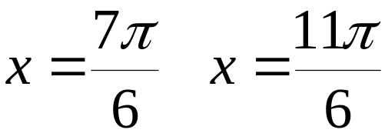
Example: Using an Identity to Solve a Trigonometric Equation
Solve the equation:
The solutions in the interval are

Slide 11






Example: Solving Trigonometric Equations with a Calculator
Solve the equation, correct to four decimal places, for
tanx is positive in quadrants I and III
In quadrant I
In quadrant III
The solutions for this equation are 1.2592 and 4.4008.

Slide 12

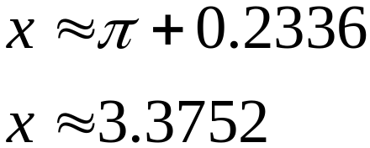


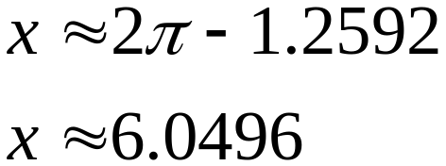
Example: Using a Calculator to Solve Trigonometric Equations
Solve the equation, correct to four decimal places, for
Sin x is negative in quadrants III and IV
In quadrant III
In quadrant IV
The solutions for this equation are 3.3752 and 6.0496.

