Slide 1

Chapter P
Prerequisites:
Fundamental Concepts of Algebra
P.6 Rational Expressions
Copyright © 2014, 2010, 2007 Pearson Education, Inc.

Slide 2
Objectives:
Specify numbers that must be excluded from the domain of a rational expression.
Simplify rational expressions.
Multiply rational expressions.
Divide rational expressions.
Add and subtract rational expressions.
Simplify complex rational expressions.

Slide 3
Rational Expressions
A rational expression is the quotient of two polynomials. The set of real numbers for which an algebraic expression is defined is the domain of the expression. Because rational expressions indicate division and division by zero is undefined, we must exclude numbers from a rational expression’s domain that make the denominator zero.

Slide 4
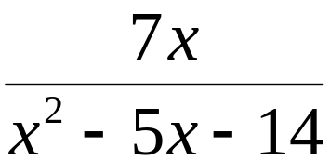



Example: Excluding Numbers from the Domain
Find all the numbers that must be excluded from the domain of the rational expression:
To determine the numbers that must be excluded from the domain, examine the denominator.
We set each factor equal to zero to find the excluded values.

Slide 5


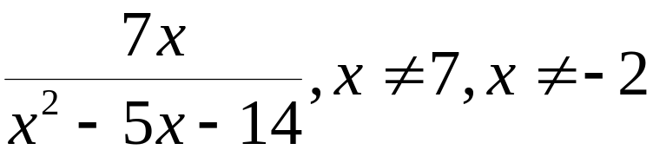
Example: Excluding Numbers from the Domain
(continued)
For the rational expression
the values that must be excluded from the domain are
and
These excluded numbers are often written to the right of a rational expression:

Slide 6
Simplifying Rational Expressions
A rational expression is simplified if its numerator and denominator have no common factors other than 1 or
–1. The following procedure can be used to simplify rational expressions:
1. Factor the numerator and the denominator
completely.
2. Divide both the numerator and the denominator by
any common factors.

Slide 7
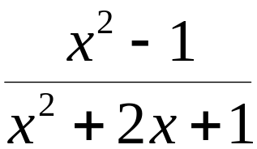
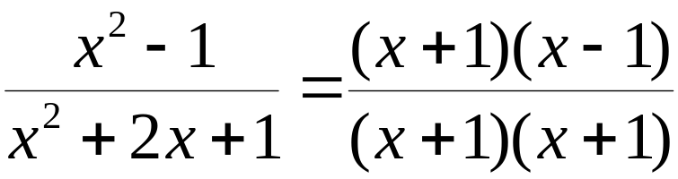

Example: Simplifying Rational Expressions
Simplify:
Factor the numerator and the denominator:
Check for excluded values.
Because the denominator is

Slide 8
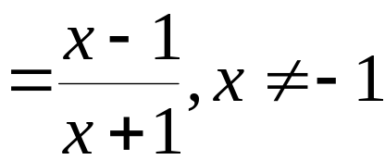
Example: Simplifying Rational Expressions
(continued)
We have factored the numerator and denominator:
Divide out the common factor, (x + 1)

Slide 9
Multiplying Rational Expressions
1. Factor all numerators and denominators completely.
2. Divide numerators and denominators by common factors.
3. Multiply the remaining factors in the numerators and multiply the remaining factors in the denominators.

Slide 10
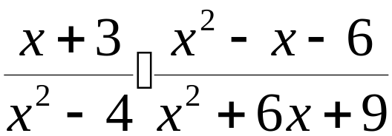
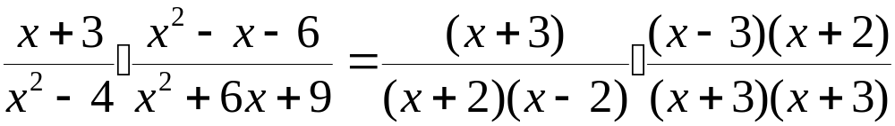
Example: Multiplying Rational Expressions
Multiply:
Factor the numerator and the denominator:
Check for excluded values.
Because the denominator is

Slide 11
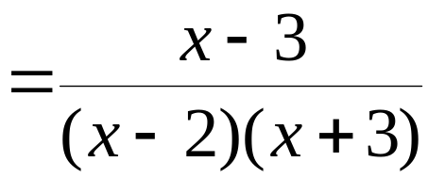
Example: Multiplying Rational Expressions
(continued)
Divide numerators and denominators by common factors:

Slide 12
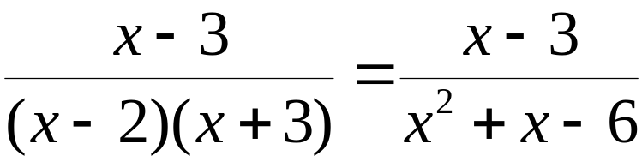
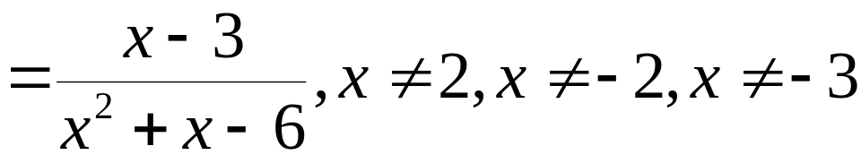
Example: Multiplying Rational Expressions
(continued)
Multiply the remaining factors in the numerators and denominators.
Thus,

Slide 13
Dividing Rational Expressions
The quotient of two rational expressions is the product of the first expression and the multiplicative inverse, or reciprocal, of the second expression. The reciprocal is found by interchanging the numerator and the denominator. Thus, we find the quotient of two rational expressions by inverting the divisor and multiplying.

Slide 14
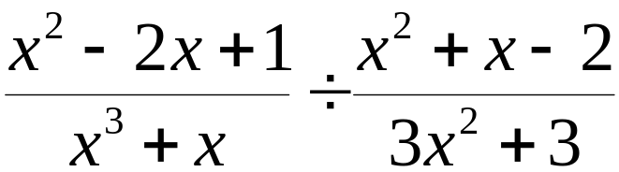
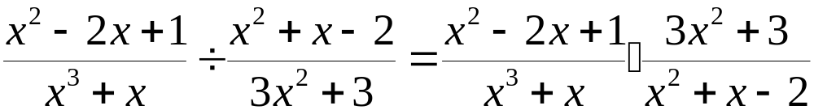
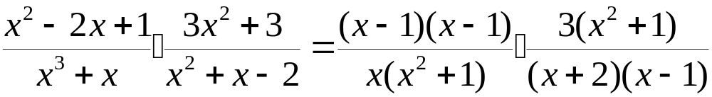
Example: Dividing Rational Expressions
Divide:
Invert the divisor and multiply.
Factor as many numerators and denominators as possible.

Slide 15
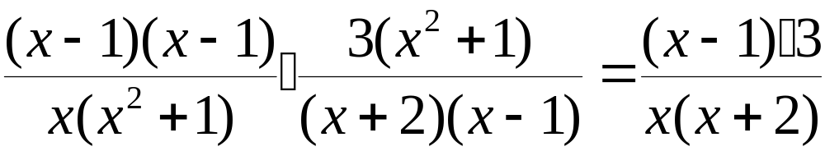
Example: Dividing Rational Expressions (continued)
Check for excluded values.
Because the denominator is
Divide numerators and denominators by common factors.

Slide 16
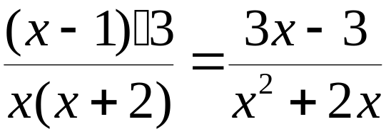
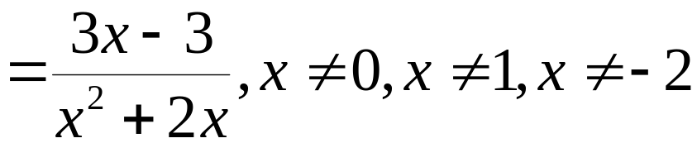
Example: Dividing Rational Expressions (continued)
Multiply the remaining factors in the numerators and in the denominators.
Thus,

Slide 17
Adding and Subtracting Rational Expressions with the Same Denominator
To add or subtract rational expressions with the same denominator:
1. Add or subtract the numerators.
2. Place this result over the common denominator.
3. Simplify, if possible.
Reminder: check for excluded values.

Slide 18
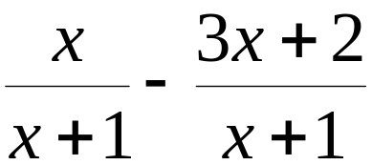

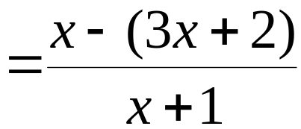
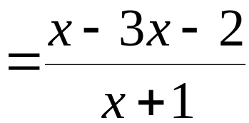
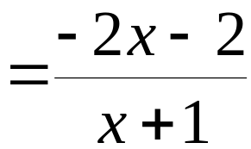
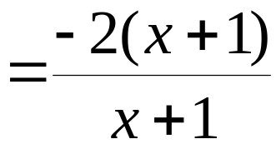

Example: Subtracting Rational Expressions with the Same Denominator
Subtract:
Check for excluded values:

Slide 19
Finding the Least Common Denominator (LCD)
1. Factor each denominator completely.
2. List the factors of the first denominator.
3. Add to the list in step 2 any factors of the second denominator that do not appear in the list.
4. Form the product of the factors from the list in step 3. This product is the least common denominator (LCD).

Slide 20
Adding and Subtracting Rational Expressions That Have Different Denominators
1. Find the LCD of the rational expressions.
2. Rewrite each rational expression as an equivalent expression whose denominator is the LCD. To do so, multiply the numerator and the denominator of each rational expression by any factor(s) needed to convert the denominator into the LCD.
3. Add or subtract numerators, placing the resulting expression over the LCD.
4. If possible, simplify the resulting rational expression.

Slide 21
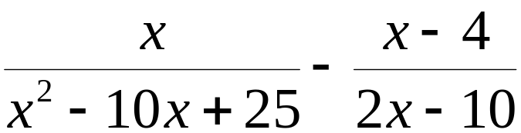



Example: Subtracting Rational Expressions with Different Denominators
Subtract:
Step 1 Find the least common denominator
The LCD is

Slide 22
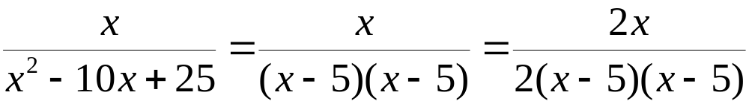
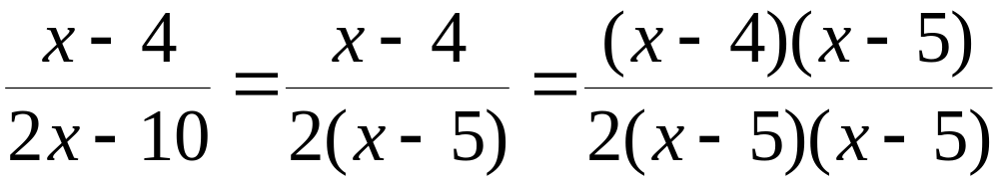
Example: Subtracting Rational Expressions with Different Denominators (continued)
Step 2 Write equivalent expressions with the LCD as denominators

Slide 23
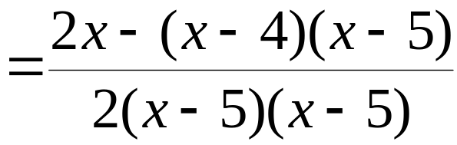
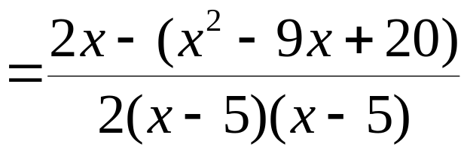
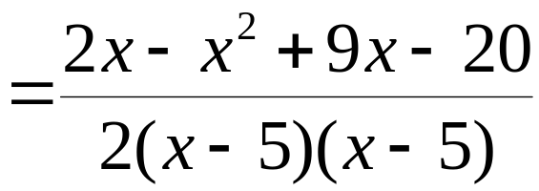
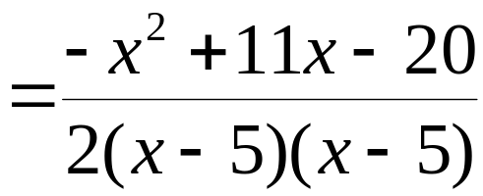
Example: Subtracting Rational Expressions with Different Denominators (continued)
Step 3 Subtract numerators, putting this difference over the LCD

Slide 24
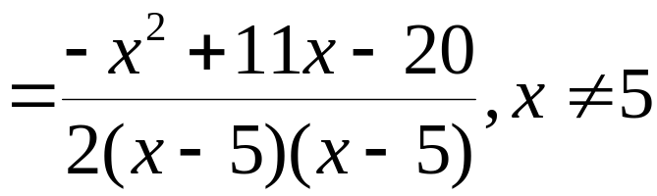
Example: Subtracting Rational Expressions with Different Denominators (continued)
Step 4 If necessary, simplify.
Because the numerator is prime, no further simplification is possible.

Slide 25
Complex Rational Expressions
Complex rational expressions, also called complex fractions, have numerators or denominators containing one or more rational expressions. A complex fraction must be simplified so that neither the numerator nor the denominator contains any rational expressions.

Slide 26
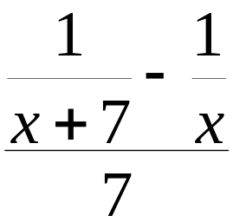

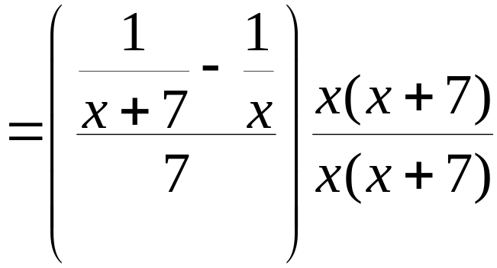
Example: Simplifying a Complex Rational Expression
Simplify
We will use the method of multiplying the numerator and the denominator by the least common denominator for all rational expressions. The least common denominator for all rational expressions is

Slide 27
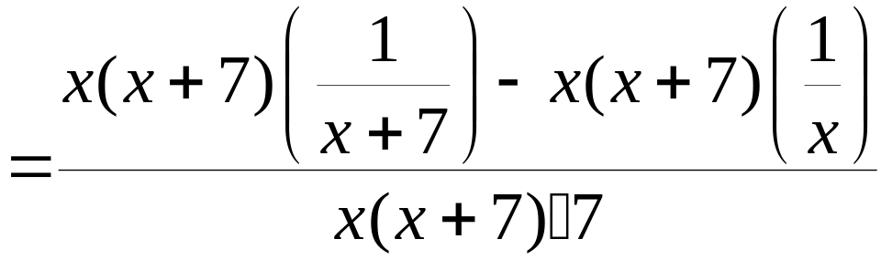
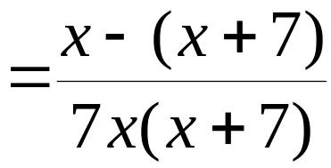
Example: Simplifying a Complex Rational Expression
(continued)
We continue the process of simplifying

Slide 28
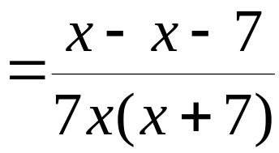
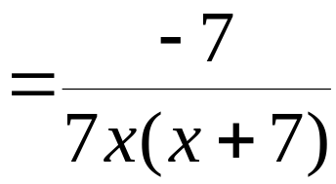
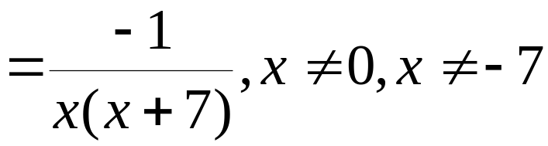
Example: Simplifying a Complex Rational Expression
(continued)
We continue the process of simplifying

