Slide 1
Chapter 3
Introduction to Logic

Slide 2
Chapter 3: Introduction to Logic
3.1 Statements and Quantifiers
3.2 Truth Tables and Equivalent Statements
3.3 The Conditional and Circuits
3.4 The Conditional and Related Statements
3.5 Analyzing Arguments with Euler Diagrams
3.6 Analyzing Arguments with Truth Tables

Slide 3
Section 3-1
Statements and Quantifiers

Slide 4
Statements and Qualifiers
Distinguish between statements and nonstatements.
Compose negations of statements.
Translate between words and symbols.
Interpret statements with quantifiers and form their negations.
Find truth values of statements involving quantifiers and number sets.

Slide 5
Statements
A statement is defined as a declarative sentence that is either true or false, but not both simultaneously.

Slide 6
Compound Statements
A compound statement may be formed by combining two or more statements. The statements making up the compound statement are called the component statements. Various connectives, such as and, or, not, and if…then, can be used in forming compound statements.

Slide 7
Example: Deciding Whether a Statement is Compound
Decide whether each statement is compound.
a) You can pay me now, or you can pay me later.
b) My pistol was made by Smith and Wesson.
Solution
a) The connective is or. The statement is compound.
b) This is not compound since and is part of a
manufacturer name and not a logical connective.

Slide 8
Negations
The sentence “Max has a valuable card” is a statement; the negation of this statement is “Max does not have a valuable card.” The negation of a true statement is false and the negation of a false statement is true.

Slide 9
Example: Forming Negations
Form the negation of each statement.
a. That city has a mayor.
b. The moon is not a planet.
Solution
a. That city does not have a mayor.
b. The moon is a planet.

Slide 10




Inequality Symbols
Use the following inequality symbols for the next example.
Symbolism | Meaning
 | a is less than b
 | a is greater than b
 | a is less than or equal to b
 | a is greater than or equal to b

Slide 11
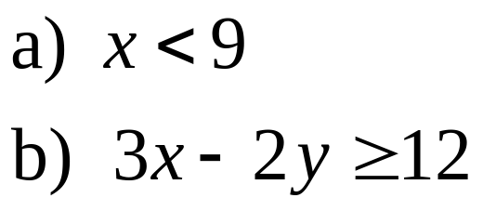

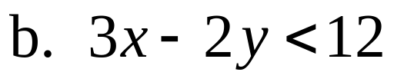
Example: Negating Inequalities
Give a negation of each inequality. Do not use a slash symbol.
Solution

Slide 12



Symbols
To simplify work with logic, we use symbols. Statements are represented with letters, such as p, q, or r, while several symbols for connectives are shown below.
Connective | Symbol | Type of Statement
and |  | Conjunction
or |  | Disjunction
not |  | Negation

Slide 13
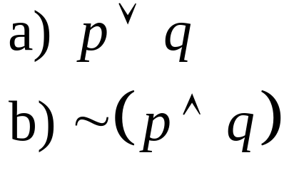
Example: Translating from Symbols to Words
Let p represent “It is raining,” and let q represent “It is March.” Write each symbolic statement in words.
Solution
a) It is raining or it is March.
b) It is not the case that it is raining and it is March.

Slide 14
Quantifiers
The words all, each, every, and no(ne) are called universal quantifiers, while words and phrases such as some, there exists, and (for) at least one are called existential quantifiers.
Quantifiers are used extensively in mathematics to indicate how many cases of a particular situation exist.

Slide 15
Negations of Quantified Statements
Statement | Negation
All do. | Some do not.
Some do. | None do.

Slide 16
Example: Forming Negations of Quantified Statements
Form the negation of each statement.
  Some cats have fleas.
  Some cats do not have fleas.
  No cats have fleas.
Solution
  No cats have fleas.
  All cats have fleas.
  Some cats have fleas.

Slide 17
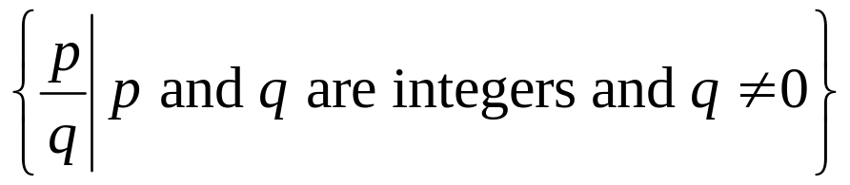
Sets of Numbers
Natural (counting) {1, 2, 3, 4, …}
Whole numbers {0, 1, 2, 3, 4, …}
Integers {…,–3, –2, –1, 0, 1, 2, 3, …}
Rational numbers
May be written as a terminating decimal, like 0.25, or a repeating decimal, like 0.333…
Irrational {x | x is not expressible as a quotient of integers} Decimal representations never terminate and never repeat.
Real numbers {x | x can be expressed as a decimal}

Slide 18
Example: Deciding Whether the Statements are True or False
Decide whether each of the following
statements about sets of numbers is true or false.
a. There exists a whole number that is not a
natural number.
b. Every integer is a natural number.
Solution
a. This is true (0 is it).
b. This is false; –1 is an integer and not a natural number.

