Slide 1
Chapter 3
Introduction to Logic

Slide 2
Chapter 3: Introduction to Logic
3.1 Statements and Quantifiers
3.2 Truth Tables and Equivalent Statements
3.3 The Conditional and Circuits
3.4 The Conditional and Related Statements
3.5 Analyzing Arguments with Euler Diagrams
3.6 Analyzing Arguments with Truth Tables

Slide 3
Section 3-2
Truth Tables and Equivalent Statements

Slide 4
Truth Tables and Equivalent Statements
Find the truth value of a conjunction.
Find the truth value of a disjunction.
Find the truth values for compound mathematical statements.
Construct truth tables for compound statements.
Understand and determine equivalence of statements.
Use De Morgan’s laws to find negations of compound statements.

Slide 5
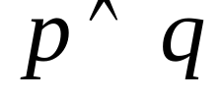
Conjunctions
The truth values of component statements are used to find the truth values of compound statements.
The truth values of the conjunction p and q, symbolized , are given in the truth table on the next slide. The connective and implies “both.”

Slide 6
Conjunction Truth Table
p and q
p q
T T | T
T F | F
F T | F
F F | F

Slide 7

Example: Finding the Truth Value of a Conjunction
Let p represent the statement 4 > 1 and q represent the statement 12 < 9. Find the truth value of
Solution
False, since q is false.

Slide 8

Disjunctions
The truth values of the disjunction p or q, symbolized , are given in the truth table on the next slide. The connective or implies “either.”

Slide 9
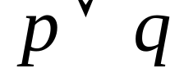
Disjunctions
p or q
p q
T T | T
T F | T
F T | T
F F | F

Slide 10

Example: Finding the Truth Value of a Disjunction
Let p represent the statement 4 > 1 and q represent the statement 12 < 9. Find the truth value of
Solution
True, since p is true.

Slide 11

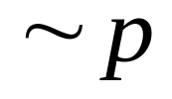
Negation
The truth values of the negation of p, symbolized
are given in the truth table below.
not p
p
T | F
F | T

Slide 12
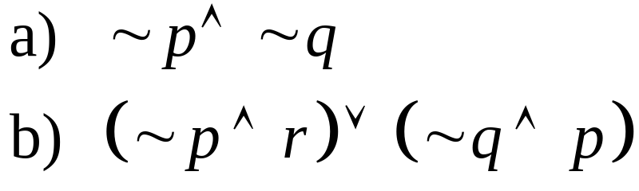
Example: Mathematical Statements
Let p represent the statement 4 > 1, q represent the statement 12 < 9, and r represent the statement 0 < 1. Decide whether each statement is true or false.
Solution
a) False, since ~ p is false.
b) True

Slide 13
Truth Tables
Use the following standard format for listing the possible truth values in compound statements involving two component statements.
p q | Compound Statement
T T
T F
F T
F F

Slide 14
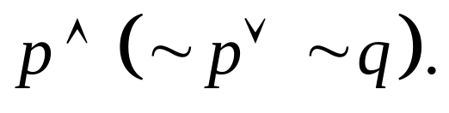
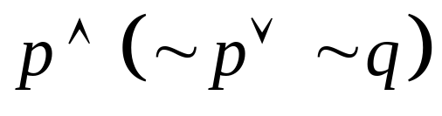

Example: Constructing a Truth Table
Construct the truth table for
Solution
p q | ~ p | ~ q
T T | F | F | F | F
T F | F | T | T | T
F T | T | F | T | F
F F | T | T | T | F

Slide 15
Number of Rows in a Truth Table
A logical statement having n component statements will have 2^{n} rows in its truth table.

Slide 16
Alternative Method for Constructing Truth Tables
After making several truth tables, some people prefer a shortcut method where not every step is written out.

Slide 17
Equivalent Statements
Two statements are equivalent if they have the same truth value in every possible situation.

Slide 18
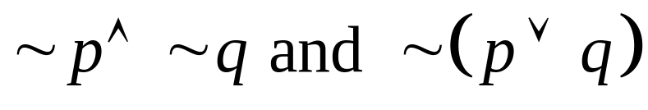
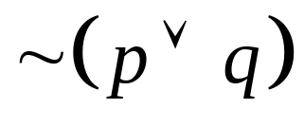

Example: Equivalent Statements
Are the following statements equivalent?
Solution
Yes, see the tables below.
p q
T T | F | F
T F | F | F
F T | F | F
F F | T | T

Slide 19
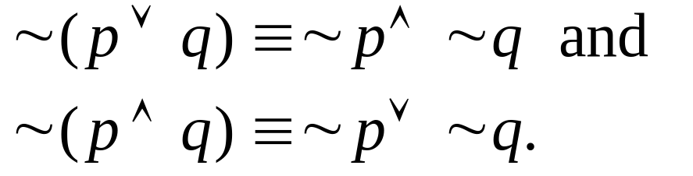
De Morgan’s Laws
For any statements p and q:

Slide 20
Example: Applying De Morgan’s Laws
Find a negation of each statement by applying
De Morgan’s Laws.
a) I got an A or I got a B.
b) She won’t try and he will succeed.
Solution
a) I didn’t get an A and I didn’t get a B.
b) She will try or he won’t succeed.

