Slide 1
Chapter 2
Introduction to Logic

Slide 2
Chapter 2: Introduction to Logic
2.1 Statements and Quantifiers
2.2 Truth Tables and Equivalent Statements
2.3 The Conditional and Circuits
2.4 The Conditional and Related Statements
2.5 Analyzing Arguments with Euler Diagrams
2.6 Analyzing Arguments with Truth Tables

Slide 3
Section 2-3
The Conditional and Circuits

Slide 4
The Conditional and Circuits
Understand the structure of the conditional statement.
Determine the truth values of conditional statements.
Express a conditional statement as a disjunction.
Express the negation of a conditional statement.
Use circuits to model conditional statements.

Slide 5

Conditionals
A conditional statement is a compound statement that uses the connective if…then.
The conditional is written with an arrow, so “if p then q” is symbolized:
We read the above as “p implies q” or “if p then q.” The statement p is the antecedent, while q is the consequent.

Slide 6
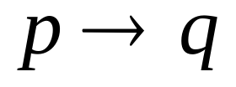
Truth Table for The Conditional: If p, then q
If p, then q
p q
T T | T
T F | F
F T | T
F F | T

Slide 7
Truth Table for The Conditional: (p→~q)→(~r→q)
(p→~q)→(~r→q)
(F→~F)→(~F→F) (F→T)→(T→F) T→F
F

Slide 8
Special Characteristics of Conditional Statements
is false only when the antecedent is true and the consequent is false.
If the antecedent is false, then is automatically true.
If the consequent is true, then is automatically true.

Slide 9
Example: Determining Whether Conditionals Are True or False
Decide whether each statement is True or False
(T represents a true statement, F a false statement).
Solution
a) False
b) True

Slide 10
Tautology
A statement that is always true, no matter what the truth values of the components, is called a tautology. They may be checked by forming truth tables.

Slide 11
Writing a Conditional as a Disjunction: “Or” Statement

Slide 12
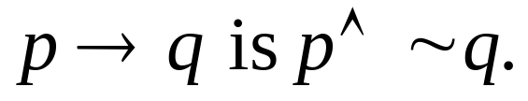
Negation of a Conditional
The negation of

Slide 13
Example: Determining Negations
Determine the negation of each statement.
a) If I’m hungry, I will eat.
b) All dogs have fleas.
Solution
a) I’m hungry and I will not eat.
b) Restate as an if…then:
If it is a dog, then it has fleas.
Negation: It is a dog and it does not have fleas.

Slide 14
Example: Determining Statements Equivalent to Conditionals
Write the conditional as an equivalent statement without using if . . . then.
If the Indians win the pennant, then Johnny will go to the World Series.
Solution
Let p represent “The Indians win the pennant” and q represent “Johnny will go to the World Series.
Restate: The Indians do not win the pennant or Johnny will go to the World Series.

Slide 15
Circuits
Logic can be used to design electrical circuits.
p
p
q
Series circuit
q
Parallel circuit

Slide 16
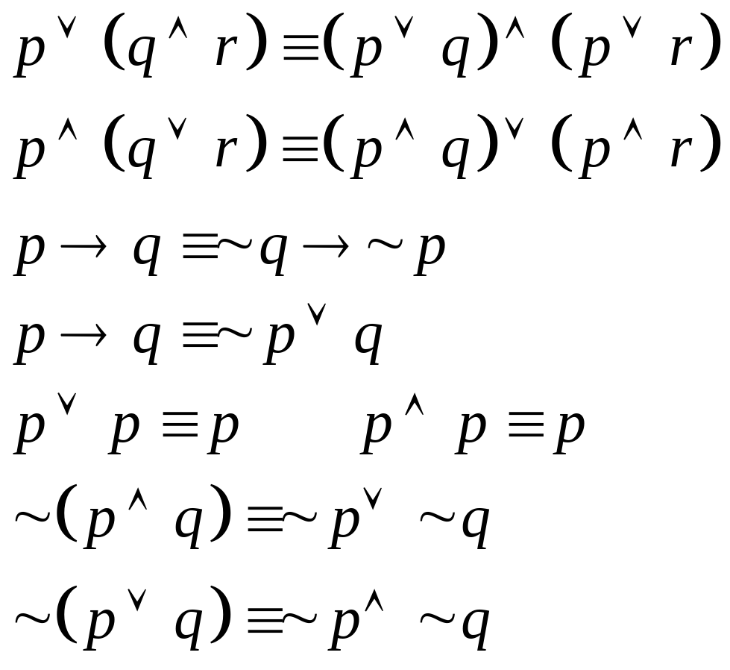
Equivalent Statements Used to Simplify Circuits

Slide 17
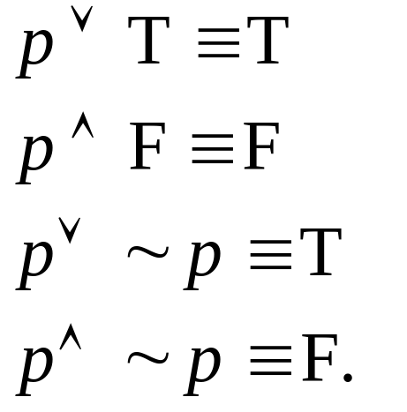
Equivalent Statements Used to Simplify Circuits
If T represents any true statement and F represents any false statement, then:

Slide 18
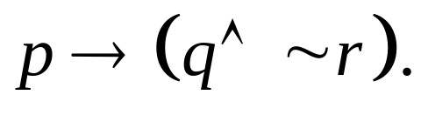
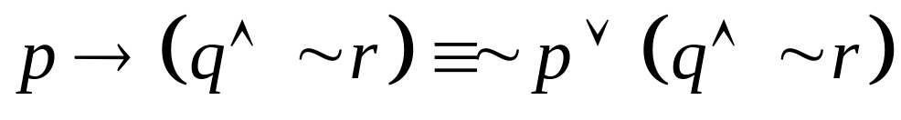
Example: Drawing a Circuit for a Conditional Statement
Draw a circuit for
Solution
~ p
q
~ r

Slide 19

Bellamy Brothers (1979)

