Slide 1
Chapter 3
Introduction to Logic

Slide 2
Chapter 3: Introduction to Logic
3.1 Statements and Quantifiers
3.2 Truth Tables and Equivalent Statements
3.3 The Conditional and Circuits
3.4 The Conditional and Related Statements
3.5 Analyzing Arguments with Euler Diagrams
3.6 Analyzing Arguments with Truth Tables

Slide 3
Section 3-4
The Conditional and Related Statements

Slide 4
The Conditional and Related Statements
Determine the converse, inverse, and contrapositive of a conditional statement.
Translate conditional statements into alternative forms.
Understand the structure of the biconditional.
Summarize the truth tables of compound statements.

Slide 5




Converse, Inverse, and Contrapositive
Conditional Statement |  | If p, then q
Converse |  | If q, then p
Inverse |  | If not p, then not q
Contrapositive |  | If not q, then not p

Slide 6
Example: Determining Related Conditional Statements
Determine each of the following, given the conditional statement:
If I am running, then I am moving.
a) the converse b) the inverse c) the contrapositive
Solution
a) If I am moving, then I am running.
b) If I am not running, then I am not moving.
c) If I am not moving, then I am not running.

Slide 7
Equivalences
A conditional statement and its contrapositive are equivalent. Also, the converse and the inverse are equivalent.

Slide 8

Alternative Forms of “If p, then q”
The conditional can be translated in any of the following ways.
If p, then q. p is sufficient for q.
If p, q. q is necessary for p.
p implies q. All p are q.
p only if q. q if p.

Slide 9
Example: Rewording Conditional Statements
Rewrite each statement in the form “If p, then q.”
a) You’ll get sick if you eat that.
b) You go to the doctor only if your temperature exceeds 101 degrees F.
c) Everyone at the game had a great time.
Solution
a) If you eat that, then you’ll get sick.
b) If you go to the doctor, then your temperature exceeds 101 degrees F.
c) If you were at the game, then you had a great time.

Slide 10
Example: Translating from Words to Symbols
Let p represent “A triangle is equilateral,” and let q represent “A triangle has three sides of equal length.” Write each of the following in symbols.
(a) A triangle is equilateral if it has three sides of equal length.
(b) A triangle is equilateral only if it has three sides of equal length.

Slide 11


Example: Translating from Words to Symbols
Solution
(a) A triangle is equilateral if it has three sides of equal length.
(b) A triangle is equilateral only if it has three sides of equal length.

Slide 12

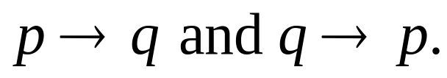
Biconditionals
The compound statement p if and only if q (often abbreviated p iff q) is called a biconditional. It is symbolized , and is interpreted as the conjunction of the two conditionals

Slide 13
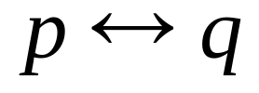
Truth Table for the Biconditional
p if and only if q
p q
T T | T
T F | F
F T | F
F F | T

Slide 14
Example: Determining Whether Biconditionals are True or False
Determine whether each biconditional statement is true or false.
a) 6 + 8 = 14 if and only if 11 + 5 = 16.
b) 6 = 5 if and only if 12 ≠ 12.
c) Mars is a moon if and only if Jupiter is a planet.
Solution
a) True (both component statements are true)
b) True (both components are false)
c) False (first component is false, second is true, making statement false)

Slide 15
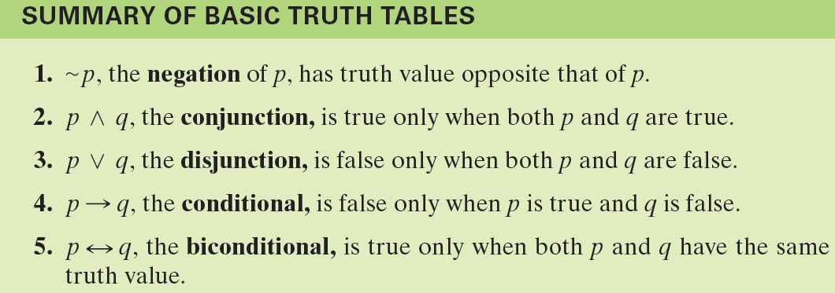
Summary of Truth Tables

