Slide 1
Chapter 3
Introduction to Logic

Slide 2
Chapter 3: Introduction to Logic
3.1 Statements and Quantifiers
3.2 Truth Tables and Equivalent Statements
3.3 The Conditional and Circuits
3.4 The Conditional and Related Statements
3.5 Analyzing Arguments with Euler Diagrams
3.6 Analyzing Arguments with Truth Tables

Slide 3
Section 3-5
Analyzing Arguments with
Euler Diagrams

Slide 4
Analyzing Arguments with Euler Diagrams
Define logical arguments.
Use Euler diagrams to analyze arguments with universal quantifiers.
Use Euler diagrams to analyze arguments with existential quantifiers.

Slide 5
Logical Arguments
A logical argument is made up of premises (assumptions, laws, rules, widely held ideas, or observations) and a conclusion. Together, the premises and the conclusion make up the argument.

Slide 6
Valid and Invalid Arguments
An argument is valid if the fact that all the premises are true forces the conclusion to be true. An argument that is not valid is invalid. It is called a fallacy.

Slide 7
Arguments with Universal Quantifiers
Several techniques can be used to check the validity of an argument. One of these is a visual technique based on Euler Diagrams.

Slide 8
Example: Using an Euler Diagram to Determine Validity (Universal Quantifier)
Is the following argument valid?
All rainy days are cloudy.
Today is not cloudy.
Today is not rainy.

Slide 9
Example: Using an Euler Diagram to Determine Validity (Universal Quantifier)
All rainy days are cloudy.
Today is not cloudy.
Today is not rainy.
Today
Solution
“Rainy days” is inside “Cloudy”. The diagram shows that “Today” is not cloudy and, therefore, not rainy. The argument is valid.
Cloudy
Rainy days

Slide 10
Example: Using an Euler Diagram to Determine Validity
Is the following argument valid?
All magnolia trees have green leaves.
That plant has green leaves.
That plant is a magnolia tree.

Slide 11
Example: Using an Euler Diagram to Determine Validity
All magnolia trees have green leaves.
That plant has green leaves.
That plant is a magnolia tree.
Solution
The x can go either inside or outside the region for “Magnolia trees”. The argument is invalid. It is a fallacy.
Things with green leaves
Magnolia trees x?
x?
x represents “that plant”

Slide 12
Example: Using an Euler Diagram to Determine Validity
Is the following argument valid?
All expensive things are desirable.
All desirable things make you feel good.
All things that make you feel good make you live longer.
All expensive things make you live longer.

Slide 13
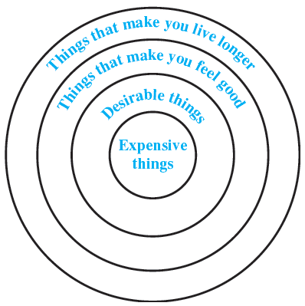
Example: Using an Euler Diagram to Determine Validity
All expensive things are desirable.
All desirable things make you feel good.
All things that make you feel good make you live longer.
All expensive things make you live longer.
Solution
If each premise is true, then the conclusion must be true because the region for “expensive things” lies completely within the region for “things that make you live longer.” Thus, the argument is valid.

Slide 14
Example: Using an Euler Diagram to Determine Validity (Existential Quantifier)
Is the following argument valid?
Many students drive Hondas.
I am a student .
I drive a Honda.

Slide 15
Example: Using an Euler Diagram to Determine Validity (Existential Quantifier)
Many students drive Hondas.
I am a student .
I drive a Honda.
Solution
The diagram shows that “I” can be inside the region for “Drive Hondas” or outside it. The argument is invalid.
People who drive Hondas
I ?
Students
I ?

