Slide 1
Chapter 3
Introduction to Logic

Slide 2
Chapter 3: Introduction to Logic
3.1 Statements and Quantifiers
3.2 Truth Tables and Equivalent Statements
3.3 The Conditional and Circuits
3.4 The Conditional and Related Statements
3.5 Analyzing Arguments with Euler Diagrams
3.6 Analyzing Arguments with Truth Tables

Slide 3
Section 3-6
Analyzing Arguments with Truth Tables

Slide 4
Analyzing Arguments with Truth Tables
Use truth tables to determine validity of arguments.
Recognize valid and invalid argument forms.
Be familiar with the arguments of Lewis Carroll.

Slide 5
Truth Tables
In section 3.5, Euler diagrams were used to test the validity of arguments. These work well with simple arguments, but may not work well with more complex ones. If the words “all,” “some,” or “no” are not present, it may be better to use a truth table than an Euler diagram to test validity.

Slide 6
Testing the Validity of an Argument with a Truth Table
Step 1 Assign a letter to represent each component statement in the argument.
Step 2 Express each premise and the conclusion symbolically.
Continued on the next slide…

Slide 7
Testing the Validity of an Argument with a Truth Table
Step 3 Form the symbolic statement of the entire
argument by writing the conjunction of all the premises as the antecedent of a conditional statement, and the conclusion of the argument as the consequent.
Step 4 Complete the truth table for the conditional statement formed in Step 3. If it is a tautology, then the argument is valid; otherwise, it is invalid.

Slide 8
Example: Using a Truth Table to Determine Validity
Is the following argument valid or invalid?
If there is a problem, then I must fix it.
There is a problem.
I must fix it.

Slide 9
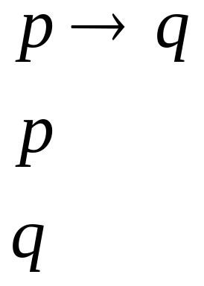
Example: Truth Tables (Two Premises)
If there is a problem, then I must fix it.
There is a problem.
I must fix it.
Solution
Let p represent “There is a problem” and q represent “I must fix it.”

Slide 10
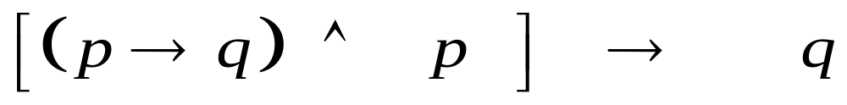
Example: Truth Tables (Two Premises)
Premise and premise implies conclusion
The truth table is on the next slide.

Slide 11
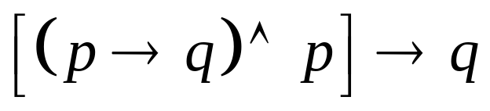
Example: Truth Tables (Two Premises)
The truth table below shows that the argument is valid.
p q
T T | T
T F | T
F T | T
F F | T

Slide 12
Example: Using a Truth Table to Determine Validity
Is the following argument valid or invalid?
If I can avoid sweets, I can avoid the dentist.
I can’t avoid the dentist.
I can’t avoid sweets.

Slide 13
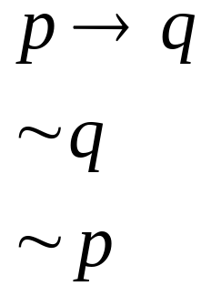
Example: Truth Tables (Two Premises)
If I can avoid sweets, I can avoid the dentist.
I can’t avoid the dentist.
I can’t avoid sweets.
Solution
Let p represent “I can avoid sweets” and q represent “I can avoid the dentist.”

Slide 14
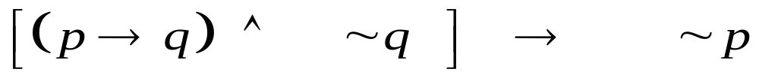
Example: Truth Tables (Two Premises)
Premise and premise implies conclusion
The truth table is on the next slide.

Slide 15
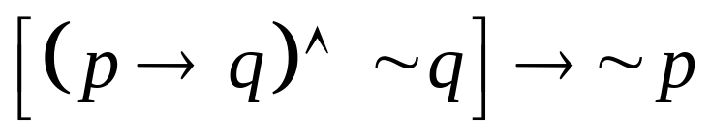
Example: Truth Tables (Two Premises)
The truth table below shows that the argument is valid.
p q
T T | T
T F | T
F T | T
F F | T

Slide 16
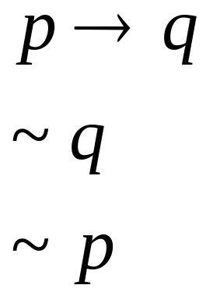
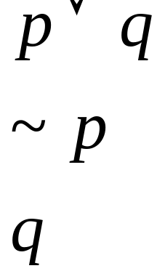
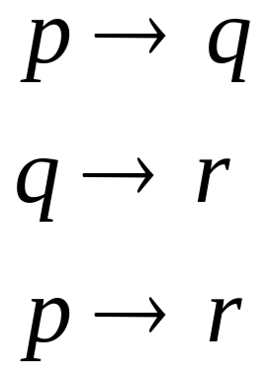
Valid Argument Forms
Modus Ponens | Modus Tollens | Disjunctive Syllogism | Reasoning by Transitivity

Slide 17
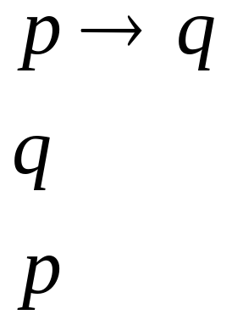
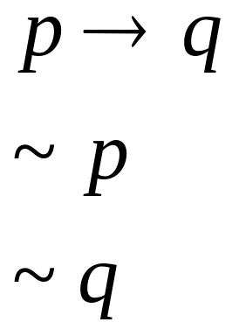
Invalid Argument Forms (Fallacies)
Fallacy of the Converse | Fallacy of the Inverse

Slide 18
Example: Truth Tables (More Than Two Premises)
Determine whether the argument is valid or invalid.
If Eddie goes to town, then Mabel stays at home. If Mabel does not stay at home, then Rita will cook. Rita will not cook. Therefore, Eddie does not go to town.
Solution
Let p represent “Eddie goes to town,” let q represent “Mabel stays at home,” and let r represent “Rita will cook.”

Slide 19
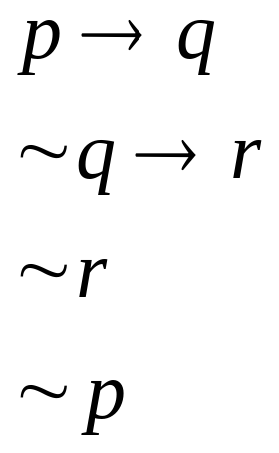
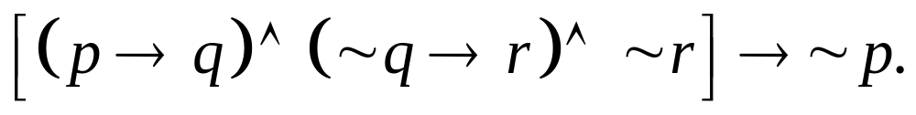
Example: Truth Tables (More Than Two Premises)
So we have
This leads to the statement
The truth table is on the next slide.

Slide 20
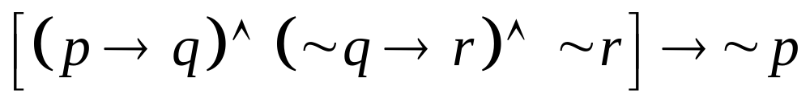
Example: Truth Tables (More Than Two Premises)
p q r
T T T | T
T T F | F
T F T | T
T F F | T
F T T | T
F T F | T
F F T | T
F F F | T

Slide 21
Example: Truth Tables (More Than Two Premises)
Because the final column does not contain all Ts, the statement is not a tautology and the argument is invalid.

Slide 22
Example: Arguments of Lewis Carroll
Supply a conclusion that yields a valid argument for the following premises.
Babies are illogical.
Nobody is despised who can manage a crocodile.
Illogical persons are despised.
Let p be “you are a baby,” let q be “you are logical,” let r be “you can manage a crocodile,” and let s be “you are despised.”

Slide 23
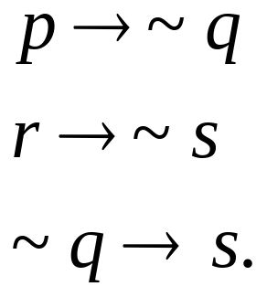
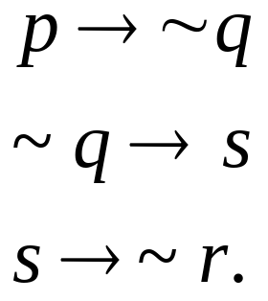
Example: Arguments of Lewis Carroll
With these letters, the statements can be written symbolically as:
Beginning with p and using a contrapositive we can get:

Slide 24

Example: Arguments of Lewis Carroll
Repeated use of reasoning by transitivity gives the conclusion:
leading to a valid argument.
In words, the conclusion is “If you are a baby, then you cannot manage a crocodile.”

