Slide 1
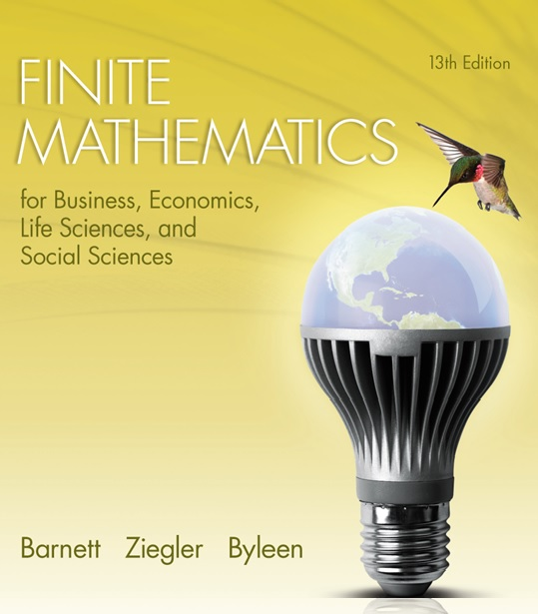
Chapter 7
Logic, Sets, and Counting
Section 2
Sets

Slide 2
Learning Objectives for Section 7.2
Sets
The student will be able to identify and use set properties and set notation.
The student will be able to perform set operations.
The student will be able to solve applications involving sets.

Slide 3
7.2 Sets
This section will discuss the symbolism and concepts of set theory.

Slide 4
Set Properties and Set Notation
Definition: A set is any collection of objects specified in such a way that we can determine whether a given object is or is not in the collection.
Notation:
e ∈ A
means “e is an element of A”, or “e belongs to set A”.
The notation
e ∉ A
means “e is not an element of A”.

Slide 5
Set Properties and Set Notation
(continued)
Example. A is the set of all the letters in the alphabet.
We write that as
A = { a, b, c, d, e, …, z}.
We use capital letters to represent sets. We list the elements of the set within braces. The three dots … indicate that the pattern continues. This is called the roster method of specifying the set.
A is a set because we can determine whether an object is or is not in the collection. For example, 3 ∉ A.

Slide 6
Null Set
Example. What are the real number solutions of the equation
x² + 1 = 0?

Slide 7
Null Set
Example. What are the real number solutions of the equation
x² + 1 = 0?
Solution: There are no real number solutions of this equation since no real number squared added to one can ever equal 0. We represent the solution as the null set, written { } or ∅.

Slide 8
Set Builder Notation
Sometimes it is convenient to represent sets using set builder notation. For example, instead of representing the set A (letters in the alphabet) by the roster method, we can use
A = {x | x is a letter of the English alphabet}
which means the same as A = {a , b, c, d, e, …, z}
Example.
{x | x² = 9} = {3, -3}
This is read as “the set of all x such that the square of x equals 9.” This set consists of the two numbers 3 and -3.

Slide 9
Subsets
A is a subset of B if every element of A is also contained in B. This is written
A ⊂ B.
For example, the set of integers
{ … –3, –2, –1, 0, 1, 2, 3, …}
is a subset of the set of real numbers.
Formal Definition:
A ⊂ B means “if x ∈ A, then x ∈ B.”

Slide 10
Subsets
(continued)
Claim: Ø (the null set) is a subset of every set.
To verify this statement, pick an arbitrary set A, and apply the definition of subset:
If x ∈ ∅, then x ∈ A.
Since the null set contains no elements, the statement x ∈ ∅
is false. We know that p → q is true if p is false. Since p is false, we conclude that the conditional statement is true. Therefore, the null set is a subset of every set.

Slide 11
Number of Subsets
Example: List all the subsets of set A = {bird, cat, dog} For convenience, we will use the notation A = {b, c, d} to represent set A.

Slide 12
Number of Subsets
Example: List all the subsets of set A = {bird, cat, dog} For convenience, we will use the notation A = {b, c, d} to represent set A.
Solution: Ø is a subset of A. We also know that every set is a subset of itself, so A = {b, c, d} is a subset of set A.
What two-element subsets are there? {b, c}, {b, d}, {c, d}
What one-element subsets? {b}, {c} and {d} .
There are a total of 8 subsets of set A.

Slide 13
Union of Sets
The union of two sets A and B is the set of all elements formed by combining all the elements of set A and all the elements of set B into one set. It is written A ∪ B.
A ∪ B = { x | x ∈A or x ∈B }.
A
B
In the Venn diagram on the left, the union of A and B is the entire region shaded.

Slide 14

Example of Union
The union of the rational numbers with the set of irrational numbers is the set of real numbers. Rational numbers are those numbers that can be expressed as fractions, while irrational numbers are numbers that cannot be represented exactly as fractions, such as .
Irrational numbers such as square root of two, pi , square root of 3
Rational numbers, such as ¾, 2/3 , 0.6
Real numbers: represented by entire shaded region

Slide 15
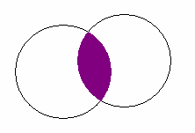
Intersection of Sets
The intersection of two sets A and B is the set of all elements that are common to both A and B. It is written A ∩ B.
A ∩ B = { x | x ∈A and x ∈B }.
A
B
In the Venn diagram on the left, the intersection of A and B is the shaded region.

Slide 16
Disjoint Sets
If two sets have no elements in common, they are said to be disjoint. Two sets A and B are disjoint if
A ∩ B = ∅.
Example: The rational and irrational numbers are disjoint.

Slide 17
The Universal Set
The set of all elements under consideration is called the universal set U.
For example, when discussing numbers, the universal set may consist of the set of real numbers. All other types of numbers (integers, rational numbers, irrational numbers ) are subsets of the universal set of real numbers.

Slide 18
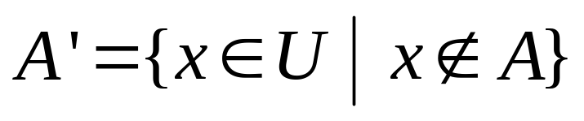
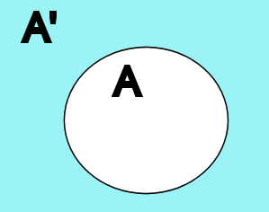
The Complement of a Set
The complement of a set A is defined as the set of elements that are contained in U, the universal set, but not contained in set A. The symbolism and notation for the complement of set A are
In the Venn diagram on the left, the rectangle represents the universe. A′ is the shaded area outside the set A.

Slide 19
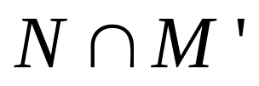
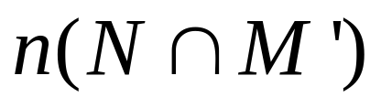
Application
A marketing survey of 1,000 commuters found that 600 answered listen to the news, 500 listen to music, and 300 listen to both. Let N = set of commuters in the sample who listen to news and M = set of commuters in the sample who listen to music. Find the number of commuters in the set
The number of elements in a set A is denoted by n(A), so in this case we are looking for

Slide 20
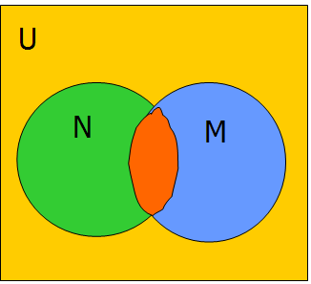
Solution
The study is based on 1000 commuters, so n(U)=1000.
The number of elements in the four sections in the Venn diagram need to add up to 1000.
The red part represents the commuters who listen to both news and music. It has 300 elements.
The set N (news listeners) consists of a green part and a red part. N has 600 elements, the red part has 300, so the green part must also be 300.
Continue in this fashion.

Slide 21
Solution
(continued)
U
200 people listen to neither news nor music
is the green part, which contains 300 commuters.
N
M
300 listen to news but not music.
200 listen to music but not news
300 listen to both music and news

