Slide 1
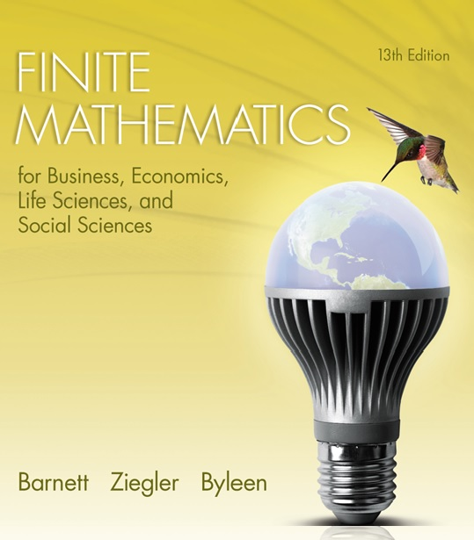
Chapter 7
Logic, Sets, and Counting
Section 3
Basic Counting Principles

Slide 2
Learning Objectives for Section 7.3
Basic Counting Principles
The student will be able to apply and use the addition principle.
The student will be able to draw and interpret Venn diagrams.
The student will be able to apply and use the multiplication principle.

Slide 3

7.3 Basic Counting Principles
In this section, we will see how set operations play an important role in counting techniques.

Slide 4
Opening Example
To see how sets play a role in counting, consider the following example:
In a certain class, there are 23 majors in Psychology, 16 majors in English and 7 students who are majoring in both Psychology and English.
If there are 50 students in the class, how many students are majoring in neither of these subjects?
How many students are majoring in Psychology alone?

Slide 5
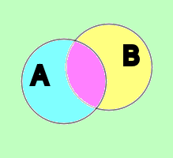
Solution
We introduce the following principle of counting that can be illustrated using a Venn diagram.
This statement says that the number of elements in the union of two sets A and B is the number of elements of A plus the number of elements of B minus the number of elements that are in both A and B (because we counted those twice).

Slide 6
Solution
(continued)
7 students in this region
Both Psych and English
23 + 16 – 7 = 32
Do you see how the numbers of each region are obtained from the given information in the problem? We start with the region represented by the intersection of Psych and English majors (7). Then, because there are 23 Psych majors, there must be 16 Psych majors remaining in the rest of the set. A similar argument will convince you that there are 9 students who are majoring in English alone.
9 students in this region
Psychology majors
English majors
16 students here

Slide 7
A Second Problem
A survey of 100 college faculty who exercise regularly found that 45 jog, 30 swim, 20 cycle, 6 jog and swim, 1 jogs and cycles, 5 swim and cycle, and 1 does all three. How many of the faculty members do not do any of these three activities? How many just jog?
We will solve this problem using a three-circle Venn Diagram in the accompanying slides.

Slide 8
Solution
We will start with the intersection of all three circles. This region represents the number of faculty who do all three activities (one). Then, we will proceed to determine the number of elements in each intersection of exactly two sets.
J =joggers
1 does all 3
S=swimmers
C=Cyclists

Slide 9
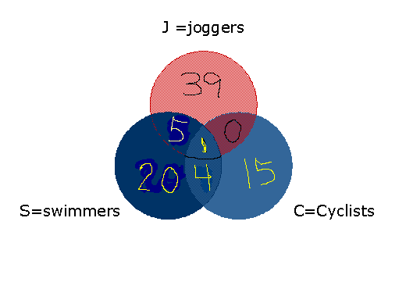
Solution
(continued)
Starting with the intersection of all three circles, we place a 1 in that region (1 does all three). Then we know that since 6 jog and swim so 5 faculty remain in the region representing those who just jog and swim. Five swim and cycle, so 4 faculty just swim and cycle but do not do all three. Since 1 faculty is in the intersection region of joggers and cyclists, and we already have one that does all three activities, there must be no faculty who just jog and cycle.
Since the sum of the numbers of these disjoint regions is 84, there must be 16 faculty who do none of these activities.

Slide 10
Multiplication Principle
An Example
To illustrate this principle, let’s start with an example.
Suppose you have 4 pairs of trousers in your closet, 3 different shirts and 2 pairs of shoes. Assuming that you must wear trousers (we hope so!), a shirt and shoes, how many different ways can you get dressed?

Slide 11
Multiplication Principle
Example Solution
Let’s assume the colors of your pants are black, grey, rust, olive. You have four choices here. The shirt colors are green, marine blue and dark blue. For each pair of pants chosen (4) you have (3) options for shirts. You have 12 = 4 • 3 options for wearing a pair of trousers and a shirt.
Now, each of these twelve options, you have two pair of shoes to choose from (Black or brown). Thus, you have a total of
4 • 3 • 2 = 24 options to get dressed.

Slide 12
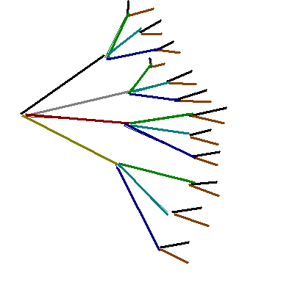
Generalized
Multiplication Principle
Suppose that a task can be performed using two or more consecutive operations. If the first operation can be accomplished in m ways and the second operation can be done in n ways, the third operation in p ways and so on, then the complete task can be performed in m·n·p … ways.

Slide 13
Another Problem
How many different ways can a team consisting of 28 players select a captain and an assistant captain?

Slide 14
Another Problem Solution
How many different ways can a team consisting of 28 players select a captain and an assistant captain?
Solution:
  Operation 1: Select the captain. If all team members are eligible to be a captain, there are 28 ways this can be done.
  Operation 2: Select the assistant captain. Assuming that a player cannot be both a captain and assistant captain, there are 27 ways this can be done, since there are 27 team members left who are eligible to be the assistant captain.
Using the multiplication principle, there are (28)(27) = 756 ways to select both a captain and an assistant captain.

Slide 15
Final Example
A sportswriter is asked to rank 8 teams in the NBA from first to last. How many rankings are possible?

Slide 16
Final Example Solution
A sportswriter is asked to rank 8 teams in the NBA from first to last. How many rankings are possible?
Solution: There are 8 choices that can be made for the first place team since all teams are eligible. That leaves 7 choices for the second place team. The third place team is determined from the 6 remaining choices and so on.
Total is the product of 8(7)…1 = 40,320.

