Slide 1
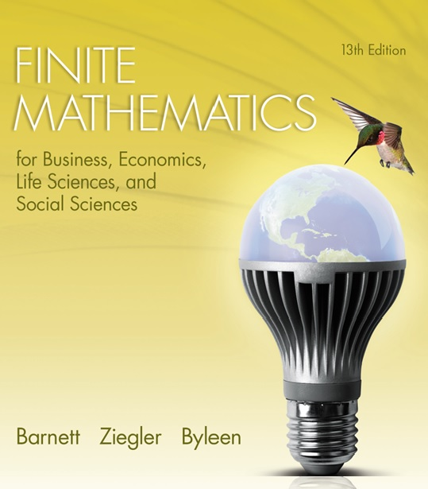
Chapter 7
Logic, Sets, and Counting
Section R
Review

Slide 2

Chapter 7 Review
Important Terms, Symbols, Concepts
7.1 Logic
  A proposition is a statement (not a question or command) that is either true or false.
  If p and q are propositions, then the compound propositions
  ¬ p, p ∨ q, p ∧ q, p → q
  can be formed using the negation symbol ¬ and the connectives .
  These propositions are called not p, p or q, p and q, and
  if p then q, respectively (or negation, disjunction, conjunction, and conditional, respectively.)

Slide 3
Chapter 7 Review
7.1 Logic (continued)
  With any conditional proposition p → q we associate the proposition q → p, called the converse of p → q, and the proposition ¬ q → ¬ p, called the contrapositive of p → q.
  A truth table for a compound proposition specifies whether it is true or false, for any assignment of truth values to its variables.
  A proposition is a tautology if each entry in its column of the truth table is T, a contradiction if each entry is F, and a contingency if at least one entry is T and at least one entry is F.

Slide 4
Chapter 7 Review
7.1 Logic (continued)
Consider the rows of the truth tables for the compound propositions P and Q.
  If whenever P is true, Q is also true, we say that P logically implies Q, and write P ⇒ Q.
  We call P ⇒ Q a logical implication.
  If the compound propositions P and Q have identical truth tables we say that P and Q are logically equivalent, and write P ≡ Q.
  We call P ≡ Q a logical equivalence.

Slide 5
Chapter 7 Review
7.1 Logic (continued) A truth table will establish that any conditional proposition is logically equivalent to its contrapositive.
7.2 Sets
  A set is a collection of objects specified in such a way that we can tell whether any given object is or is not in the collection.
  Each object in a set is called a member or element of the set. If a is an element of the set A, we write a ∈ A.

Slide 6
Chapter 7 Review
7.2 Sets (continued)
  A set without any elements is called the empty or null set, denoted Ø.
  A set can be described by listing its elements, or by giving a rule that determines the elements of the set. If P(x) is a statement about x, then {x | P(x)} denotes the set of all x such that P(x) is true.
  A set is finite if its elements can be counted and there is an end; a set such as the positive integers, in which there is no end in counting its elements, is infinite.

Slide 7
Chapter 7 Review
7.2 Sets (continued)
  We write A ⊂ B and say that A is a subset of B if each element of A is an element of B. We write A = B and say that sets A and B are equal if they have exactly the same elements. The empty set Ø is subset of every set.
  If A and B are sets, then
  A ∪ B = {x | x ∈ A or x ∈ B}
  is called the union of A and B, and
  A ∩ B = {x | x ∈ A and x ∈ B}
  is called the intersection of A and B.

Slide 8
Chapter 7 Review
7.2 Sets (continued)
  Venn diagrams are useful in visualizing set relationships.
  If A ∩ B = ∅, the sets A and B are said to disjoint.
  The set of all elements under consideration in a given discussion is called the universal set U. The set
  A′ = {x ∈U | x ∉ A}
  is called the complement of A (relative to U).

Slide 9
Chapter 7 Review
7.3 Basic Counting Principles
  If A and B are sets, then the number of elements in the union of A and B is given by the addition principle for counting.
  If the elements of a set are determined by a sequence of operations, tree diagrams can be used to list all combined outcomes. To count the number of combined outcomes without using a tree diagram, we use the multiplication principle for counting.

Slide 10
Chapter 7 Review
7.4 Permutations and Combinations
  The product of the first n natural numbers, denoted n!, is called n factorial:
    n! = n(n – 1)(n – 2)….(2)(1)
    0! = 1
    n! = n(n – 1)!
  A permutation of a set of distinct objects is an arrangement of the objects in a specific order without repetition. The number of permutations of a set of n distinct objects is given by P_{n,n} = n!

Slide 11
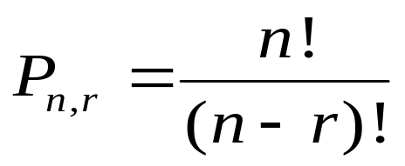
Chapter 7 Review
7.4 Permutations and Combinations (continued)
  A permutation of a set of n distinct objects taken r at a time without repetition is an arrangement of r of the n objects in a specific order. The order of the objects matters.
  The number of permutations of n distinct objects taken r at a time without repetition is given by
0 < r < n

Slide 12
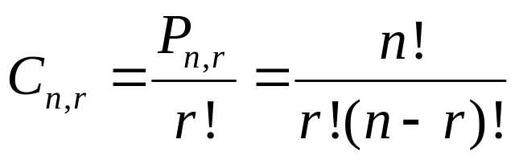
Chapter 7 Review
7.4. Permutations and Combinations (continued)
  A combination of a set of n distinct objects taken r at a time without repetition is an r-element subset of the set of n objects. The order of the objects does not matter.
  The number of combinations of n distinct objects taken r at a time without repetition is given by
0 < r < n

