Slide 1
Chapter 7
Personal Financial Management

Slide 2
Chapter 7: Personal Financial
Management
7.1 The Time Value of Money
7.2 Consumer Credit
7.3 Truth in Lending
7.4 The Costs and Advantages of Home Ownership
7.5 Financial Investments

Slide 3
Section 7-2
Consumer Credit

Slide 4
Installment Buying
Identify the different types of consumer credit.
Determine the interest, payments, and cost for installment loans.
Determine account balances and finance charges for revolving loans.

Slide 5
Installment Buying
Borrowing to finance purchases and repaying with periodic payments is called installment buying. This section addresses two types of installment credit.

Slide 6
Closed-End Credit
Closed-end credit involves borrowing a set amount up front and paying a series of equal installments (payments) until the loan is paid off. Furniture and appliances may be financed through closed-end credit (sometimes called fixed installment loans).

Slide 7
Open-End Credit
With revolving loans, or open-end credit, there is no fixed number of installments – the consumer continues paying until no balance is owed. Examples include department store charge accounts and charge cards such as MasterCard and VISA.

Slide 8
Add-On Interest
Installment loans set up under closed-end credit often are based on add-on interest. This means that if an amount P is borrowed, the annual interest rate is to be r, and payments will extend over t years, then the required interest comes from the simple interest formula I = Prt. Find the future value of a simple interest loan and divide the payments equally (usually monthly) over the t years.

Slide 9
Example: Repaying an Installment Loan
Zach buys $2800 worth of furniture. He pays $400
down and agrees to pay the balance at 6% add-on
interest for 2 years. Find
a) the total amount to be repaid and
b) the monthly payment.
Solution
Amount to be repaid = P(1 + rt)
= $2400(1 + (0.06)2)
= $2688

Slide 10
Example: Repaying an Installment Loan
Solution (continued)
b) Monthly payment = $2688/24
= $112
24 payments

Slide 11
Open-End Credit
With a typical open-end credit account, a credit limit is established initially and the consumer can make any purchases during a month (up to the credit limit).
At the end of each billing period (normally once a month), the customer receives an itemized billing, a statement listing purchases and cash advances, the total balance owed, the minimum payment required, and perhaps other account information.

Slide 12
Open-End Credit
Any charges beyond cash advanced and cash prices of items purchased are called finance charges. Finance charges may include interest, an annual fee, credit insurance coverage, a time payment differential, or carrying charges.

Slide 13
Finance Charge/Average Daily Balance Method
Most open-end lenders use a method of calculating finance charges called the average daily balance method. It considers balances on all days of the billing period and comes closer to charging card holders for credit they actually utilize.

Slide 14
Example: Average Daily Balance
The activity on a credit card account for one billing period is given on the next slide. If the previous balance was $320.75, and the bank charges 1.4% per month on the average daily balance, find the average daily balance for the next billing (April 3) and the finance charge for the April 3 billing.

Slide 15
Example: Average Daily Balance
March 3 Billing date
March 12 Payment $250.00
March 17 Car repairs $422.85
March 20 Food $124.80
April 1 Clothes $64.32

Slide 16
Example: Average Daily Balance
Solution
First we make a table of the running balance
Date | Running Balance
March 3 | $320.75
March 12 | $320.75 – $250.00 = $70.75
March 17 | $70.75 + $422.85 = $493.60
March 20 | $493.60 + $124.80 = $618.40
April 1 | $618.40 + $64.32 = $682.72

Slide 17
Example: Average Daily Balance
Solution (continued)
Take the number of days of the balance times the balance.
Date | Balance | Days | Product
March 3 | $320.75 | 9 | $2886.75
March 12 | $70.75 | 5 | $353.75
March 17 | $493.60 | 3 | $1480.80
March 20 | $618.40 | 12 | $7420.80
April 1 | $682.72 | 2 | $1365.44

Slide 18
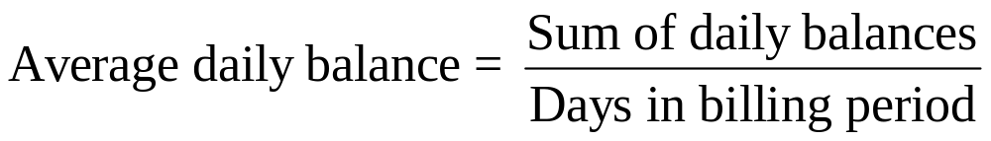
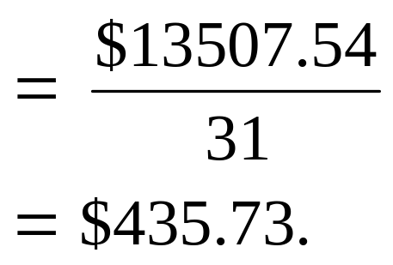
Example: Average Daily Balance
Solution (continued)
Find the sum of the daily balances by adding the last column = $13507.54.
Finance charge = (0.014)($435.73) = $6.10.

