Slide 1
Chapter 7
Personal Financial Management

Slide 2
Chapter 13: Personal Financial
Management
7.1 The Time Value of Money
7.2 Consumer Credit
7.3 Truth in Lending
7.4 The Costs and Advantages of Home Ownership
7.5 Financial Investments

Slide 3
Section 7-3
Truth in Lending

Slide 4
Truth in Lending
Determine the annual percentage rate for different types of loans.
Calculate unearned interest.

Slide 5
Truth in Lending
The Consumer Credit Protection Act, which
passed in 1968, has commonly been known as
the Truth in Lending Act. Two major issues are
addressed in the law:
1. How can I tell the true interest rate a lender is charging?
2. How much of the finance charge am I entitled to save if I decide to pay off a loan sooner than originally scheduled?

Slide 6
Annual Percentage Rate (APR)
Truth in Lending standardized the so-called annual interest rate, or annual percentage rate, commonly denoted APR. All sellers must disclose the APR when you ask, and the contract must state the APR whether or not you ask.

Slide 7
APR Table
The table on page 725 relates the three quantities:
APR = true annual interest rate
n = total number of scheduled monthly payments
h = finance charge per $100 of amount financed

Slide 8
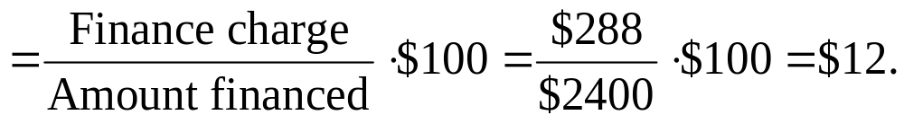
Example: Finding the APR for an Add-On Interest Loan
Find the APR for a $2400, two-year, add-on interest loan, that had a finance charge of $288.
Solution
First, we find the finance charge per $100 financed:

Slide 9
Example: Finding the APR for an Add-On Interest Loan
Solution (continued)
This $12 represents h, the finance charge per $100 of the amount financed. Because the loan was to be paid over 24 months, look down to the “24 monthly payments” row of the table (page 725). Then look across the table for the h value closest to $12, which is $11.86. From that point read up the column to find the APR, 11.0%.

Slide 10
Unearned Interest
If a loan is paid off early, the amount by which the original finance charge is reduced is called the unearned interest. We cover two common methods of calculating unearned interest, the actuarial method and the rule of 78. The borrower may not save all the unearned interest since the lender is entitled to impose an early payment penalty.

Slide 11
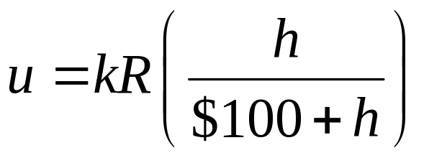
Unearned Interest – Actuarial Method
For a closed-end loan requiring monthly payments, which is paid off earlier than originally scheduled, let:
R = regular monthly payment
k = remaining number of scheduled payments
(after current payment)
h = finance charge per $100, corresponding to a loan with the same APR and k monthly payments.
Then the unearned interest, u, is calculated as follows:

Slide 12
Payoff Amount
An installment loan requiring regular monthly payments R can be paid off early, along with the current payment. If the original loan had k additional payments scheduled (after the current payment), and the unearned interest is u, then disregarding any possible prepayment penalty, the payoff amount is calculated as follows:
Payoff amount = (k + 1)R – u

Slide 13
Example: Finding Early Payoff Amount (Actuarial Method)
Suppose you have a loan for 4 years, with monthly
payments of $185, and an APR of 9.0% (original finance charge of $1426). If you decide to pay it off
in 3 years rather than 4 years, find
a) the unearned interest and
b) the payoff amount.
Solution
a) Use

Slide 14
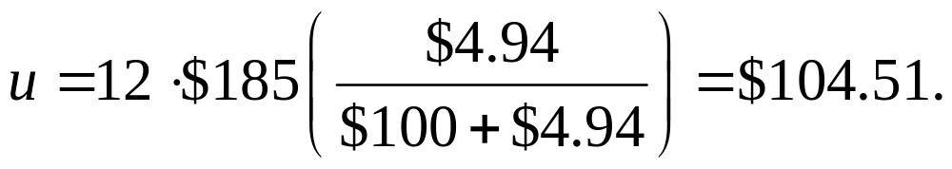
Example: Unearned Interest/Payoff Amount
Solution (continued)
From the APR table (12 payments left), we find that
h = $4.94. With R = $185 and k = 12, we have:
b) Payoff amount = (k + 1)R – u
= (12 + 1)$185 – $104.51 = $2300.49

Slide 15
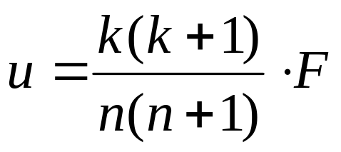
Unearned Interest – Rule of 78
For a closed-end loan requiring monthly payments, which is paid off earlier than originally scheduled, let:
F = original finance charge
n = number of payments originally scheduled
k = remaining number of scheduled payments (after current payment)
Then the unearned interest, u, is calculated as follows:

Slide 16
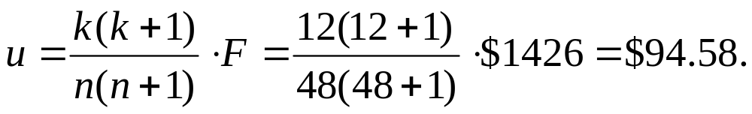
Example: Finding Early Payoff Amount (Rule of 78)
Use the rule of 78 to compute the unearned interest from the last example.
Solution
Note that this is $9.93 less than your savings by the actuarial method.

Slide 17
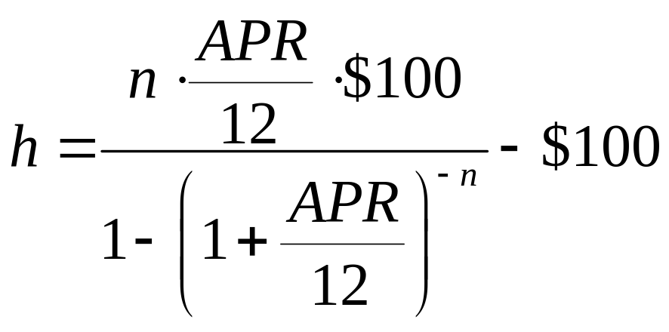
Finance Charge per $100 Financed
If an installment loan requires n equal monthly payments and APR denotes the true annual interest rate for the loan (as a decimal), then h, the finance charge per $100 financed, is calculated as follows.

Slide 18
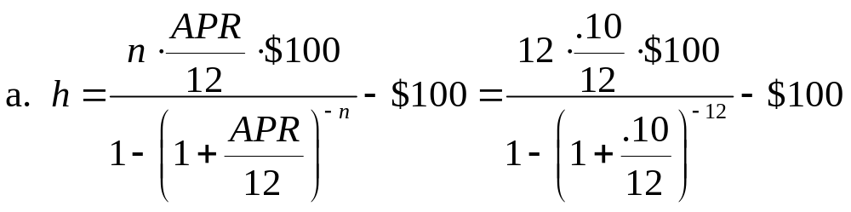
Example: Finding Unearned Interest and Early Payoff Amount
A loan states an APR of 10% and stipulates 30 payments of $125.40 each. If the loan is paid off on the eighteenth payment, find the unearned interest and the payoff amount.
Solution

Slide 19
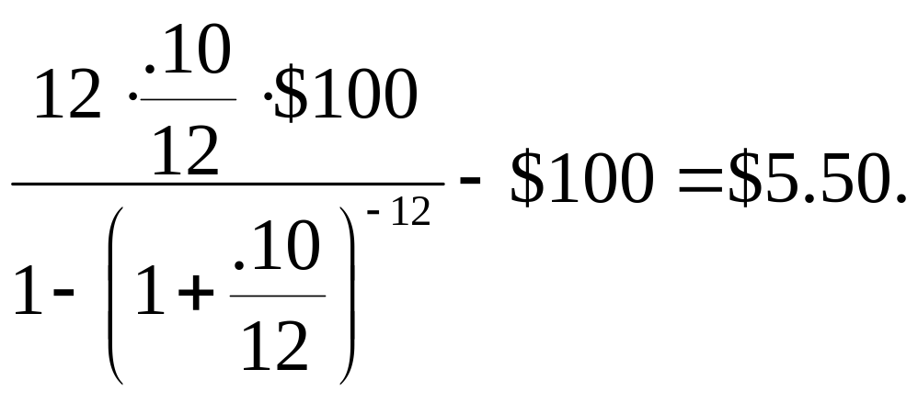
Example: Finding Unearned Interest and Early Payoff Amount
Solution (continued)
Next use the actuarial formula for unearned interest u.
Regular monthly payment: R = $125.40
Remaining number of payments: k = 30 – 18 = 12

Slide 20
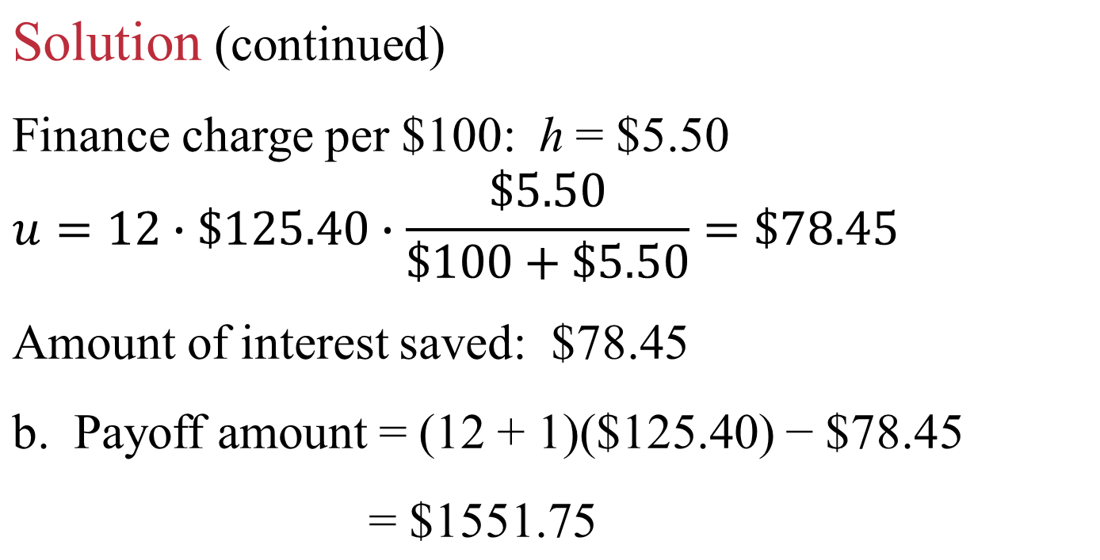
Example: Finding Unearned Interest and Early Payoff Amount

