Slide 1
Chapter 7
Personal Financial Management

Slide 2
Chapter 7: Personal Financial
Management
7.1 The Time Value of Money
7.2 Consumer Credit
7.3 Truth in Lending
7.4 The Costs and Advantages of Home Ownership
7.5 Financial Investments

Slide 3
Section 7-4
The Costs and Advantages
of Home Ownership

Slide 4
The Costs and Advantages of Home Ownership
Understand the characteristics of fixed rate mortgages.
Understand the characteristics of adjustable-rate mortgages.
Be familiar with the closing costs associated with mortgages.
Be familiar with the recurring costs of home ownership.

Slide 5
Fixed-Rate Mortgages
A loan for a substantial amount, extending over a lengthy time interval, for the purpose of buying a home or other property or real estate, and for which property is pledged as security for the loan, is called a mortgage. (A mortgage may also be called a deed of trust or a security deed.)

Slide 6
Fixed-Rate Mortgages
The time until the final payoff is called the term of the mortgage.
The portion of the purchase price of the home which the buyer pays initially is called the down payment.
The principal amount of the mortgage (amount borrowed) is found by subtracting the down payment from the purchase price.

Slide 7
Fixed-Rate Mortgages
With a fixed-rate mortgage, the interest rate will remain constant throughout the term, and the initial principal balance, together with interest due on the loan, is repaid to the lender through regular (constant) periodic (we assume monthly) payments. This is called amortizing the loan.

Slide 8
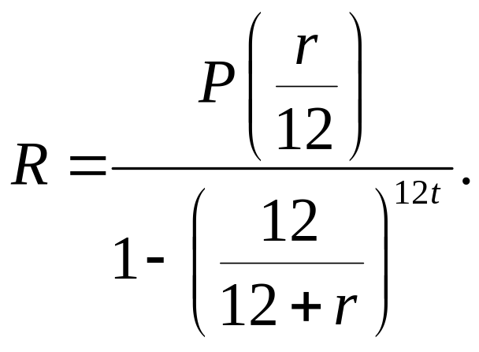
Regular Monthly Payment
The regular monthly payment required to repay the loan of P dollars, together with interest at an annual rate r, over a term of t years, is given by

Slide 9
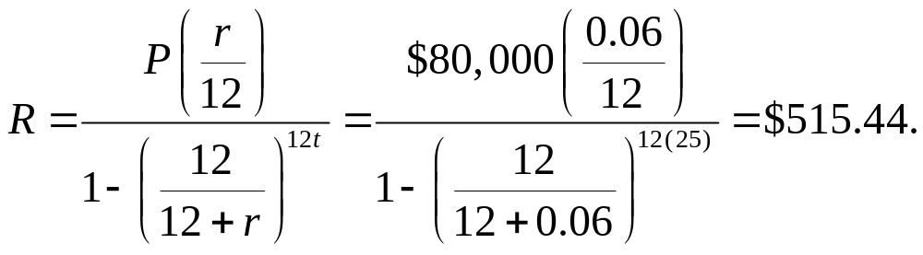
Example: Monthly Mortgage Payment
Find the monthly payment necessary to amortize an $80,000 mortgage at 6% annual interest for 25 years.
Solution

Slide 10
Regular Monthly Payment
Another approach to find the monthly payment is to use a tool such as table 7 on page 734.
Using the information from the last example, we find the intersection of the 6% row and the 25 year column, which is $6.44301.
Multiply that number by the number of $1000s for our loan, which is 80:
80($6.44301) = $515.44.

Slide 11
Amortization Schedule
Once the regular monthly payment has been determined, an amortization schedule (or repayment schedule) can be generated. It will show the allotment of payments for interest and principal, and the principal balance, for one or more months during the life of the loan.

Slide 12
Example: Amortization Schedule
Using the information from the last example, fill in the table (monthly payment $515.44).
Payment | Interest Payment | Principal Payment | Balance of Principal
 |  |  | $80,000
1
2

Slide 13
Example: Amortization Schedule
Solution
The monthly interest = (balance)(.06/12).
Principal payment = $515.44 – interest payment.
Payment | Interest Payment | Principal Payment | Balance of Principal
 |  |  | $80,000
1 | $400 | $115.44 | $79884.56
2 | $399.42 | $116.02 | $79768.54

Slide 14
Adjustable-Rate Mortgages
An adjustable-rate mortgage (ARM), also known as a variable-rate mortgage (VRM), generally starts out with a lower rate than similar fixed-rate loans, but the rate changes periodically, reflecting changes in prevailing rates.

Slide 15
Adjustable-Rate Mortgages
Your ARM interest rate may change every 1, 3, or 5 years. The frequency of change in rate is called the adjustment period. When the rate changes, your payment changes, too. These adjustments are caused by fluctuations in an index upon which your rate is based.

Slide 16
Adjustable-Rate Mortgages
To determine your interest rate, the lender will add to the applicable index a few percentage points called the margin. The index and margin are both used in determining the cost of the loan.

Slide 17
Example: ARM
Suppose that for a $120,000 house loan, you take
out a 1-year ARM for 30 years. The lender uses the 1-year Treasury index (previously 4.5%) and a 2% margin. Find your monthly payment for the first year.
Solution
The first-year rate will be the Index rate + Margin
= 4.5% + 2% = 6.5%.

Slide 18
Example: ARM
Solution (continued)
Look up 6.5% for a 30-year loan in the table and find a payment of $6.32068 per $1000.
So the monthly payment is
($6.32068)(120) = $758.48.

Slide 19
Adjustable-Rate Mortgages
Sometimes initial rates offered on an ARM are less than the sum of the index and the margin. Such a discount often is the result of the seller paying the lender an amount in order to reduce the buyer’s initial interest rate. The arrangement is called a “seller buydown.”

Slide 20
Adjustable-Rate Mortgages
An interest rate cap limits the amount your interest rate can increase. A periodic cap limits how much the rate can increase from one adjustment period to the next (typically about 1% per 6 months or 2% per year). An overall cap limits how much the rate can increase over the life of the loan.

Slide 21
Adjustable-Rate Mortgages
Some ARMs also have payment caps, which limit how much the payment can increase at each adjustment. Because of the cap, it is possible that your payment may not even cover the interest owed. You may then find yourself owing more principal at the end of the adjustment period than you did at the beginning. This situation is called negative amortization.

Slide 22
Adjustable-Rate Mortgages
Another way to reduce risk is with a convertibility feature. This allows you to convert the mortgage to a fixed-rate mortgage.
If you think you may want to completely, or partially, pay off the principal of the loan ahead of schedule, try to negotiate an ARM with no prepayment penalty.

Slide 23
Closing Costs
There are some significant one-time expenses that apply to both fixed-rate and adjustable-rate mortgages and are paid when the mortgage is originally set up. Together, these charges are called closing costs (or settlement charges). The closing, or settlement, occurs when all the details of the transaction have been determined and the final contracts are signed.

Slide 24
Example: Closing Costs
For a $85,000 mortgage, the borrower was charged the following closing costs.
Loan origination fee (1% of mortgage) $_____
Broker loan fee $1640
Lender document and underwriting fees $350
Lender tax and wire fees $210
Fee to title company $225
Title insurance fee $320
Title reconveyance fee $70
Document recording fee $40
Compute the total closing costs for this mortgage.

Slide 25
Example: Closing Costs
Solution
Loan origination fee (1% of mortgage amount)
= ($85000)(0.01) = $850
The total sum = $3,705.

Slide 26
Points
“Loan origination fees” are commonly referred to as points. Each “point” amounts to 1% of the mortgage amount. By imposing points, the lender can raise the interest rate without raising the monthly payments (because points are typically paid at closing).

Slide 27
Taxes, Insurance, and Maintenance
The primary financial considerations for most new
homeowners are the following.
1. Accumulating the down payment
Having sufficient cash and income to qualify for the loan
Making the mortgage payments

Slide 28
Taxes, Insurance, and Maintenance
Property taxes are collected by your county or local government. Property taxes, and also mortgage interest, are deductible on your income taxes.
Homeowner’s insurance usually covers losses due to fire, storm damages, and other casualties.
Homes also require maintenance, but these costs can vary greatly.

Slide 29
Example: Taxes and Insurance
A couple has a 25-year, $175,000 fixed-rate loan at 7%. In addition, they owe $2800 in annual taxes and $750 annually for homeowner’s insurance. What is their net average monthly expenditure?
Solution
The monthly mortgage payment is $1236.86. The added monthly expense from taxes and insurance = ($2800 + $750)/12 = $295.83. This gives a total net average monthly expenditure of $1532.69.

Slide 30
Taxes, Insurance, and Maintenance
Payments of property taxes and homeowner’s insurance are commonly made from a reserve account (also called an escrow or an impound account) maintained by the mortgage lender. The borrower must pay enough each month, along with amortization costs, so that the reserve account will be sufficient to make payments when they come due.

Slide 31
Collaborative project
Complete the worksheet with a team/partner.

