Slide 1
Chapter 13
Personal Financial Management

Slide 2
Chapter 13: Personal Financial
Management
13.1 The Time Value of Money
13.2 Consumer Credit
13.3 Truth in Lending
13.4 The Costs and Advantages of Home Ownership
13.5 Financial Investments

Slide 3
Section 13-5
Financial Investments

Slide 4
Financial Investments
Become familiar with stocks.
Become familiar with bonds.
Become familiar with mutual funds.
Evaluate investment returns.
Explore strategies for building a nest egg.

Slide 5
Stocks
Buying stock in a corporation makes you a part owner of the corporation. You then share in any profits the company makes, and your share of the profits is called a dividend.
The profit you make by selling for more than you paid is called a capital gain. A negative gain, or capital loss, results if you sell for less than you paid.

Slide 6
Stocks
By return on investment, we mean the net difference between what you receive (including any dividends) and what you paid (purchase price plus any other expenses of buying and selling the stock).
The price of a share of stock is determined by the law of supply and demand at institutions called stock exchanges.

Slide 7
Example: Return on Stock
You buy 100 shares of stock in Company X on February 2, 2016, paying $28.50 per share. On February 2, 2017, you receive a dividend of $0.60 per share and the stock price had risen to $29.75 per share. Find the following.
a) Your total cost for the stock
b) The total dividend amount
c) The capital gain if you sold the stock
d) The total return and percentage return for one
year of ownership of this stock

Slide 8
Example: Return on Stock
Solution
a) Total cost = (100)($28.50) = $2850
b) Total dividend = (100)($0.60) = $60
c) Capital gain = $2975 – $2850 = $125
d) The total return = $125 + $60 = $185
Percentage return = ($185/$2850)(100) = 6.5%

Slide 9
Reading a Stock Table
YTD %CHG | 52-WEEK HI LO |  | STOCK (SYM) | YLD DIV % PE
3.5 | 19.55 | 12.66 | WARDENS WRD | 0.53 | 2.8 | 35
Company pays an annual dividend of $0.53, which is 2.8% (yield) of the price of the stock. The 35 is the price-to-earnings ratio, stock price divided by earnings per share over the last 12 months
Stock increased 3.5% so far this calendar year
Highest and lowest price in the last 52 weeks
2012 Pearson Education, Inc.

Slide 10
Reading a Stock Table (continued)
VOL 100s | CLOSE | NET CHG
1411 | 18.79 | 0.03
On this day, 1411(100)= 141,100 shares were sold
The stock price closed for the day at $18.79, which is $0.03 higher than that of the previous trading day
2012 Pearson Education, Inc.

Slide 11
Special Features in Stock Listings
1. A line listed in boldface print distinguishes a stock whose price changed by 5% or more.
2. An underlined row in the listings indicates a stock with an especially high volume of trading for the day relative to its usual volume.

Slide 12
Special Features in Stock Listings
3. A “pf” between the company name and symbol indicates a “preferred” stock, a special category of stock issued by some companies in addition to their ordinary, or “common,” stock. A company must pay dividends to holders of its preferred stock before it can pay dividends to holders of its common stock.
4. The symbol ▲at the left indicates a new 52-week high, while the symbol ▼indicates a new
52-week-low.

Slide 13
Brokers
To buy or sell a stock, generally it is necessary to use a broker. A broker has representatives at the stock exchange who will execute a buy or sell order. The broker will charge a commission (broker’s fee).
Full-service brokers, who offer research, professional opinions, and various other services, tend to charge the highest commissions. Discount brokers buy and sell stock for clients and offer little in the way of additional services.

Slide 14
Commissions
Commissions will normally be some percentage of the value of a purchase or sale (called the principal). Rates may depend on whether the order is for a round lot of shares (a multiple of 100) or an odd lot. On the odd-lot portion, you may be charged an odd-lot differential. Also, it is possible to place a limit order, where the broker is instructed to buy or sell if the stock reaches a predesignated price. An example of a commission structure is shown on the next two slides.

Slide 15
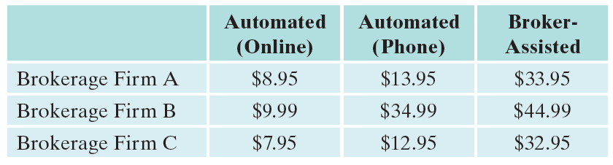
Typical Discount Commission Structure

Slide 16
Example: Cost for a Broker-Assisted Stock Purchase
Find the total cost for a broker-assisted purchase from Brokerage Firm A of 800 shares of a stock at $5.45 per share. Use the information from the previous slide.
Solution
Basic cost = $5.45(800) = $4360
Broker commission = $33.95
Total cost = $4360 + $33.95 = $4393.95

Slide 17
Bonds
You may lend money to a company, receiving an agreed-upon rate of interest for the use of your money. In this case you would buy a bond from the company. The bond (loan) is issued with a stated term (life span), after which the bond “matures” and the principal (or face value) is paid back to you.

Slide 18
Example: Return on a Bond
$5000 in invested in a 10-year corporate bond paying 7.5% annual interest, paid semiannually. Find the total return on the investment if it is held
to maturity.
Solution
We use the simple interest formula:
I = Prt = $5000(0.075)(10) = $3750.

Slide 19
Mutual Funds
A mutual fund is a pool of money collected by an investment company from individuals and/or institutions and invested in many stocks, bonds, or money market instruments.

Slide 20
Mutual Funds Versus Stocks and Bonds – Advantages of Mutual Funds
1. Simplicity
Someone else does the work.
2. Diversification
You own interests in many different stocks, which decreases vulnerability to large losses in one particular stock.
3. Access to New Issues
The large assets of fund managers give them more clout to get initial public offerings (IPOs), which can be profitable.

Slide 21
Mutual Funds Versus Stocks and Bonds – Advantages of Mutual Funds
4. Economies of Sale
Expenses are shared by large numbers of investors.
5. Professional Management
6. Indexing
An index fund can mimic a popular index (like the S&P 500). This way individual investors can achieve returns close to those of the index.

Slide 22
Mutual Funds Versus Stocks and Bonds – Disadvantages of Mutual Funds
1. Impact of One-Time Charges and Recurring Fees
Sales charges, management fees, “12b-1” fees, and fund expenses can mount.
2. Hidden Cost of Brokerage
Recurring fees and expenses are added to give the expense ratio of a fund. But commissions paid by the fund for stock purchases and sales are in addition to the expense ratio.

Slide 23
Mutual Funds Versus Stocks and Bonds – Disadvantages of Mutual Funds
3. Hidden Risks of Fund Ownership
Getting out of a fund in a market crash may
mean accepting securities rather than cash.
Managers may stray from stated strategies of
the fund.
Since tax liability is passed on to fund investors, and depends on purchases and sales made by fund managers, investors may be unable to avoid inheriting unwanted tax basis.
Source: Forbes Guide to the Markets, John Wiley & Sons, Inc.

Slide 24
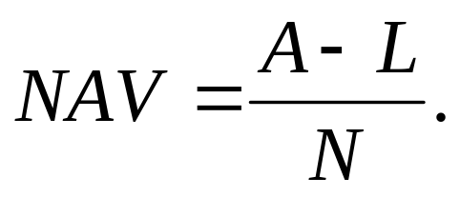
Net Asset Value of a Mutual Fund
If A = Total fund assets, L = Total fund liabilities, and N = Number of shares outstanding, then the net asset value is given by

Slide 25
Example: NAV
A mutual fund has $520 million worth of stock, $700,000 in cash, and $300,000 in other assets.
The fund also has $4 million in liabilities. If there are 30 million shares outstanding, find the NAV.
Solution
A = $520,000,000 + $700,000 + $300,000
= $521,000,000
L = $4,000,000
N = 30,000,000

Slide 26
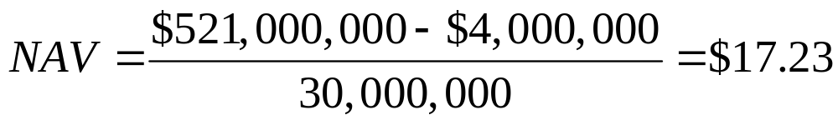
Example: NAV
Solution (continued)

Slide 27
Evaluating Investment Returns
It is important to be able to accurately evaluate and compare returns (profits or losses). Even though past performance is never a guarantee of future returns, it is crucial information. A wealth of information on stock and bond markets and mutual funds is available though publications and internet resources.
The most important measure of an investment is the annual rate of return. It is not the same as percentage return because it depends on the time period involved.

Slide 28
Example: Mutual Fund’s Annual Rate of Return
You own shares of a mutual fund and the only return that the fund earns is dividends of 0.5% per month, which are reinvested. Find the annual rate of return.
Solution
The “return relative” is 1 + 0.005 = 1.005
Because of compounding, we have (1 + 0.005)¹², which gives 1.062. Subtract 1 and multiply by 100 to convert to a percentage rate. The annual percentage rate is 6.2%.

Slide 29
Building a Nest Egg
The most important function of investing, for most people, is to build an account for some future use, probably for retirement living.
The remainder of the slides goes over a few topics associated with retirement accounts.

Slide 30
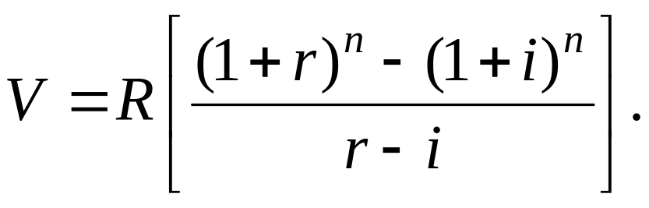
Future Value of an Inflation-Adjusted Retirement Account
Assume annual deposits into a retirement account, adjusted for inflation. If
i = annual rate of inflation,
R = initial deposit (at the end of year 1),
r = annual rate of return on money in the account, and
n = number of years deposits are made,
then the value V of the account at the end of n years is:

Slide 31
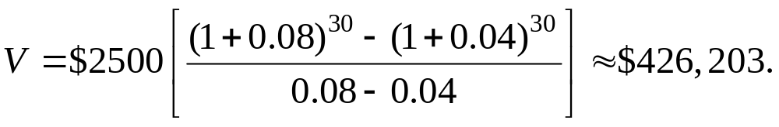
Example: Adjusting a Retirement Account for Inflation
Find the final account value of an account paying 8%, with initial deposit amount of $2500, after
30 years of deposits, assuming that the deposited amounts had been adjusted for a 4% annual inflation rate.
Solution

Slide 32
Tax-Deferred Versus Taxable Retirement Accounts
In both cases,
R = amount withheld annually from salary,
r = annual rate of return on money in the account,
t = marginal tax rate of account holder,
n = number of years contributions are made,
V = final value of the account, following all
accumulations and payment of all taxes.

Slide 33
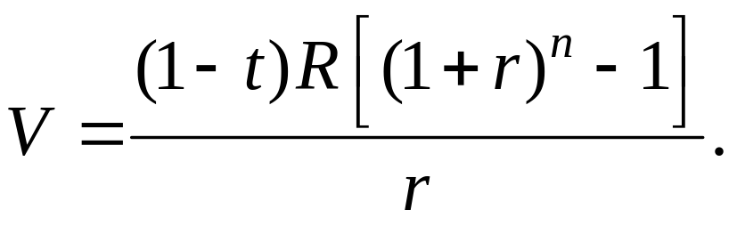
Tax-Deferred Versus Taxable Retirement Accounts
Tax Deferred Account
The entire amount R is contributed each year. All contributions, plus earnings, earn a return over the n years, at which time tax is paid on all money in the account. The final account value is given by:

Slide 34
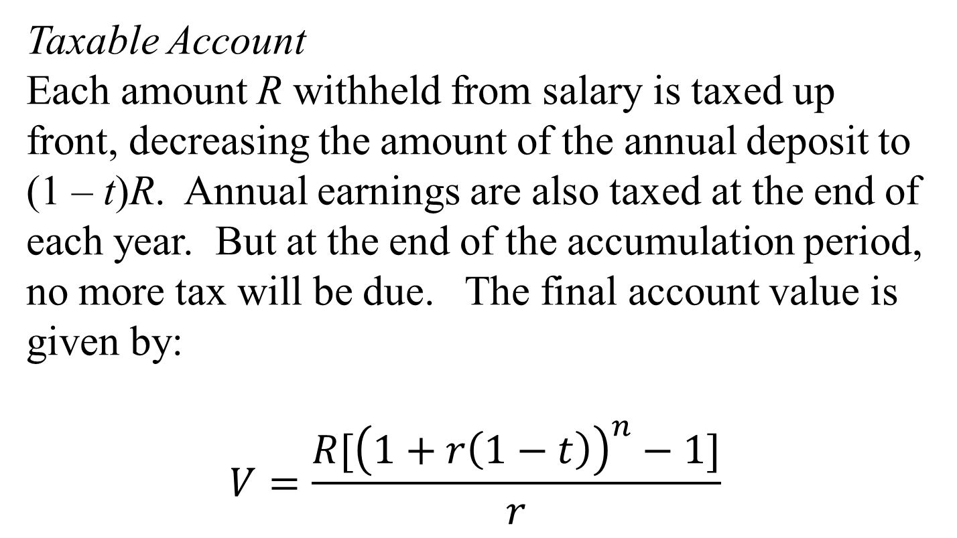
Tax-Deferred Versus Taxable Retirement Accounts

Slide 35
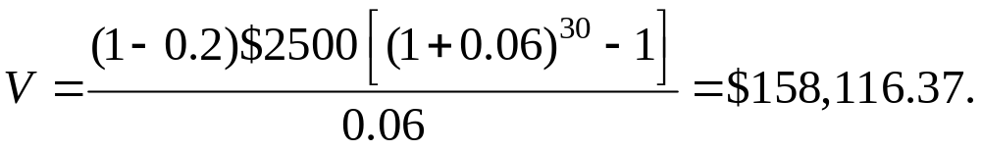
Example: Comparing Accounts
Compare the final account values of a tax-deferred account and a taxable account with R = $2500, n = 30, r = 0.06, and t = 0.20.
Solution
Tax-deferred account

Slide 36
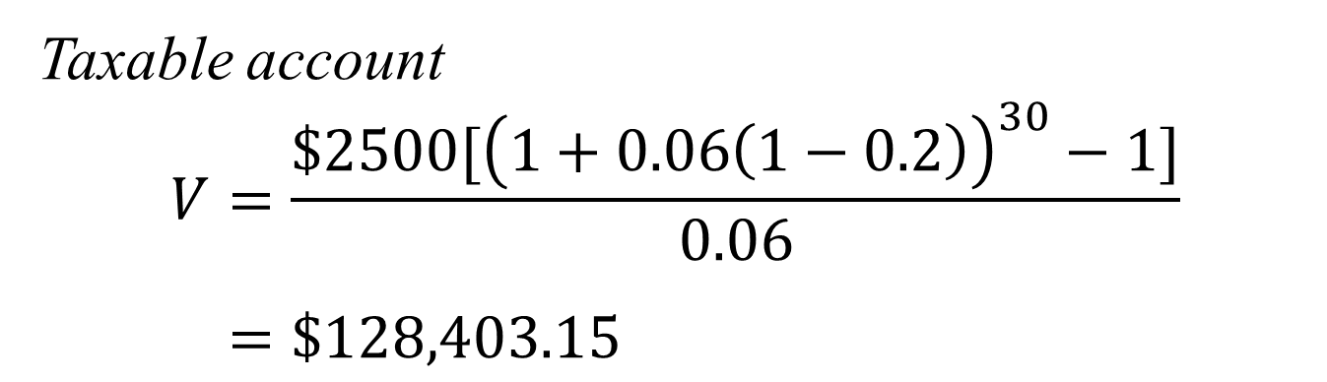
Example: Comparing Accounts
Solution (continued)
The tax-deferred account will have $29,713.22 more in it at the end of the period.

