Slide 1
Chapter 13
Personal Financial Management

Slide 2
Chapter 13: Personal Financial
Management
13.1 The Time Value of Money
13.2 Consumer Credit
13.3 Truth in Lending
13.4 The Costs and Advantages of Home Ownership
13.5 Financial Investments

Slide 3
Section 13-1
The Time Value of Money

Slide 4
The Time Value of Money
Know the meaning of interest.
Calculate simple interest.
Determine future value and present value.
Calculate compound interest.
Find the effective annual yield.
Use the rate of inflation to compare values over time.

Slide 5
Interest
If we borrow an amount of money today, we will repay a larger amount later. The increase in value is known as interest. The money gains value over time.
The amount of a loan or a deposit is called the principal. The interest is usually computed as a percent of the principal. This percent is called the rate of interest (or the interest rate, or simply the rate). The rate of interest is assumed to be an annual rate unless otherwise stated.

Slide 6
Interest
Interest calculated only on principal is called simple interest. Interest calculated on principal plus any previously earned interest is called compound interest.

Slide 7
Simple Interest
If P = principal, r = annual interest rate, and
t = time (in years), then the simple interest I is calculated as follows.
I = Prt

Slide 8
Example: Finding Simple Interest
Find the simple interest paid to borrow $4800 for 6 months at 7%.
Solution
I = Prt = $4800(0.07)(6/12) = $168.
6 months is 6/12 of a year.

Slide 9
Future and Present Value
In the last example, the borrower would have to repay $4800 + $168 = $4968.
The total amount repaid is called the maturity value (or the value) of the loan. We will refer to it as the future value, or future amount. The original principal, denoted P, can also be thought of as present value.

Slide 10
Future Value for Simple Interest
If a principal P is borrowed at simple interest for t years at an annual interest rate of r, then the future value of the loan, denoted A, is given by
A = P(1 + rt).

Slide 11
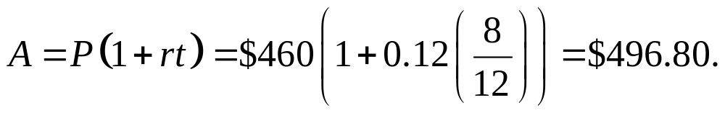
Example: Future Value for Simple Interest
Find the future value of $460 in 8 months, if the annual interest rate is 12%.
Solution

Slide 12
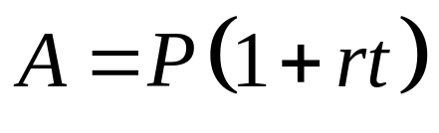
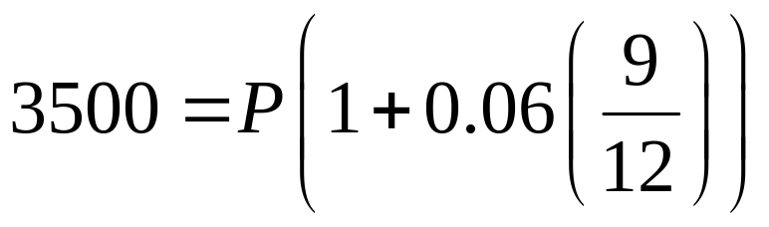
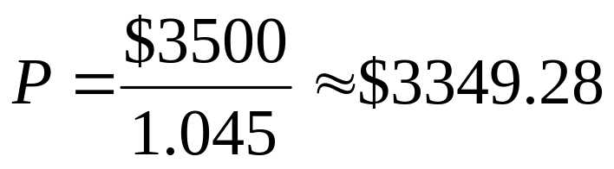
Example: Present Value for Simple Interest
If you can earn 6% interest, what lump sum must be deposited now so that its value will be $3500 after
9 months?
Solution

Slide 13
Compound Interest
Interest paid on principal plus interest is called compound interest. After a certain period, the interest earned so far is credited (added) to the account, and the sum (principal plus interest) then earns interest during the next period.

Slide 14
Compounding Period
Interest can be credited to an account at time intervals other than 1 year. For example, it can be done semiannually, quarterly, monthly, or daily. This time interval is called the compounding period (or the period).

Slide 15
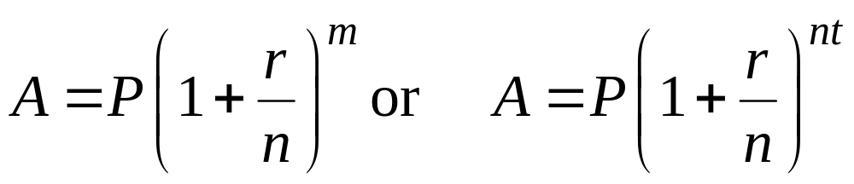
Future Value for Compound Interest
If P dollars are deposited at an annual interest rate of r, compounded n times per year, and the money is left on deposit for a total of m periods (or t = m/n years), then the future value, A (the final amount on deposit), is given by:

Slide 16
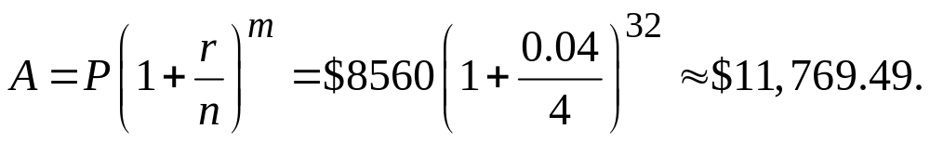
Example: Finding Future Value for Compound Interest
Find the future value of $8560 at 4% compounded quarterly for 8 years.
Solution
P = $8560, r = 4% = 0.04, n = 4.
Over 8 years m = 8n = 8(4) = 32.

Slide 17
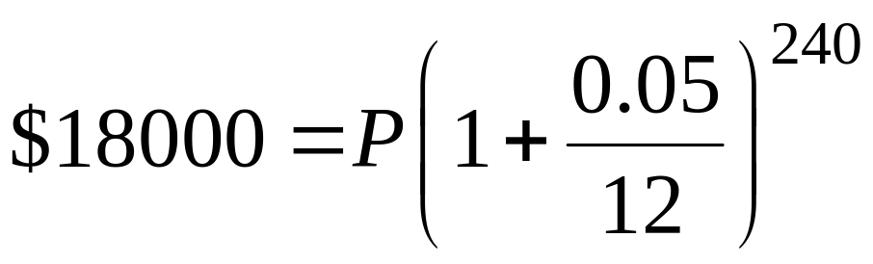
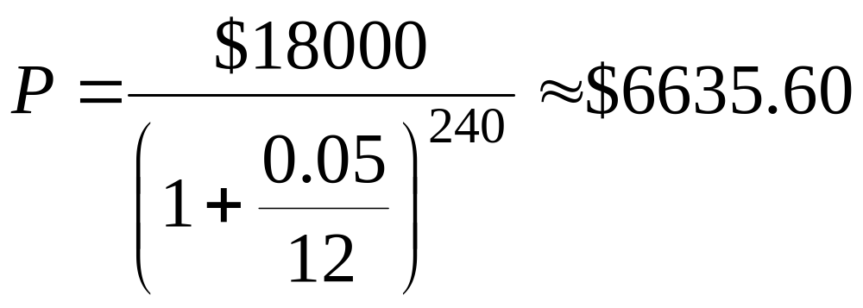
Example: Finding Present Value for Compound Interest
What amount must be deposited today, at 5% compounded monthly, so that it will be $18,000 in 20 years?
Solution

Slide 18
Effective Annual Yield
Savings institutions often give two quantities when advertising the rates. The first, the actual annualized interest rate, is the nominal rate (the “stated” rate). The second quantity is the equivalent rate that would produce the same final amount, or future value, at the end of 1 year if the interest being paid were simple rather than compound. This is called the “effective rate,” or the effective annual yield.

Slide 19
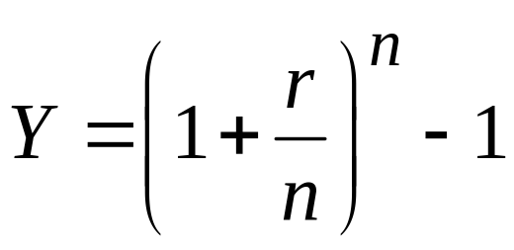
Effective Annual Yield
A nominal interest rate of r, compounded n times per year, is equivalent to the following effective annual yield.

Slide 20
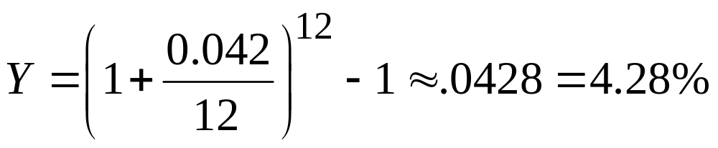
Example: Effective Annual Yield
What is the effective annual yield of an account paying a nominal rate of 4.2%, compounded monthly?
Solution

Slide 21
Inflation
In terms of the equivalent number of goods or services that a given amount of money will buy, it is normally more today than it will be later. In this sense, the money loses value over time. This periodic increase in the cost of living is called price inflation.
Unlike account values under interest compounding, which make sudden jumps at just certain points in time, price levels tend to fluctuate gradually over time. It is appropriate, for inflationary estimates, to use a formula for continuous compounding.

Slide 22
Inflation
Inflation in an economy usually is expressed as a monthly or annual rate of price increases, estimated by government agencies in a systematic way. In the United States, the Bureau of Labor Statistics publishes consumer price index (CPI) figures, which reflect the prices of certain items purchased by large numbers of people (see table on page 714 of the text).

Slide 23
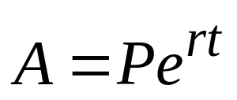
Future Value for Continuous Compounding
If an initial deposit of P dollars earns continuously compounded interest at an annual rate r for a period of t years, then the future value, A, is calculated as follows.

Slide 24
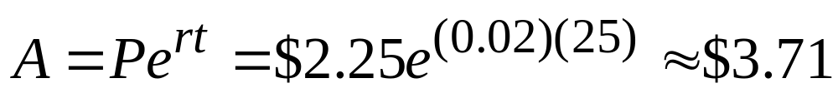
Example: Future Value for Continuous Compounding
Suppose that a cup of your favorite coffee is $1.25. If the inflation rate persists at 2% over time, find the approximate cost of the coffee in 25 years.
Solution
The coffee will cost about $3.71.

Slide 25
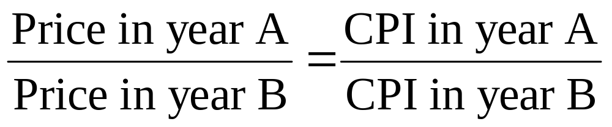
Inflation Proportion
For a consumer product or service subject to average inflation,

Slide 26
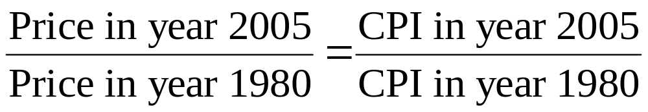
Example: Inflation
If your mother paid $3,000 in tuition in 1980 at the same college that you will be attending and paying $9,300 in 2005, compare the school’s tuition increase to inflation over that same period of time.
Solution
Let x represent what we expect the tuition to be in 2005 if it had increased at the average rate since 1980.

Slide 27
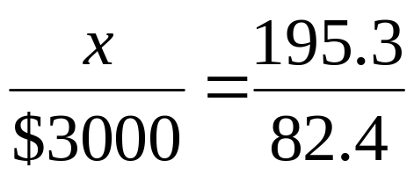

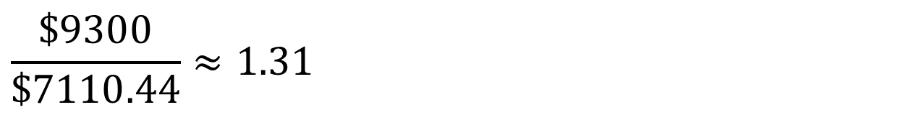
Example: Inflation
Solution (continued)
Now compare with the actual 2005 tuition.
Tuition at the school increased approximately 31% more than the average CPI-U rate.

Slide 28
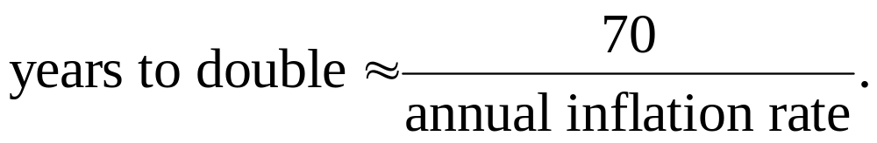
Example: Inflation
An estimation of the years to double, which is the number of years it takes for the general level of prices to double for a given annual rate of inflation, is given by

Slide 29
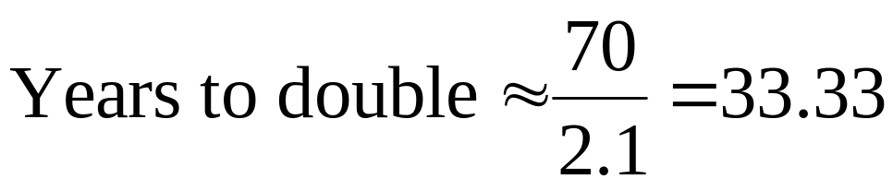
Example: Estimating Years to Double by the Rule of 70
Estimate the number of years to double for an annual inflation rate of 2.1%
Solution
With an inflation rate of 2.1%, prices would double in about 34 years.

