Slide 1
Chapter 4
Numeration Systems

Slide 2
Chapter 4: Numeration Systems
4.1 Historical Numeration Systems
4.2 More Historical Numeration Systems
4.3 Arithmetic in the Hindu-Arabic System
4.4 Conversion between Number Bases

Slide 3
Section 4-1
Historical Numeration Systems

Slide 4
Historical Numeration Systems
Understand the basics of numeration.
Understand ancient Egyptian numeration.
Understand ancient Roman numeration.
Understand classical Chinese numeration.

Slide 5
Numeration Systems
The various ways of symbolizing and working with the counting numbers are called numeration systems. The symbols of a numeration system are called numerals.

Slide 6
Example: Counting by Tallying
Tally sticks and tally marks have been used for a long time. Each mark represents one item. For example, eight items are tallied by writing the following:

Slide 7
Counting by Grouping
Counting by grouping allows for less repetition of symbols and makes numerals easier to interpret. The size of the group is called the base (usually ten) of the number system.

Slide 8
Ancient Egyptian Numeration – Simple Grouping
The ancient Egyptian system is an example of a simple grouping system. It uses ten as its base and the various symbols are shown on the next slide.

Slide 9
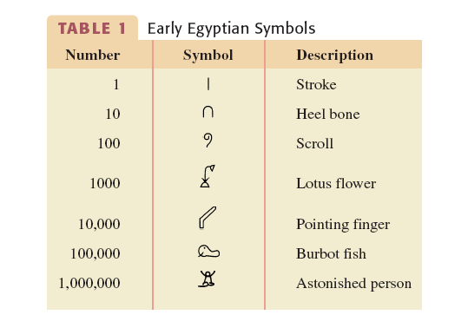
Ancient Egyptian Numeration

Slide 10




Example: Interpreting an Egyptian Numeral
Write the number below in our system.
Solution
2 (100,000) = 200,000
3 (1,000) = 3,000
1 (100) = 100
4 (10) = 40
5 (1) = 5
Answer: 203,145

Slide 11
Ancient Roman Numeration
The ancient Roman method of counting is a modified grouping system. It uses ten as its base, but also has symbols for 5, 50, and 500.
The Roman system also has a subtractive feature which allows a number to be written using subtraction.
A smaller-valued symbol placed immediately to the left of the larger value indicated subtraction.

Slide 12
Ancient Roman Numeration
The ancient Roman numeration system also has a multiplicative feature to allow for bigger numbers
to be written.
A bar over a number means multiply the number
by 1000.
A double bar over the number means multiply
by 1000² or 1,000,000.

Slide 13
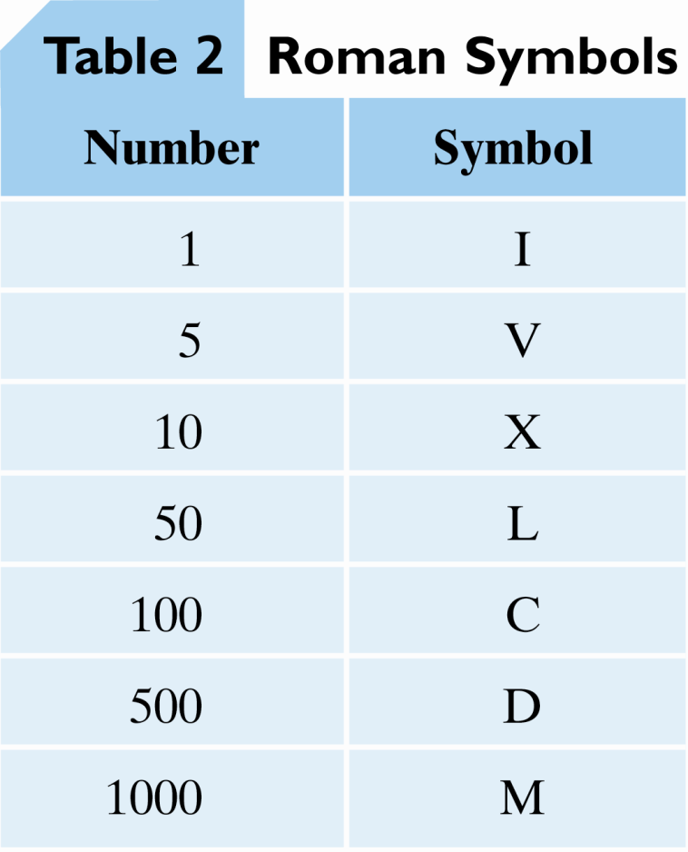
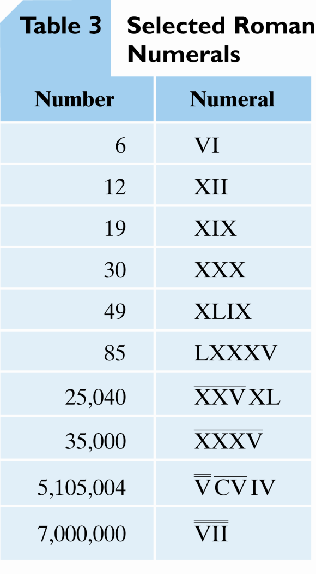
Ancient Roman Numeration

Slide 14
Example: Interpreting Roman Numerals
Write the number below in our system.
MCMXLVII
Solution
M = 1000
CM = –100 + 1000
XL = –10 + 50
V= 5
I= 1
I= 1
Answer:
1000 + 900 + 40 + 5 + 1 + 1= 1947

Slide 15
Traditional Chinese Numeration – Multiplicative Grouping
A multiplicative grouping system involves pairs of symbols, each pair containing a multiplier and then a power of the base. The symbols for a Chinese version are shown on the next slide.

Slide 16
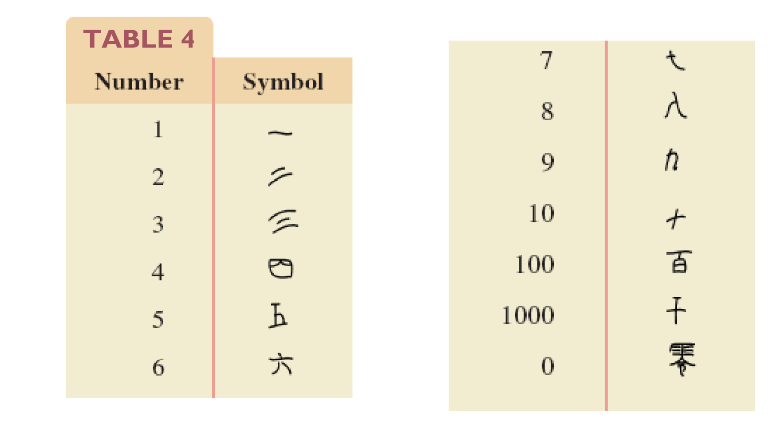
Chinese Numeration
Notes:
This art will need to be changed to make the number on the table “table 3”

Slide 17







Example: Interpreting Chinese Numerals
Interpret each Chinese numeral.
a) b)

Slide 18
Example: Interpreting Chinese Numerals
Solution
7000
200
400
0 (tens)
1
80
2
Answer:
7482
Answer:
201

