Slide 1
Chapter 4
Numeration Systems

Slide 2
Chapter 4: Numeration Systems
4.1 Historical Numeration Systems
4.2 More Historical Numeration Systems
4.3 Arithmetic in the Hindu-Arabic System
4.4 Conversion between Number Bases

Slide 3
Section 4-2
More Historical Numeration Systems

Slide 4
More Historical Numeration Systems
Understand the basic features of positional numeration systems.
Understand Hindu-Arabic numeration.
Understand Babylonian numeration.
Understand Mayan numeration.
Understand Greek numeration.

Slide 5
Positional Numeration
A positional system is one where the various powers of the base require no separate symbols. The power associated with each multiplier can be understood by the position that the multiplier occupies in the numeral.

Slide 6
Positional Numeration
In a positional numeral, each symbol (called a
digit) conveys two things:
1. Face value – the inherent value of the symbol.
2. Place value – the power of the base which is associated with the position that the digit occupies in the numeral.

Slide 7
Positional Numeration
To work successfully, a positional system must have a symbol for zero to serve as a placeholder in case one or more powers of the base is not needed.

Slide 8
Hindu-Arabic Numeration – Positional
One such system that uses positional form is our system, the Hindu-Arabic system.
The place values in a Hindu-Arabic numeral, from right to left, are 1, 10, 100, 1000, and so on. The three 4s in the number 45,414 all have the same face value but different place values.

Slide 9
Hindu-Arabic Numeration
Hundred thousands
Millions
Ten thousands
Thousands
Decimal point
Hundreds
Tens
Units
7, 5 4 1, 7 2 5 .

Slide 10
Babylonian Numeration
The ancient Babylonians used a modified base 60 numeration system.
The digits in a base 60 system represent the number of 1s, the number of 60s, the number of 3600s, and so on.
The Babylonians used only two symbols to create all the numbers between 1 and 59.
▼ = 1 and ‹ =10

Slide 11
Example: Converting Babylonian Numerals to Hindu-Arabic
Convert each Babylonian numeral to Hindu-Arabic form.
a) ‹ ‹ ‹ ▼ ▼ ▼ ▼
b) ▼ ▼ ‹ ‹ ‹ ▼ ▼ ▼ ▼ ▼

Slide 12







Example: Converting Babylonian Numerals to Hindu-Arabic
Solution
‹ ‹ ‹ ▼ ▼ ▼ ▼
Answer: 34
▼ ▼ ‹ ‹ ‹ ▼ ▼ ▼ ▼ ▼
Answer: 155

Slide 13
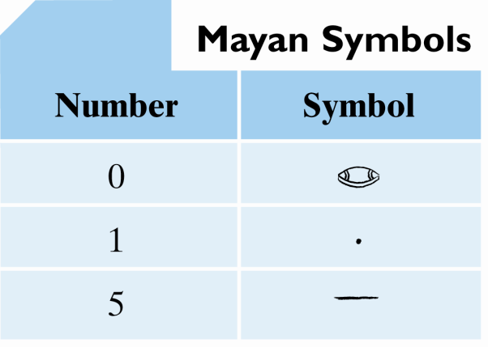
Mayan Numeration
The ancient Mayans used a base 20 numeration system, but with a twist.
Normally the place values in a base 20 system would be 1s, 20s, 400s, 8000s, etc. Instead, the Mayans used 360s as their third place value.
Mayan numerals are written from top to bottom.
Table 1

Slide 14




Example: Converting Mayan Numerals to Hindu-Arabic
Convert the Mayan numeral to Hindu-Arabic form.
Solution
Answer: 3619

Slide 15
Greek Numeration
The classical Greeks used a ciphered counting system.
They had 27 individual symbols for numbers,
based on the 24 letters of the Greek alphabet, with
3 Phoenician letters added.
The Greek number symbols are shown on the
next slide.

Slide 16
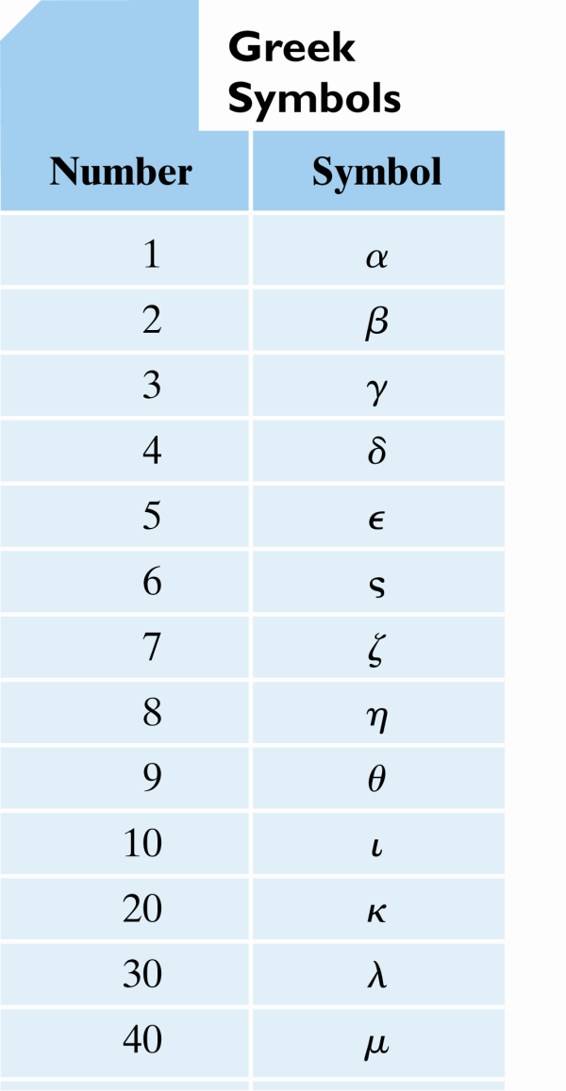
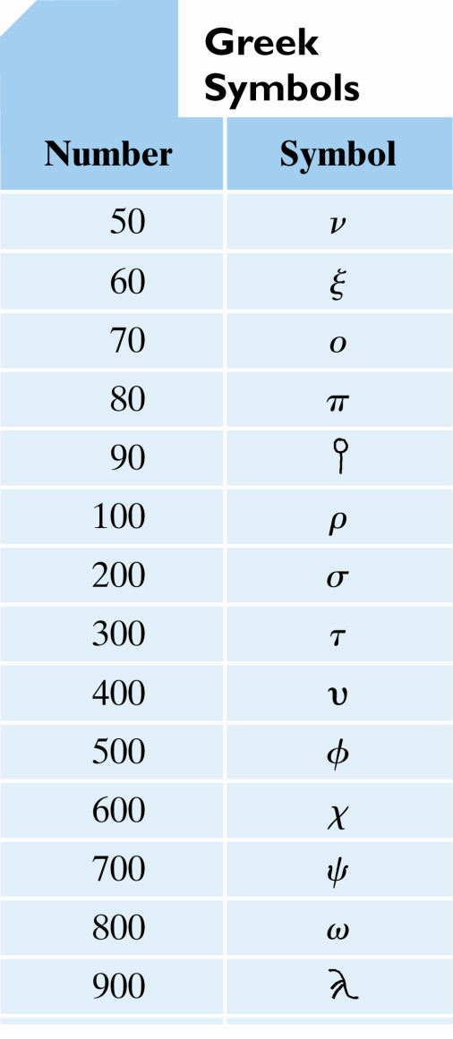
Greek Numeration
Table 2
Table 2
(cont.)

Slide 17
Example: Converting Greek Numerals to Hindu-Arabic
Convert each Greek numeral to Hindu-Arabic form.
a) μα
b) χπθ

Slide 18
Example: Converting Greek Numerals to Hindu-Arabic
Solution
a) μα
b) χπθ
Answer: 41
Answer: 689

