Slide 1
Chapter 4
Numeration Systems

Slide 2
Chapter 4: Numeration Systems
4.1 Historical Numeration Systems
4.2 More Historical Numeration Systems
4.3 Arithmetic in the Hindu-Arabic System
4.4 Conversion between Number Bases

Slide 3
Section 4-3
Arithmetic in the Hindu-Arabic System

Slide 4
Arithmetic in the Hindu-Arabic System
Express Hindu-Arabic numerals in expanded form.
Explore historical calculation devices.

Slide 5
Expanded Form
By using exponents, numbers can be written in expanded form in which the value of the digit in each position is made clear.

Slide 6
Example: Writing Numbers in Expanded Form
Write the number 23,671 in expanded form.
Solution

Slide 7
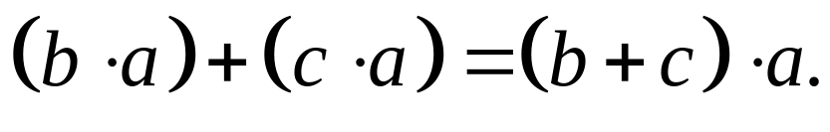
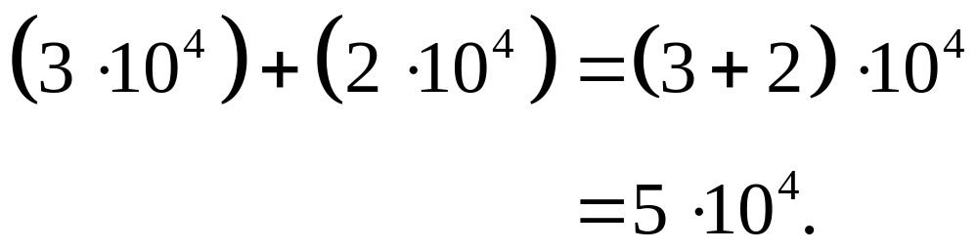
Distributive Property
For all real numbers a, b, and c,
For example,

Slide 8
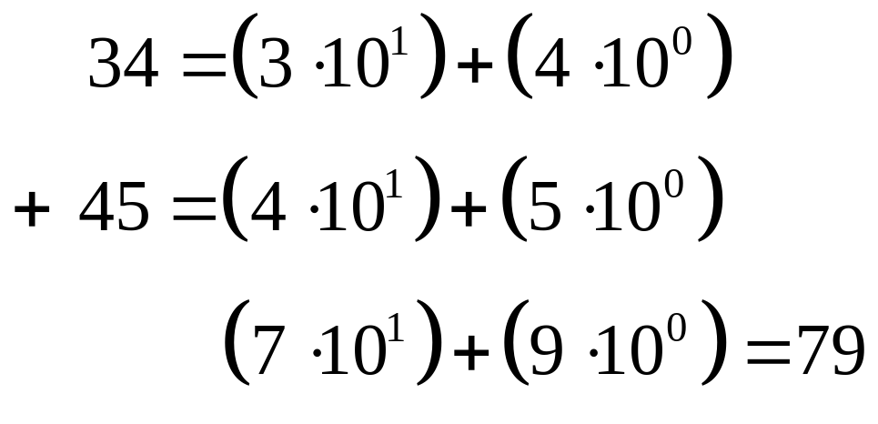
Example: Adding Expanded Form
Use expanded notation to add 34 and 45.
Solution

Slide 9
Decimal System
Because our numeration system is based on powers of ten, it is called the decimal system, from the Latin word decem, meaning ten.

Slide 10
Historical Calculation Devices
One of the oldest devices used in calculations is the abacus. It has a series of rods with sliding beads and a dividing bar. The abacus is pictured on the next slide.

Slide 11
Abacus
Reading from right to left, the rods have values of 1, 10, 100, 1000, and so on. The bead above the bar has five times the value of those below. Beads moved toward the bar are in “active” position.

Slide 12
Example: Reading an Abacus
Which number is shown below?
Solution
1000 + (500 + 200) + 0 + (5 + 1) = 1706

Slide 13
Lattice Method
The Lattice Method was an early form of a paper-and-pencil method of calculation. This method arranged products of single digits into a diagonalized lattice.
The method is shown in the next example.

Slide 14

Example: Using the Lattice Method for Products
Find the product by the lattice method.
Solution
Set up the grid
to the right.
7 9 4
3
8

Slide 15
Example: Using the Lattice Method for Products
Fill in products
7 9 4
2 1 | 2 7 | 1 2
5 6 | 7 2 | 3 2
3
8

Slide 16
Example: Using the Lattice Method for Products
Add diagonally right to left and carry as necessary to the next diagonal.
1
2
2 1 | 2 7 | 1 2
5 6 | 7 2 | 3 2
3
0
1 7 2

Slide 17
Example: Using the Lattice Method for Products
1
2
2 1 | 2 7 | 1 2
5 6 | 7 2 | 3 2
3
0
1 7 2
Answer: 30,172

Slide 18
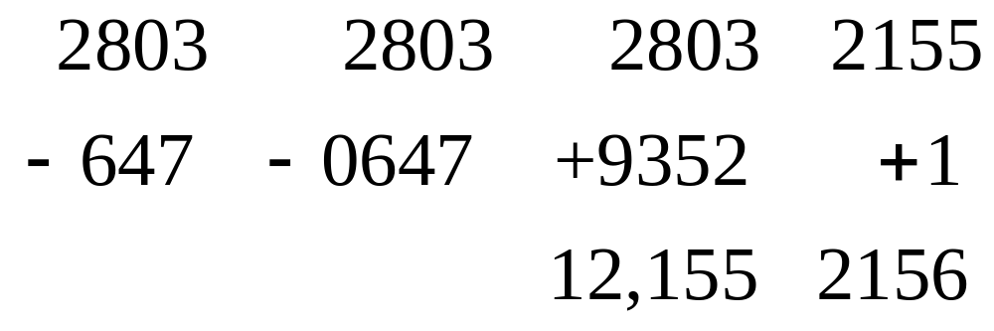
Example: Using the Nines Complement Method
Use the nines complement method to subtract
2803 – 647.
Solution
Step 1 Step 2 Step 3 Step 4

