Slide 1
Chapter 4
Numeration Systems

Slide 2
Chapter 4: Numeration Systems
4.1 Historical Numeration Systems
4.2 More Historical Numeration Systems
4.3 Arithmetic in the Hindu-Arabic System
4.4 Conversion between Number Bases

Slide 3
Section 4-4
Conversion Between Number Bases

Slide 4
Conversion Between Number Bases
Convert numerals from one base to another.
Use different bases in the context of computer mathematics.

Slide 5
General Base Conversions
We consider bases other than ten. Bases other than ten will have a spelled-out subscript as in the numeral 54_{eight}. When a number appears without a subscript, assume it is base ten. Note that 54_{eight} is read “five four base eight.” Do not read it as “fifty-four.”

Slide 6
Powers of Alternative Bases
 | Fourth Power | Third Power | Second Power | First Power | Zero Power
Base two | 16 | 8 | 4 | 2 | 1
Base five | 625 | 125 | 25 | 5 | 1
Base seven | 2401 | 343 | 49 | 7 | 1
Base eight | 4096 | 512 | 64 | 8 | 1
Base sixteen | 65,536 | 4096 | 256 | 16 | 1

Slide 7
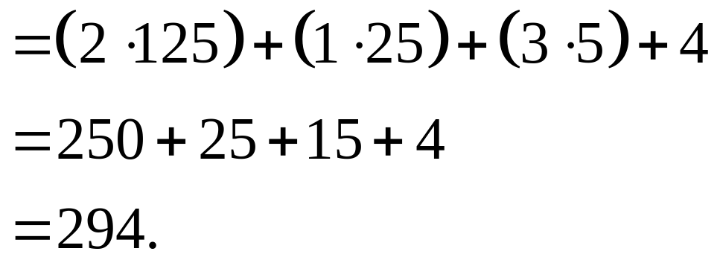
Example: Converting Bases
Convert 2134_{five} to decimal form.
Solution
2134_{five}

Slide 8
Calculator Shortcut for Base Conversion
To convert from another base to decimal form: Start with the first digit on the left and multiply by the base. Then add the next digit, multiply again by the base, and so on. The last step is to add the last digit on the right. Do not multiply it by the base.

Slide 9
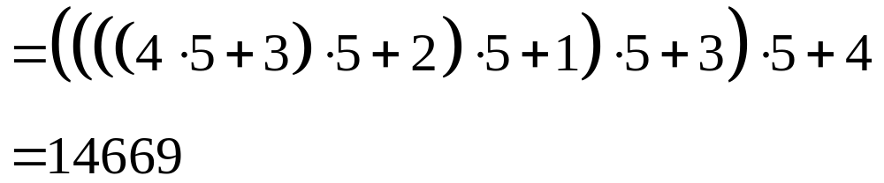
Example: Calendar Shortcut
Use the calculator shortcut to convert 432134_{five} to decimal form.
Solution
432134_{five}

Slide 10
Example: Converting Bases
Convert 7508 to base seven.
Remainder
Solution
Divide by 7, then divide the resulting quotient by 7, until a quotient of 0 results.
From the remainders (bottom to top) we get the answer:
7508 = 30614_{seven}
7508
1072 4
153 1
21 6
3 0
0 3

Slide 11
Converting Between Two Bases Other Than Ten
Many people feel the most comfortable handling conversions between arbitrary bases (where neither is ten) by going from the given base to base ten and then to the desired base.

Slide 12
Computer Mathematics
There are three alternative base systems that are most useful in computer applications. These are binary (base two), octal (base eight), and hexadecimal (base sixteen) systems.
Computers and handheld calculators use the binary system.

Slide 13
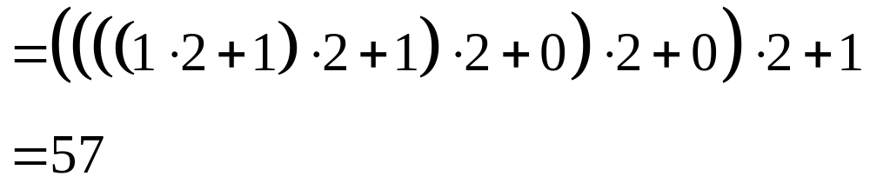
Example: Convert Binary to Decimal
Convert 111001_{two} to decimal form.
Solution
111001_{two}

Slide 14
Example: Convert Hexadecimal to Binary
Convert 8B4F_{sixteen} to binary form.
Solution
Each hexadecimal digit yields a 4-digit binary equivalent.
8 B 4 F_{sixteen}
1000 1011 0100 1111_{two}
Combine to get
8B4F_{sixteen} = 1000101101001111_{two}.

