Slide 1
Chapter 10
Number Theory

Slide 2
Chapter 10: Number Theory
10.1 Prime and Composite Numbers
10.2 Selected Topics From Number Theory
10.3 Greatest Common Factor and Least Common Multiple
10.4 The Fibonacci Sequence and the Golden Ratio

Slide 3
Section 10-1
Prime and Composite Numbers

Slide 4
Prime and Composite Numbers
Identify prime and composite numbers.
Apply divisibility tests for natural numbers.
Apply the fundamental theorem of arithmetic.

Slide 5
Number Theory
Number Theory is the branch of mathematics devoted to the study of the properties of the natural numbers.
Natural numbers are also known as counting numbers and the positive integers.

Slide 6
Divisibility
A counting number is divisible by another if the operation of dividing the first by the second leaves a remainder of 0.
Formally: the natural number a is divisible by the natural number b if there exists a natural number k such that a = bk. If b divides a, then we write b|a.

Slide 7
Terminology
If the natural number a is divisible by the natural number b, then b is a factor (or divisor) of a, and a is a multiple of b.
The number 30 equals 6 · 5; this product is called a factorization of 30.

Slide 8
Example: Finding Factors
Find all the natural number factors of each number.
a) 24 b) 13
Solution
a) To find factors try to divide by 1, 2, 3, 4, 5, 6 and so on to get the factors 1, 2, 3, 4, 6, 8, 12, and 24.
b) The only factors are 1 and 13.

Slide 9
Prime and Composite Numbers
A natural number greater than 1 that has only itself and 1 as factors is called a prime number. A natural number greater than 1 that is not prime is called composite.

Slide 10
Alternative Definition of a Prime Number
A prime number is a natural number that has exactly two different natural number factors.
The natural number 1 is neither prime nor composite.

Slide 11
Sieve of Eratosthenes
One systematic method for identifying primes is known as the Sieve of Eratosthenes. To construct a sieve, list all the natural numbers from 2 through some given natural number. The number 2 is prime, but all multiples of it are composite. Circle the 2 and cross out all other multiples of 2. Continue this process for all primes less than or equal to the square root of the last number in the list. Circle all remaining numbers that are not crossed out.

Slide 12
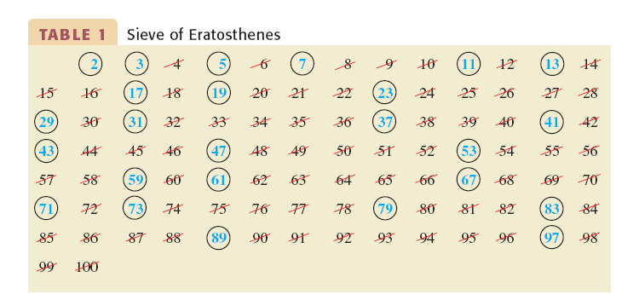
Sieve of Eratosthenes

Slide 13
Divisibility Tests
Divisibility tests are an aid to determine whether a natural number is divisible by another natural number. Simple tests are given on the next two slides. There are tests for 7 and 11, but they are more involved.

Slide 14
Divisibility Tests
Divisible by | Test
2 | Number ends in 0, 2, 4, 6, or 8.
3 | Sum of the digits is divisible by 3.
4 | Last two digits form a number divisible by 4.
5 | Number ends in 0 or 5.
6 | Number is divisible by both 2 and 3.

Slide 15
Divisibility Tests (continued)
Divisible by | Test
8 | Last three digits form a number divisible by 8.
9 | Sum of the digits is divisible by 9.
10 | The last digit is 0.
12 | Number is divisible by both 3 and 4.

Slide 16
Example: Applying Divisibility Tests
Is the number 2,984,094 divisible by 4?
Solution
The last two digits form the number 94. Since 94 is not divisible by 4, the given number is not divisible by 4.

Slide 17
Example: Applying Divisibility Tests
Is the number 4,355,211 divisible by 3?
Solution
Check: 4 + 3 + 5 + 5 + 2 + 1 + 1 = 21, which is divisible by 3. Therefore, the given number is divisible by 3.

Slide 19
The Fundamental Theorem of Arithmetic
Every natural number can be expressed in one and only one way as a product of primes (if the order of the factors is disregarded). This unique product of primes is called the prime factorization of the natural number.

Slide 20
Example: Unique Prime Factorization
Find the prime factorization of 240.
Solution
Using a tree format:
240
2 120
2 60
2 30
2 15
3 5
240 = 2⁴ · 3 · 5

Slide 21
Large Prime Numbers
Understand the infinitude of primes.
Investigate several categories of prime numbers.
Learn how large primes are identified.

Slide 22
The Infinitude of Primes
There is no largest prime number. Euclid proved this around 300 B.C.

Slide 23
The Search for Large Primes
Primes are the basis for modern cryptography systems, or secret codes. Mathematicians continue to search for larger and larger primes.
The theory of prime numbers forms the basis of security systems for vast amounts of personal, industrial, and business data.

Slide 24
Mersenne Numbers and Mersenne Primes
For n = 1, 2, 3, …, the Mersenne numbers are those generated by the formula:
1. If n is composite, then M_{n} is composite.
2. If n is prime, then M_{n} may be prime or composite.
The prime values of M_{n} are called Mersenne primes.

Slide 25
Example: Mersenne Numbers
Find the Mersenne number for n = 5.
Solution
M ₅ = 2⁵ – 1 = 32 – 1 = 31

Slide 26
Fermat Numbers
Fermat numbers are another attempt at generating prime numbers.
The Fermat numbers are generated by the formula:
The first five Fermat numbers (through n = 4) are prime.

Slide 27
Euler’s and Escott’s Formulas for Finding Primes
Euler’s prime number formula first fails at n = 41:
Escott’s prime number formula first fails at n = 80:

