Slide 1
Chapter 5
Number Theory

Slide 2
Chapter 5: Number Theory
5.1 Prime and Composite Numbers
5.2 Large Prime Numbers
5.3 Selected Topics From Number Theory
5.4 Greatest Common Factor and Least Common Multiple
5.5 The Fibonacci Sequence and the Golden Ratio

Slide 3
Section 5-2
Large Prime Numbers

Slide 4
Large Prime Numbers
Understand the infinitude of primes.
Investigate several categories of prime numbers.
Learn how large primes are identified.

Slide 5
The Infinitude of Primes
There is no largest prime number. Euclid proved this around 300 B.C.

Slide 6
The Search for Large Primes
Primes are the basis for modern cryptography systems, or secret codes. Mathematicians continue to search for larger and larger primes.
The theory of prime numbers forms the basis of security systems for vast amounts of personal, industrial, and business data.

Slide 7
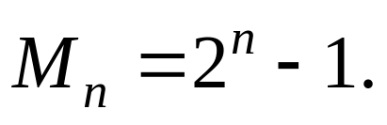
Mersenne Numbers and Mersenne Primes
For n = 1, 2, 3, …, the Mersenne numbers are those generated by the formula:
1. If n is composite, then M_{n} is composite.
2. If n is prime, then M_{n} may be prime or composite.
The prime values of M_{n} are called Mersenne primes.

Slide 8
Example: Mersenne Numbers
Find the Mersenne number for n = 5.
Solution
M ₅ = 2⁵ – 1 = 32 – 1 = 31

Slide 9
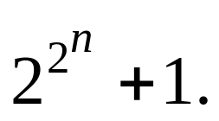
Fermat Numbers
Fermat numbers are another attempt at generating prime numbers.
The Fermat numbers are generated by the formula:
The first five Fermat numbers (through n = 4) are prime.

Slide 10
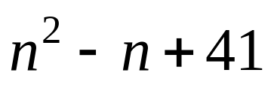
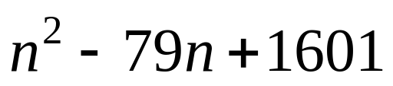
Euler’s and Escott’s Formulas for Finding Primes
Euler’s prime number formula first fails at n = 41:
Escott’s prime number formula first fails at n = 80:

