Slide 1
Chapter 10
Number Theory

Slide 2
Chapter 10: Number Theory
10.1 Prime and Composite Numbers
10.2 Selected Topics From Number Theory
10.3 Greatest Common Factor and Least Common Multiple
10.4 The Fibonacci Sequence and the Golden Ratio

Slide 3
Section 10-2
Selected Topics from Number Theory

Slide 4
Selected Topics from Number Theory
Understand and identify perfect numbers.
Understand and identify deficient and abundant numbers.
Understand amicable (friendly) numbers.
State and evaluate Goldbach’s conjecture.
Understand and identify twin primes.
State and evaluate Fermat’s Last Theorem.

Slide 5
Perfect Numbers
A natural number is said to be perfect if it is equal to the sum of its proper divisors.
6 is perfect because 6 = 1 + 2 + 3.

Slide 6
Deficient and Abundant Numbers
A natural number is deficient if it is greater than the sum of its proper divisors. It is abundant if it is less than the sum of its proper divisors.

Slide 7
Example: Identifying Deficient and Abundant Numbers
Decide whether 12 is deficient or abundant.
Solution
The proper divisors of 12 are 1, 2, 3, 4, and 6. Their sum is 16. Because 16 > 12, the number 12 is abundant.

Slide 8
Amicable (Friendly) Numbers
The natural numbers a and b are amicable, or friendly, if the sum of the proper divisors of a is b, and the sum of the proper divisors of b is a.
The smallest pair of amicable numbers is 220 and 284.

Slide 9
Goldbach’s Conjecture (Not Proved)
Every even number greater than 2 can be written as the sum of two prime numbers.

Slide 10
Example: Expressing Numbers as Sums of Primes
Write each even number as the sum of two primes.
a) 12 b) 40
Solution
a) 12 = 5 + 7
b) 40 = 17 + 23

Slide 11
Twin Primes
Twin primes are prime numbers that differ by 2.
Examples: 3 and 5, 11 and 13

Slide 12
Twin Primes Conjecture (Not Proved)
There are infinitely many pairs of twin primes.

Slide 13

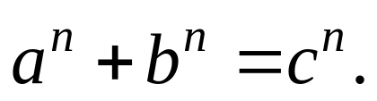
Fermat’s Last Theorem
For any natural number n 3, there are no triples (a, b, c) that satisfy the equation:

Slide 14
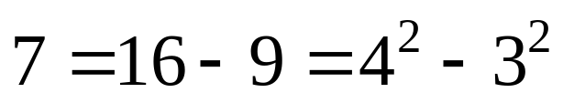
Example: Using a Theorem Proved by Fermat
Every odd prime can be expressed as the difference of two squares in one and only one way.
Express 7 as the difference of two squares.
Solution

