Slide 1
Chapter 5
Number Theory

Slide 2
Chapter 5: Number Theory
5.1 Prime and Composite Numbers
5.2 Large Prime Numbers
5.3 Selected Topics From Number Theory
5.4 Greatest Common Factor and Least Common Multiple
5.5 The Fibonacci Sequence and the Golden Ratio

Slide 3
Section 5-4
Greatest Common Factor and
Least Common Multiple

Slide 4
Greatest Common Factor and Least Common Multiple
Find the greatest common factor by several methods.
Find the least common multiple by several methods.

Slide 5
Greatest Common Factor
The greatest common factor (GCF) of a group of natural numbers is the largest number that is a factor of all of the numbers in the group.

Slide 6
Finding the Greatest Common Factor (Prime Factors Method)
Step 1 Write the prime factorization of each number.
Step 2 Choose all primes common to all factorizations, with each prime raised to the least exponent that appears.
Step 3 Form the product of all the numbers in
Step 2; this product is the greatest common factor.

Slide 7
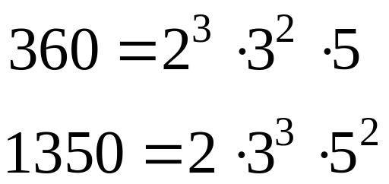
Example: Greatest Common Factor by Prime Factors Method
Find the greatest common factor of 360 and 1350.
Solution
The prime factorizations are below.
The GCF is 2 · 3² · 5 = 90.

Slide 8
Finding the Greatest Common Factor (Dividing by Prime Factors Method)
Step 1 Write the numbers in a row.
Step 2 Divide each of the numbers by a common prime factor. Try 2, then 3, and so on.
Step 3 Divide the quotients by a common prime factor. Continue until no prime will divide into all the quotients.
Step 4 The product of the primes in steps 2 and 3 is the greatest common factor.

Slide 9
Finding the Greatest Common Factor (Dividing by Prime Factors Method)
Find the greatest common factor of 12, 18, and 30.
Solution
2 12 18 30
6 9 15
2 3 5
Divide by 2
3
Divide by 3
No common factors
Since there are no common factors in the last row, the GCF is 2 · 3 = 6.

Slide 10
Finding the Greatest Common Factor (Euclidean Algorithm)
To find the greatest common factor of two unequal numbers, divide the larger by the smaller. Note the remainder, and divide the previous divisor by this remainder. Continue the process until a remainder of 0 is obtained. The greatest common factor is the last positive remainder obtained.

Slide 11
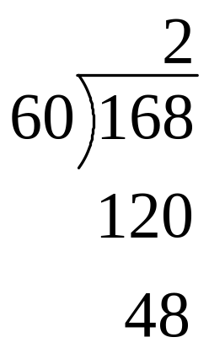
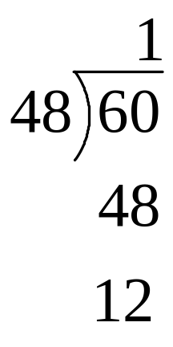
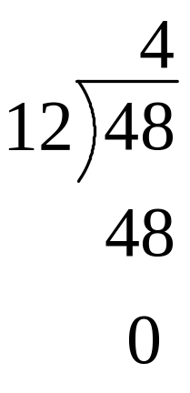
Example: Euclidean Algorithm
Use the Euclidean algorithm to find the greatest common factor of 60 and 168.
Solution
Step 1 Step 2 Step 3
The GCF is 12.

Slide 12
Least Common Multiple
The least common multiple (LCM) of a group of natural numbers is the smallest natural number that is a multiple of all of the numbers in the group.

Slide 13
Finding the Least Common Multiple (Prime Factors Method)
Step 1 Write the prime factorization of each number.
Step 2 Choose all primes belonging to any factorization, with each prime raised to the power indicated by the greatest exponent that it has in any factorization.
Step 3 Form the product of all the numbers in
Step 2; this product is the least common multiple.

Slide 14
Example: Finding the LCM
Find the least common multiple of 360 and 1350.
Solution
The prime factorizations are below.
The LCM is 2³ · 3³ · 5² = 5400.

Slide 15
Finding the Least Common Multiple (Dividing by Prime Factors Method)
Step 1 Write the numbers in a row.
Step 2 Divide each of the numbers by a common prime factor. Try 2, then 3, and so on.
Step 3 Divide the quotients by a common prime factor. When no prime will divide all quotients, but a prime will divide some of them, divide where possible and bring any nondivisible quotients down.
Continued on next slide…

Slide 16
Finding the Least Common Multiple (Dividing by Prime Factors Method)
Step 3 (step 3 continued) Continue until no prime will divide any two quotients.
Step 4 The product of the prime divisors in steps 2 and 3 as well as all remaining quotients is the least common multiple.

Slide 17
Finding the Least Common Multiple (Dividing by Prime Factors Method)
Find the least common multiple of 12, 18, and 30.
Solution
2 12 18 30
6 9 15
2 3 5
Divide by 2
3
Divide by 3
No common factors
The LCM is 2 · 3 · 2 · 3 · 5 = 180.

Slide 18
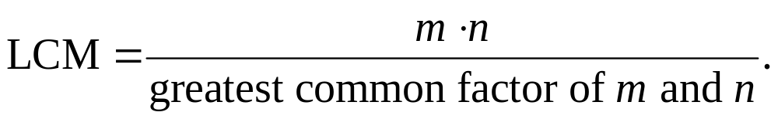
Finding the Least Common Multiple (Formula)
The least common multiple of m and n is given by

Slide 19
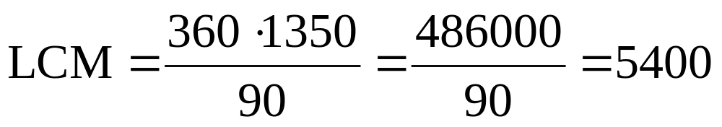
Example: LCM Formula
Find the LCM of 360 and 1350.
Solution
The GCF is 90.

Slide 20
Example: Finding the Greatest Common Size of Stacks of Cards
Joshua has 450 football cards and 840 baseball cards. He wants to place them in stacks on a table so that each stack has the same number of cards, and no stack has different types of cards within it. What is the greatest number of cards that he can have in each stack?
Solution
Looking for the greatest number that will divide evenly into 450 and 840. Using any method, you will find the GCF is 30.

