Slide 1
Chapter 5
Number Theory

Slide 2
Chapter 5: Number Theory
5.1 Prime and Composite Numbers
5.2 Large Prime Numbers
5.3 Selected Topics From Number Theory
5.4 Greatest Common Factor and Least Common Multiple
5.5 The Fibonacci Sequence and the Golden Ratio

Slide 3
Section 5-5
The Fibonacci Sequence and the Golden Ratio

Slide 4
The Fibonacci Sequence and the Golden Ratio
Work with the Fibonacci sequence.
Understand the golden ratio.
See relationships between the Fibonacci sequence and the golden ratio.

Slide 5
The Fibonacci Sequence
A famous problem:
A man put a pair of rabbits in a cage. During the first month the rabbits produced no offspring, but each month thereafter produced one new pair of rabbits. If each new pair thus produced reproduces in the same manner, how many pairs of rabbits will there be at the end of one year?

Slide 6
The Fibonacci Sequence
The solution of the problem leads to the Fibonacci sequence. Here are the first thirteen terms of the sequence:
1, 1, 2, 3, 5, 8, 13, 21, 34, 55, 89, 144, 233
Notice the pattern. After the first two terms (both 1), each term is obtained by adding the two previous terms.

Slide 7
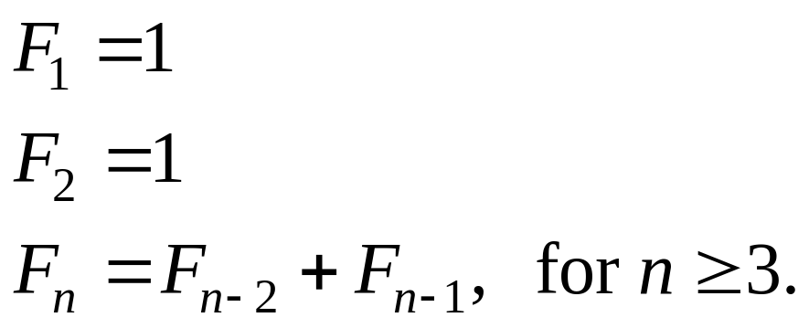
Recursive Formula for Fibonacci Sequence
If F_{n} represents the Fibonacci number in the nth position in the sequence, then

Slide 8
Example: Observing a Pattern of the Fibonacci Numbers
Find the sum of the squares of the first n Fibonacci numbers for n = 1, 2, 3, 4, 5, and examine the pattern. Generalize this relationship.
Solution
F₁ · F₂
F₂ · F₃ F₃ · F₄
F₄ · F₅ F₅ · F₆
1² = 1
1² + 1² = 2
1² + 1² + 2² = 6
1² + 1² + 2² + 3² = 15
1² + 1² + 2² + 3² +5² = 40
Pattern:
F_{n} · F_{n+1}

Slide 9
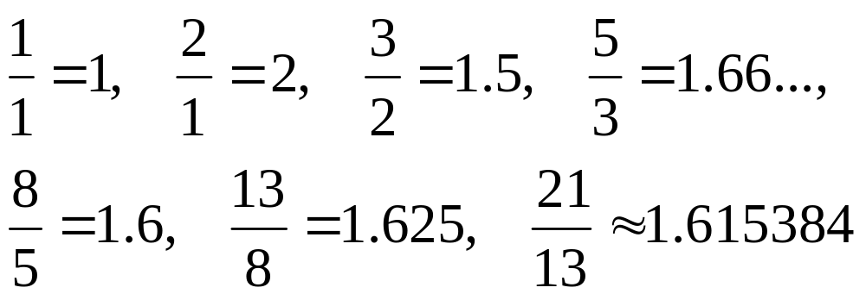
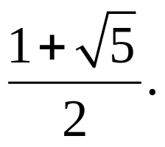
The Golden Ratio
Consider the quotients of successive Fibonacci numbers and notice a pattern.
These quotients seem to go toward 1.618.
In fact, they approach
This number is known as the golden ratio.

Slide 10
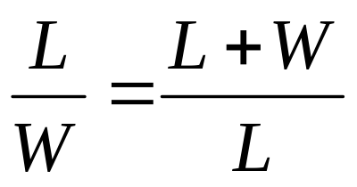
Golden Rectangle
A golden rectangle is one that can be divided into a square and another (smaller) rectangle, the same shape as the original.
L
W
L

Slide 11
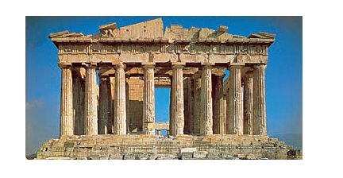
Example of Golden Rectangle: Parthenon in Athens

Slide 12
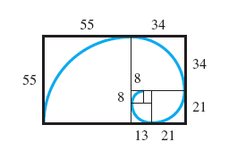
Spiral
Construct the divisions of a (nearly) golden rectangle below. Use a smooth curve to connect the vertices of the squares formed. This curve is a spiral.

Slide 13
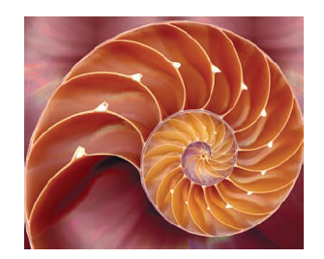
Example of Spiral in Nature: Shell of Chambered Nautilus

