Slide 1
Chapter 10
Number Theory

Slide 2
Chapter 10: Number Theory
10.1 Prime and Composite Numbers
10.2 Selected Topics From Number Theory
10.3 Greatest Common Factor and Least Common Multiple
10.4 The Fibonacci Sequence and the Golden Ratio
10.X Modular Arithmetic and Cryptography

Slide 3
Section 10-Extension
Modular Arithmetic
&
Cryptography

Slide 4
Objectives
Clock Arithmetic
Modular Systems
Residues of Large Numbers
Basics of Cryptography
Key Exchange
Public Key Cryptography

Slide 5
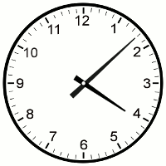
Clock Arithmetic
It’s 8 PM, what time will it be 33 hours from now?
One way to solve is to count using a clock. Set the hour hand to 8:00 and rotate the hour hand through 33 hours.

Slide 6
Clock Arithmetic
As we go through the hours we notice that we count through the set {1, 2, 3, 4, 5, 6, 7, 8, 9, 10, 11, 12}.
NOTE: It is easier if we replace 12 with 0 and our set becomes {0, 1, 2, 3, 4, 5, 6, 7, 8, 9, 10, 11, 12}.
We can use a calculator to compute:
8+33=41 and 41/12 = 3.416666667

Slide 7
Clock Arithmetic
Since we don’t care about the number of revolutions (3) we then use 12*0.416666667 =5
Therefore 8+33=(3*12)+5 , but since 12=0
8+33=(3*0)+5=5
Thus we deal with the remainder when 8+33 or 41 is divided by 12.

Slide 8
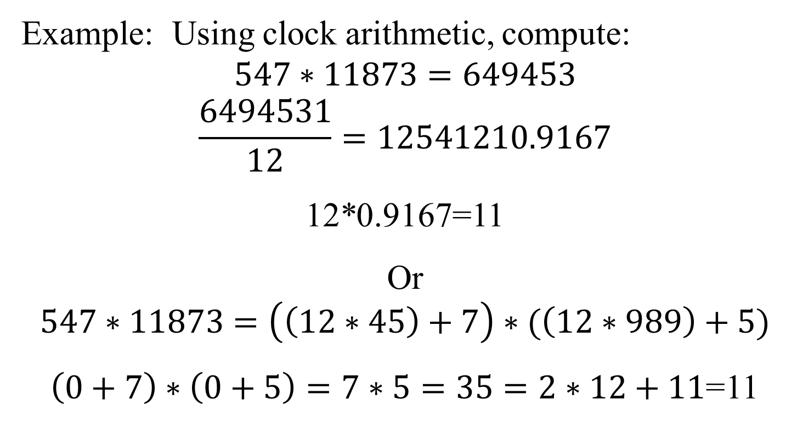
Clock Arithmetic
Example: Using clock arithmetic, compute:
$$547∗11873=649453$$
$$\frac{6494531}{12}=12541210.9167$$
12*0.9167=11
Or
$$547∗11873=\left(\left(12∗45\right)+7\right)∗(\left(12∗989\right)+5)$$
$\left(0+7\right)∗\left(0+5\right)=7∗5=35=2∗12+11$=11

Slide 9
Modular Systems
True or False:
a) 16≡10 mod 2 b) 49≡32 mod 5 c) 30≡345 mod 7
a) 16-10=6 is divisible by 2 so strictly this is a true statement.
b) 49-32=17 which is not divisible by 5 so this is a false statement.
c) 30-345=-315 which is divisible by 7.

Slide 10
Congruence Modulo n
a≡b(mod n) if and only if the same remainder is obtained when a and b are divided by n

Slide 11
Residues of Large Numbers
The basic concern of a modular system is, given a number n, no matter how large b find a such that a is in the set {0, 1, 2, … ,n-1}. This number a is called the remainder or residue.
Examples:
x=846238527 mod 23
x=(23*36792979)+10
x=10
Rule: The residue of a product is the product of residues
Example:
458687*931056 mod 18
(458687 mod 18)*(931056 mod 18)
11*6=66 mod 18 = 12

Slide 12
Basics of Cryptography
Cryptography involves secret codes, a way of disguising information such that only the sender and receiver know the information.
Basic Requirements of a Cryptography System:
A secret algorithm for encrypting and decrpting data.
A secret key that provides additional information for a receiver to decrypt.

Slide 13

Basics of Cryptography
Difficulty is that until the 1970’s all encryption functions were two-way functions. An adversary could decrypt with the algorithm.
In the 1970’s researchers discovered how to construct a one way function that overcame this problem. It is an exponential function given by:
Where M and n are known to the parties and k computed.
$$C=M^{k}\left(mod n\right)$$

Slide 14
Key Exchange
Alice and Bob will determine a key to encrypt and decrypt using the following procedure:
Alice’s actions | Bob’s Actions
1) Choose secret value of a. | 1) Choose secret value of b.
2) Compute α=Mª(mod n) | 2) Compute β=M^{b} (mod n)
3) Send the value of α to Bob. | 3) Send the value of β to Alice
4) Receive β | 4) Receive α
5) Compute the key: K=βª (mod n) | 5) Compute the key: K=α^{b} (mod n)

Slide 15
Key Exchange
Alice and Bob will determine a key to encrypt and decrypt using the following procedure: (they agree M=7, n=13 note use of primes)
Alice’s actions | Bob’s Actions
1) Choose secret value of a. (Alice selects 5) | 1) Choose secret value of b. (Bob chooses 8)
2) Compute α=Mª (mod n) 7⁵(mod 13) 16807 mod 13 α=11 | 2) Compute β=M^{b} (mod n) 7⁸ (mod 13) 5764801 (mod 13) β=3
3) Send the value of α to Bob. | 3) Send the value of β to Alice
4) Receive β | 4) Receive α
5) Compute the key: K=βª (mod n) K=3⁵ mod 13 243 mod 13 9 | 5) Compute the key: K=α^{b} (mod n) K=11⁸ mod 13 214358881 mod 13 9

Slide 16
Public Key Exchange (RSA Basics)
Alice (the receiver) completes the following steps:
1) Choose two prime numbers, p and q which are kept secret
2) Compute the modulus n = p * q
3) Compute ℓ=(p-1)(q-1)
4) Chose e to be relatively prime between 1 and ℓ
5) Find the decryption exponent d such that
e*d=1 mod (mod ℓ)
6) Provide Bob with a public Key (n and e)

Slide 17
Public Key Exchange (RSA Basics)
Bob (the sender) completes the following to send Alice a secure message:
7) Convert the message to Alice into a number M (called a plaintext message)
8) Encrypt M using Alice’s public key
C=Me (mod n)
9) Transmit C to Alice
When Alice receives C, she completes the final step:
10) Decrypt C using the private key
M=C^{d} (mod n)

Slide 18
Public Key Exchange (Example)
Alice (the receiver) completes the following steps:
1) Choose two prime numbers, p=7 and q=13 which are secret
2) Compute the modulus n = p * q = 7 * 13 = 91
3) Compute ℓ=(p-1)(q-1)=(7 – 1)(13 – 1) = 72
4) Chose e=11 to be relatively prime between 1 and ℓ
5) Find the decryption exponent d such that
11*d=1 mod (mod 7)
d=59
6) Provide Bob with a public Key (n=91 and e=11, p & q
are secret)

Slide 19
Public Key Exchange (Example)
Bob (the sender) completes the following to send Alice a secure message (“HI”, H is letter 8 and I is letter 9) :
7) Convert the message to Alice into a number M (“HI” = 89 )
8) Encrypt M using Alice’s public key
C=Me (mod n)
C=89¹¹
C=89¹⁺²⁺⁸
C=(89¹ mod 91)(89² mod 91)(89⁴ mod 91)
C=(89 mod 91)(7921 mod 91)(3.936588806E15 mod 91)
C=89*4*74 mod 91
C=26344 mod 91
C=45
9) Transmit C to Alice
Notes:
89^8 = ((89^2)^2)^2 use rules of modular arithmetic to accomplish this
89^2=7921
4 = 7921 mod 91
4^2 = 16 mod 91
16^2 = 256
74 = 256 mod 91

Slide 20
Public Key Exchange (Example)
When Alice receives C, she completes the final step:
10) Decrypt C using the private key
M=C^{d} (mod n)
M=45⁵⁹ mod 91
M=45¹⁺²⁺⁸⁺¹⁶⁺³² mod 91
M=(45¹*45²*45⁸*45¹⁶*45³² )mod 91
M=45*23*16*74*16 mod 91
M= 19607040 mod 91
M=89=”HI” (our original message)
Notes:
45^59=45^1*45*^2*45^8*45^16*45^32
45^2 = 2025 (mod 91) = 23
45^8 = (45^2)^4 = 23^4 = 279841 mod 91 = 16
45^16 = (45^8)^2 = 16^2 = 256 mod 91 = 74
45^32 = (45^16)^2 = 74^2 = 5476 mod 91 = 16
Note 45^8 == 45^32 (mod 91) which ,means 45^24 = 1 mod 91
Then M=45*23*16*74*16 = 19607040 mod 91 = 89

