Slide 1
Chapter 11
Graph Theory

Slide 2
Chapter 11: Graph Theory
11.1 Basic Concepts
11.2 Euler Circuits and Route Planning
11.3 Hamilton Circuits and Algorithms
11.4 Trees and Minimum Spanning Trees

Slide 3
Section 11-2
Euler Circuits and Route Planning

Slide 4
Euler Circuits and Route Planning
State the Konigsberg’s bridge problem and explain its historical relevance to graph theory.
State and apply Euler’s theorem for Euler circuits.
Identify a cut edge of a graph.
Apply Fleury’s algorithm to find an Euler circuit.
Minimize deadheading on a street grid by converting it to a graph with an Euler circuit.
..

Slide 5
Konigsberg Bridge Problem
..
In the early 1700s, the city of Konigsberg was the capital of East Prussia. The river Pregel ran through the city in two branches with an island between the branches (see figure on next slide).
There were seven bridges joining various parts of the city. The following problem was well known. Is it possible for a citizen of Konigsberg to take a stroll through the city, crossing each bridge exactly once, and beginning and ending at the same place?
..
..

Slide 6
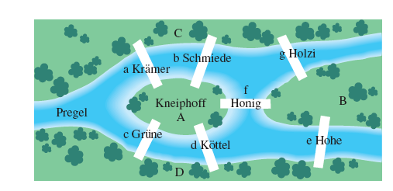
Map of Konigsberg
..

Slide 7
Graph of the Map
The vertices represent landmasses. The edges represent the bridges
C
g
a
b
f
B
A
c
d
e
D

Slide 8
Euler Path and Euler Circuit
An Euler path in a graph is a path that uses every edge of the graph exactly once. An Euler circuit in a graph is a circuit that uses every edge of the graph exactly once.

Slide 9
Example: Recognizing Euler Circuits
Consider the graph below.
a) Is an Euler circuit?
b) Does the graph have an Euler circuit?
E
F
D
A
C
B

Slide 10
Example: Recognizing Euler Circuits
Solution
a) No, it does not use edge BD.
b) Yes, the circuit
is an Euler circuit.
E
F
D
A
C
B

Slide 11
Euler and the Bridge Problem
Leonhard Euler published a paper in 1736 that explained why it is impossible to find a walk of the required kind, and he provided a simple way for deciding whether a given graph has an Euler circuit.

Slide 12
Euler’s Theorem
Suppose we have a connected graph.
1. If the graph has an Euler circuit, then each vertex of the graph has even degree.
2. If each vertex of the graph has even degree, then the graph has an Euler circuit.

Slide 13
Example: Using Euler’s Theorem
Does the graph below have an Euler circuit?
B
C
F
H
A
D
E
G
Solution
Yes, because the graph is connected and each vertex has even degree.

Slide 14
Cut Edge
A cut edge in a graph is an edge whose removal disconnects a component of the graph.

Slide 15
Example: Identifying Cut Edges
Identify the cut edges in the graph below.
B
C
H
F
A
D
E
G
Solution
CE and GH are cut edges; if either is removed, it would disconnect the graph.

Slide 16
Fleury’s Algorithm
Fleury’s algorithm can be used to find an Euler circuit in any connected graph in which each vertex has even degree. An algorithm is like a recipe; follow the steps and you achieve what you need.

Slide 17
Fleury’s Algorithm
Step 1: Start at any vertex. Go along any edge from this vertex to another vertex. Remove this edge from the graph.
Step 2: You are now on a vertex on the revised graph. Choose any edge from this vertex, but not a cut edge, unless you have no other option. Go along your chosen edge. Remove this edge from the graph.

Slide 18
Fleury’s Algorithm
Step 3: Repeat Step 2 until you have used all the edges and gotten back to the vertex at which you started.

Slide 19
Example: Using Fleury’s Algorithm
Find an Euler circuit for the graph below.
B
C
F
A
D
E
Solution
B
C
Remove BC
F
A
D
E

Slide 20
Example: Using Fleury’s Algorithm
Solution (continued)
B
C
Remove CF
F
A
D
E
B
C
F
Remove FD
A
D
E

Slide 21
Example: Using Fleury’s Algorithm
Solution (continued)
B
C
F
Remove DE
A
D
E
Now it is clear to finish with

Slide 22
Example: Using Fleury’s Algorithm
Solution (continued)
The complete Euler circuit is
Note that a graph that has an Euler circuit always has more than one Euler circuit.

Slide 23
Route Planning
When planning routes for mail delivery, street sweeping, or snow plowing, the roads in the regions to be covered usually do not have a Euler circuit. Unavoidably, certain stretches of road must be traveled more than once. This is referred to as deadheading. Planners try to find a route on which the driver will spend as little time as possible deadheading.

Slide 24
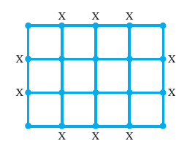
Example: Finding an Euler Circuit on a Street Grid
The street grid shown has every odd degree marked with an X. Insert edges coinciding with existing roads to change it to a graph with an Euler circuit.

Slide 25
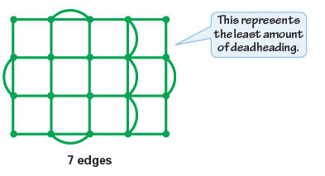
Example: Finding an Euler Circuit on a Street Grid
Solution
Trial and error is used to find the least number of edges that must be inserted to ensure that the grid graph has an Euler circuit.
With just 7 additional edges, we obtain a graph with an Euler circuit.

