Slide 1
Chapter 11
Graph Theory

Slide 2
Chapter 11: Graph Theory
11.1 Basic Concepts
11.2 Euler Circuits and Route Planning
11.3 Hamilton Circuits and Algorithms
11.4 Trees and Minimum Spanning Trees

Slide 3
Section 11-3
Hamilton Circuits and Algorithms

Slide 4
Hamilton Circuits and Algorithms
Define and identify a Hamilton circuit in a graph.
Determine the number of Hamilton circuits in a complete graph with n vertices.
Know the meanings of the terms weighted graph and minimum Hamilton circuit.
Apply the brute force algorithm for a complete, weighted graph.
Know the meaning of the terms efficient algorithm and approximate algorithm.
Apply the nearest neighbor algorithm.

Slide 5
Hamilton Circuit
A Hamilton circuit in a graph is a circuit that visits each vertex exactly once (returning to the starting vertex to complete the circuit).

Slide 6
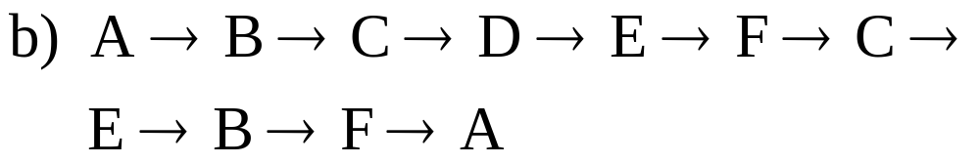
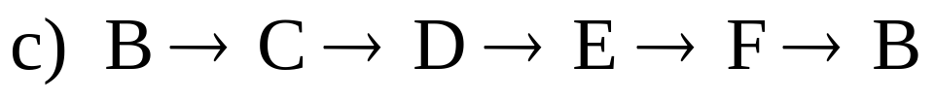
Example: Identifying Hamilton Circuits
Refer to the graph below. Which of the following are Hamilton circuits?
B
C
D
A
F
E

Slide 7
Example: Identifying Hamilton Circuits
Solution
a) It is a Hamilton circuit for the graph.
b) It is not a Hamilton circuit since it visits B more than once.
c) It is not a Hamilton circuit since it does not visit all the vertices.

Slide 8
Hamilton Circuits for Complete Graphs
Any complete graph with three or more vertices has a Hamilton circuit.

Slide 9
When Hamilton Circuits Are the Same
Hamilton circuits that differ only in their starting points will be considered to be the same circuit.

Slide 10
Number of Hamilton Circuits in a Complete Graph
A complete graph with n vertices has (n – 1)! Hamilton circuits.

Slide 11
Example: Number of Circuits
How many Hamilton circuits are in a complete graph with 5 vertices?
Solution
Here n = 5, so there are (5 – 1)! = 4! = 24 Hamilton circuits.

Slide 12
Minimum Hamilton Circuits
In a weighted graph, a minimum Hamilton circuit is a Hamilton circuit with the smallest possible weight.

Slide 13
Brute Force Algorithm
Step 1: Choose a starting point.
Step 2: List all the Hamilton circuits with that starting point.
Step 3: Find the total weight of each circuit.
Step 4: Choose a Hamilton circuit with the smallest total weight.

Slide 14
Example: Using the Brute Force Algorithm
Find a minimum Hamilton circuit for the complete, weighted graph below.
3
A
B
1
5
1
7
D
3
C

Slide 15






Example: Using the Brute Force Algorithm
Solution
3
A
B
1
5
1
7
D
3
C
Weight of circuit
14
12
Min.
14
12
(opposite of 2)
14
(opposite of 3)
14
(opposite of 1)

Slide 16
Algorithms
Algorithms that do not take too much computer time are called efficient algorithms. The Brute Force Algorithm is not an efficient algorithm.
There are some algorithms that do not take too much computer time and that give reasonably good solutions most of the time. They are called approximate algorithms because they give an approximate solution to the problem. The Nearest Neighbor Algorithm is an approximate algorithm for finding a minimum Hamilton circuit.

Slide 17
Nearest Neighbor Algorithm
Step 1: Choose a starting point. Call this vertex A.
Step 2: Check all the edges joined to A, and choose one that has the smallest weight. Proceed along this edge to the next vertex.
Step 3: At each vertex you reach, check the edges from there to vertices not yet visited. Choose the smallest weight. Proceed along this edge to the next vertex.

Slide 18
Nearest Neighbor Algorithm
Step 4: Repeat Step 3 until you have visited all the vertices.
Step 5: Return to the starting vertex.

Slide 19
Example: Using the Nearest Neighbor Algorithm
The time it takes to travel between points (in minutes) is shown on the graph below. Use the nearest neighbor algorithm to approximate the least time to visit each location.
A
9
20
13
9
E
B
3
8
8
10
5
C
7
D

Slide 20





Example: Using the Nearest Neighbor Algorithm
Solution
Start | Circuit | Weight
A |  | 40
B |  | 37
C |  | 37
D |  | 37
E |  | 51

Slide 21

Example: Using the Nearest Neighbor Algorithm
Solution (continued)
From the information on the previous slide, we would say that a route of 37 minutes should be about the least amount of time.
Note that
has a total weight of 36 minutes. All we can expect from the nearest neighbor algorithm is a reasonably good solution.

